Slide 1
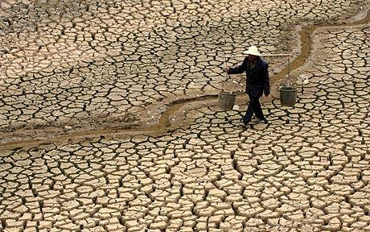
Responses of terrestrial ecosystems to drought
肖劲锋
Earth Systems Research Center, University of New Hampshire
The 7th International Symposium on Modern Ecology
Guangzhou, China, June 10-12, 2013

Slide 2
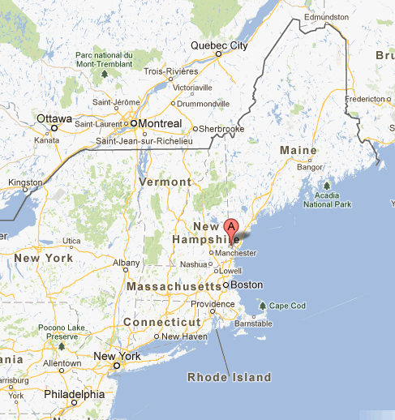


Where are New Hampshire and UNH?

Slide 3



Where are New Hampshire and UNH?

Slide 4
Definitions of drought
“a significant deviation from the normal hydrological conditions of an area” – Palmer 1965
“drought means a sustained, extended deficiency in precipitation” - The World Meteorological Organization (WMO 1986)
“drought means the naturally occurring phenomenon that exists when precipitation has been significantly below normal recorded levels, causing serious hydrological imbalances that adversely affect land resource production systems” - The UN Convention to Combat Drought and Desertification (UN Secretariat General 1994)
“the percentage of years when crops fail from the lack of moisture” – FAO 1983

Slide 5
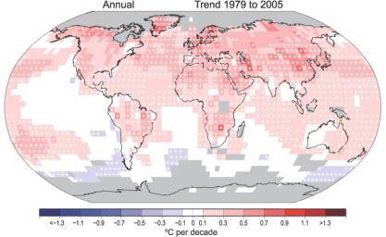
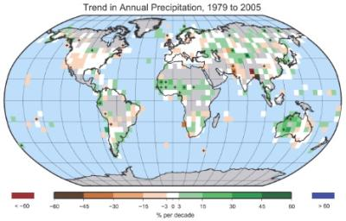
Global climate change
Source: IPCC, AR4, Nov 2007
Notes:
Figure 3.1. Annual anomalies of global land-surface air temperature (°C), 1850 to 2005, relative to the 1961 to 1990 mean for CRUTEM3 updated from Brohan et al. (2006). The smooth curves show decadal variations (see Appendix 3.A). The black curve from CRUTEM3 is compared with those from NCDC (Smithand Reynolds, 2005; blue), GISS (Hansen et al., 2001; red) and Lugina et al. (2005; green).
Figure 10.4. Multi-model means of surface warming (relative to 1980–1999) for the scenarios A2, A1B and B1, shown as continuations of the 20th-century simulation. Values beyond 2100 are for the stabilisation scenarios (see Section 10.7). Linear trends from the corresponding control runs have been removed from these time series. Lines show the multi-model means, shading denotes the ±1 standard deviation range of individual model annual means. Discontinuities between different periods have no physical meaning and are caused by the fact that the number of models that have run a given scenario is different for each period and scenario, as indicated by the coloured numbers given for each period and scenario at the bottom of the panel. For the same reason, uncertainty across scenarios should not be interpreted from this figure (see Section 10.5.4.6 for uncertainty estimates).

Slide 6
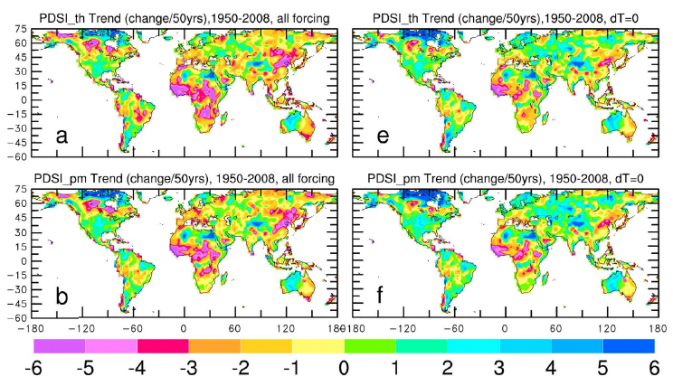
Trend maps in annual PDSI
Dai, JGR, 2011

Slide 7
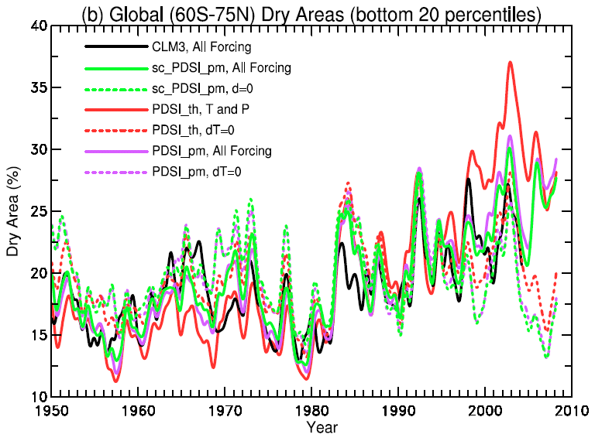
Dai, JGR, 2011

Slide 8
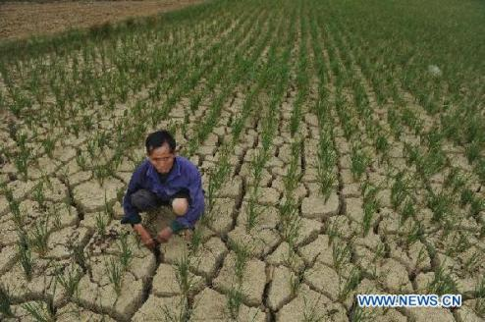
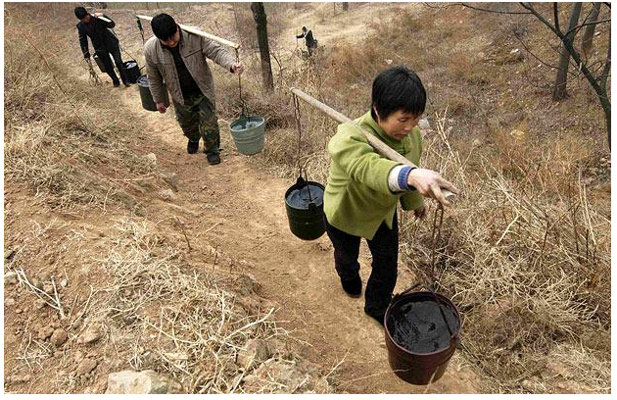
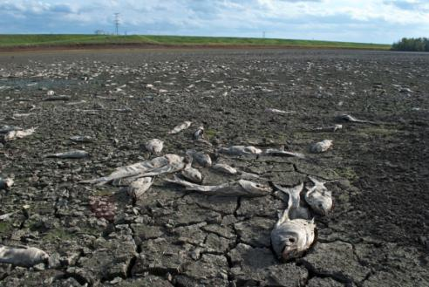
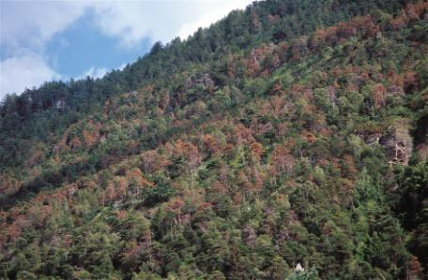

Slide 9
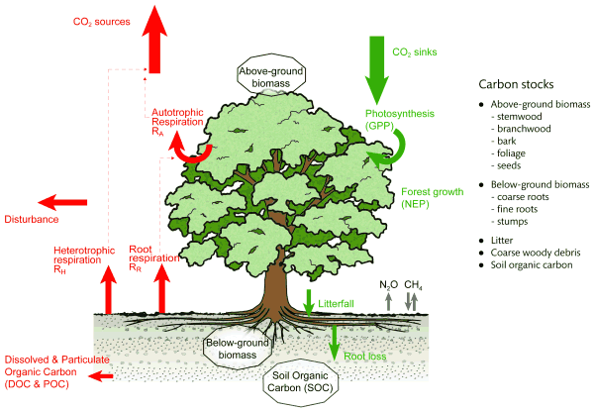
Carbon release
Carbon uptake

Slide 10

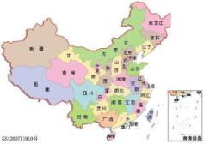
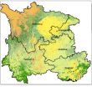
Case studies
3. In-situ data and upscaling
2. Ecosystem modeling
1. Remote sensing

Slide 11
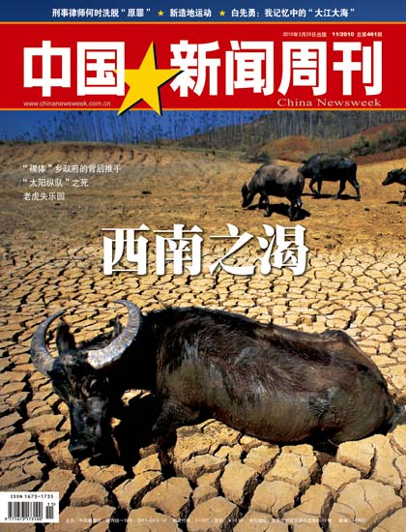
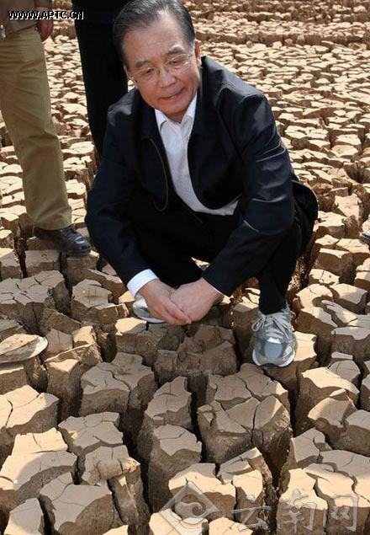
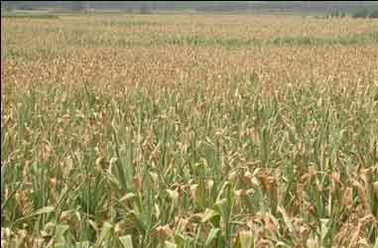

Slide 12
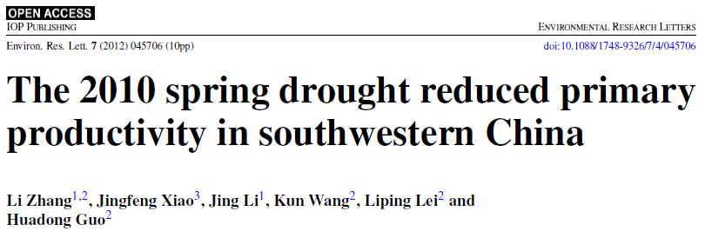
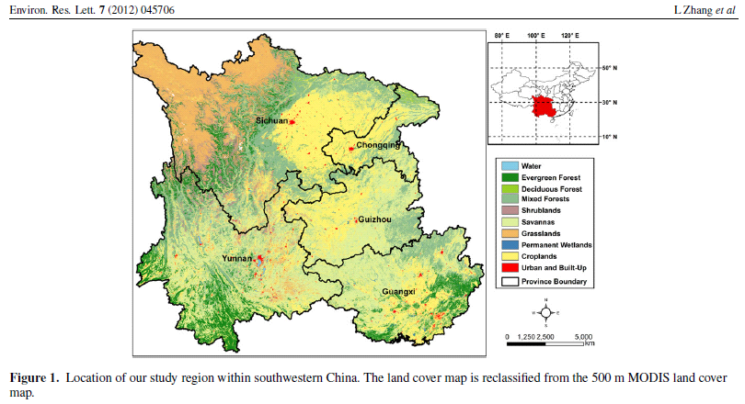

Slide 13
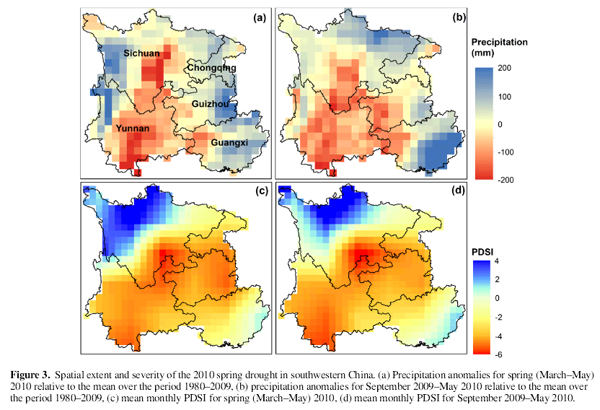
Zhang et al., ERL, 2012

Slide 14
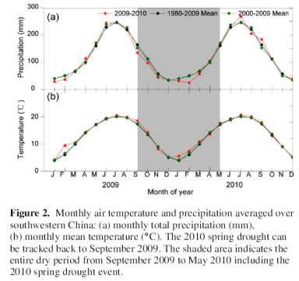
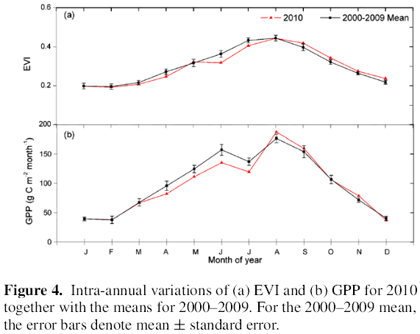
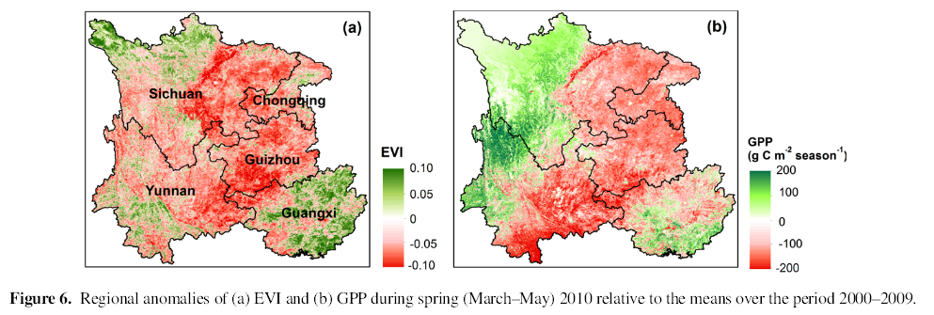
Zhang et al., ERL, 2012

Slide 15
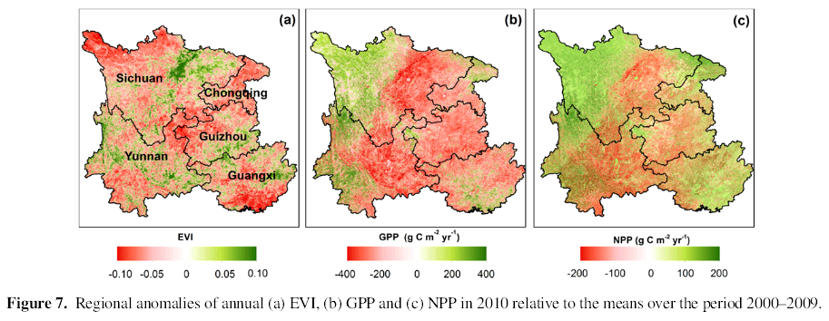
The drought reduced regional annual GPP and NPP in 2010 by 65 and 46 Tg C yr−1, respectively. Both annual GPP and NPP in 2010 were the lowest over the period 2000–2010
The negative effects of the drought were partly offset by the high productivity in August and September and the farming practices adopted
Like summer droughts, spring droughts can also have significant impacts on vegetation productivity and terrestrial carbon cycling
Zhang et al., ERL, 2012

Slide 16
Case studies
3. In-situ data and upscaling
2. Ecosystem modeling
1. Remote sensing

Slide 17
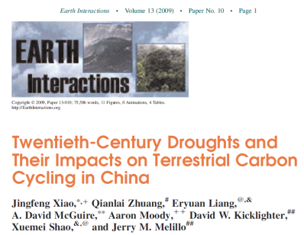
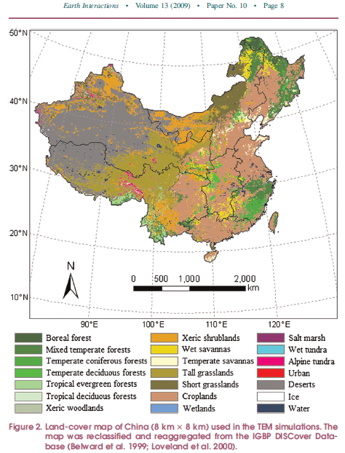
A process-based biogeochemical model, the Terrestrial Ecosystem Model (TEM)
TEM simulates the cycling of carbon, nitrogen, and water among vegetation, soils, and the atmosphere at monthly time steps.

Slide 18
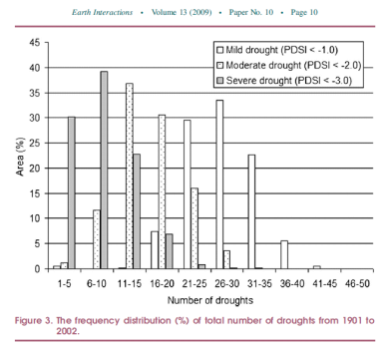
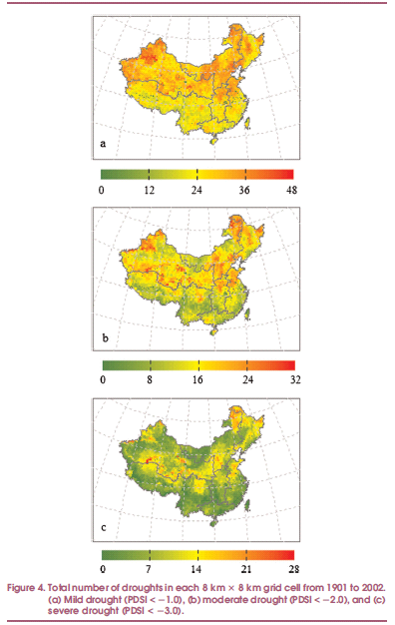
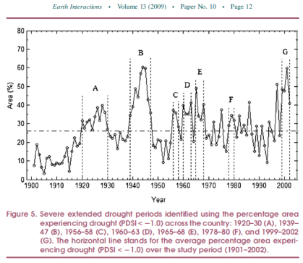
Mild
Moderate
Severe

Slide 19
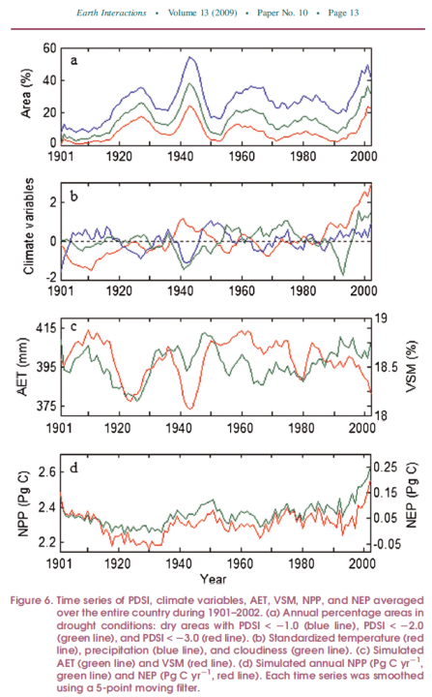
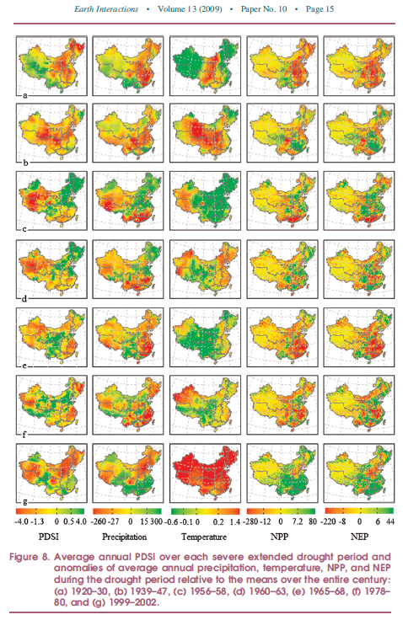

Slide 20
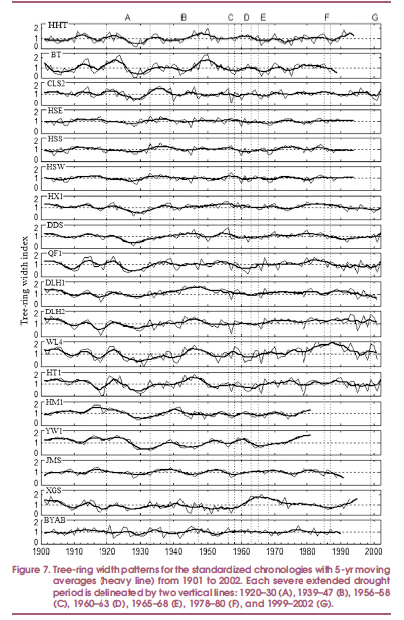
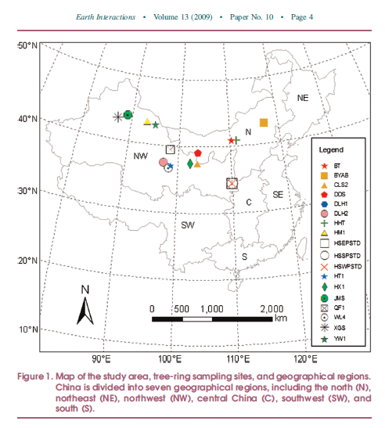
Tree-ring chronologies

Slide 21
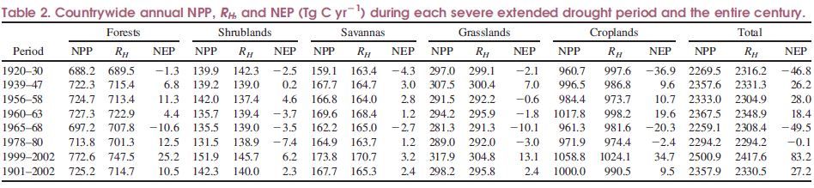
Most droughts generally reduced NPP and NEP in large parts of drought-affected areas.
Out of the seven droughts, three (1920–30, 1965–68, and 1978–80) caused the countrywide terrestrial ecosystems to switch from a carbon sink to a source, and one (1960–63) substantially reduced the magnitude of the countrywide terrestrial carbon sink.
Strong decreases in NPP were mainly responsible for the anomalies in annual NEP during these drought periods.

Slide 22
Case studies
3. In-situ data and upscaling
2. Ecosystem modeling
1. Remote sensing

Slide 23
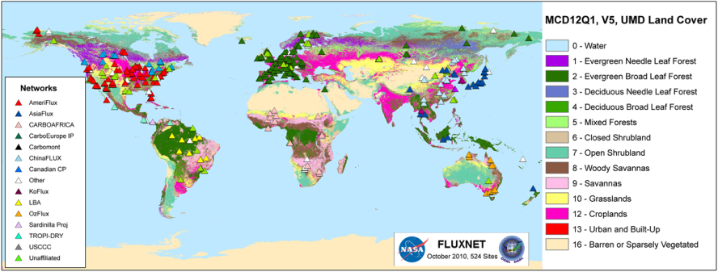
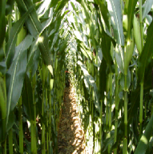
AmeriFlux, other regional flux networks, and FLUXNET
UMBS (MI)
Fort Peck (MT)
SOO (CA)
Mead Rotation (NE)

Slide 24
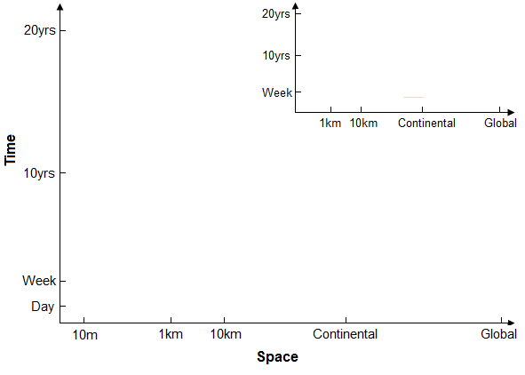
EC-MOD upscaling system
Eddy flux
Gridded flux fields
Upscaling
MODIS data, climate data, and other spatial data
Conceptual framework for upscaling of fluxes from towers to broad regions

Slide 25
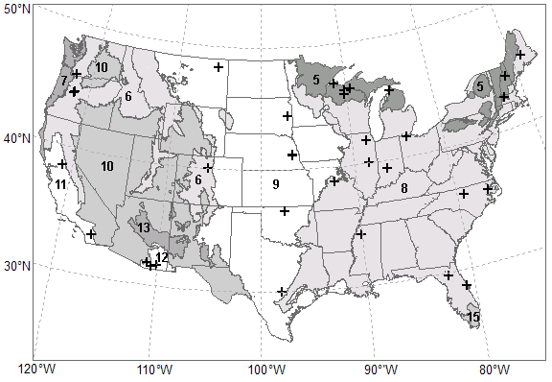
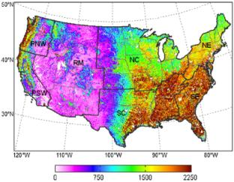
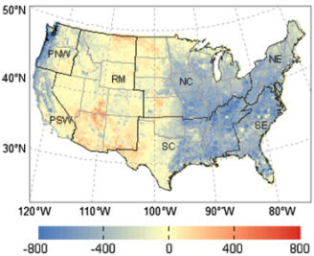
Upscaling AmeriFlux data to the national scale
Observations from 42 towers
Data-driven approach
MODIS data streams
Gridded EC-MOD flux dataset
Xiao et al., Agri. For. Met., 2008; Remote Sens. Environ., 2010; Agri. For. Met., 2011

Slide 26
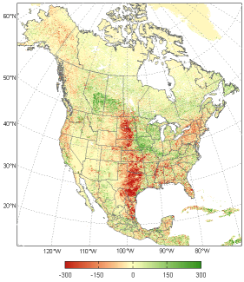
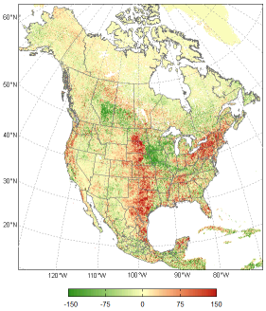
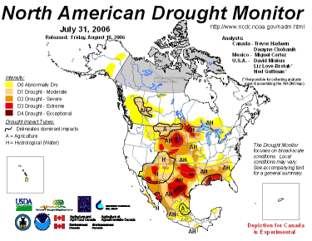
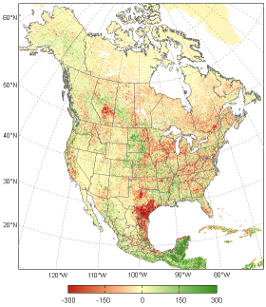
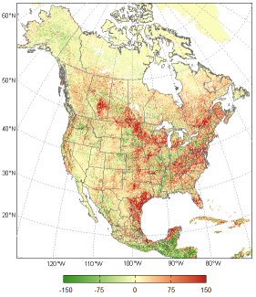
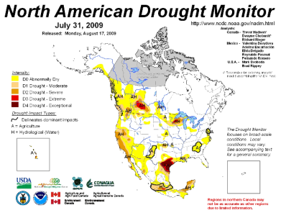
2006 2006
GPP NEE
2009 2009
GPP NEE
Xiao et al. unpublished

Slide 27
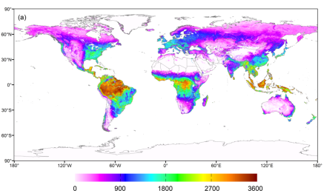
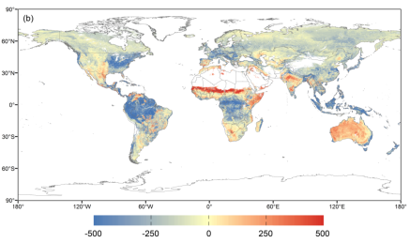
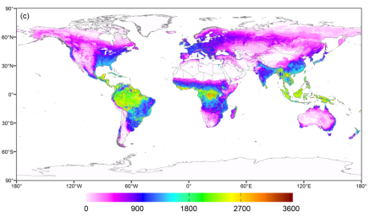
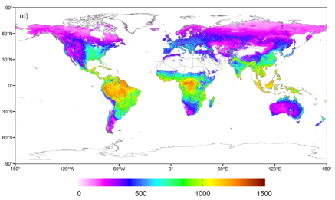
Global flux fields – EC-MOD (2000-2010)
GPP
NEE
ER
ET
Xiao et al. unpublished

Slide 28
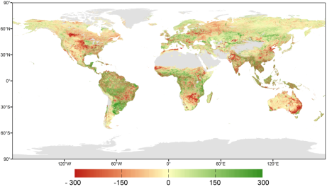



2002
GPP
NEE
ET
PDSI
Xiao et al. unpublished

Slide 29




2005
GPP
NEE
ET
PDSI
Xiao et al. unpublished

Slide 30
GPP (South America)
NEE (South America)
ET (South America)
ET vs. GPP
ET vs. NEE
NEE (Globe)
Xiao et al. unpublished

Slide 31




2007
2009
2010

Slide 32
Indirect effects?

Slide 33




Slide 34



Slide 35


Slide 36
Summary
Drought has significant effects on plant growth and carbon fluxes
Severe extended droughts could substantially reduce net carbon uptake or even lead to carbon sources
Strong decreases in NPP were mainly responsible for the anomalies in annual NEP during drought periods
The different methods are useful and complementary
Future droughts will likely have larger positive feedbacks to the climate system

Slide 37
Ongoing and future research
Soil hydrology and respiration
Tree mortality and fire
Droughts vs. heat waves
Uncertainty
Food security
Team effort

Slide 38
Ongoing and future research
Soil hydrology and respiration
Tree mortality and fire
Droughts vs. heat waves
Uncertainty
Food security
Team effort

Slide 39

Ongoing and future research
Soil hydrology and respiration
Tree mortality and fire
Droughts vs. heat waves
Uncertainty
Food security
Team effort

Slide 40

Ongoing and future research
Soil hydrology and respiration
Tree mortality and fire
Droughts vs. heat waves
Uncertainty
Food security
Team effort

Slide 41

Ongoing and future research
Soil hydrology and respiration
Tree mortality and fire
Droughts vs. heat waves
Uncertainty
Food security
Team effort
Courtesy of Changsheng Li

Slide 42


Ongoing and future research
Soil hydrology and respiration
Tree mortality and fire
Droughts vs. heat waves
Uncertainty
Food security
Team effort

Slide 43
Special session at 2013 AGU meeting
B31: Impacts of Extreme Climate Events and Disturbances on Carbon Dynamics
Convener(s): Jingfeng Xiao (University of New Hampshire) and Shuguang Liu (USGS EROS)
Since 2011
San Francisco, Dec 9-13, 2013

Slide 44


Slide 45



Dr. Jingfeng Xiao
Global Ecology Group
Earth Systems Research Center
University of New Hampshire
Email: j.xiao@unh.edu
http://globalecology.unh.edu
Carbon cycle
Ecosystem modeling
Remote sensing
Data assimilation
Data synthesis
Upscaling
Earth System Models

