Slide 1
景观生态学最新进展及其对保护和恢复的意义 Landscape Ecology: State-of-the-Science and Implications for Conservation and Restoration
JIANGUO WU
Dean’s Distinguished Professor
Arizona State University, Tempe, AZ 85287 &
Center for Human-Environment System Sustainability (CHESS)
Beijing Normal University, Beijing
美国亚利桑那州立大学 生命科学学院和全球可持续性科学研究所
北京师范大学 人与环境系统可持续性研究中心
CHESS

Slide 2
OUTLINE
Landscape ecology’s top 10 list in 2013
Landscape ecological principles for conservation and restoration
A new science in the making
Landscape sustainability science (LSS)
LSS as the ultimate goal of LE, CB, & RE

Slide 3
OUTLINE
Landscape ecology’s top 10 list in 2013
Landscape ecological principles for conservation and restoration
A new science in the making
Landscape sustainability science (LSS)
LSS as the ultimate goal of LE, CB, & RE

Slide 4
LANDSCAPE ECOLOGY – WHAT IS IT?
Wu and Hobbs (2007):
The integration of science and art of studying and improving the relationship between spatial pattern and ecological as well socioeconomic processes on multiple scales.
Wu J. and Hobbs R. 2007. Landscape ecology: The-state-of-the-science. In Wu J. and Hobbs R. (eds.), Key Topics in Landscape Ecology, pp. 271-287. Cambridge University Press, Cambridge, UK.

Slide 5
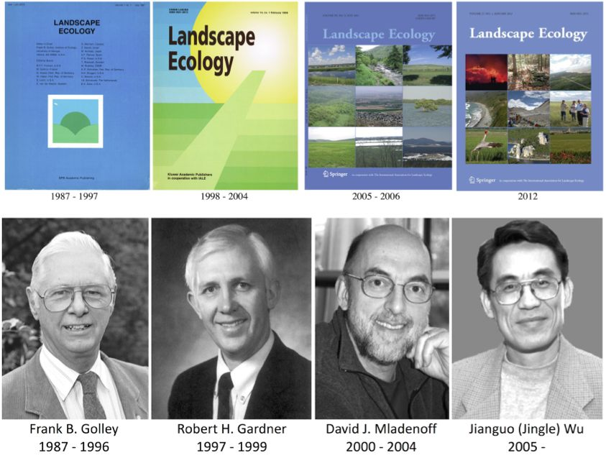
State of the Science in LE?
--- The flagship journal, Landscape Ecology, as a barometer …
Landscape Ecology
1987 - 2011
Notes:
The quality of data and metadata will directly determine landscape ecologists’ ability and effectiveness of detecting patterns and relating them to processes, and consequently affect research results and practical recommendations.

Slide 6
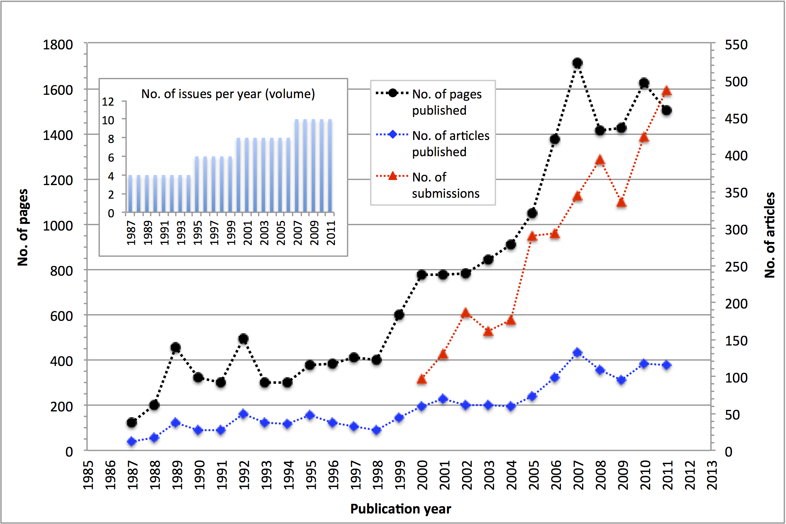
Landscape Ecology (1987 – 2011)

Slide 7
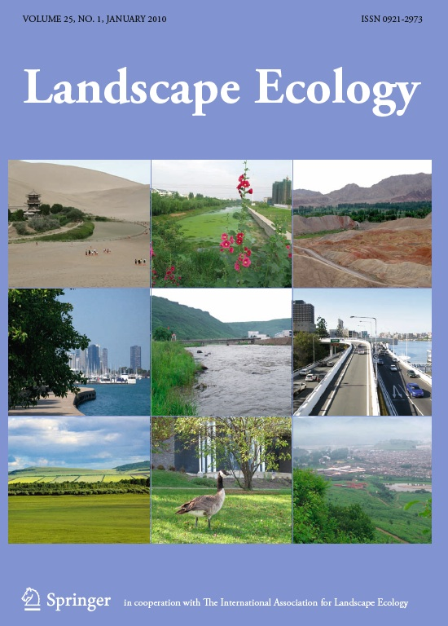
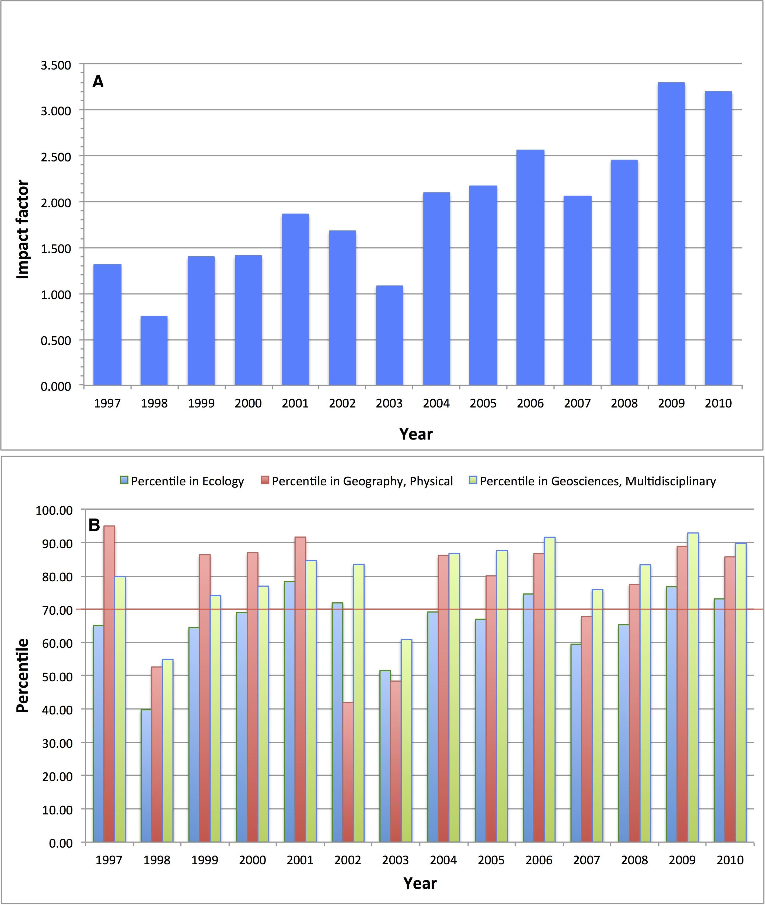
#Ecology journals:
~ Top 30 out of 130
#Physical Geography journals:
~ Top 5 out of 36
#Multidisciplinary Geosciences journals:
~ Top 10 of 155
The impact factor of Landscape Ecology and its ranking (data from Thomson Reuters’ Web of Science)
Notes:
#Ecology journals ~ 130 (LE: top 30)
#Physical Geography journals ~ 36 (LE: top 5)
#Multidisciplinary Geosciences ~ 155 (LE: top 10)

Slide 8
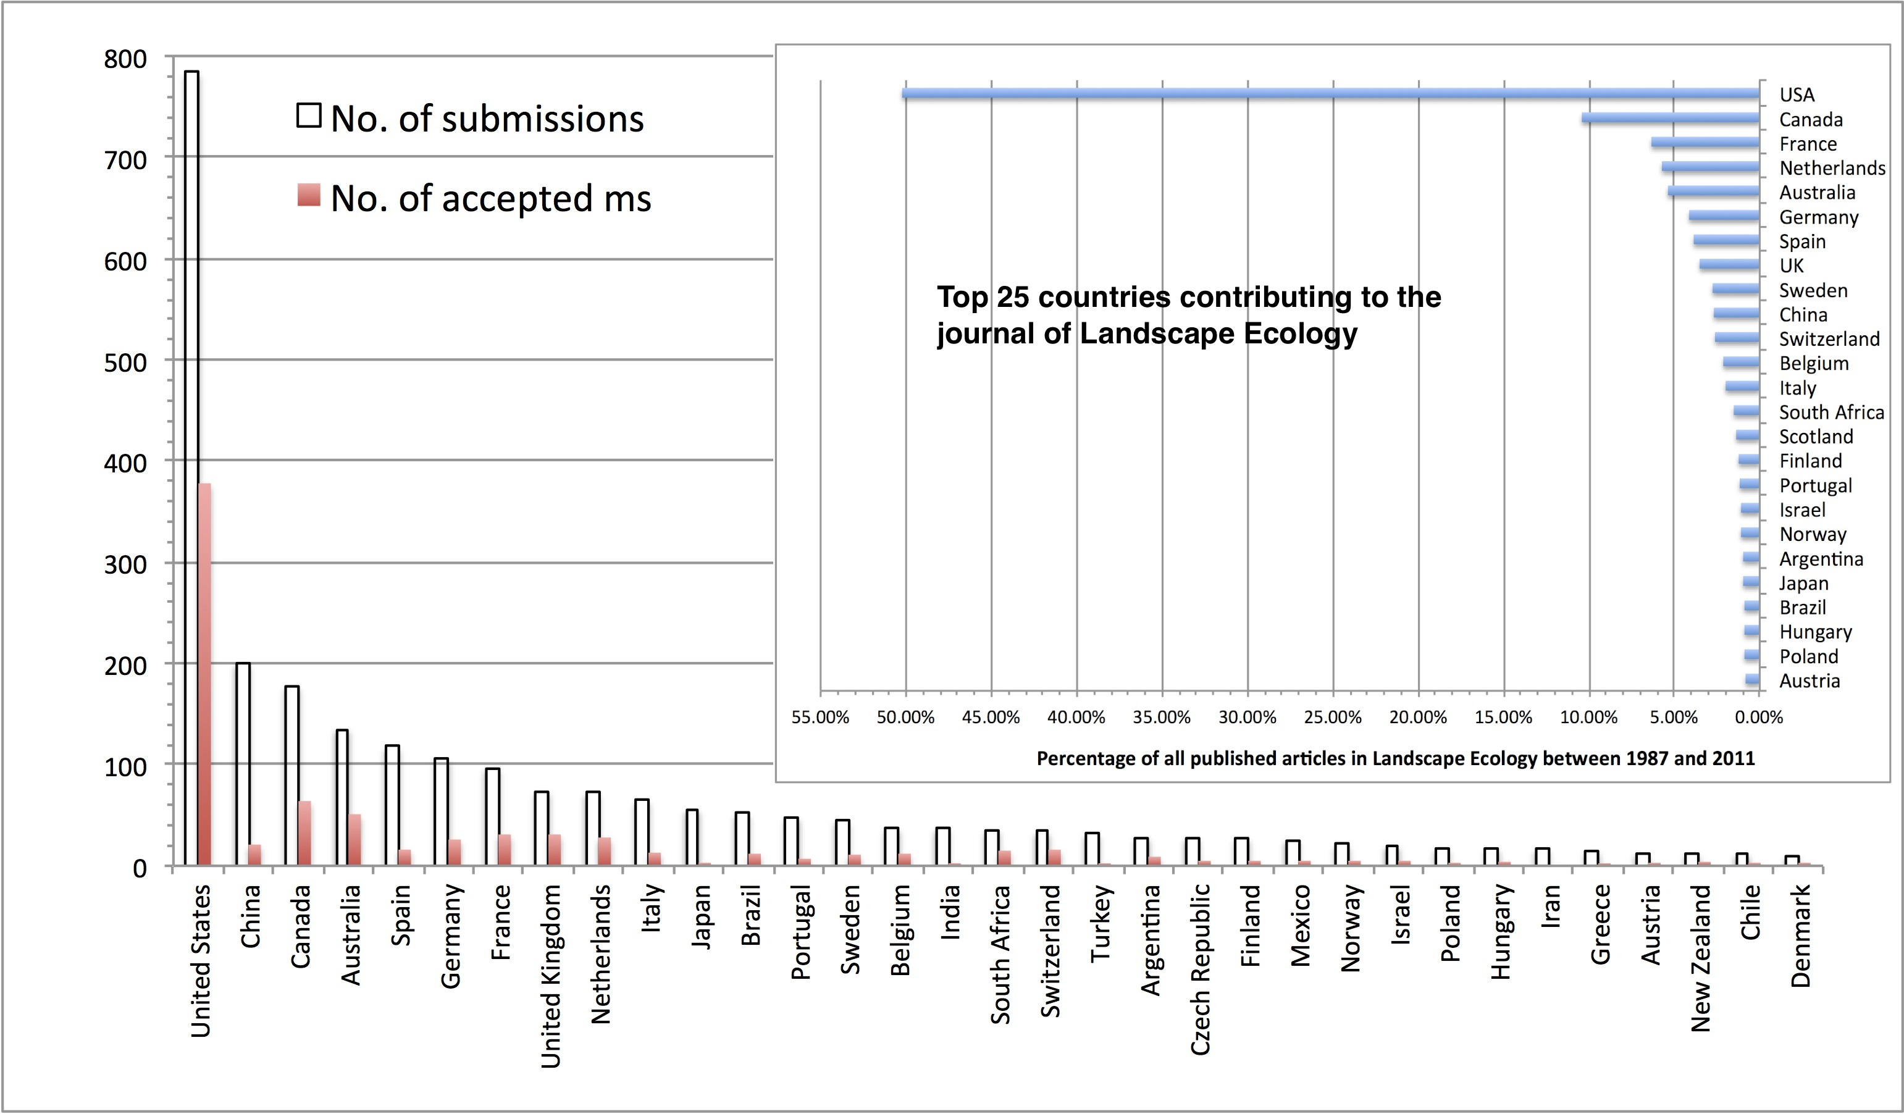
Based on 7-yr data (1/1/2005 - 12/31/2011), including only countries with ≥ 20 submissions

Slide 9
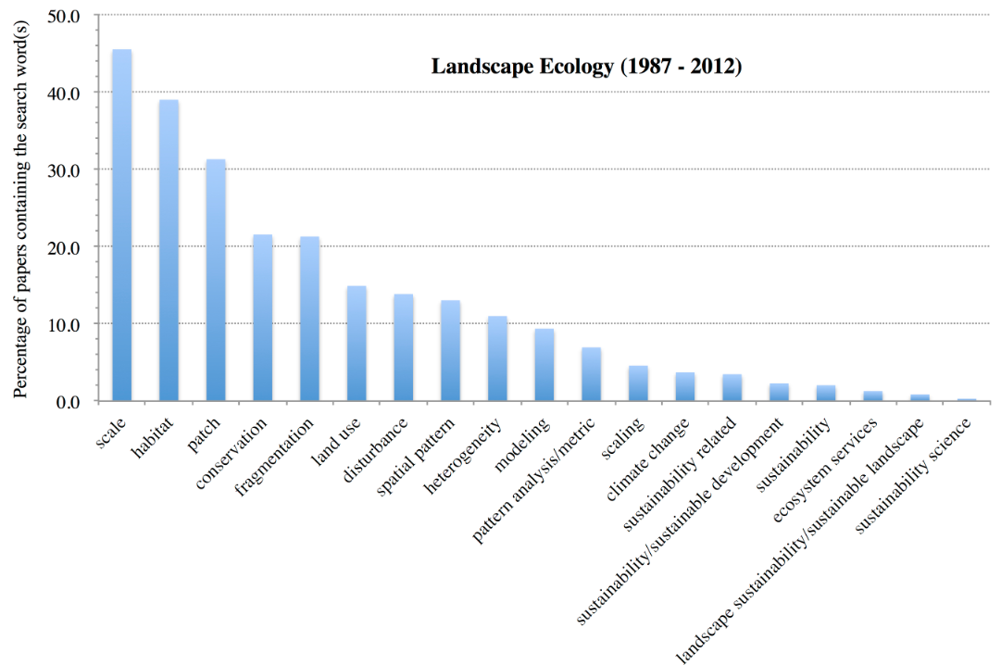

Slide 10
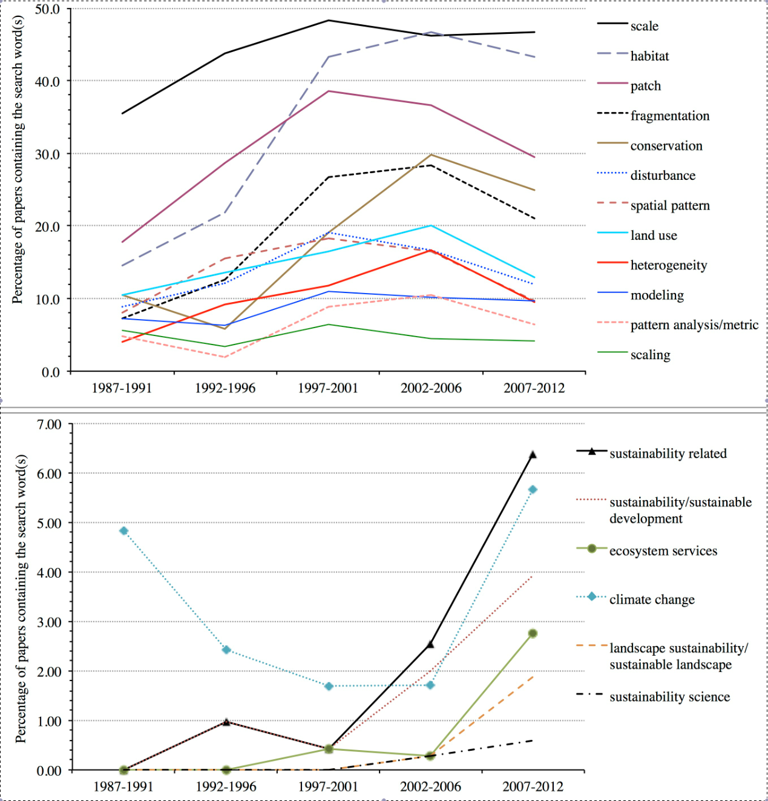

Slide 11
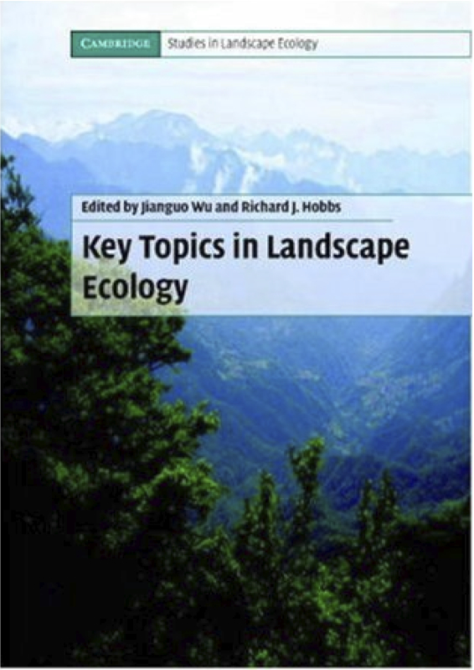
Key Topics in Landscape Ecology Wu and Hobbs (2002, 2007)
Notes:
Fig. 2. Top 10 research topics in landscape ecology. All the topics need to address the issues of theory, methodology, and application. However, some of them focus more on theoretical or methodological developments, whereas others have more a emphasis on application. The exact positions of the 10 topics in the 3-dimensional space are somewhat arbitrary, but a proper balance among the three components may be desirable in the study of each topic.

Slide 12
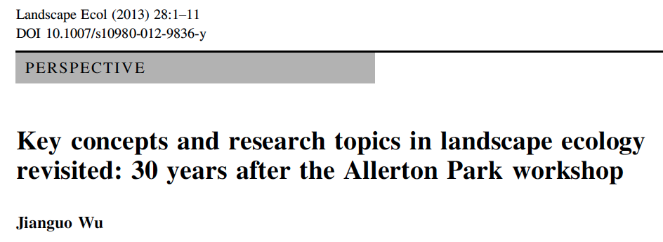
Notes:
Fig. 2. Top 10 research topics in landscape ecology. All the topics need to address the issues of theory, methodology, and application. However, some of them focus more on theoretical or methodological developments, whereas others have more a emphasis on application. The exact positions of the 10 topics in the 3-dimensional space are somewhat arbitrary, but a proper balance among the three components may be desirable in the study of each topic.

Slide 13
Wu’s Landscape Ecology Top 10 List in 2013
Pattern-process-scale relationships of landscapes
Landscape connectivity and fragmentation
Scale and scaling
Spatial analysis and landscape modeling
Land use and land cover change
Landscape history and legacy effects
Landscape and climate change interactions
Ecosystem services in changing landscapes
Landscape sustainability
Accuracy assessment and uncertainty analysis

Slide 14
OUTLINE
Landscape ecology’s top 10 list in 2013
Landscape ecological principles for conservation and restoration
A new science in the making
Landscape sustainability science (LSS)
LSS as the ultimate goal of LE, CB, & RE

Slide 15
生态恢复是（人类）帮助退化，受损，或毁灭的生态系统复原的过程。
(2004)
生态恢复
生态重建
Biodiversity & Ecosystem Integrity
生物多样性保护
生态系统保护
Conservation: the process of protecting biodiversity and ecosystem integrity, focusing on intact or less degraded habitats.

Slide 16
Term (术语) | Reference/Target | Emphasis/Success Criteria
Restoration (恢复) | Historical/Original | Structure & Function
Rehabilitation (修复) | Historical/Original | Function
Reclamation (垦复) | Non-historic/ | Function (present-day needs)
Ecological Engineering (生态工程) | Non-historic/designed | Function (present-day needs)
Ecological Reconstruction (生态重建) | Historical or non-historical | Structure & function; or function only
Reference/Target
Restoration
Rehabilitation
恢复
Historical/
Original
修复
Ecological
Reconstruction
Reclamation
垦复
Ecological Engineering
生态工程
Non-historical/
Present-day needs
生态重建
Ecosystem structure
Ecosystem function
Emphasis/Success Criteria

Slide 17
Landscape Ecological Principles for Conservation & Restoration
1 goal and 5 principles (1个最终目标, 5 条基本原理）
Ultimate goal: Sustainability = ES + HW
Landscape pattern matters.
Scale matters.
History matters.
Climate change matters.
Ecosystem services matter.

Slide 18
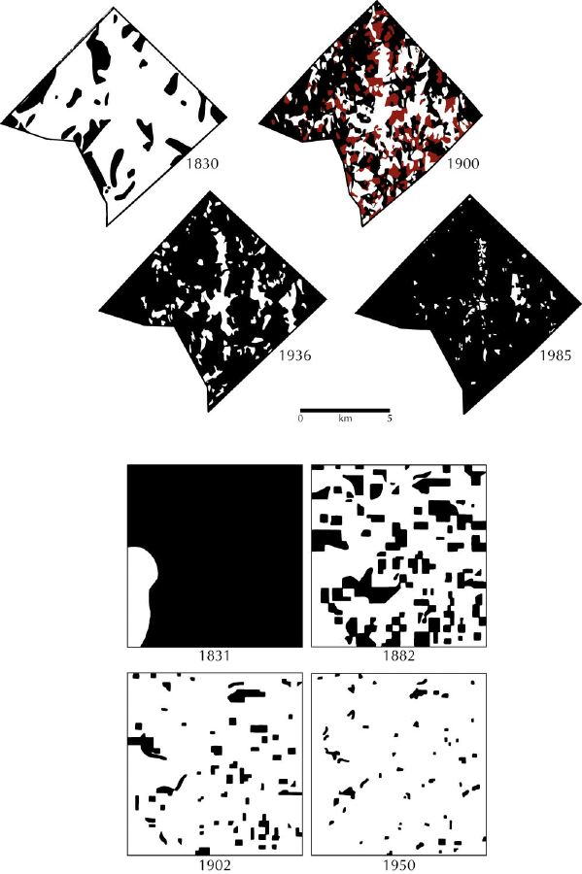
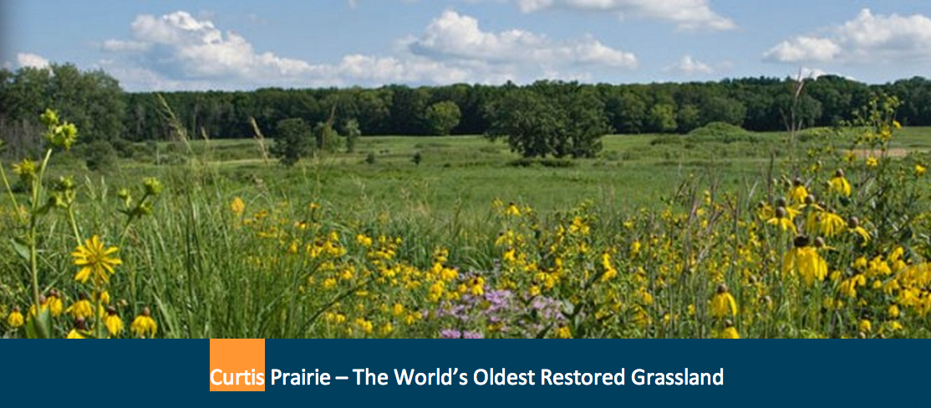
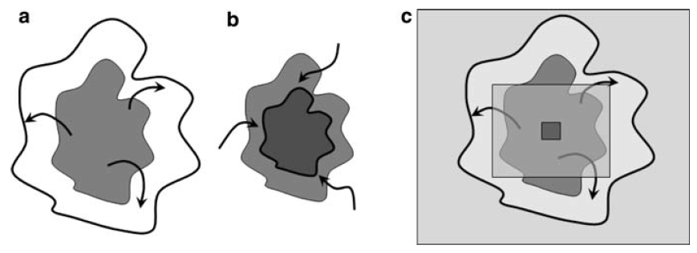
Landscape pattern matters.
Scale matters.
History matters.
Climate change matters.
Ecosystem services matter.
Wiens (2009)

Slide 19
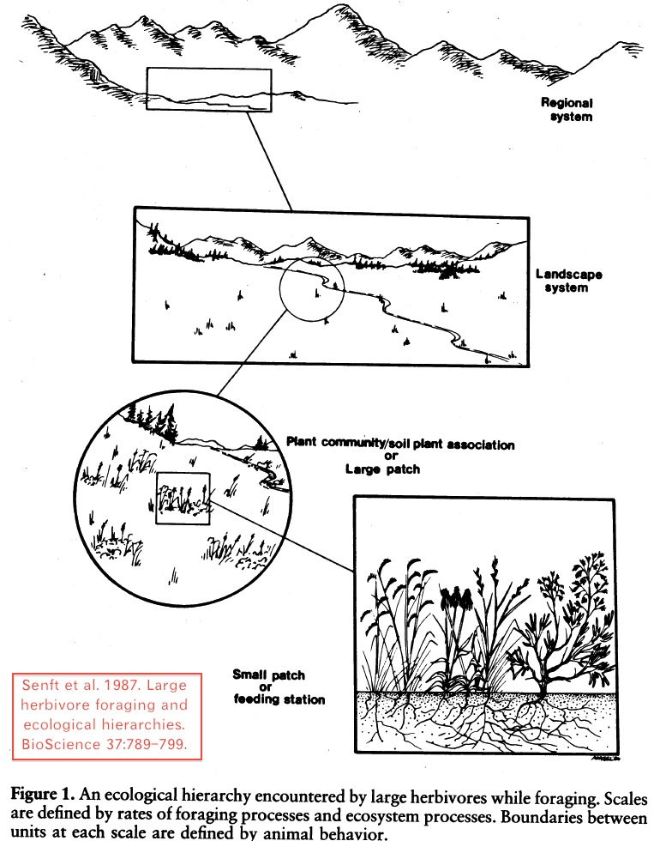
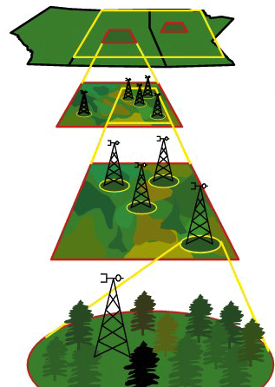
Landscape context matters.
Scale matters.
History matters.
Climate change matters.
Ecosystem services matter.

Slide 20
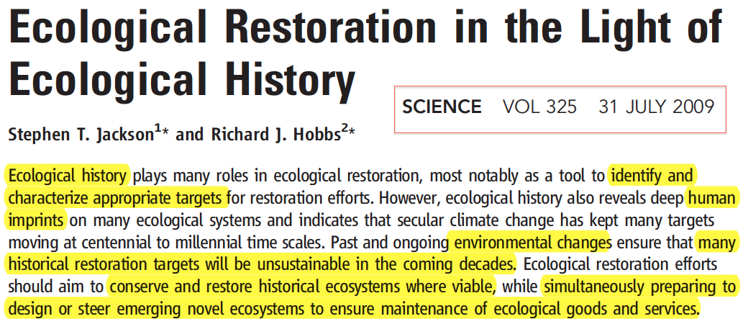
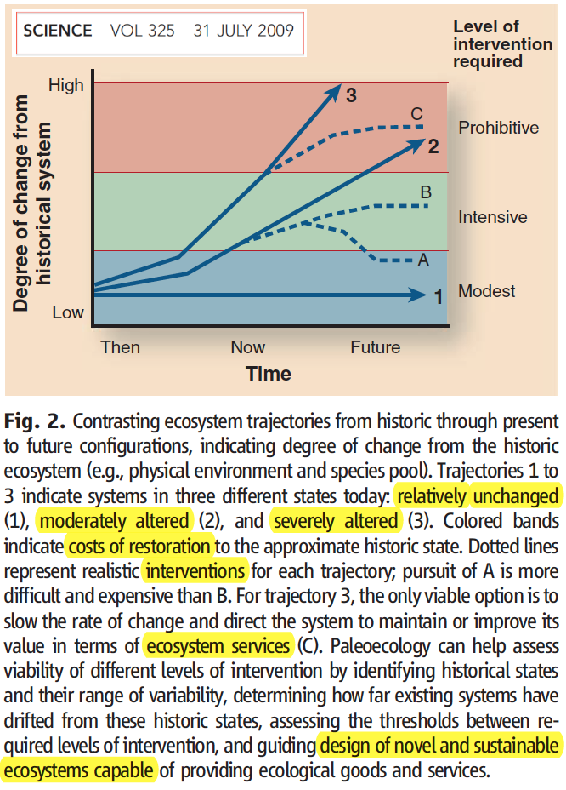
Landscape context matters.
Scale matters.
History matters.
Climate change matters.
Ecosystem services matter.

Slide 21
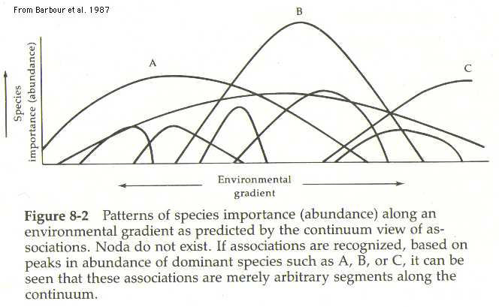
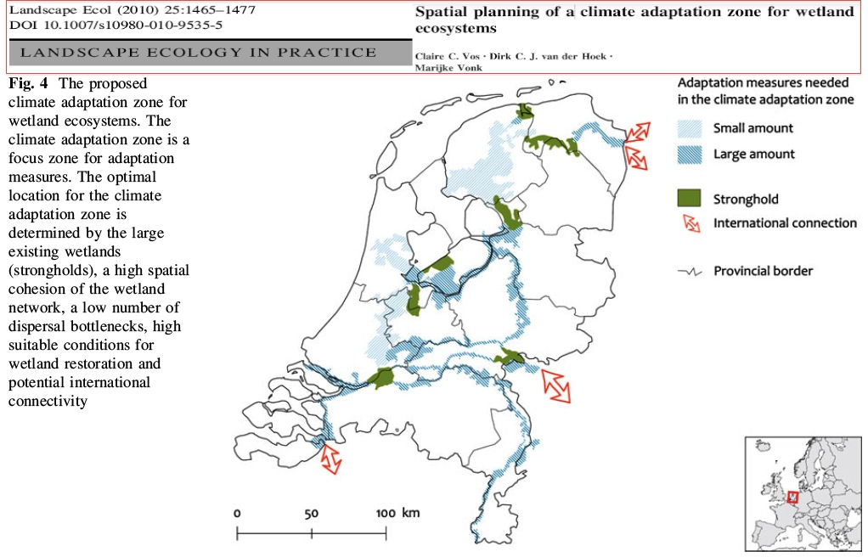
Landscape context matters.
Scale matters.
History matters.
Climate change matters.
Ecosystem services matter.

Slide 22
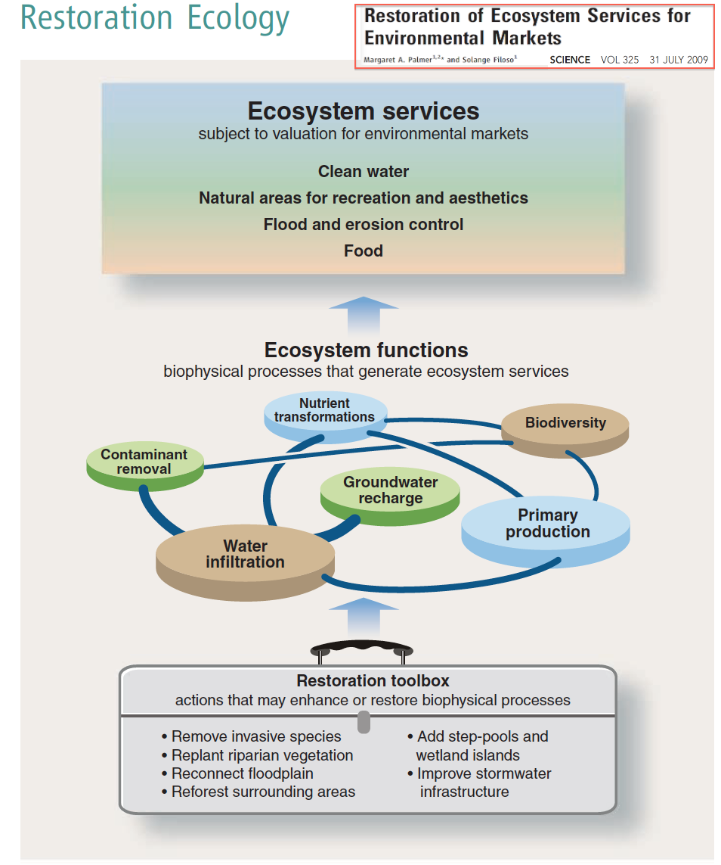
Landscape context matters.
Scale matters.
History matters.
Climate change matters.
Ecosystem services matter.

Slide 23
OUTLINE
Landscape ecology’s top 10 list in 2013
Landscape ecological principles for conservation and restoration
A new science in the making
Landscape sustainability science (LSS)
LSS as the ultimate goal of LE, CB, & RE

Slide 24
What Is Landscape Sustainability?
Landscape sustainability is the capacity of a landscape to consistently provide long-term, landscape-specific ecosystem services essential for maintaining and improving human well-being in a regional context and despite environmental and sociocultural changes.
Wu, J. (2013). Landscape sustainability science: Ecosystem services and human well-being in changing landscapes.
Landscape Ecology 28 (in press)

Slide 25
What Is Landscape Sustainability Science (LSS)?
Landscape sustainability science (LSS) is a place-based, use-inspired science of understanding and improving the dynamic relationship between ecosystem services and human well-being with spatially explicit methods.
Wu, J. (2013). Landscape sustainability science: Ecosystem services and human well-being in changing landscapes.
Landscape Ecology 28 (in press)

Slide 26
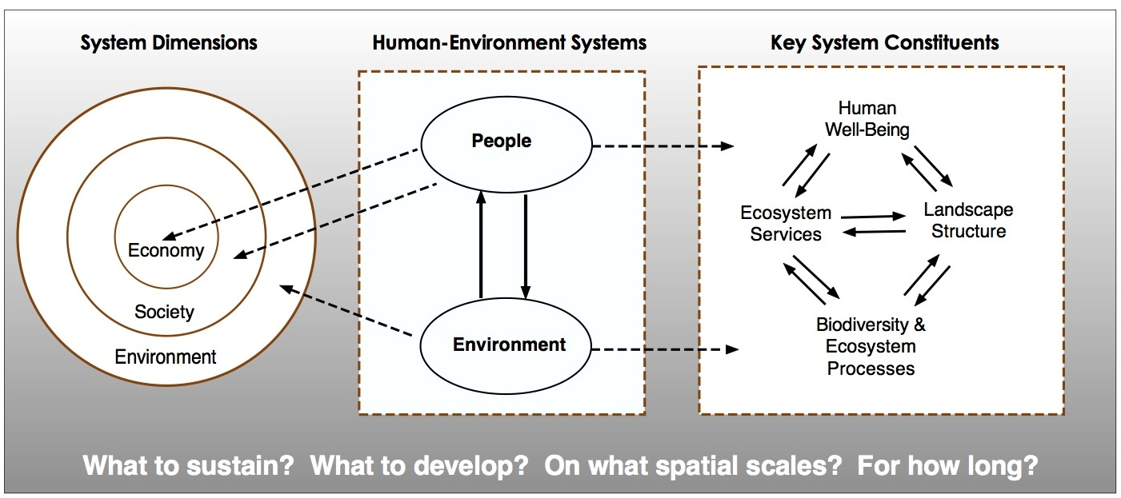
Wu, J. (2013). Landscape sustainability science: Ecosystem services and human well-being in changing landscapes. Landscape Ecology 28 (in press)

Slide 27
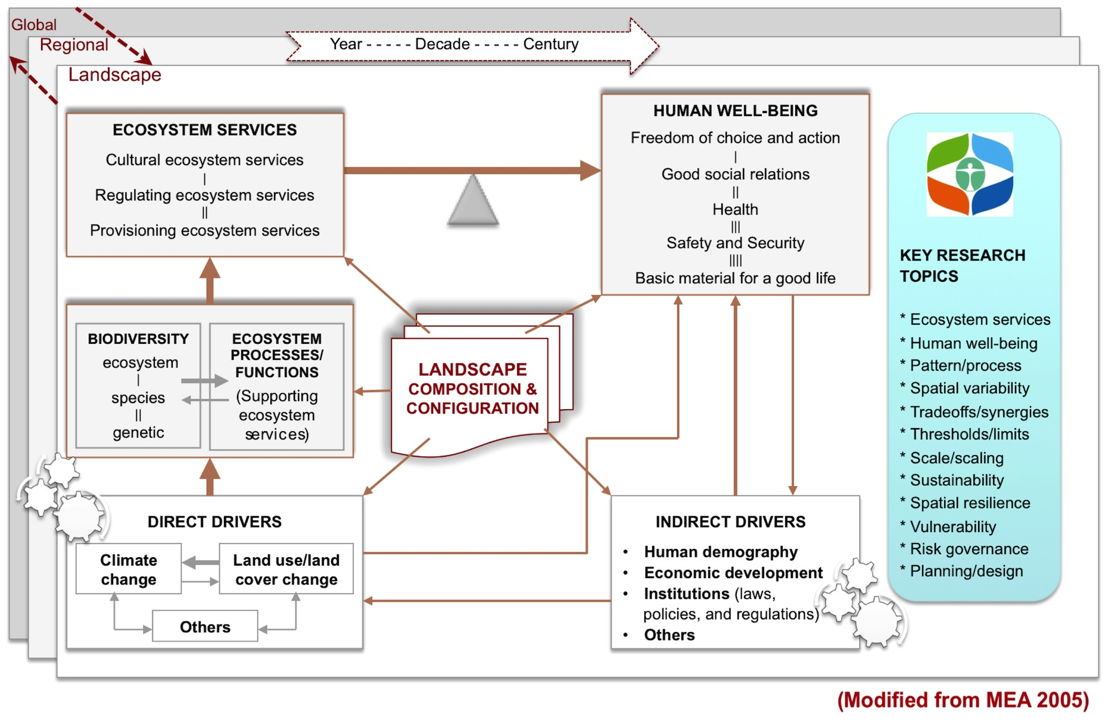
Conservation & Restoration
Notes:
Fig. 5. A framework for landscape sustainability science, in which the landscape is conceptualized as a spatially heterogeneous, coupled human-environment system from a strong sustainability perspective, and with a focus on the nexus of ecosystem services and human well-being (A). Key components, interactions, drivers, and research topics are illustrated in (B), which is modified from MEA (2005).

Slide 28
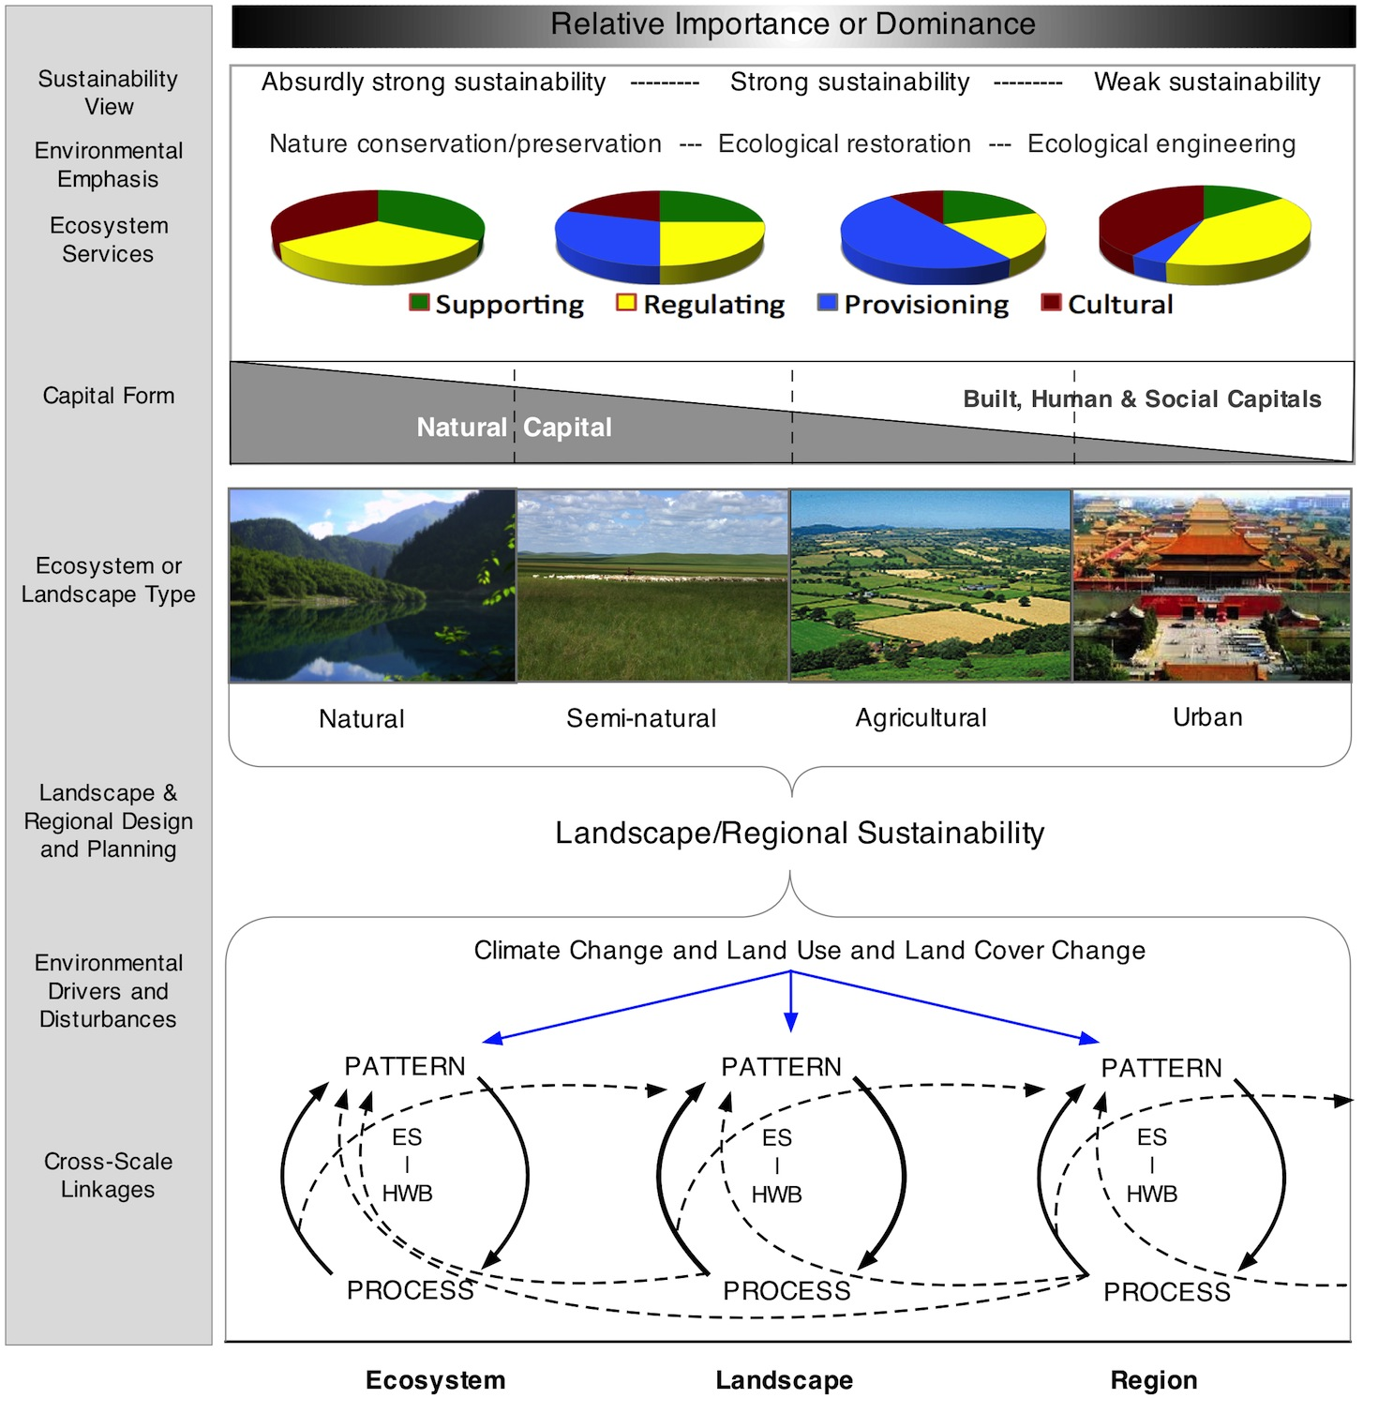
Conservation & Restoration
Notes:
Fig. 6. Relative importance of different sustainability views (strong vs. weak), forms of capital, types of ecosystem services, and environmental actions among different landscapes (upper panels), and the scale multiplicity of landscape and regional sustainability (bottom panel). Note that the proportions of the different ecosystem services for each landscape are not meant to be numerically precise, but rather illustrate their relative abundance across landscapes with various degrees of human modifications in a given geographic region. The illustration of cross-scale linkages is modified from Figure 5.1 in Charles (2009), in which ES denotes Ecosystem Services and HWB stands for Human Well-Being.

Slide 29
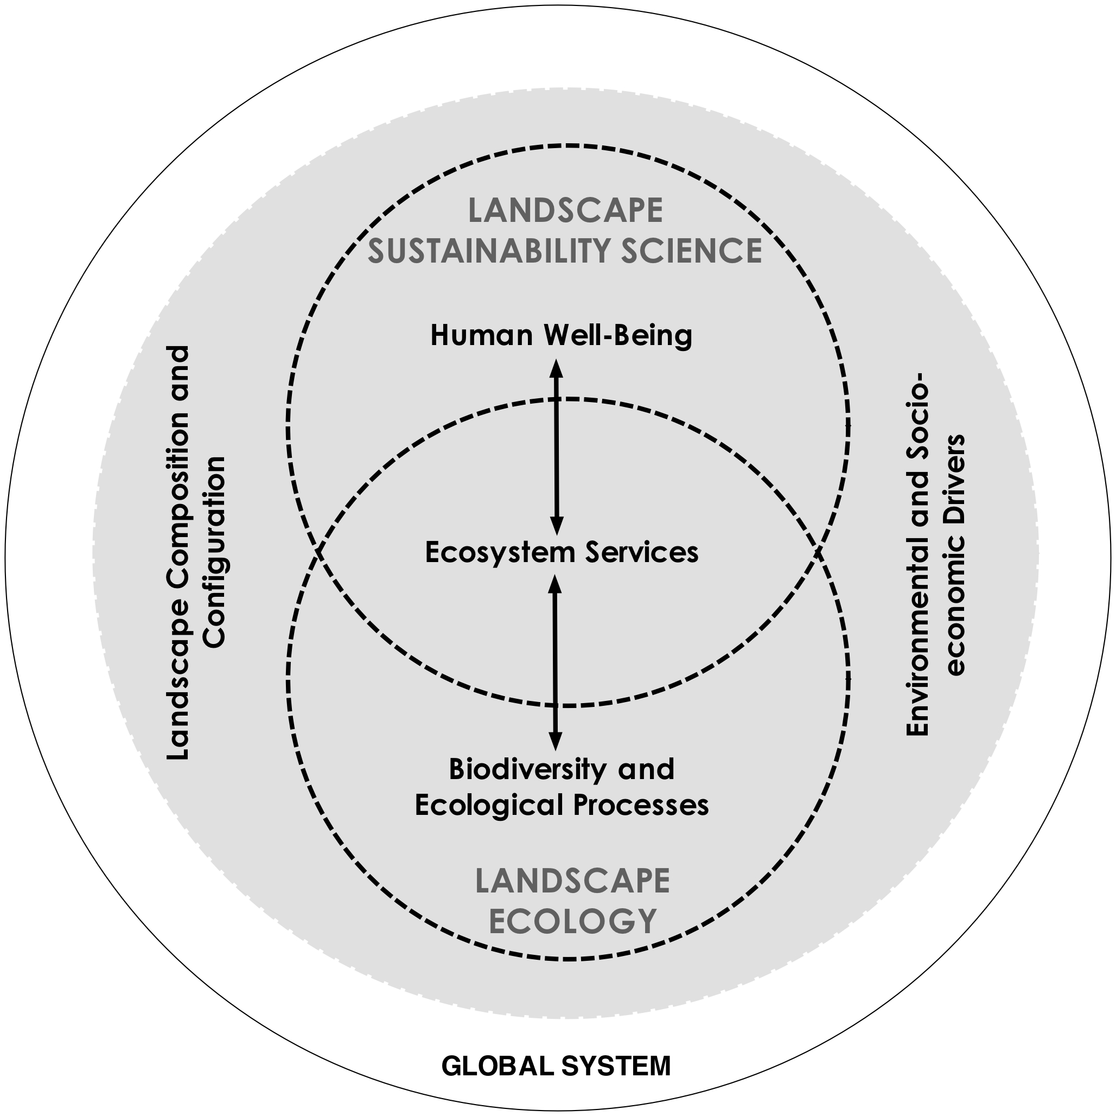
Conservation and Restoration
Wu, J. (2013). Landscape sustainability science: Ecosystem services and human well-being in changing landscapes. Landscape Ecology 28 (in press)

Slide 30
For More Information: http://LEML.asu.edu
Thank You
Wu, J. 2013. Key concepts and research topics in landscape ecology revisited: 30 years after the Allerton Park workshop. Landscape Ecology 28:1-11.
Wu, J. 2013. Landscape sustainability science: Ecosystem services and human well-being in changing landscapes. Landscape Ecology 28 (in press)
CHESS

