Slide 1

Recent advances in ecosystem nitrogen cycling: mechanism, measurement, and modeling of N₂O emissions
^{唐剑武}
^{jtang@mbl.edu}

Slide 2
Outlines
The nitrogen cycle
N₂O production
Measurement of N₂O fluxes
Control on N₂O fluxes
C-N interaction

Slide 3


Why nitrogen?
Along with carbon, nitrogen is the building block for all organisms.
Human alters the nitrogen cycle more than the carbon cycle:
  Anthropogenic N fixation is more than the natural process.
  Extra N is released to the atmosphere and deposited to the earth: N deposition.
  Extra N as the form of N₂O is emitted to the atmosphere as a potent greenhouse gas.
  Extra N is transferred to the water: eutrophication

Slide 4
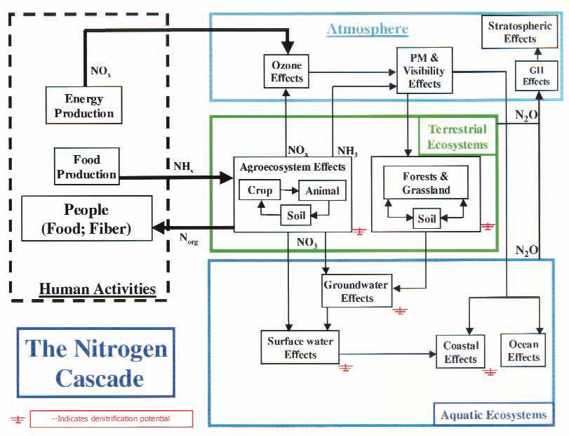
Galloway et al. 2003

Slide 5
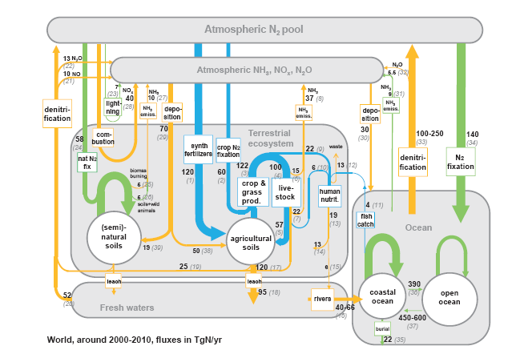
www.Initrogen.org

Slide 6
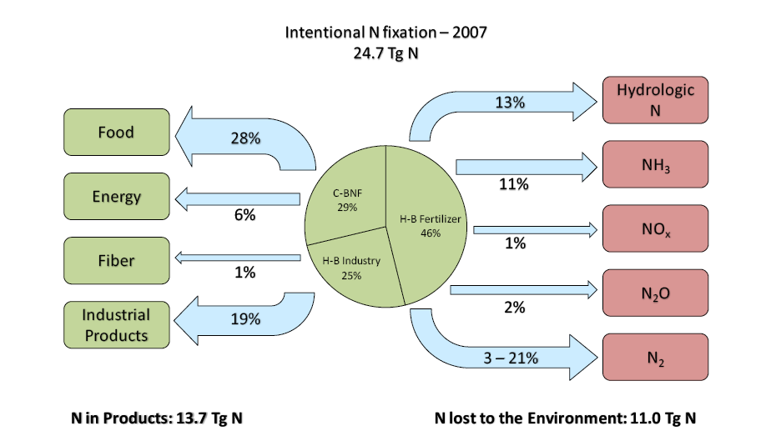
The fate of fixed N in the U.S. in 2007
Suddick and Davidson 2012

Slide 7
Research Goal
Advancing our understanding in the nitrogen cycle to optimize the N use and minimize the harmful impacts on human and the environment:
  N₂O emissions
  N pollution

Slide 8
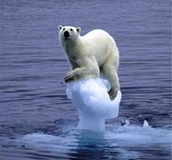
Climate change and greenhouse gases
Climate change
  Global warming (~0.1°C/10 years, not regional, not short-term)
  Sea level rise (~0.8 mm/year)
  Changed precipitation pattern
  Extreme weather
Climate change is induced by greenhouse gases: CO₂, CH₄, and N₂O

Slide 9
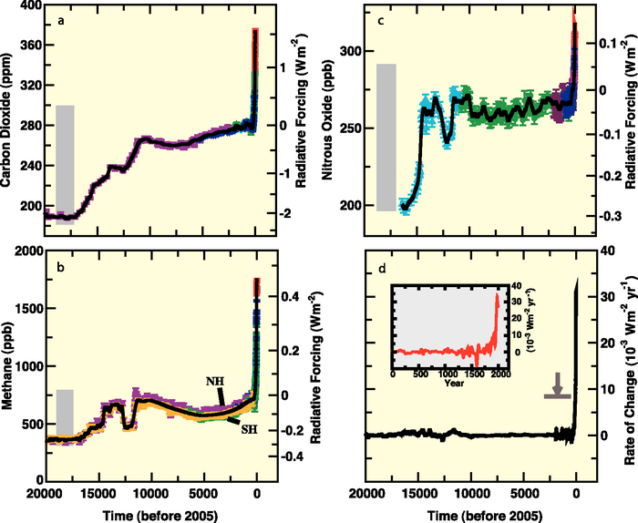
Atmospheric GHG concentration
CO₂
N₂O
CH₄
IPCC 2007

Slide 10
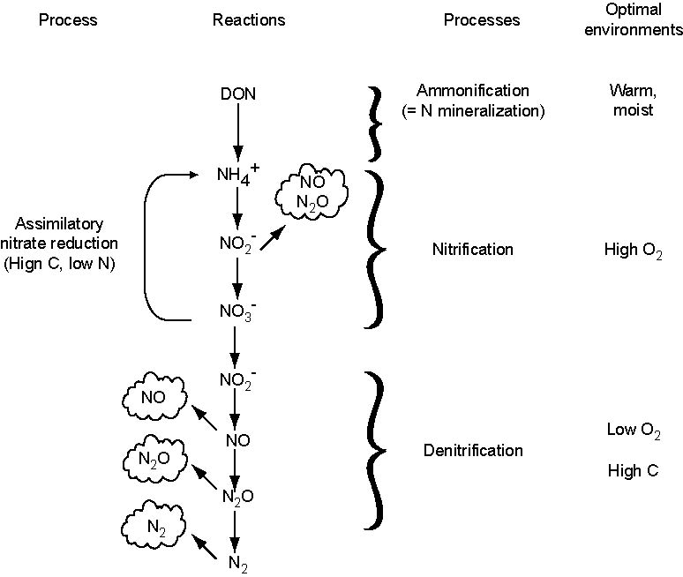
Nitrification and denitrification
Chapin et al, 2002

Slide 11
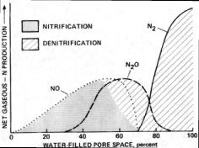
N₂O production
Hole-in-the-piple model (Davidson et al. 2000)
N₂O flux is driven by temperature, moisture, redox potential, pH, and substrate availability (N & C).

Slide 12
IPCC emissions factor
1% of fertilizer N (IPCC 2007)
2.5% of fertilizer N (Davidson 2009)
3-5% of fertilizer N (Crutzen et al. 2008)
Can we simply use the emissions factor to calculate N₂O emissions?

Slide 13
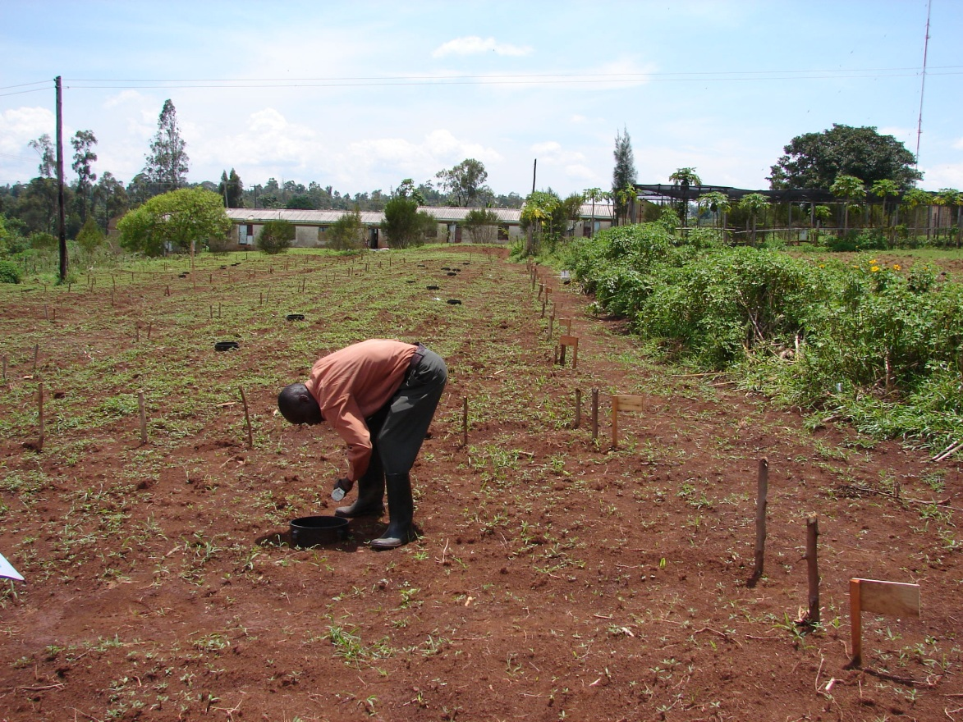
Africa’s new green revolution:
Can we boost the yield while minimize N₂O emissions?
Increasing average nutrient additions from 8 to 50 kg fertilizer ha⁻¹ yr⁻¹ could result in 2-3 times of crop yield.
But what is the consequence of greenhouse gas emissions?
IFDC 2006

Slide 14
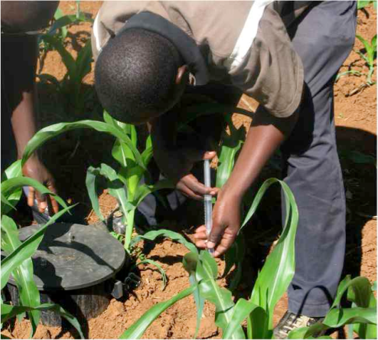
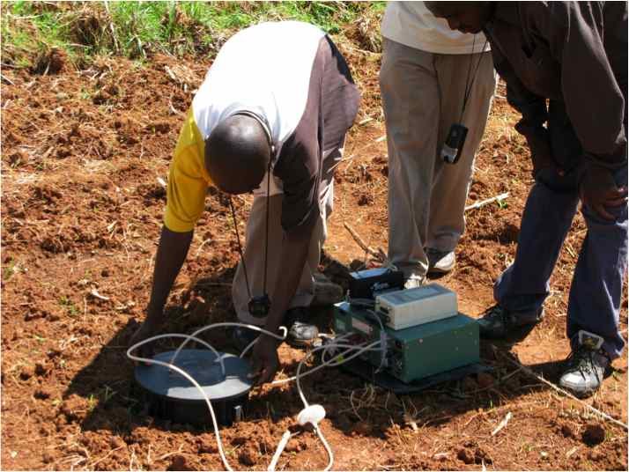
Can we find an optimal line?
Crop yield
Greenhouse gas emissions
Fertilizer
???

Slide 15
Questions for N₂O production
How do N₂O fluxes respond to temperature, N contents, and soil properties?
Are N₂O fluxes primarily driven by denitrification or nitrification processes?

Slide 16
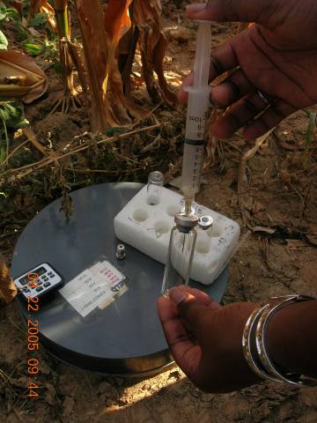
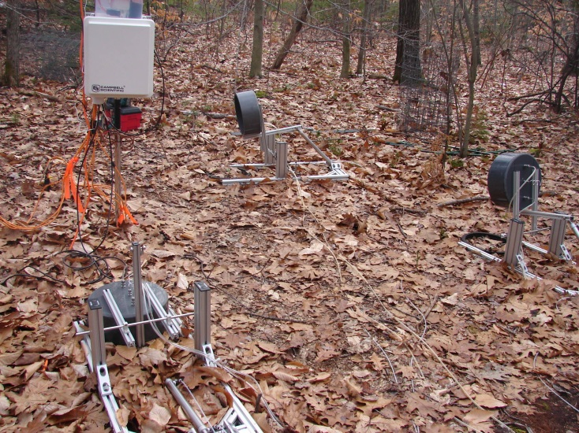
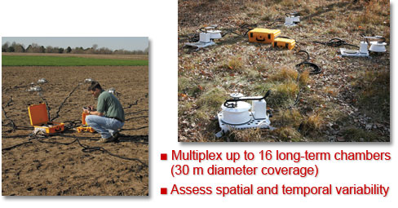
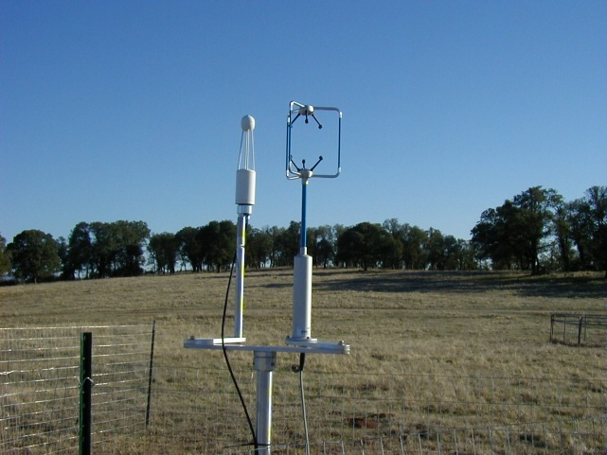
Gas flux measurement
Chambers
Tang et al.
Eddy covariance
Notes:
PP: Custom-built chamber

Slide 17
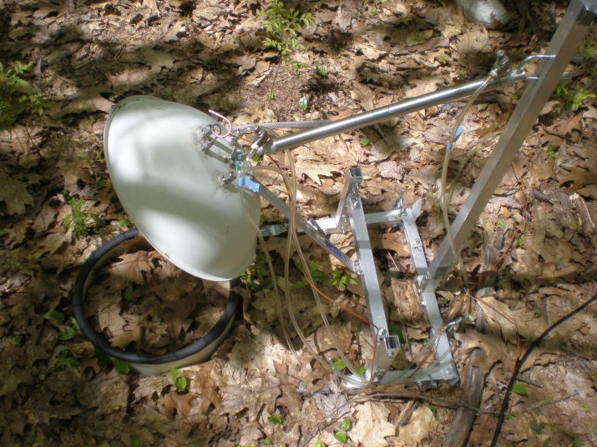
Calculating flux from chamber measurement
C
t
where C is mole concentration (μmol m⁻³), V is volume (m³), and A is area (m²).
where C_{v} is volume concentration (ppm), P is air pressure (Pa), T is soil absolute temperature (K), and R is universal gas constant (8.3144 J mol⁻¹ K⁻¹).
Therefore,

Slide 18
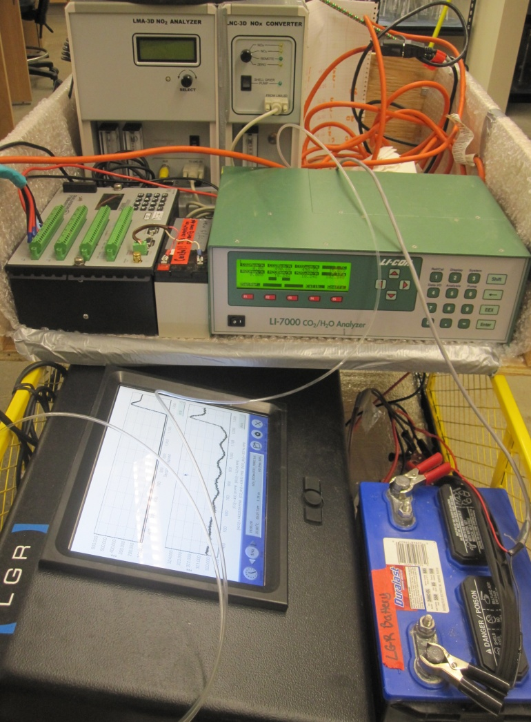
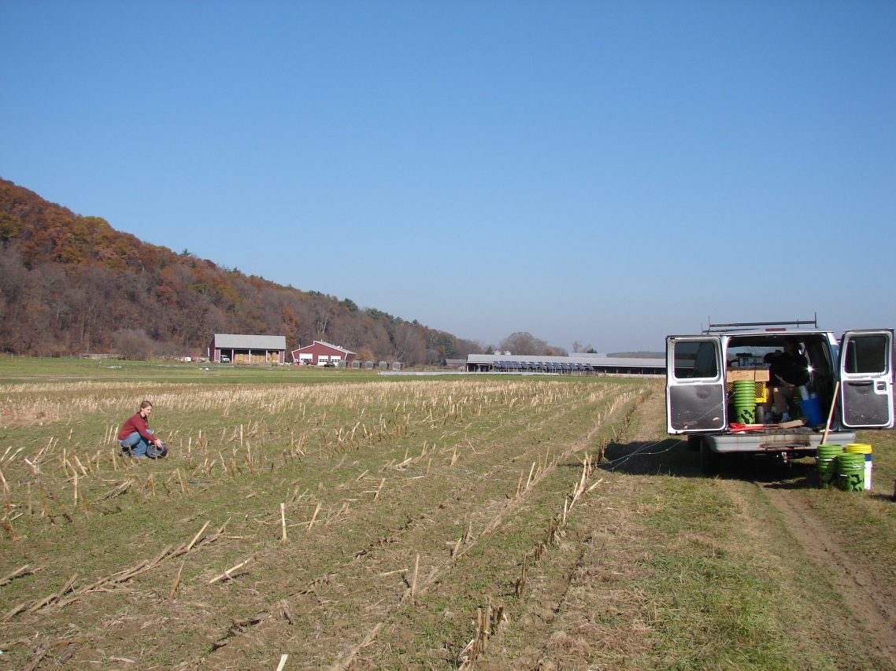
Chamber-based GHG measurement system
Tang et al. in preparation

Slide 19
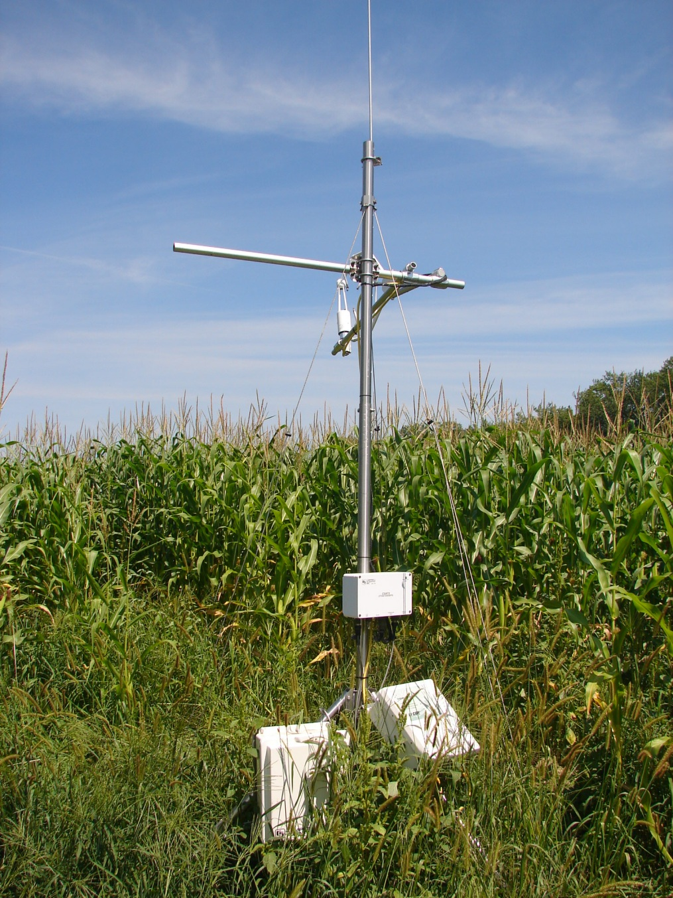
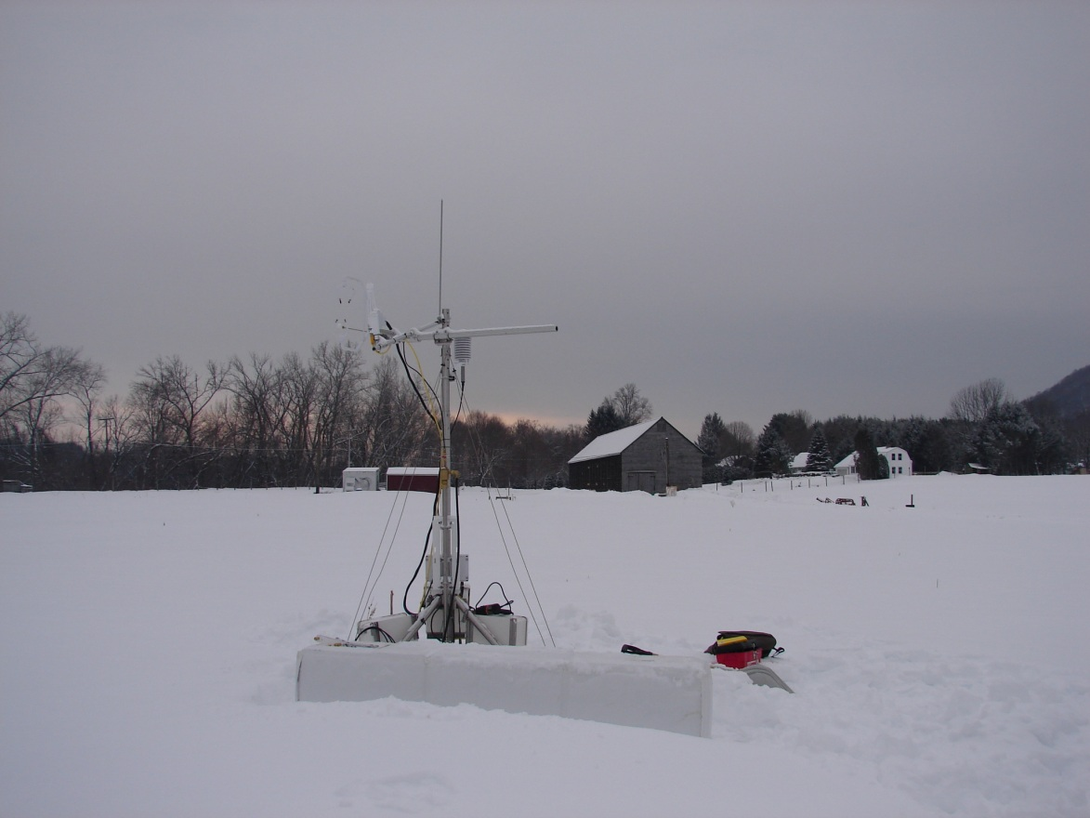
Eddy covariance measurement of GHGs on the landscape scale
Tang et al. in preparation

Slide 20
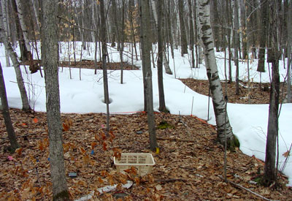
Coupled warming and N addition effects on greenhouse gas emissions
Melillo et al. 2002. Science

Slide 21
Long-term N addition experiment at Harvard Forest
Control
Low N
High N
Magill et al. 2004

Slide 22
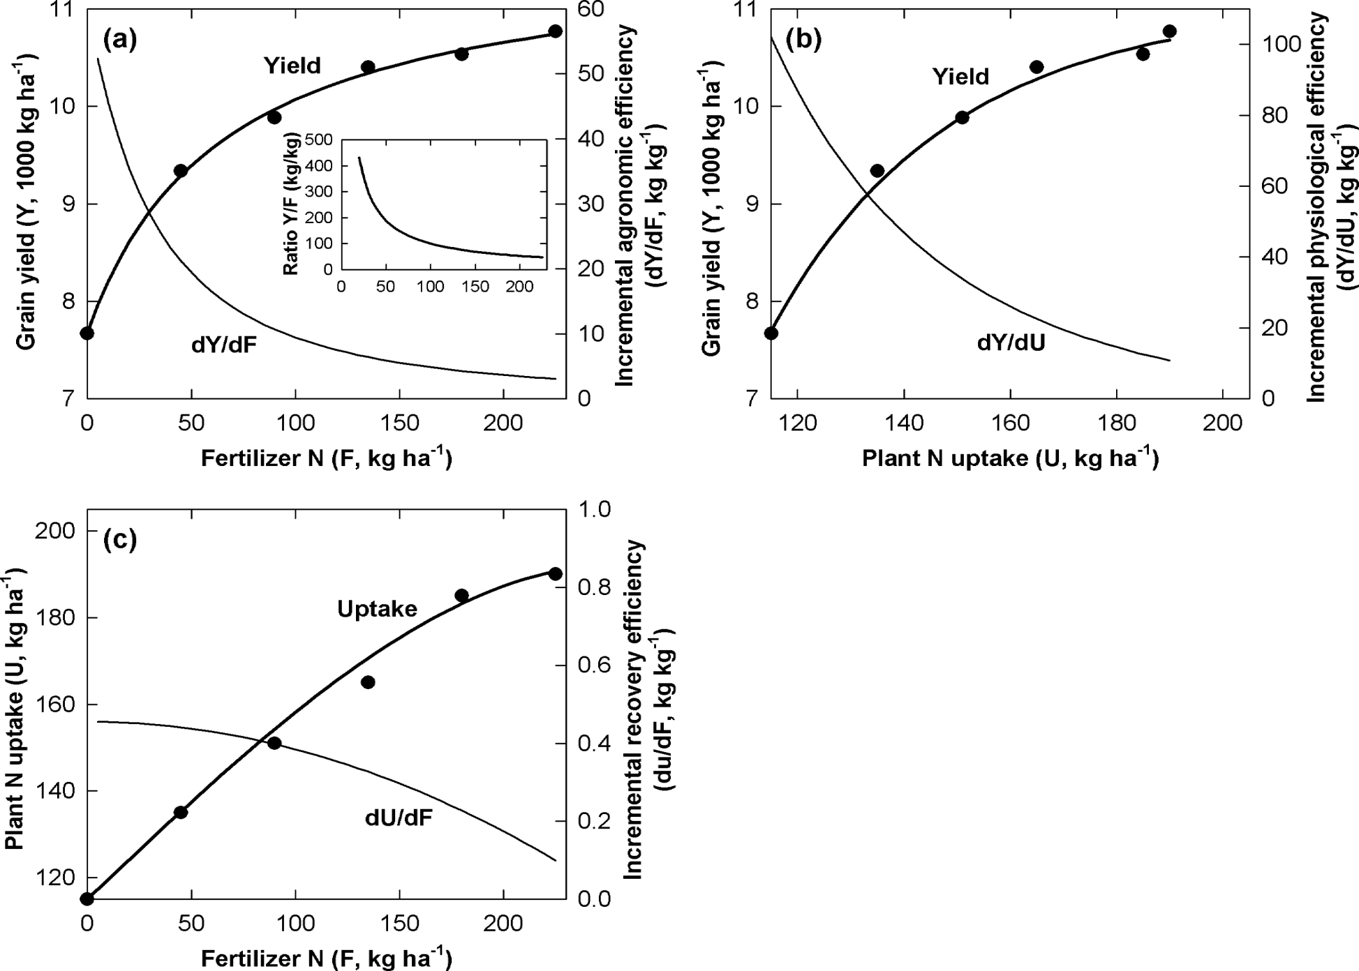
Crop yield and N
Cassman et al. 2003

Slide 23
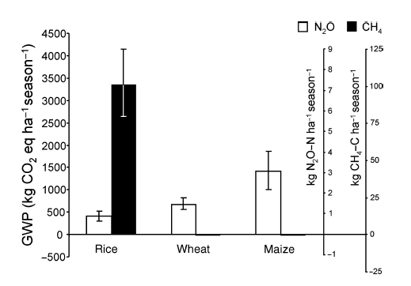
N₂O and CH₄ emissions in agriculture
Linquist et al. 2012

Slide 24
N₂O flux with temperature from agriculture
-- Q₁₀ model
Tang et al. in preparation

Slide 25
GHG flux vs. N in agriculture
Tang et al. in preparation

Slide 26
N₂O and CO₂ fluxes in response to N and warming
at Harvard Forest

Slide 27
N₂O pulse after rainfall
Hickman et al. in preparation

Slide 28
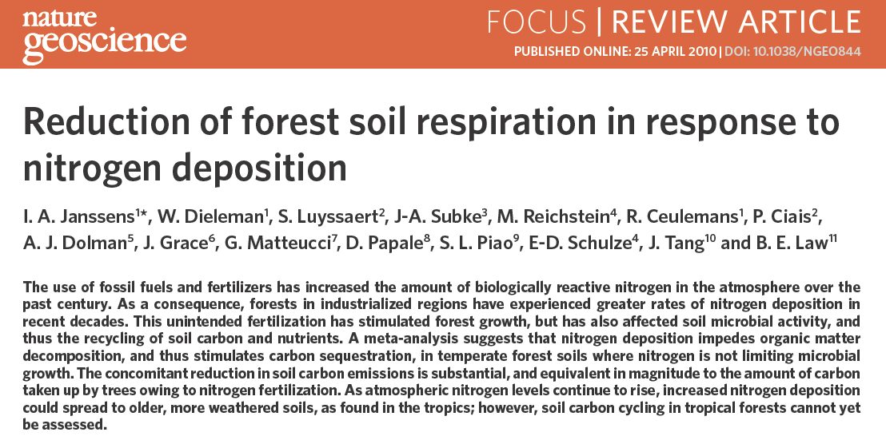
C-N coupling

Slide 29
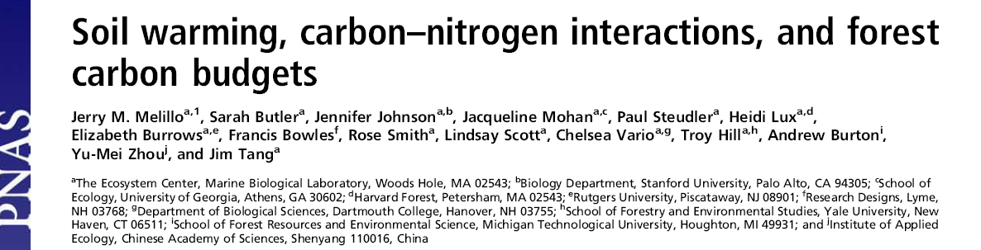
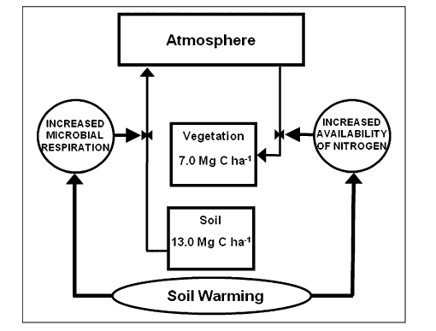
Temperature-C-N interactions

Slide 30


An experiment for the world:
China’s scientists are using a variety of approaches to boost crop yields and limit environmental damage.
Zhang et al. 2013. Nature

Slide 31
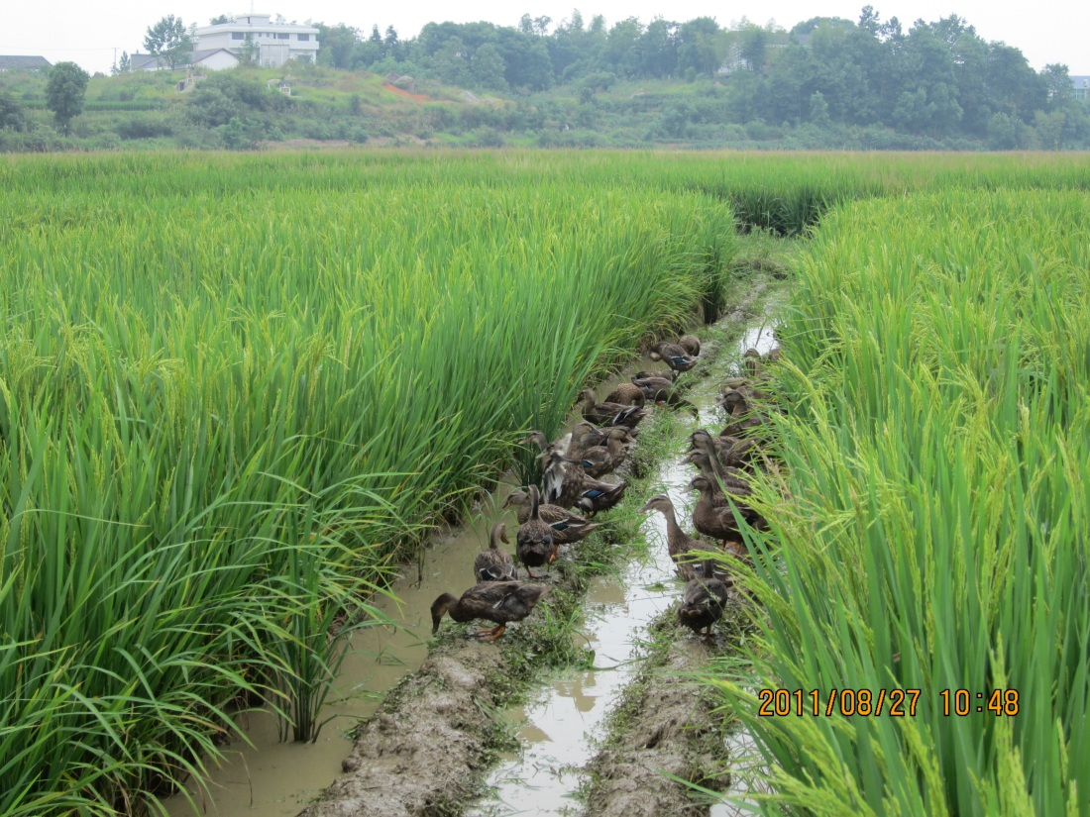
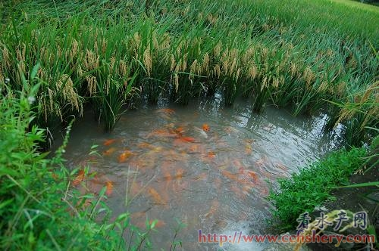
Rice-fish and rice-duck systems in China:
Symbiotic processes for C and N
Zheng et al. In review

Slide 32
Summary
Simulating and predicting greenhouse gas emissions requires us to advance knowledge in coupled carbon and nitrogen cycles.
Sustainable ecosystem management requires us to optimizing nitrogen use while decreasing environmental impacts.

