Slide 1
Multiple Scale Analysis of Climate Change and Socioeconomic Impacts on Urban Ecological Process
Junmei Tang
Geography and Environmental System
University of Maryland, Baltimore County

Slide 2
Outline
Background
American 16 cities climate change analysis
Eastern shore metropolitan
Baltimore-Washington region
Forest Phenology at tree level
Summary

Slide 3
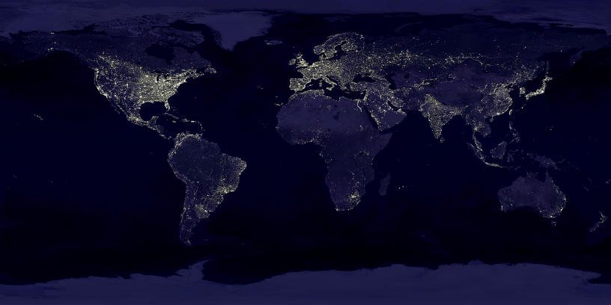
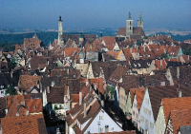
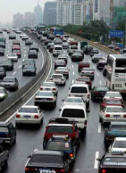
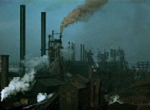
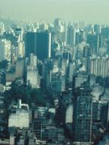
Background
Hirschhorn am Neckar, Germany
Beijing, China
Houston, USA
Sao Paulo, Brazil
Global Urbanization
1900 - 14% of humanity lived in urban areas, 2010 – 50.5%

Slide 4
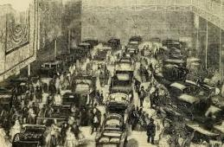
Urbanization History
I. Boat/coach era (~1830)
Before 1830, harbor cities: New York, Boston, Baltimore, Philadelphia etc; Hudson River.
From 1790-1830, population from 4 millions to 13 millions.
II. steam engine/railway era (1830-1870)
1830-1870, largest cities: New York, Chicago (concentric pattern).
From 1830-1860, population grew to 32 million (immigration).

Slide 5
Urbanization History
III. steam engine/steel era (1870-1920)
Industrial cities: Boston, New York, Philadelphia, Baltimore, Pittsburg, Cleveland, Detroit, Chicago; city → metropolitan
From 1870-1920, population grew to 41 million, more cities: Los Angeles, San Francisco, Seattle etc.
IV. Auto/Airplane era (1920-1970)
Two Characterizes: Suburbanization; Super-metropolitan/megalopolitan urban areas; the most growth area is the South (Los Angeles→ Atlanta)
In 1970, population in suburban is 76 million (37.2%), population grew to 150 million.
V. Disaggregate era (after 1970)
Conterurbanization, post-industrial/postmodern city
Population has the first drop in the metropolitan area.

Slide 6
Urbanization History

Slide 7
Largest 16 cities in US

Slide 8
Data collection and processing
1. National Weather Service (NWS) Cooperative Observer Program (COOP)
2. National NLCD impervious percentage map
3. US Census Bureau

Slide 9
Climate change from 1950-2010
Average temperature in January
New York
Average temperature in July
New York

Slide 10
Spatial Pearson's correlation
Spatial Pearson’s Correlation in ArcGIS

Slide 11
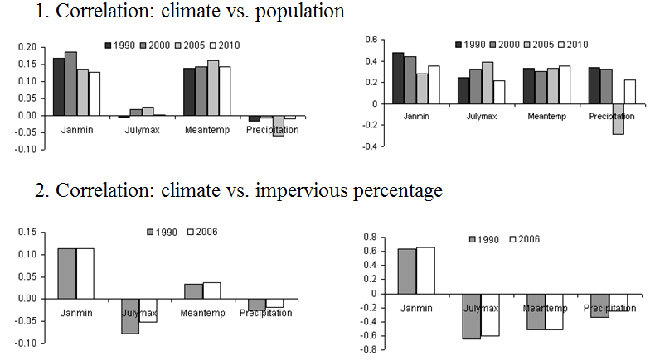
Spatial Pearson's correlation

Slide 12
Eastern shore metropolitan
Has the longest history in Urbanization.
One of the highest population density area.
Boston-Washington Metropolitan.

Slide 13
Temperature, precipitation, and NDVI

Slide 14
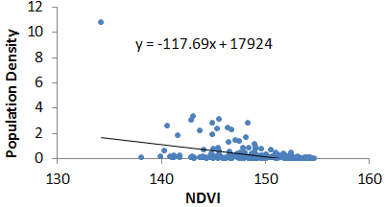
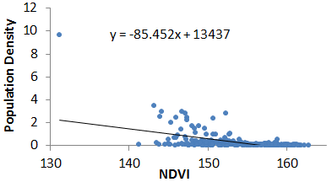
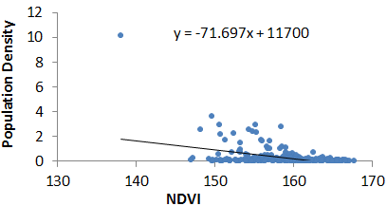
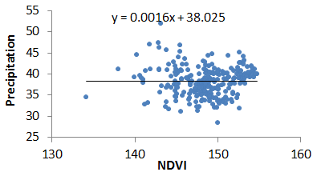
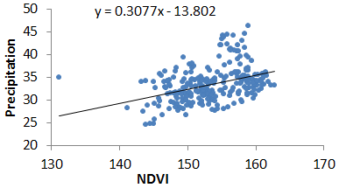
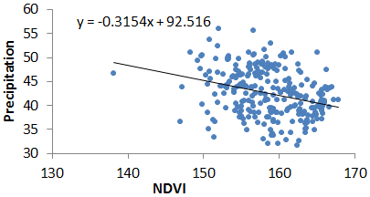
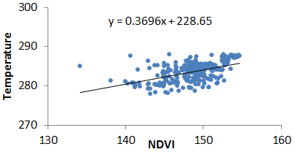
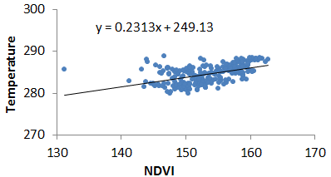
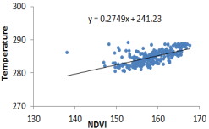
Zone statistic at county level
Population
Density
Precipitation
Temperature

Slide 15
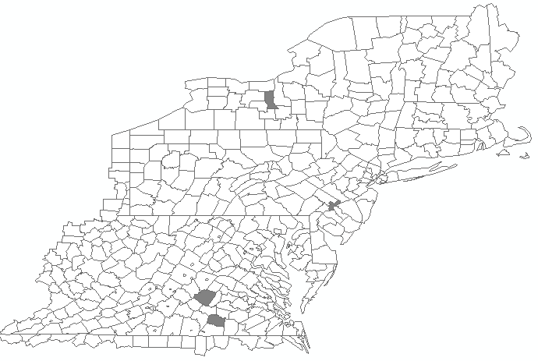
County level phenology analysis
Buckingham, Virginia Lunenburg, Virginia;
Philadephia, Pennsylvania;
Seneca, New York

Slide 16
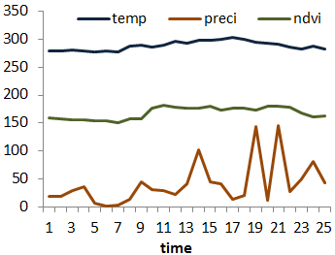
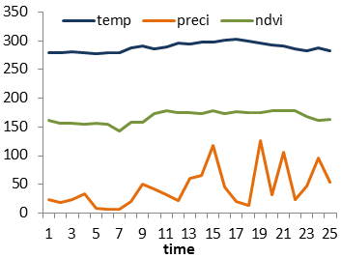
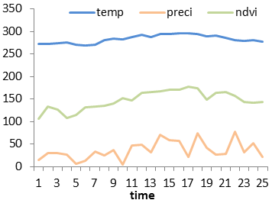
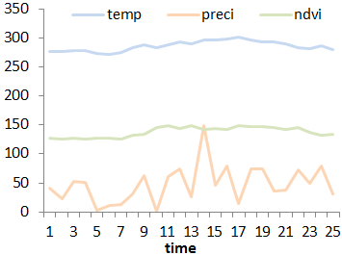
County level phenology analysis
Correlation: 0.7671; 0.3491
Correlation: 0.7659; 0.4208
Correlation: 0.8766; 0.5492
Correlation: 0.8318; 0.2853

Slide 17
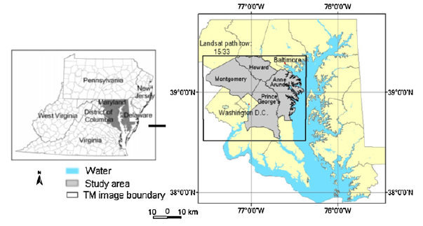
Baltimore-Washington Region

Slide 18
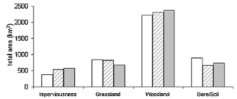
Green Density Change in 1990-2010

Slide 19
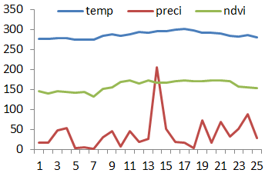
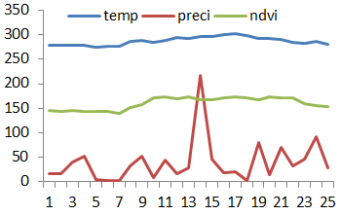
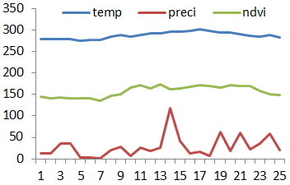
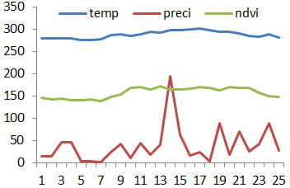
Phenology change in each county
Howard County
Montgomery County
Correlation: 0.8465, 159, 45%
Correlation: 0.8433, 160, 43%
Anne Arundel County
Prince George County
Correlation: 0.8350, 157, 42%
Correlation: 0.8243, 157, 40%

Slide 20
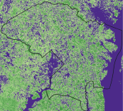
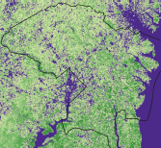
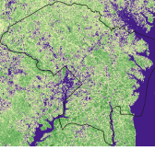
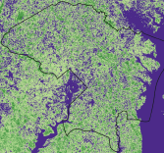
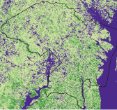
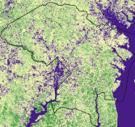
Ecological function 1990-2010
LAI
fPAR

Slide 21
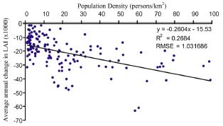
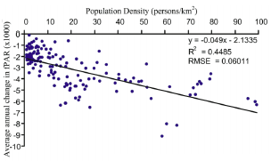
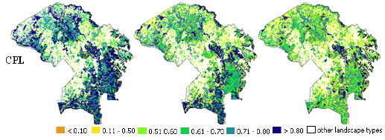
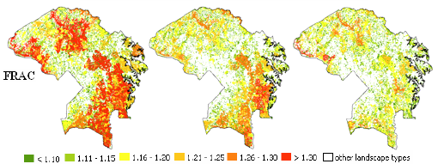
Ecological Function 1990-2010

Slide 22
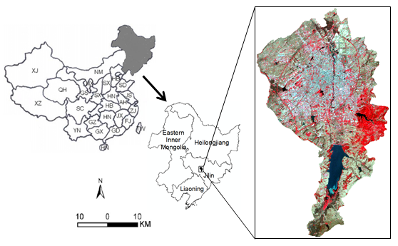
First forest city in China: Changchun

Slide 23
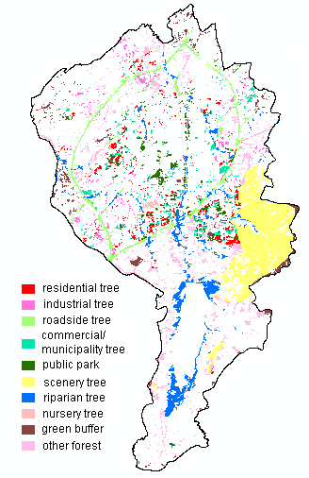
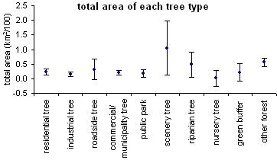
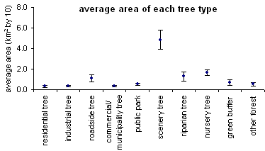
Different urban forest types

Slide 24
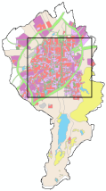
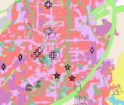
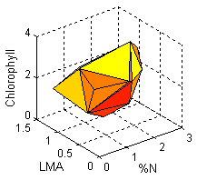
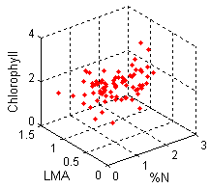
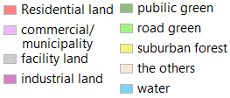
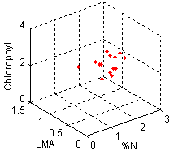
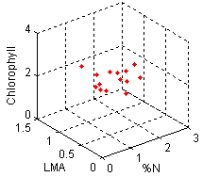
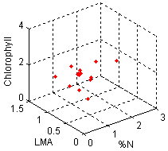
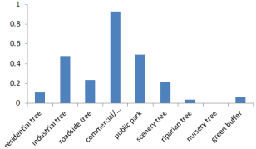
Functional trait volume

Slide 25
Forest structure, pattern, and function

Slide 26
Urban forest phenology

Slide 27
Liriodendron Tulipifera-AKA (Tulip Poplar)
Native to North America.
Limbs may start at 25-30m, up to 50m+.
Fast growing.
April begins flowering.

Slide 28
The First Study Site
Big Tree: DBH 75cm; Height: 36.4m;
Mediam Tree: DBH 38.7cm; Height: 26.4m;
Understory: American Beech, Musclewood, Sassafras, Northern hackberry;
Groundcover: Oak, Beech, Spicebush, Common greenbriar.

Slide 29
The Second Study Site
Small Tree: DBH 21.4 cm; Height: 11.3 m;
Tiny Tree: DBH 9.5 cm; Height: 5.8 m;
Understory: American Beech, Muslewood, Sassafras, Northern hackberry;
Groundcover: Oak, Beech, Spicebush, Common greenbriar.

Slide 30
Phenological spectral indicator
Visible Ratios:
SRPI = R₄₃₀/R₆₈₀
PRI = (R₅₃₁-R₅₇₀)/(R₅₃₁+R₅₇₀)
Visible/NIR Ratios:
NDVI = (R₇₇₄-R₆₇₇)/(R₇₇₄+R₆₇₇)
SIPI = (R₈₀₀-R₄₅₀)/(R₈₀₀+R₆₅₀)
Red Edge Reflectance-Ratio Indices:
Carter = R₆₉₅/R₇₆₀
Vogelmann = (R₇₃₄-R₇₄₇)/(R₇₁₅+R₇₂₆)

Slide 31
Phenological spectral indicator
April, 6
August, 30
November, 3
Big Tree, Sunlight

Slide 32
Photochemical Reflectance Index

Slide 33
Pearson's correlation

Slide 34
UMBC: An Honor University

Slide 35
Thanks!
Questions & Comments?

