Slide 1




Predictability of the Terrestrial Carbon Cycle
Yiqi Luo University of Oklahoma, USA
Tsinghua University, China
Trevor Keenan Harvard University, USA
Matthew Smith Microsoft Research, Cambridge, UK
YingPing Wang CSIRO
Jianyang Xia University of Oklahoma, USA
Sasha Hararuk University of Oklahoma, USA
Ensheng Weng Princeton University, USA
Yaner Yan Fudan University, China
yluo@ou.edu
http://ecolab.ou.edu

Slide 2
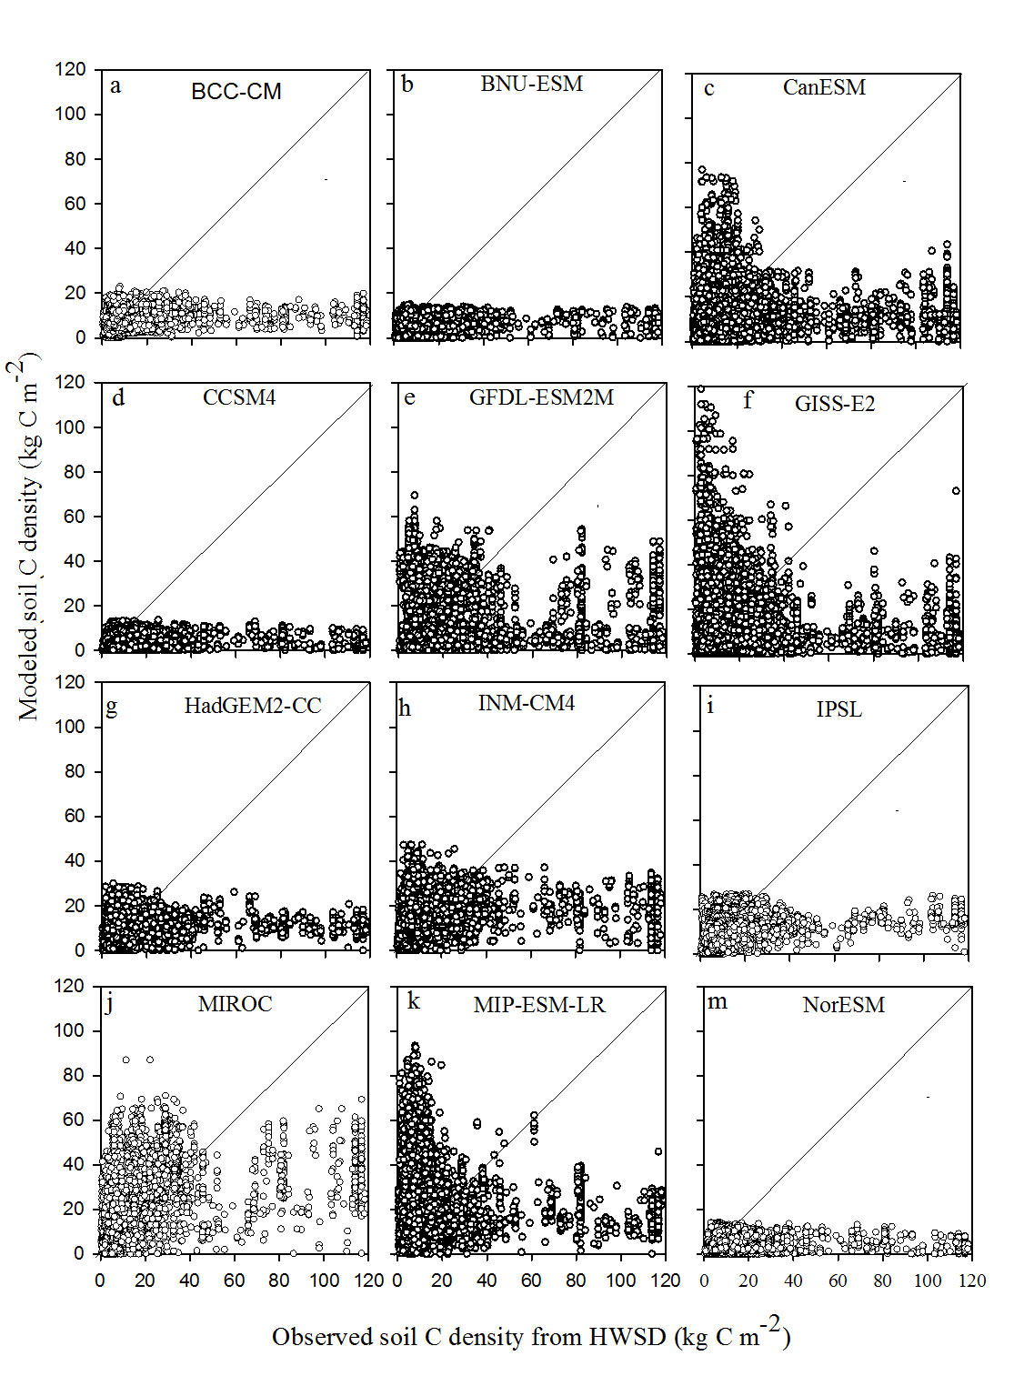
IPCC assessment report
Soil carbon modeled in CMIP5 vs. HWSD
Yan et al. submitted

Slide 3
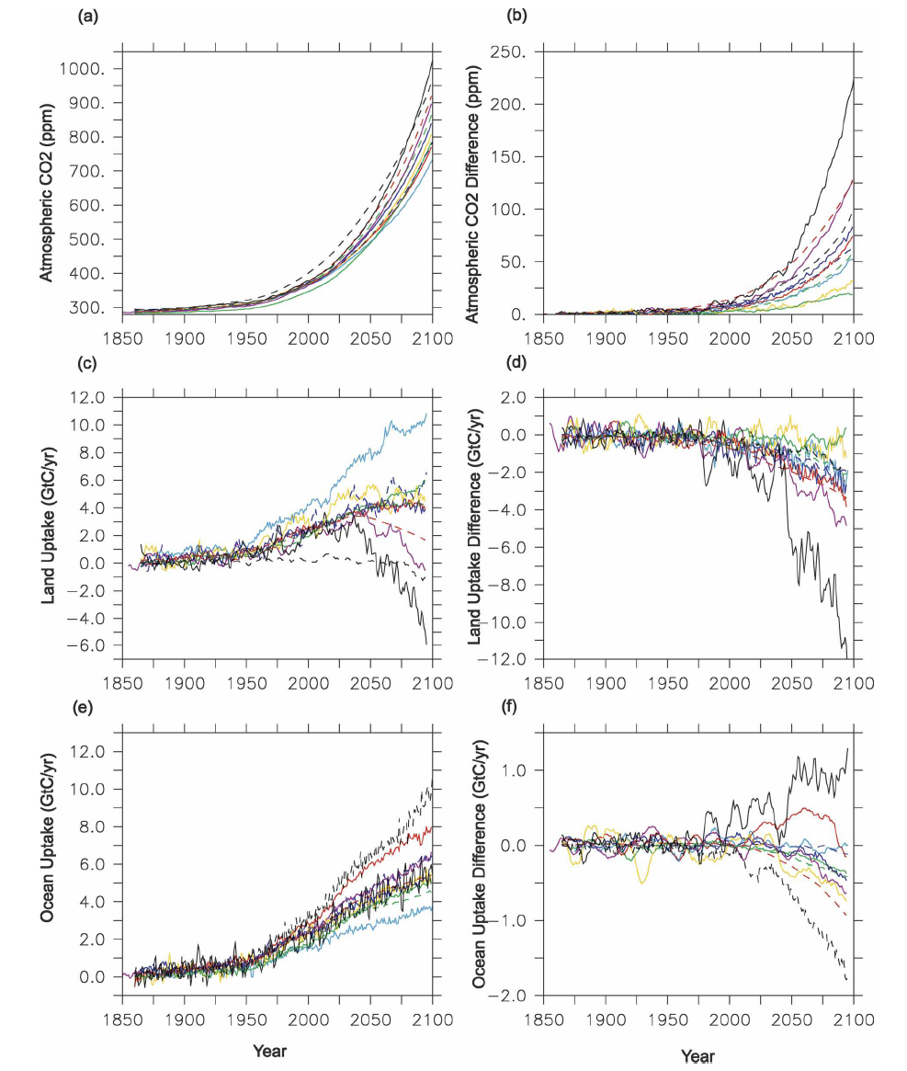
Great uncertainty among models
Does the uncertainty reflect variability in the nature or result from artifacts?
Friedlingsterin et al. 2006

Slide 4
Current efforts to improve the predictive understanding

Slide 5
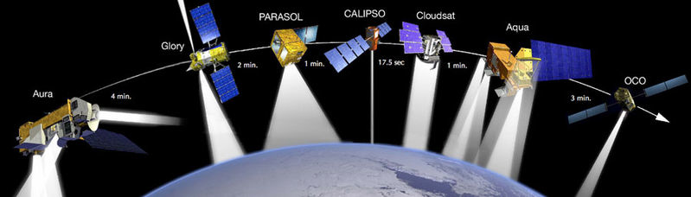
Satellite measurement of CO₂

Slide 6
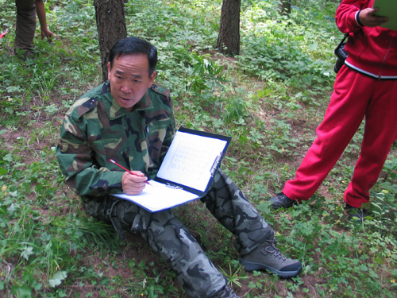
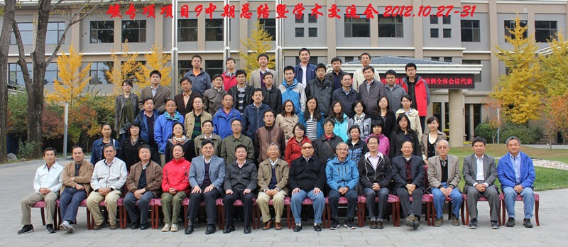
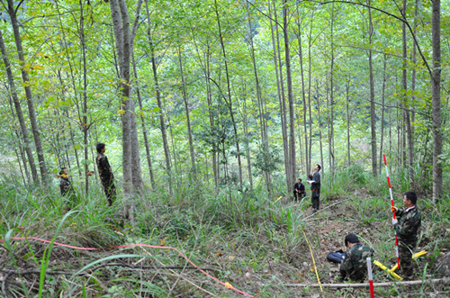
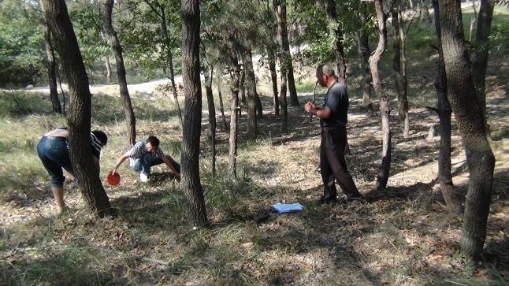
中科院碳循环研究专项

Slide 7

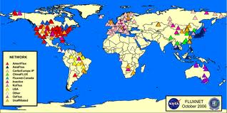
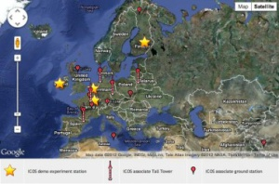

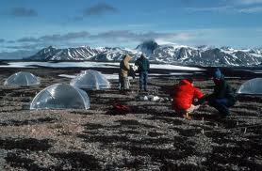
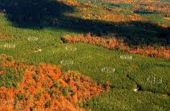
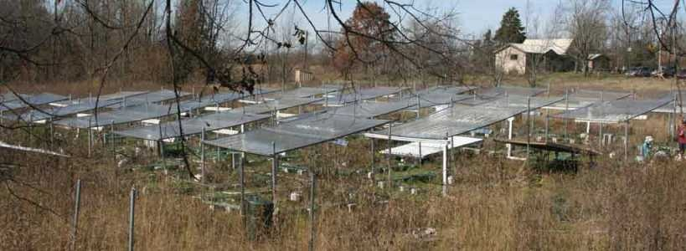
Observation and experiment
Can they make IPCC assessment report better?

Slide 8
Modeling
Method | Merit | Issue
Adding components | Simulating more processes realistically | Complexity Intractability
Model intercomparison | Illustrating uncertainty | Attribution to its sources
Benchmark analysis | Performance skills | Objective benchmarks
Data assimilation | Improving models | Various challenges

Slide 9
Theoretical analysis
The terrestrial carbon cycle is a relatively simple system
It is intrinsically predictable.
The uncertainty shown in model intercomparison studies can be substantially reduced with relatively easy ways
We should sharpen our research focus on key issues
Notes:
9

Slide 10
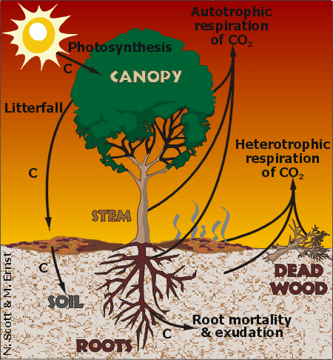
Properties of terrestrial carbon cycle
Photosynthesis as the primary C influx pathway
Compartmentalization,
Partitioning among pools
Donor-pool dominated carbon transfers
1st-order transfers from the donor pools
Luo and Weng 2011

Slide 11
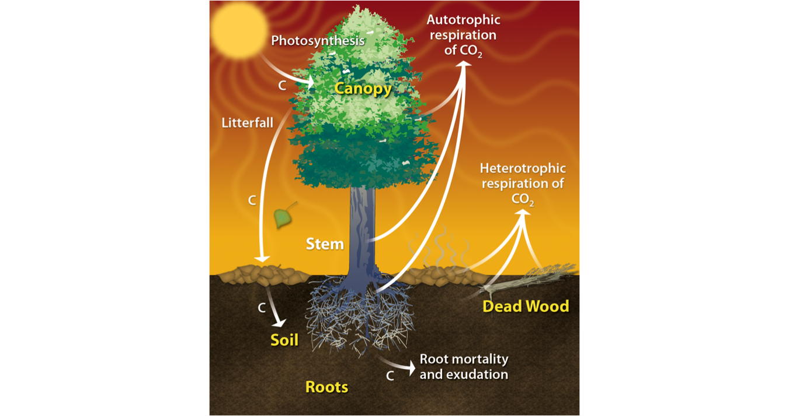
Theoretical analysis
Photosynthesis
CO₂
Leaf (X₁)
Root (X₂)
Wood (X₃)
Metabolic litter (X₄)
Structure litter (X₅)
CO₂
Microbes (X₆)
CO₂
CO₂
CO₂
Model development
CO₂
CO₂
Slow SOM (X₇)
CO₂
A: Basic processes
Passive SOM (X₈)
Theoretical analysis
B: Shared model structure
Encoding
D: General model
Generalization
C: Similar algorithm
Luo et al. 2003 GBC
Luo and Weng 2011 TREE
Luo et al. 2012
Luo et al. submitted

Slide 12
General equations
Empirical evidence
First-order decay of litter decomposition (Zhang et al. 2008)
Carbon release from soil incubation data (Schaedel et al. 2013)
Ecosystem recovery after disturbance (Yang et al. 2011)
Model structure analysis
11 models in CMIP5 (Todd-Brown et al. 2013)
Notes:
12

Slide 13
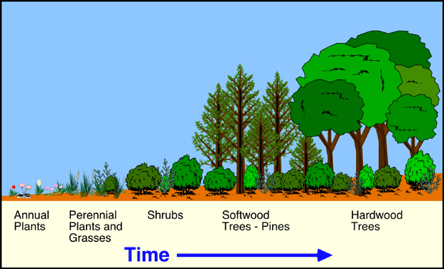
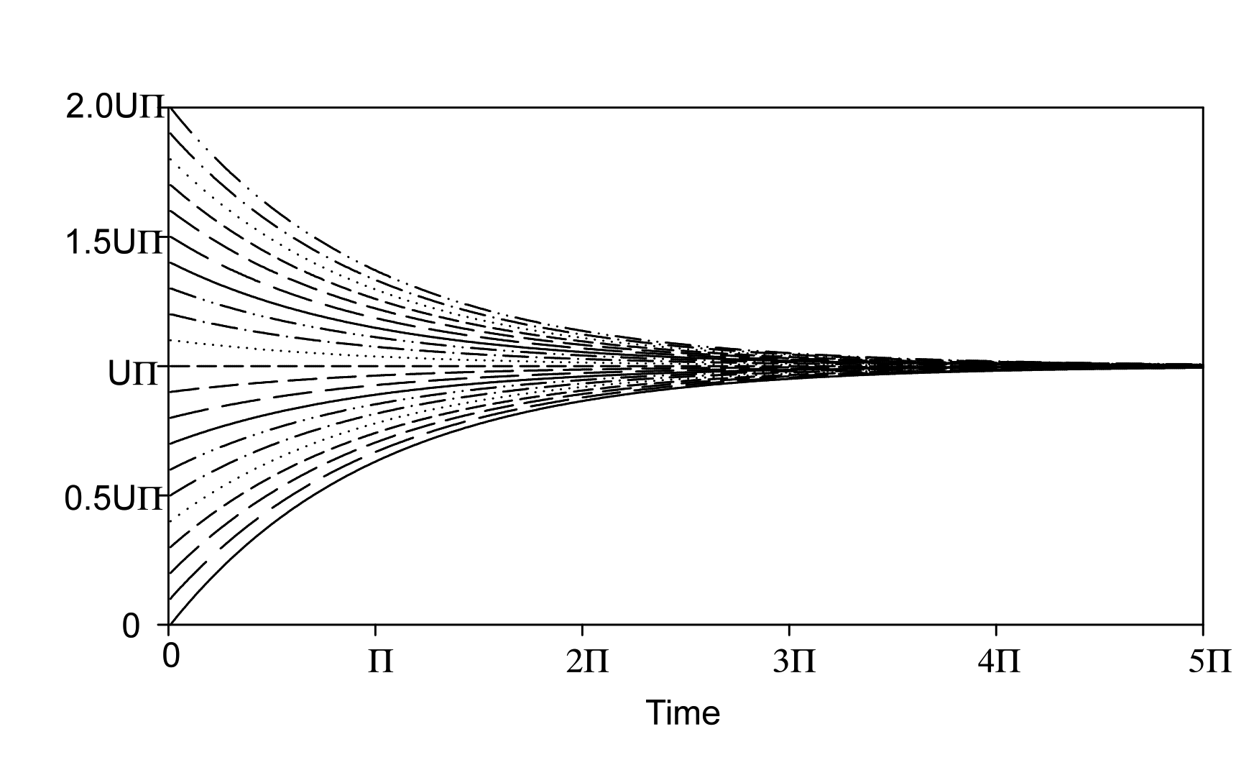
Internal C processes to equilibrate efflux with influx as in an example of forest succession
C sink strength becomes smaller as efflux is equalized with influx
When initial values of C pools differ, the magnitude of disequilibrium varies without change in the equilibrium C storage capacity.

Slide 14
Focusing research on dynamic disequilibrium
Convergence
An ultimate goal of carbon research is to quantify
Carbon-climate feedback
Which occurs only when carbon cycle is at disequilibrium
Luo and Weng 2011
Notes:
14

Slide 15
Predictability of the terrestrial carbon cycle
Nonautomatous system
External forcing Response
Terrestrial carbon cycle
Periodic climate
(e.g., seasonal)
Periodicity
Disturbance event
(e.g. fire and land use)
Pulse-recovery
Climate change
(e.g., rising CO₂)
Gradual change
Disturbance regime
disequilibrium
Ecosystem state change
(e.g., tipping point)
Abrupt change
Given one class of forcing, we likely see a highly predictable pattern of response
Luo, Smith, and Keenan, submitted
Notes:
15

Slide 16
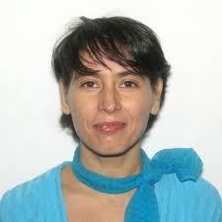


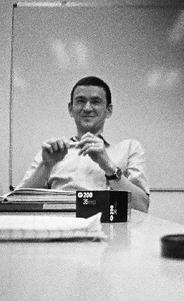
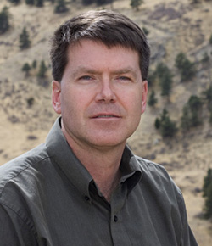


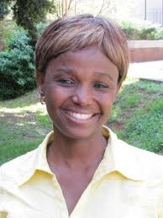
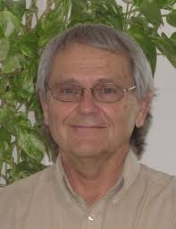


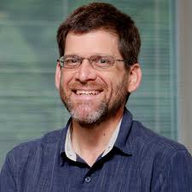

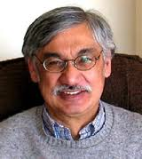
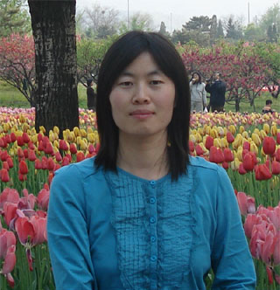
working group
Nonautonamous system
The 3-D parameter space is expected to bound results of all global land models and to analyze their uncertainty and traceability.

Slide 17
Computational efficiency of spin-up
Xia et al. 2012 GMD

Slide 18
Computational efficiency of spin-up
Xia et al. 2012 GMD

Slide 19
Semi-analytical spin-up with CABLE
Traditional: 2780 years
-92.4%
Initial step: 200 years
Final step: 201 years
Traditional: 5099 years
Initial step: 200 years
-86.6%
Final step: 483 years
Xia et al. 2012 GMD

Slide 20
Xia et al. 2013 GCB

Slide 21
Traceability of carbon cycle in land models
Xia et al. 2013 GCB

Slide 22
Traceability of carbon cycle in land models
Climate forcing
Preset Residence times
Precipitation
Temperature
Litter lignin fraction
Soil texture
NPP ( )
Xia et al. 2013 GCB

Slide 23
Traceability for differences among biomes
Long τ_{E} but low NPP.
(τ_{E})
(τ_{E})
High NPP but short τ_{E.}
Based on spin-up results from CABLE with 1990 forcings.
Xia et al. 2013 GCB

Slide 24
Traceability for model intercomparison
CABLE
CLM3.5
ENF
EBF
DNF
DBF
Shrub
C3G
C4G
Tundra
Model-model Intercomparison

Slide 25
Traceability for impact of additional model component
Xia et al. 2013 GCB
Notes:
reduces X_{ss} in all biomes in comparison with that in the carbon-only model;
mainly by decreasing NPP in woody biomass and via shortened τ_{E}' in other non-woody biomes.

Slide 26
Sources of model uncertainty
Residence time
Environmental scalar
Transfer coefficient
Partitioning coefficient
Carbon influx
Initial values of carbon pools
Notes:
26

Slide 27
Sources of model uncertainty
Residence time
Carbon influx
Initial values of carbon pools
Notes:
27

Slide 28
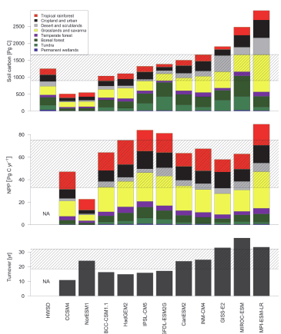
Initial values of carbon pools
Soil carbon modeled in CMIP5 vs. HWSD
Carbon influx
Residence time
Todd-Brown et al. 2013 BG

Slide 29
Soil carbon modeled in CMIP5 vs. HWSD
Yan et al. submitted

Slide 30
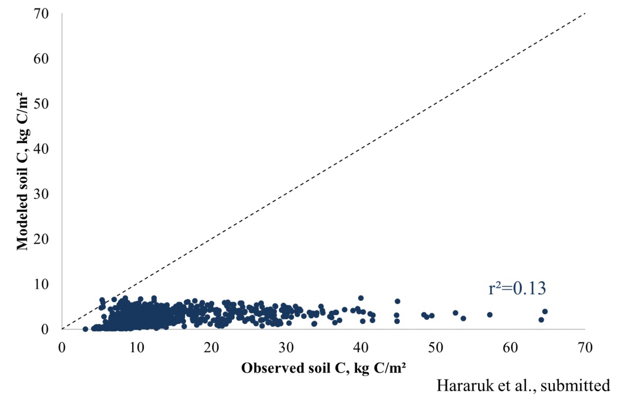
Data assimilation to reduce uncertainty

Slide 31
Summary
Photosynthesis
CO₂
Leaf (X₁)
Root (X₂)
Wood (X₃)
Metabolic litter (X₄)
Structure litter (X₅)
CO₂
Microbes (X₆)
CO₂
CO₂
CO₂
Model development
CO₂
CO₂
Slow SOM (X₇)
CO₂
A: Basic processes
Passive SOM (X₈)
Theoretical analysis
B: Shared model structure
Encoding
D: General model
Generalization
C: Similar algorithm
Luo et al. 2003 GBC
Luo and Weng 2011 TREE
Luo et al. 2012
Luo et al. submitted

Slide 32
Applications
Research focus on dynamic disequilibrium (Luo and Weng 2011)
Computational efficiency of spin-up (Xia et al. 2012)
Traceability for structural analysis (Xia et al. 2013)
Predictability of the terrestrial carbon cycle (Luo et al. submitted)
Sources of uncertainty
Data assimilation to improve models (Hararuk et al. submitted)
Parameter space (work in progress)
A: Basic processes
Theoretical analysis
D: General model
Luo et al. 2003 GBC
Luo and Weng 2011 TREE
Luo et al. 2012
Luo et al. submitted

Slide 33
Relevance to empirical research
External forcing Response
Terrestrial carbon cycle
Periodic climate
(e.g., seasonal)
Periodicity
Disturbance event
(e.g. fire and land use)
Pulse-recovery
Climate change
(e.g., rising CO₂)
Gradual change
Disturbance regime
disequilibrium
Ecosystem state change
(e.g., tipping point)
Abrupt change
Find examples to refute this equation
Disequilibrium vs. equilibrium states
Disturbance regimes have not been quantified
Mechanisms underlying state change have not been understood
Response functions to link carbon cycle processes to forcing are not well characterized.
Disturbance-recovery trajectory, especially to different states, is not quantified
Notes:
33

Slide 34
Relevance to modeling studies
Method | Merit | Issue
Adding components | Simulating more processes realistically | Complexity Intractability
Model intercomparison | Illustrating uncertainty | Attribution to its sources
Benchmark analysis | Performance skills | Objective benchmarks
Data assimilation | Improving models | Various challenges
Benchmarks to be developed from data and used to evaluate models
Traceability of modeled processes
Pinpointing model uncertainty to its sources
Data assimilation to improve models
Standardize model structure for those processes we well understood but allow variations among models for processes we have alternative hypotheses
Parameter ensemble analysis

