Slide 1

The benefits and the environmental costs of anthropogenic reactive nitrogen
刘玲莉
中国科学院植物研究所
植被与环境变化国家重点实验室
The 7th ISOME & the 4th IYEF, GuangZhou, 06/12/2013

Slide 2
Outline
Non-reactive nitrogen (N₂)
VS. Reactive Nitrogen (NOx, NHx, organic N)
The good and the bad of reactive nitrogen
Can N cycle be better managed?
  An assessment on the potential of nitrification inhibitors for better N fertilizer management

Slide 3
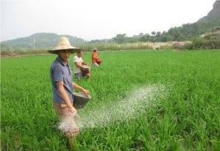
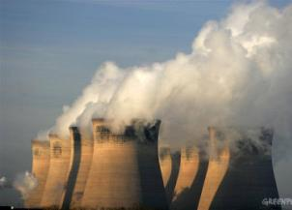
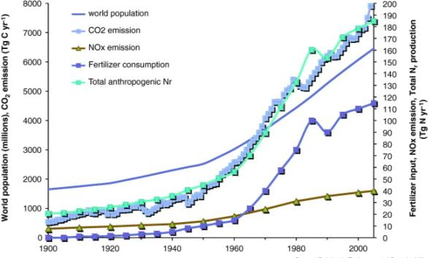
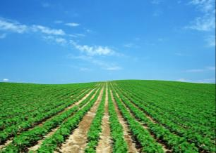
Humans have more than doubled the amount of natural N fixation
Fertilizer
natural biological N fixation on land: 110 Tg N/yr
in ocean: 140 Tg N/yr
Fossil fuel
Legume crop
Erisman et al. 2011, Current opinion in environmental sustainability
Notes:
natural biological N fixation on land: 110 Tg N/yr
in ocean: 140 Tg N/yr

Slide 4
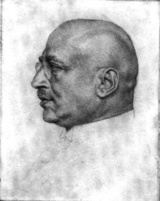
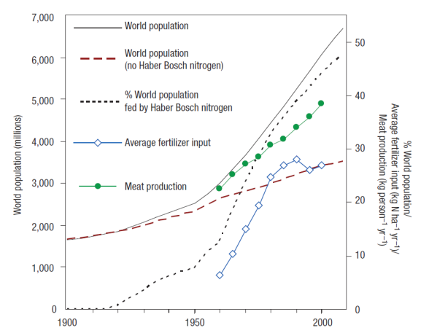
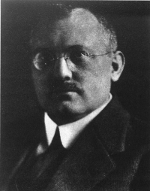
The good of anthropogenic Nr: Food Productivity
Almost half of the food consumed by mankind is based on the increased production by use of nitrogen fertilizers
Fritz Haber : Nobel Prize in Chemistry, 1918, -”for the synthesis of ammonia from its elements”
Erisman et al 2008, Nature Geoscience
Carl Bosch (1874-1940): Nobel Prize in Chemistry, 1931, -”chemical high pressure methods”

Slide 5
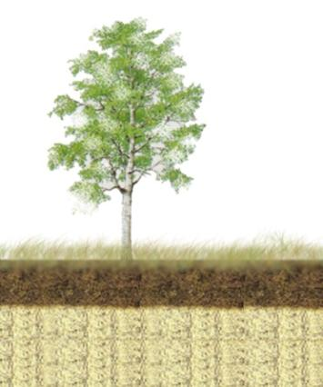
Nitrogen’s carbon benefit
Liu and Greaver, 2009. Ecology Letters

Slide 6
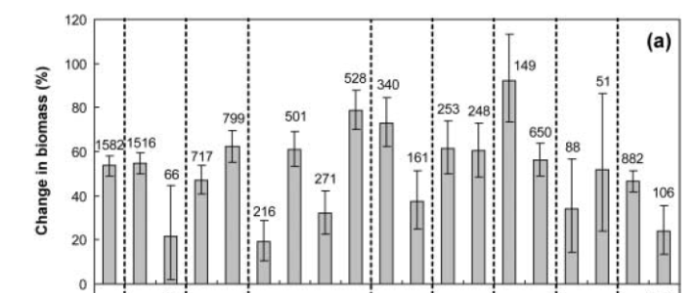
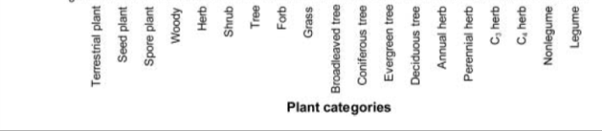
Anthropogenic Nr stimulates vegetation growth
Xia and Wan, 2008, New Phytologist

Slide 7
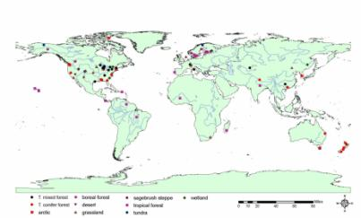
Anthropogenic Nr input may increase soil C sequestration
Liu and Greaver, 2010. Ecology Letters

Slide 8


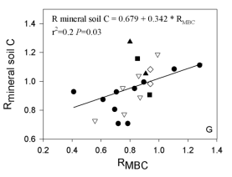
Why ?
C input (↑)
C output (n.s.)
Organic layer (↑)
Mineral soil (n.s.)
microbial activity
Liu and Greaver, 2010. Ecology Letters

Slide 9
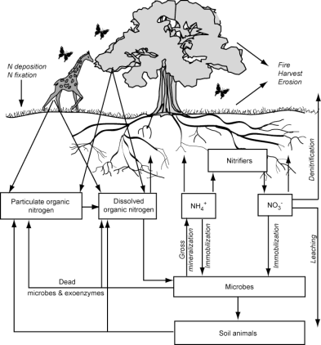
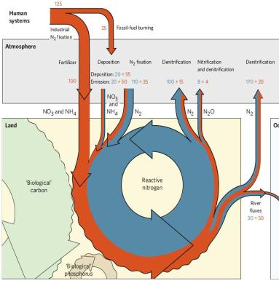
Nitrogen saturation
Closed N cycle
Open and leaky N cycle
NH₃
Chapin et al. 2011, Principles of Terrestrial Ecosystem Ecology
Gruber and Galloway 2008, Nature

Slide 10
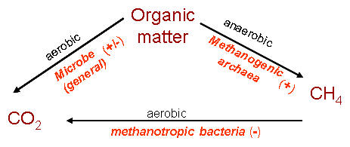
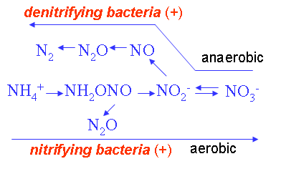
Increases biogenic N₂O and CH₄ emission
CO₂
CH₄
N₂O
CO₂
Photosynthesis (+)
autotrophic
respiration (+)
ANPP (+)
N input
C allocation
BNPP(+/-)
C supply (+/-)
N toxicity (+)
root uptake
C:N (-)
heterotrophic
respiration (+/-)
C substrate supply (+/-)
C cycle
N cycle
+ positive feedback
- negative feedback
SOC
DOC
DIN/DON
Liu and Greaver, 2009, Ecology Letters

Slide 11
Nitrogen’s carbon benefit is largely offset by N₂O an CH₄ emission
53-76%
CO₂ uptake CH₄ emission
CH₄ uptake N₂O emission
Liu and Greaver, 2009, Ecology letters

Slide 12
Impacts of reactive N on climate change
Process altered by reactive N | Climate forcer | direction | description
N₂O | N₂O emission | warming | ecological and atmospheric processes
N deposition➔ CH₄ | CH₄ emission | warming | ecological processes
N deposition➔ CO₂ | CO₂ uptake | cooling | ecological processes
NOx➔ ozone ➔ CO₂ | CO₂ emission | warming | ecological processes
NOx➔ ozone ➔ CH₄ | ozone, CH₄ | cooling | Atmospheric processes
Nox ➔ aerosol | sulfate, nitrate, ammonium aerosol | cooling | Atmospheric processes
NH₃➔aerosol | sulfate, nitrate, ammonium aerosol | cooling | Atmospheric processes

Slide 13
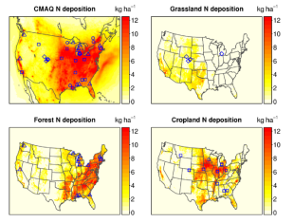
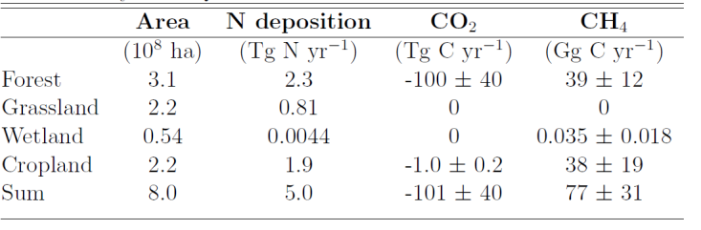
Estimates of net changes in US GHG fluxes
CO₂, CH₄ and N₂O
emission/ uptake factors
+

Slide 14
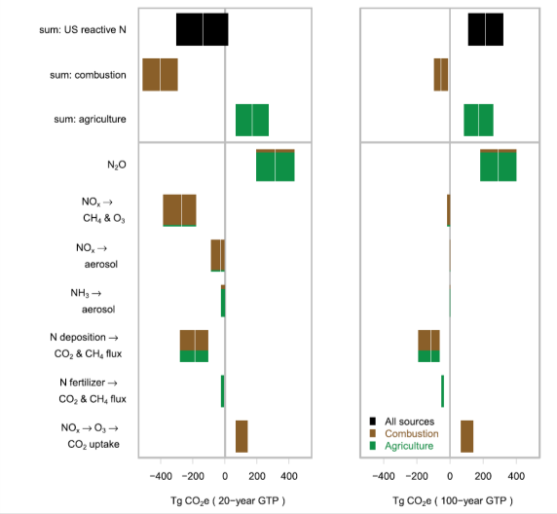
Climate change impact of US Nr emissions for 20 yrs and 100 yrs
cooling
warming
Atmospheric & ecological processes
Atmospheric processes
Ecological processes
Pinder et al. 2012. PNAS
Notes:
20年的时间尺度上，Nr表现为冷却效应

Slide 15
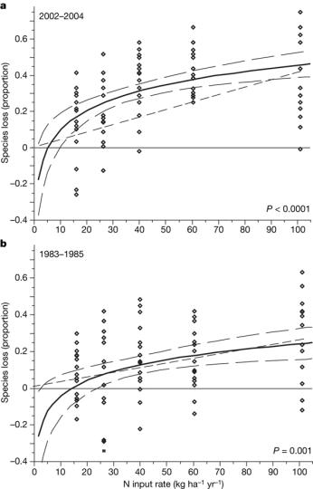
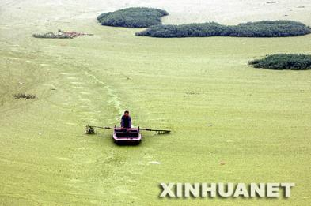
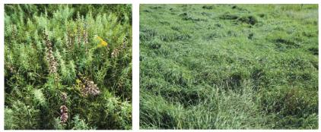
Nr’s other environmental costs
Clark and Tilman 2008 Nature

Slide 16
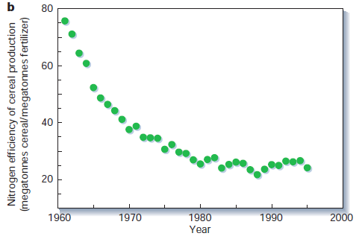
Could N cycle be better managed?
Low nitrogen fertilizer use efficiency
Tilman et al. 2002, Nature

Slide 17
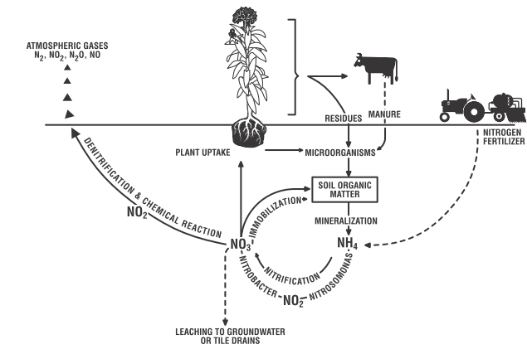
Synchronize N release to that plant growth uptake
20-50% of the applied N fertilizer
Nitrification inhibitor

Slide 18
The potential of nitrification inhibitors for better N fertilizer management
Qiao et al. In preparation
Notes:
The potential of nitrification inhibitors for better nitrogen fertilizer management

Slide 19

N
C cycle
N cycle
Atmosphere
+ increased - Decreased
n.s no significant changes
Photosynthesis
N decomposition
NO (- 20%)
N₂O (- 56%)
NH₃
(+ 11%)
CH₄
(n.s)
CO₂
(n.s)
Yield (+ 12%) N concentration (+ 10%)
Denitrification
N₂O
Litter
N uptake (+ 17%)
Soil
N fertilizer
+NI
CO₂
Mineralization
Nitrification
SOM
NH₄⁺
(+ 53%)
NO₃⁻
(- 41%)
Immobilization
AMO
DIN (n.s)
CH₄
Surface and ground water
NH₄+ leaching
(+78%)
NO₃- leaching
(- 57%)
DIN leaching (- 35%)
Qiao et al. In preparation

Slide 20
Cost/benefit analysis of NI in agriculture ecosystem
Variable |  | Response kg N/ha | $/kg N | Monetary value $/ha | Cost/benefit $/ha
Environmental impact | N₂O | -0.430 | 1.240 | 0.533 | 22.454
 | NH₃ | -2.480 | -1.300 | -3.224
 | NO | -0.001 | 23.000 | 0.023
 | DIN leaching | -9.270 | 2.710 | 25.122
Fertilizer input | N fertilizer save | 9.270 | 1.210 | 11.217 | -0.450
 | Nitrification inhibitor | - | -1.167 | -11.667
Crop yield | Wheat productivity | 0.7 t/ha | 249 $/t | 174.300 | 174.300
Total monetary value |  |  |  |  | 196.304
Qiao et al. In preparation

Slide 21
Conclusion
The use of Nr fertilizers makes remarkable contribution to alleviate global food shortage.
The anthropogenic Nr loading also enhances ecosystem carbon sequestration
The massive release of the excess N creates severe environmental problems: GHG emission, biodiversity loss, eutrophication, soil acidification…
NI is an applicable approach to improve N managements .

Slide 22
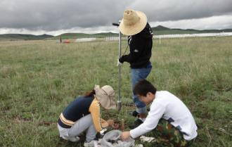
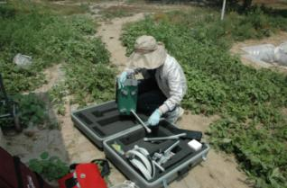





Thank you!
Lingli.liu@ibcas.ac.cn
010-62836160

Slide 23
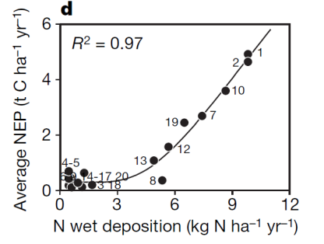
How many kg C can be fixed with 1kg N/ha N deposition?
Critical C:N ratio
Wood 200+
Leaves 20-40
Legume leaves 10
Fungi 8-15
Bacteria 5-10
Surface soil 14
Magnani et al. 2007, Nature
175-225 kg C per Kg N (Magnani et al. 2008, Nature)
30-70 kg C per Kg N (de Vries et al. 2008, Nature)
65 kg C per Kg N (Thomas et al. 2010, Nature Geoscience)
24.5 kg C per Kg N (Liu and Greaver 2009, Ecology letters)

