Slide 1

Concepts and Applications of Coupled Human and Natural Systems
Jiquan Chen
陈吉泉
examples
concept
future
The7th ISOME & 4th IYEF
June 11, 2013

Slide 2

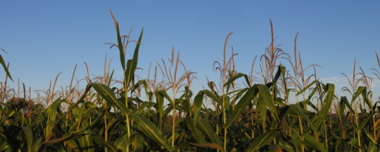
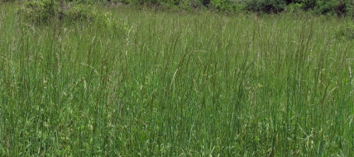
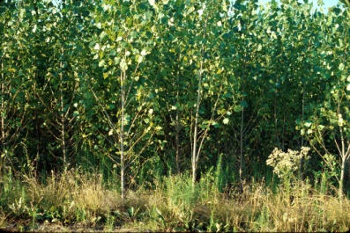
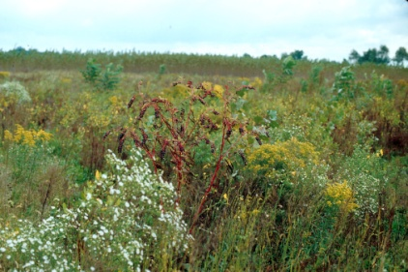
Example 1
GLBRC: support the biomass-to-bioenergy pipeline by developing ecological, agricultural, & life cycle practices that are economically viable & environmentally responsive
High Input, Low Diversity
Continuous Corn
Model Systems
Corn-Soybean-Canola
Switchgrass
Miscanthus
Native grasses + Legumes
Low Input, High Diversity
Poplars
Early successional
Restored prairie
Gelfand et al. 2011

Slide 3
Do we have the lands for these bioenergy systems?
Is it sound to convert forests or other types of land into biofuel systems?

Slide 4

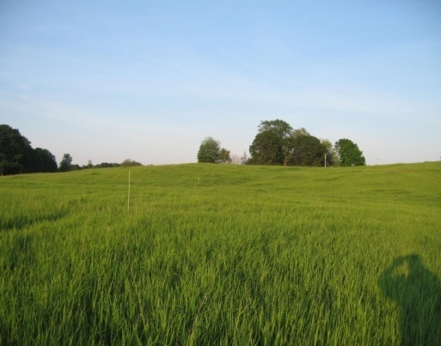
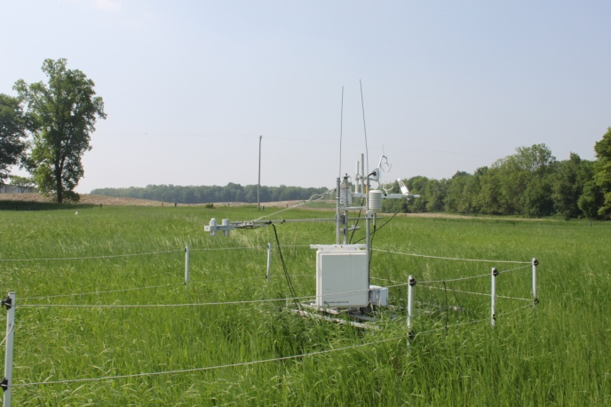
Clean Energy: Biofuels
Experimental design
Baseline 2009 2010
CRP Grassland reference site
CRP grassland
Soybean
Corn
Soybean
Mixed prairie + oat
Soybean
Switchgrass + oat
Corn/soybean rotation
Soybean
Corn
Soybean
Mixed prairie + oat
Soybean
Switchgrass + oat

Slide 5
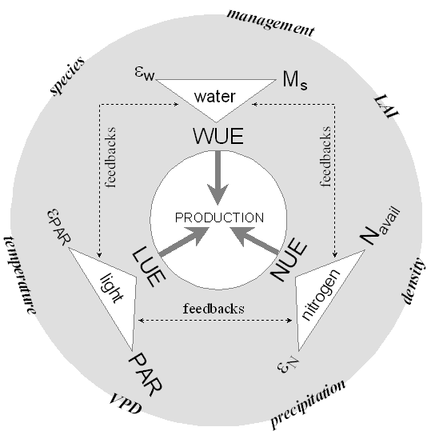
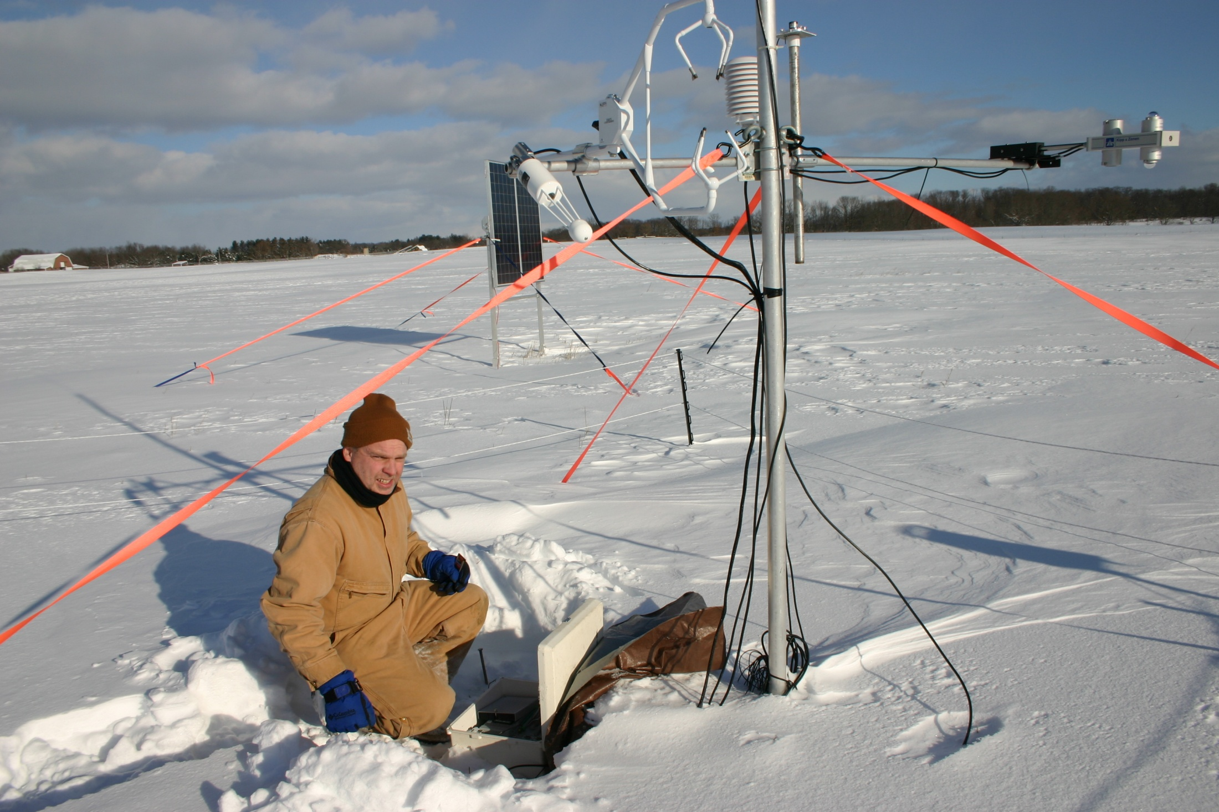
GLBRC scale up fields: sustainability
A new conceptual model on multiple resource use (MRU) as
site 1
site 2
Ref
Site 3
Site 4
Site 5
Site 6

Slide 6
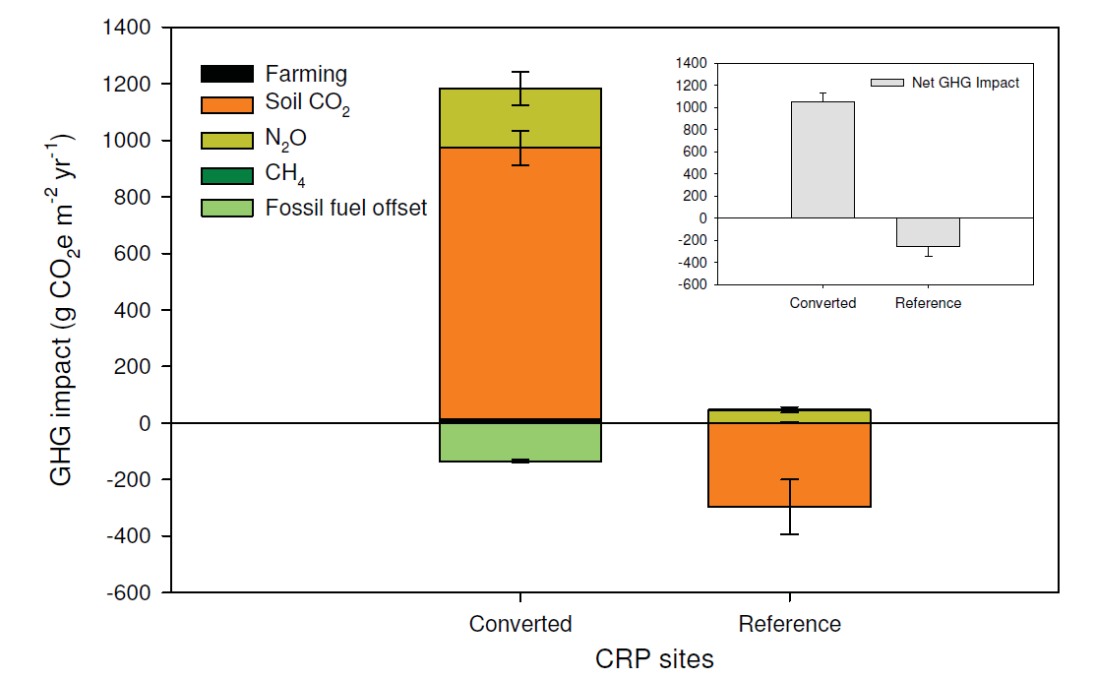
Carbon debt of a CRP grassland converted to bioenergy production. 76 yr would be required to repay a debt of 106±1 Mg CO₂e ha⁻¹ were the subsequent system continuous corn under permanent no-till. If tilled, repayment would require ~172 yr because of additional soil carbon loss that balloons total debt to 259±55 Mg CO₂e ha⁻¹. Were the subsequent system corn-soybean, repayment would require 88 (permanent no-till) or 196 (tilled) yr.
(Gelfant et al. 2011. PNAS)

Slide 7
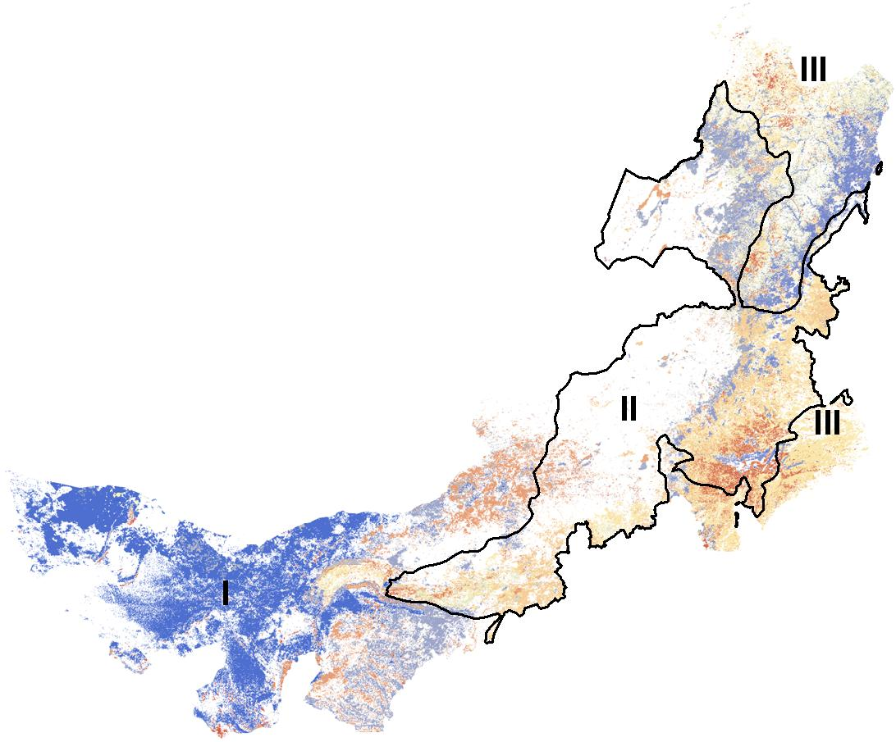

Example 2
N
The Coupling Effects
Land Use Change and Hotspots in Inner Mongolia
3
2
1
Chen et al.

Slide 8
Repeated ANOVA tests: Coupled Effects of Climate and Landuse on GPP & ET
(1) Gross Primary Production (GPP)
 | SSE | %
Type | 2.8924 | 64.3 | 2.4
Year | 1.20423 | 26.8
Year*type | 0.40085 | 8.9
total | 4.49748
(2) Evapotranspiration (ET)
 | SSE | %
Type | 11425.4 | 83.6 | 5.77
Year | 1981.1 | 14.5
Year*type | 257.1 | 1.9
total | 13663.6
Chen et al. in prep

Slide 9


One Thing in Common among These Examples
People ~ Nature

Slide 10
Concept
Coupled Human & Environment

Slide 11
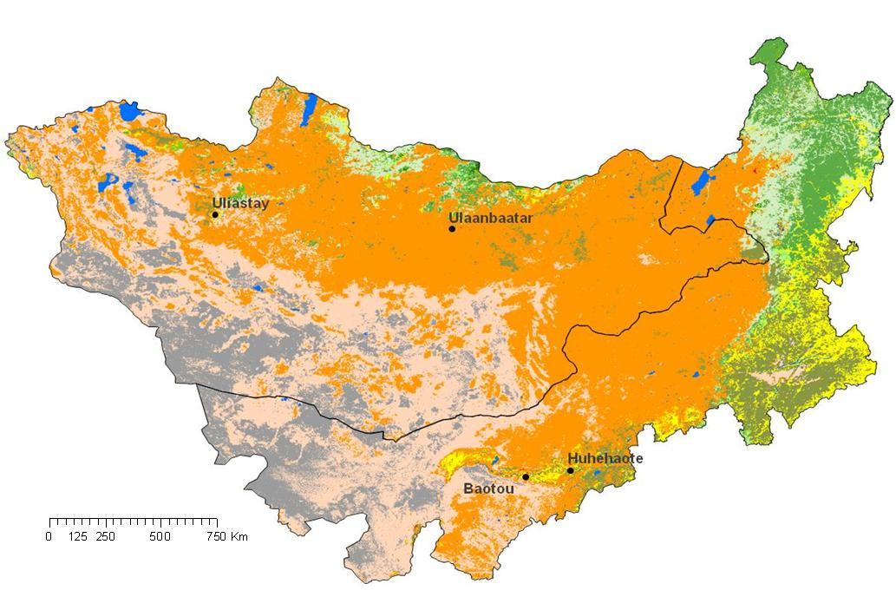
Mongolia Plateau: interactive changes of natural and human under similar climate but different land-use conditions
2011

Slide 12
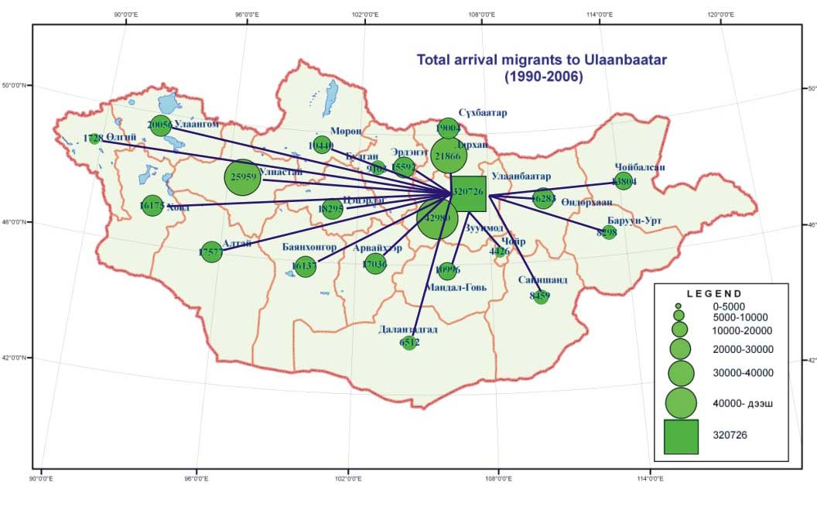
Population Migration in Mongolia
The internal migration where the flow is oriented toward to Ulaanbaatar and the central region of MG has been a trend. Nearly 70% of the migrants is concentrated in such cities area as Ulaanbaatar, Darkhan, Orkhon and Selenge aimags.

Slide 13
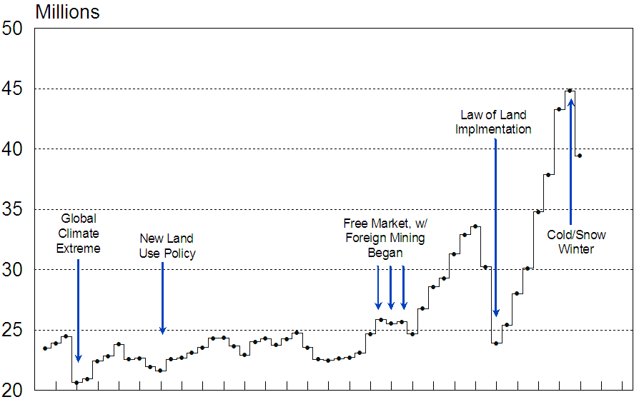
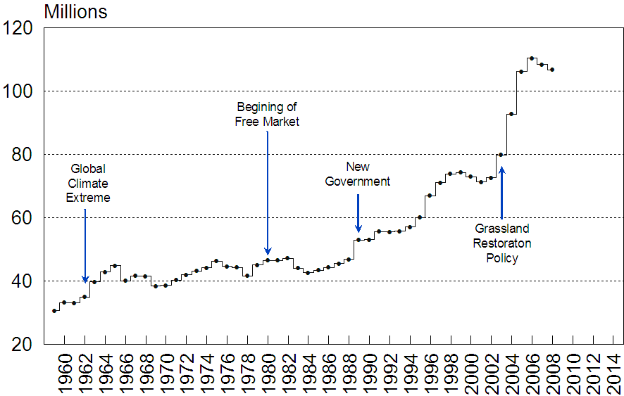
Changes in livestock, policy, and climate in IM and MG
Mongolia
Livestock (head)
Inner Mongolia
Extreme Drought
& Cold Winter
Qi et al. (2012)

Slide 14
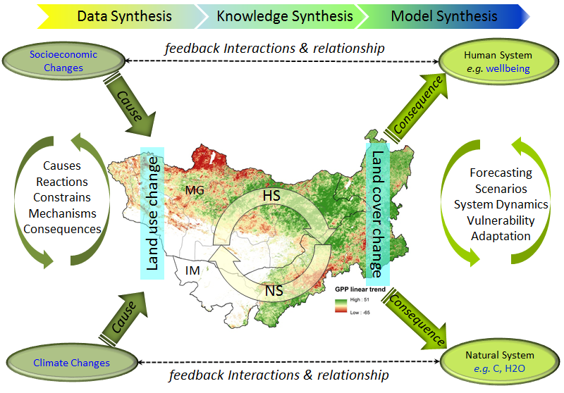
Concept
Coupled Human & Environment

Slide 15
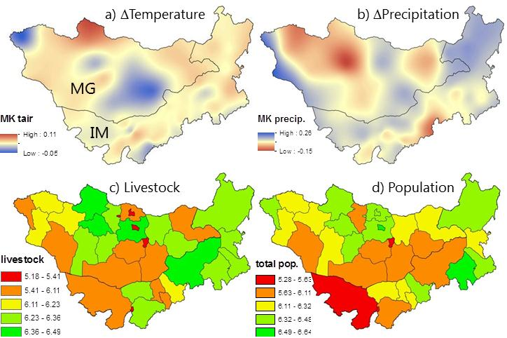
The contrasting distributions of four demonstrative variables on the Mongolia Plateau showing the mismatches in space and time

Slide 16

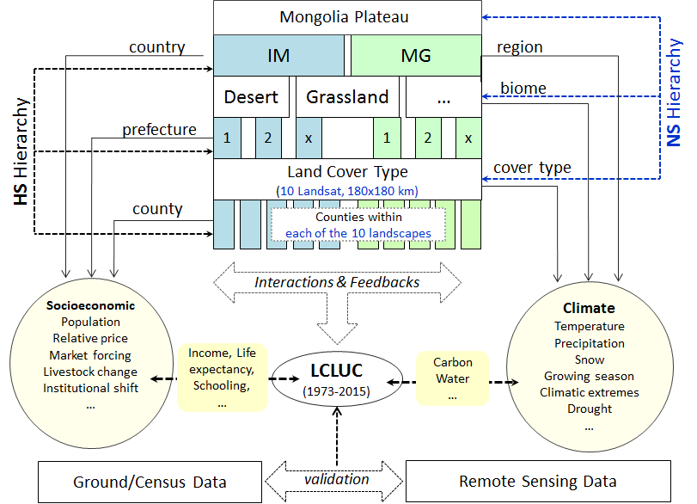
A working flowchart for synthesizing the CNH systems at different hierarchical levels

Slide 17
Challenges are to understand:
How climate and land use interact to shape ecosystem functions & dynamics.
The processes governing these interactions in ways that can be useful for forecasting and/or assessment of interventions.

Slide 18
Some of the questions:
What are the key combinations and interactions of socioeconomic and climatic drivers of LCLUC?
How well do existing ecosystem and/or socioeconomic data and model output explain the observed biophysical and socioeconomic changes in the two countries and when do these models fail?
How well can we predict changes in this CNH system as a whole, including its structure and functions?
What are the most common social and institutional responses to changing land use and cover in the region? Which of these responses are likely to be sustainable in the long run and which are likely to degrade ecosystem services over time?

Slide 19
hypotheses:
The effects of land cover change (LCC) are stronger than climate change for the CNH systems on the Mongolian Plateau by natural or by human definition.
Biophysical and socioeconomic forces driving the CNH changes play unequal roles between MG and IM.
The driving mechanisms for changes in CNH function has shifted during the past 60 years, with 1980 as the switching point thereafter there have been much greater changes in IM than those in. Additionally, both the changes and the regulating mechanisms vary by biome because of contrasting resource limitations.

Slide 20
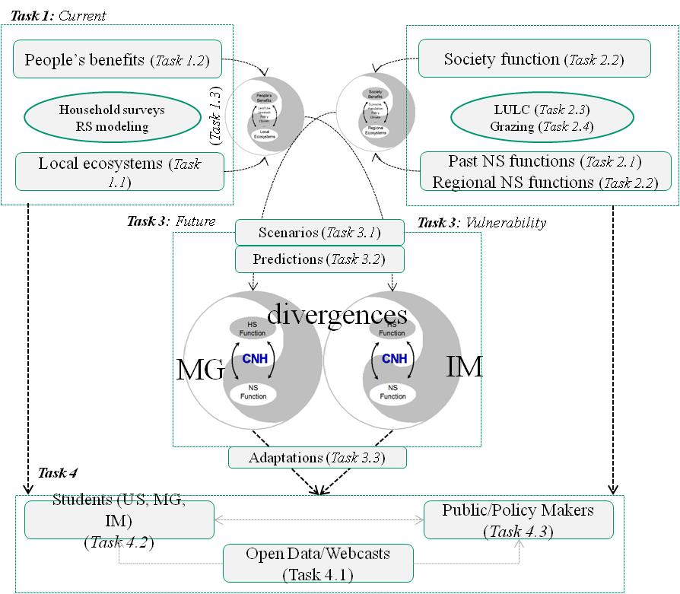
Drivers and Functions as a Moving CHN system

Slide 21
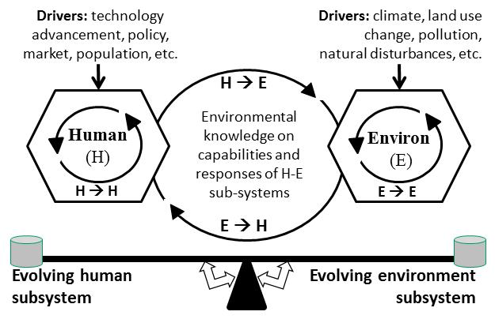
Concept
Coupled Human & Natural System (CHANS)
Jim Reynolds, 2011

Slide 22
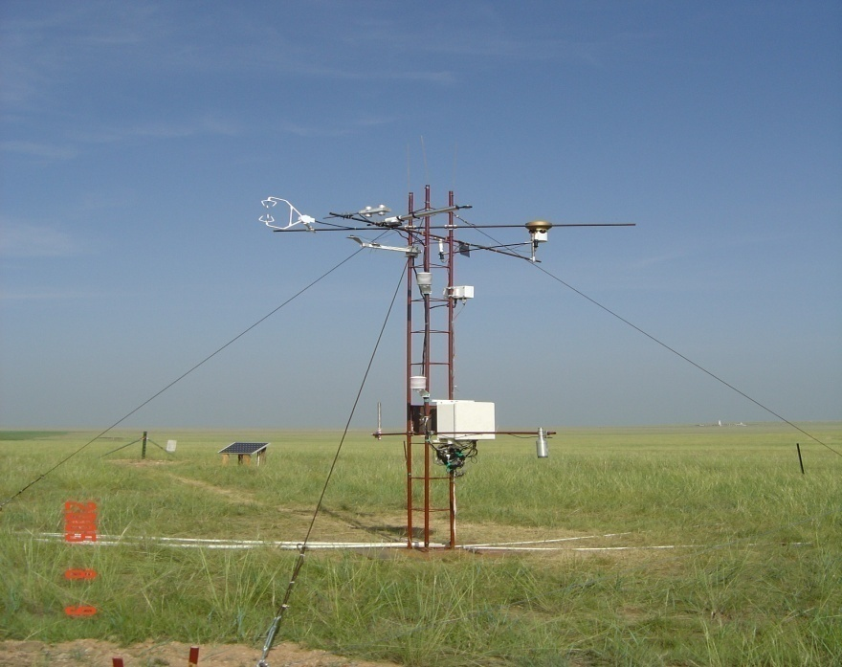
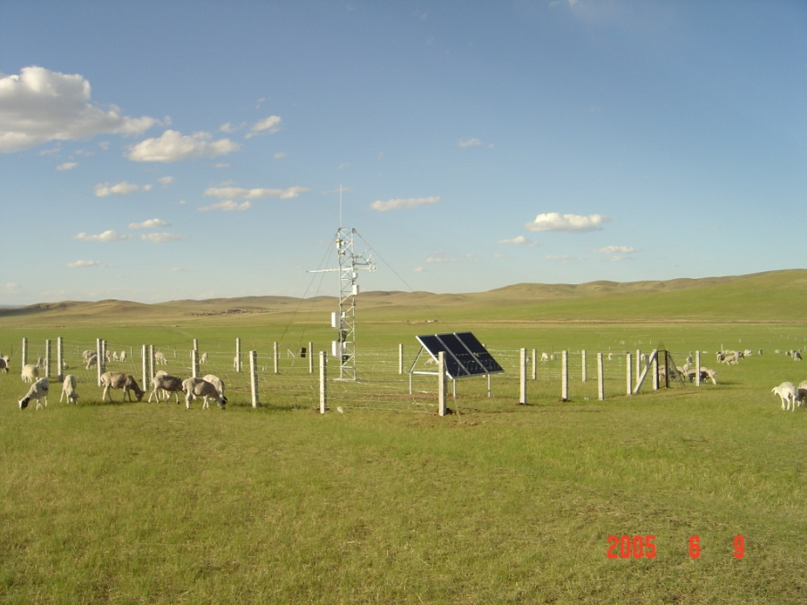
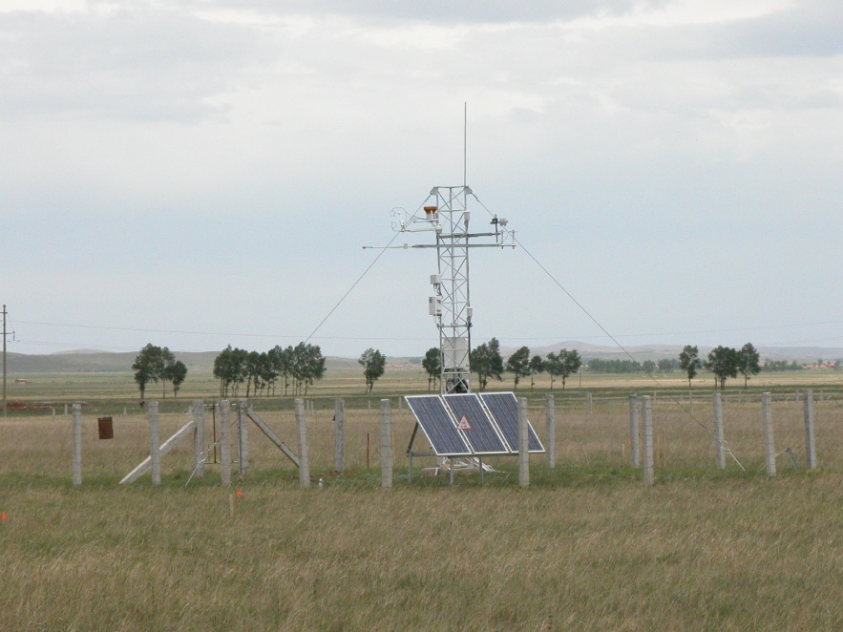
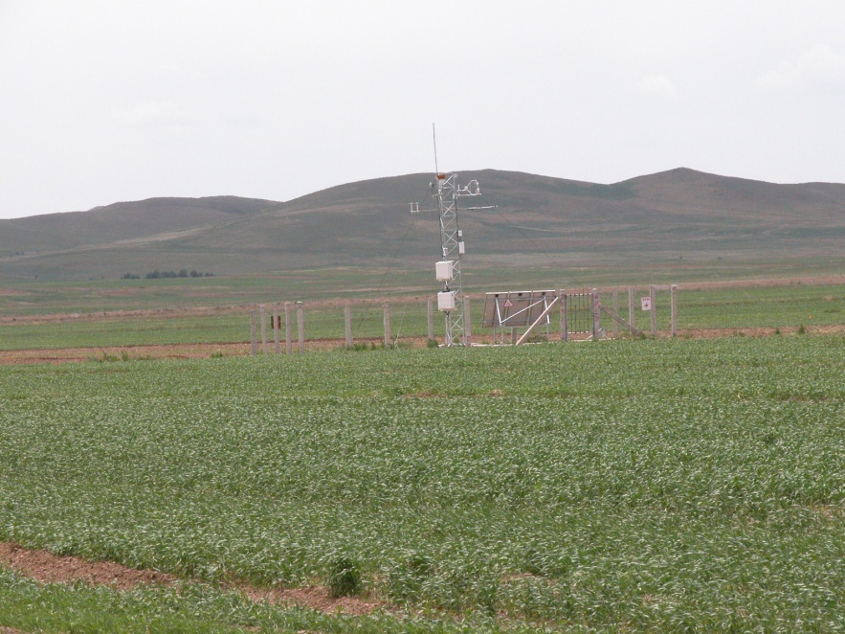
FLUXNET for direct measurements of greenhouse gases (GHG). Several thousands site-year data are available.
Typical grassland in Dongwu
Degraded grassland in Xilinhot
Stipa krylovii grassland in Duolun
Cropland in Duolun

Slide 23
Coupled Human & Environment
Overall, the functional responses of the HS and NS could be expressed as:
Matrix NS [NPP ET, BIOM, …] = Matrix HS [II, LEI, EI, …]
NPP:EI, What is this?
How do we handle the mismatched boundaries?
Latent variables (warming), quantifiable?
What about the large uncertainty?
…

Slide 24
Complex interactions and feedbacks among the elements of HS and NS
经济变化
气候变化
GDP
工业产值
农业产值
…
温度
降雨
极端气候
干旱
…
土地类型变化
遥感
ε
Δ(市区)
Δ(绿地)
Δ(…)
Δ物候
Δ水源
…
ε
人文系统
自然系统
LEI
土地利用
NPP
EI
ET
δ
δ
II
δ
Re
人文 系统
自然系统
…
…
社会变化
ε
人口流动
政策变动
体制改革
市场变更
…
ε
ε

Slide 25
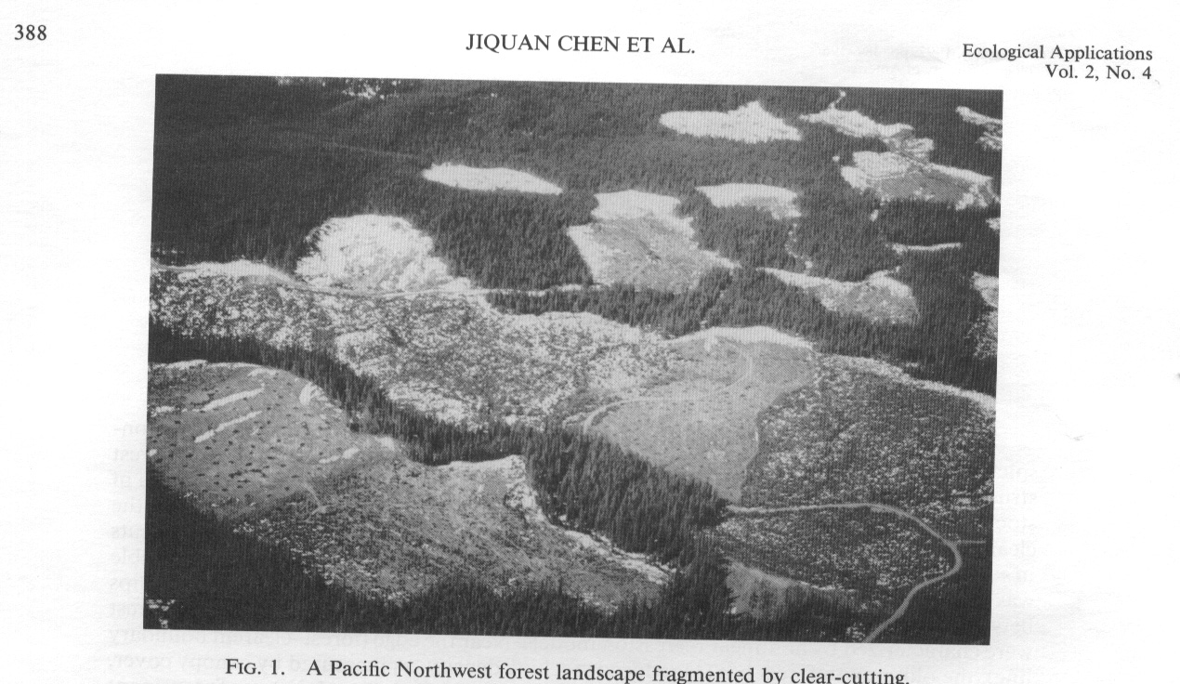
Forest fragmentation is one of the greatest environmental issues worldwide because of its significant impacts on biological diversity, disrupts the integrity of stream network (e.g., water quality), etc.

Slide 26
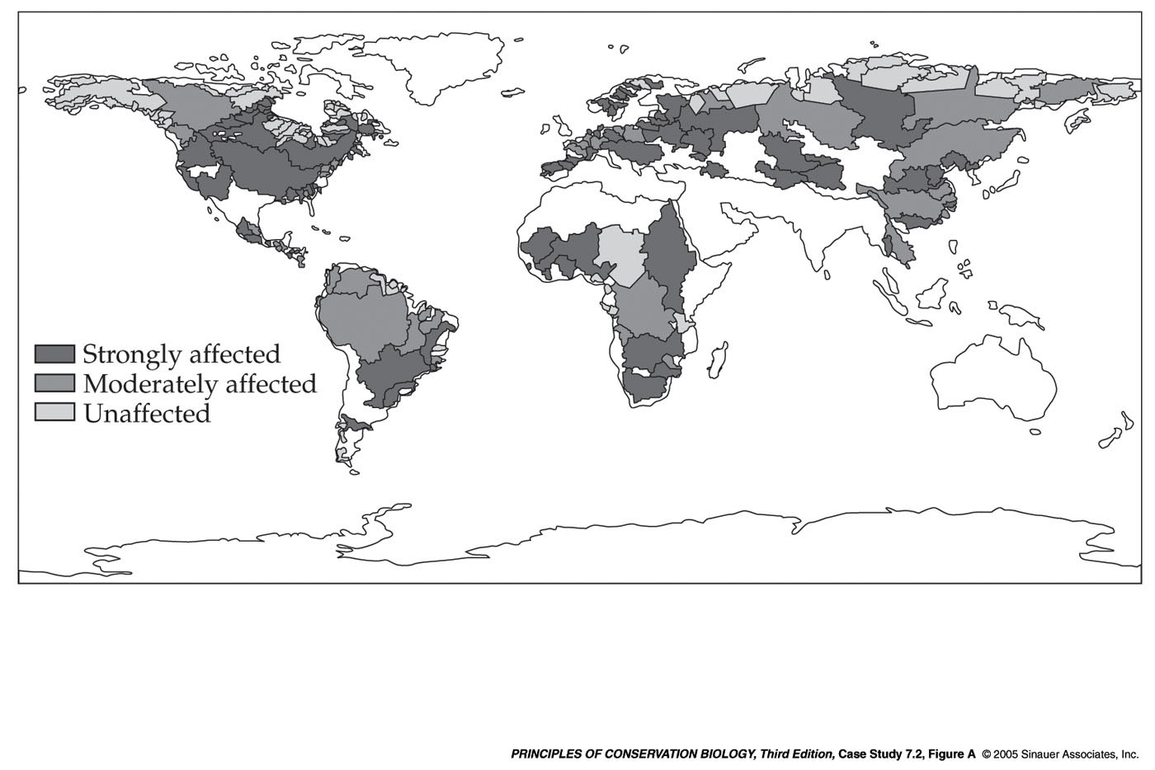
Degree of fragmentation of major river basins of the world
Notes:
pcb3e-case-07-02-fig-a-0.jpg

Slide 27
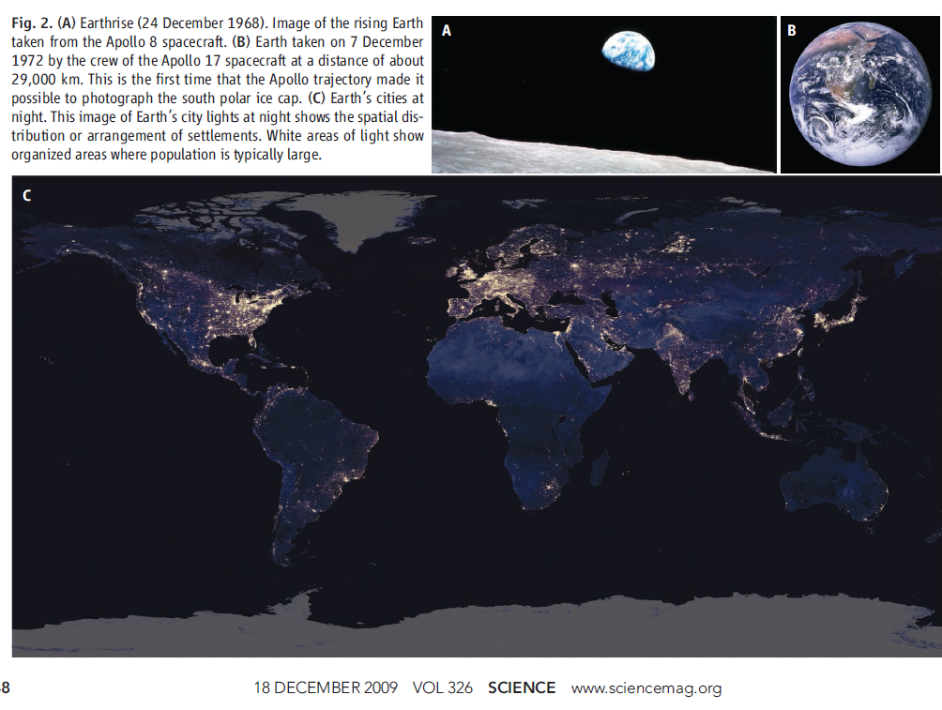
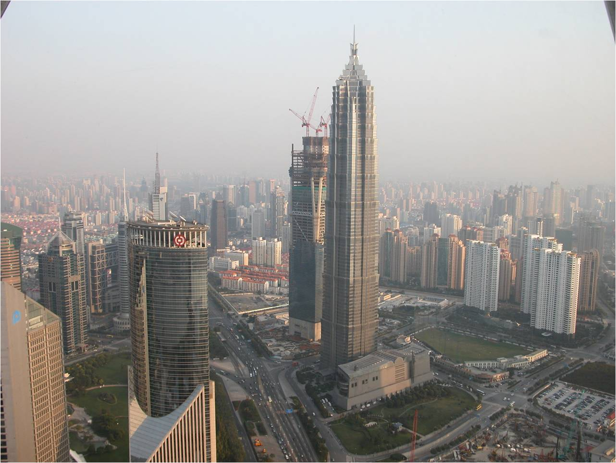
Notes:
pcb3e-fig-10-01-2.jpg

Slide 28
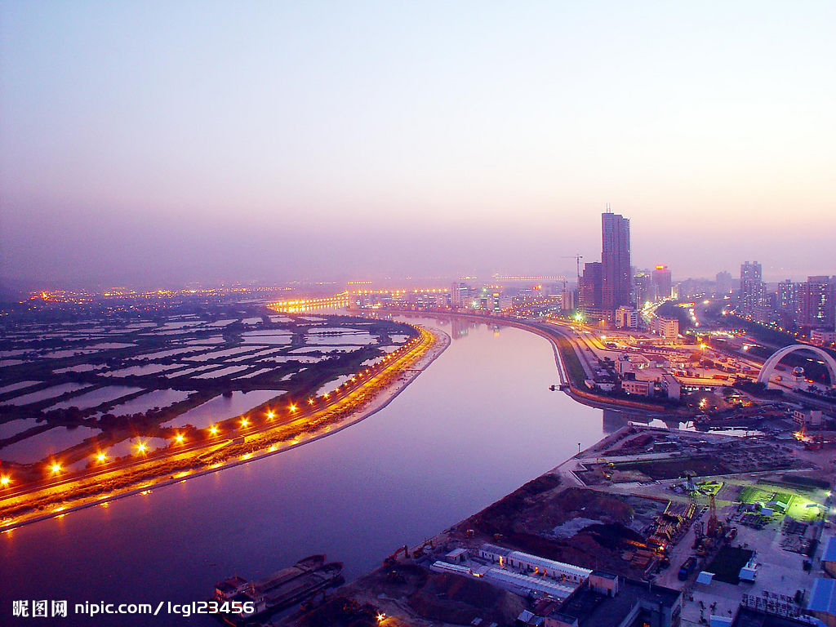
Urban heat island in 4 coastal cities in Southern China
Case Study From ShenZhen
Notes:
pcb3e-fig-10-01-2.jpg

Slide 29
Connecting nature, land use change (LCC), economy, and population in Shenzhen (Tian et al. In preparation).
Chi-square = 4.98(4df)
P = 0.474
- .69
e1
Primary I
e1
.28
- .12
Economy
.69
.78
Secondary II
e2
.36
Build L
.69
e3
.54
.62
.29
Tertiary I
e1
LCC
.68
UV Land
- .20
.67
.62
.53
Regular Pop
e1
Road L
.59
Population
.64
.34
Float Pop
e1
.49
e2

Slide 30
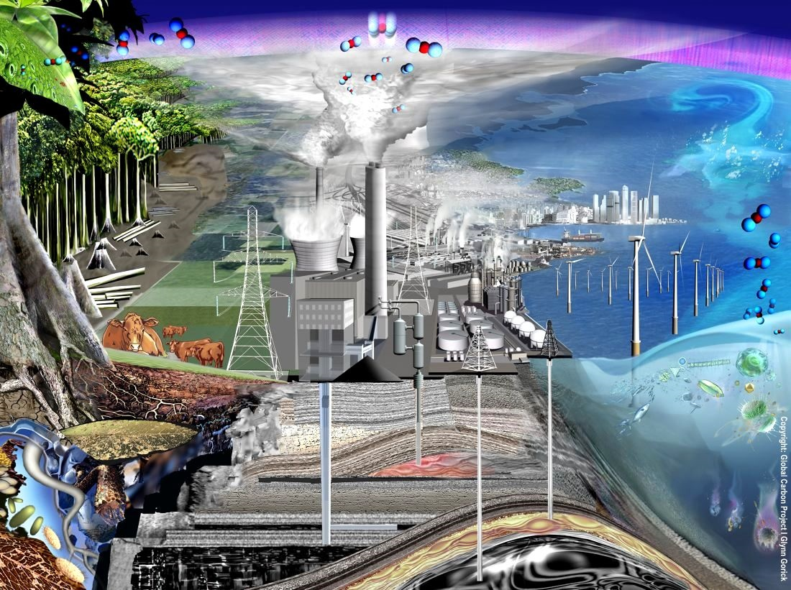
Increasing in emission of GHG and air pollution
Artist Impression of the Human Perturbation of the Carbon Cycle

Slide 31
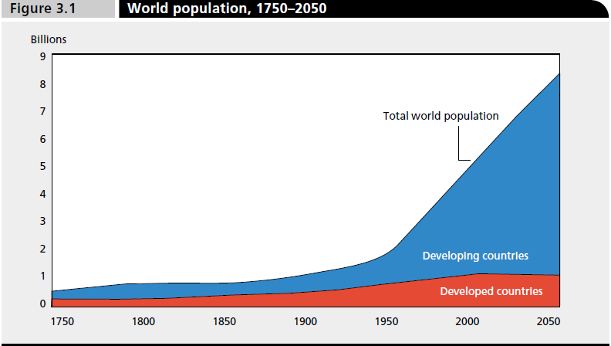
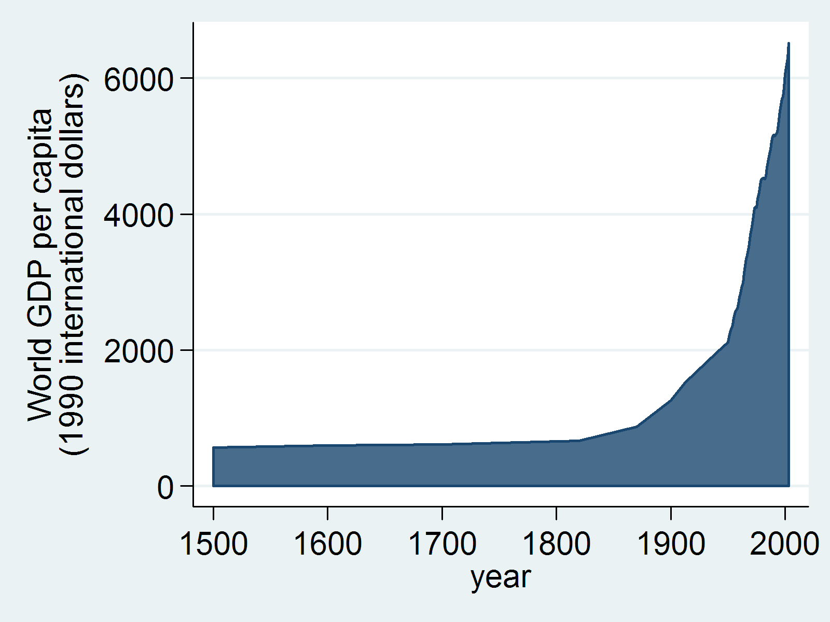
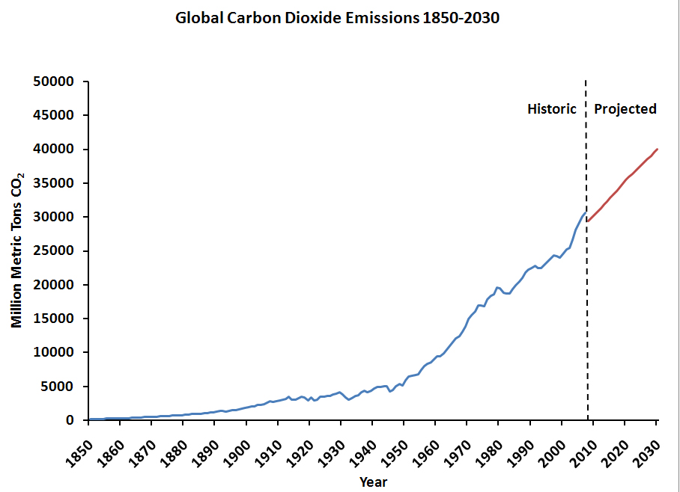

Slide 32
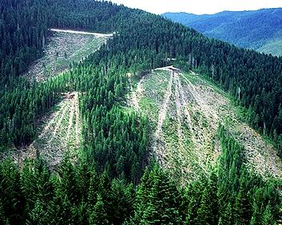
What to do?
Ecosystem Management for Maximizing the Services
Notes:
Need answers quickly!

Slide 33
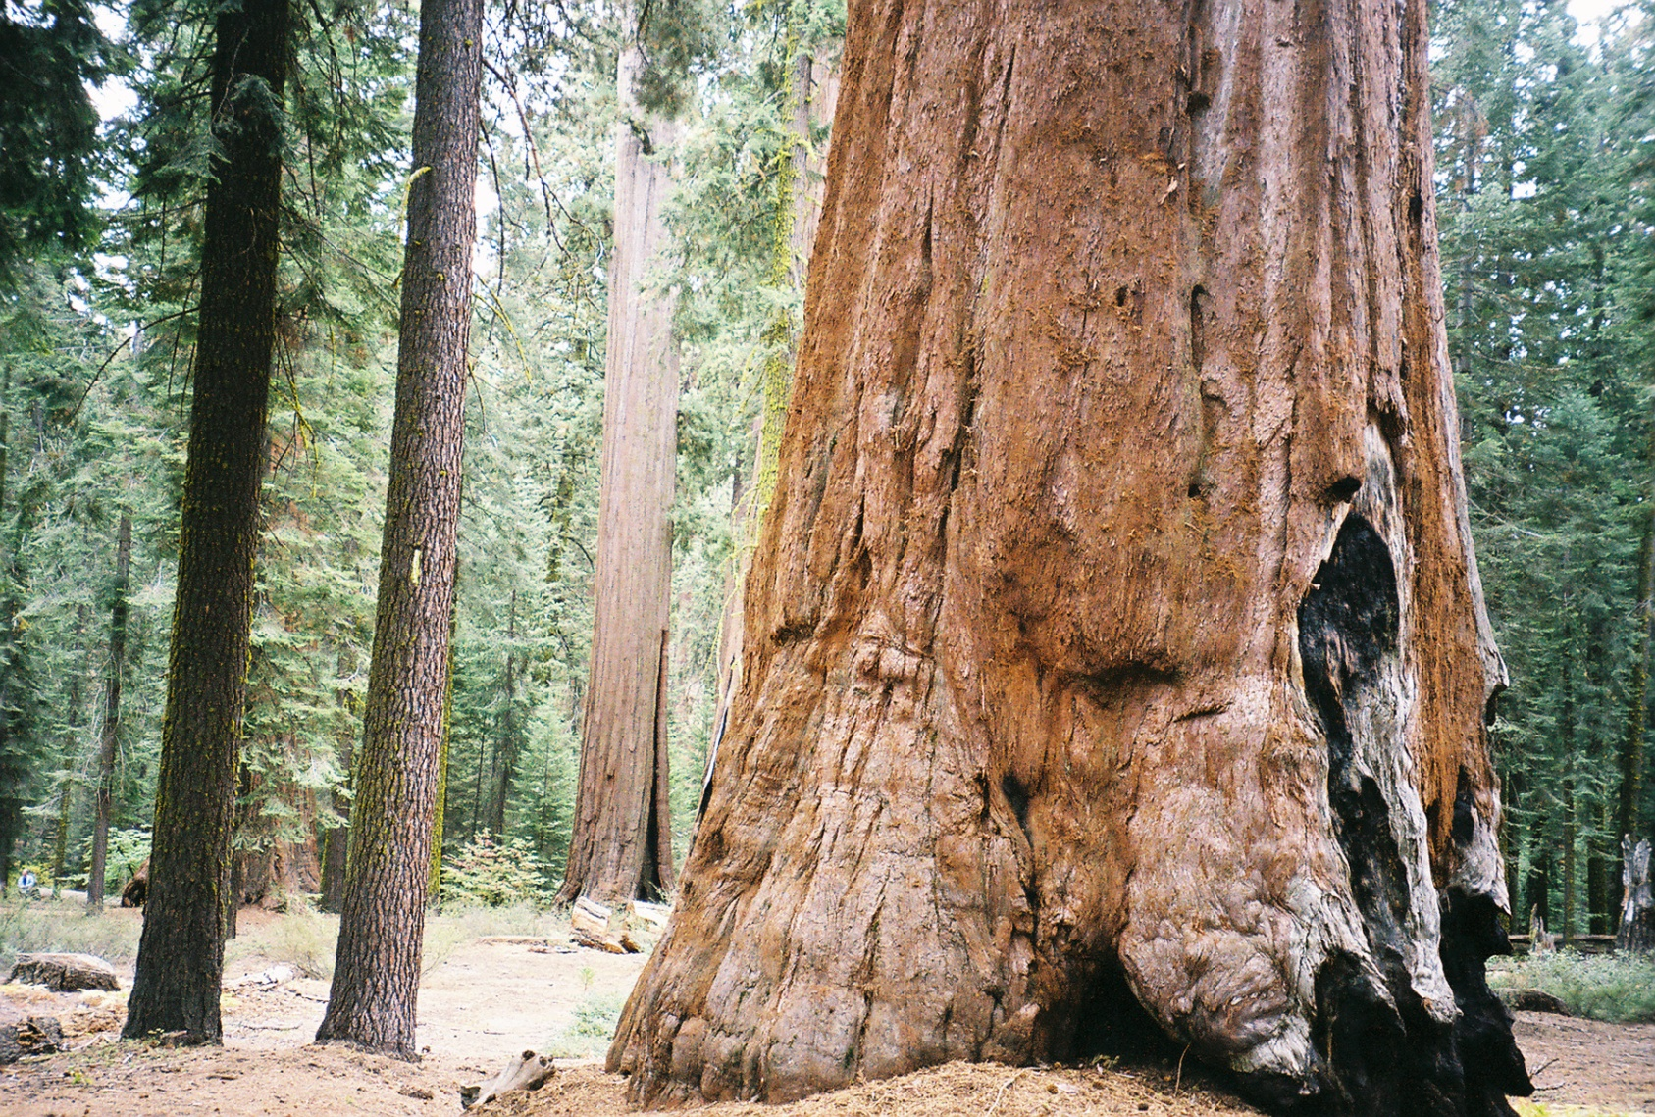
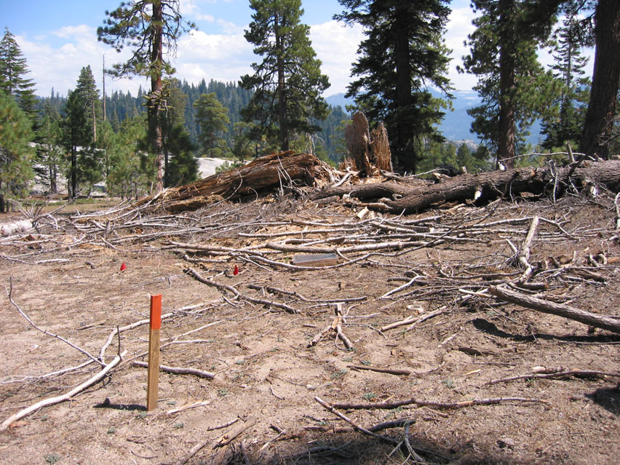
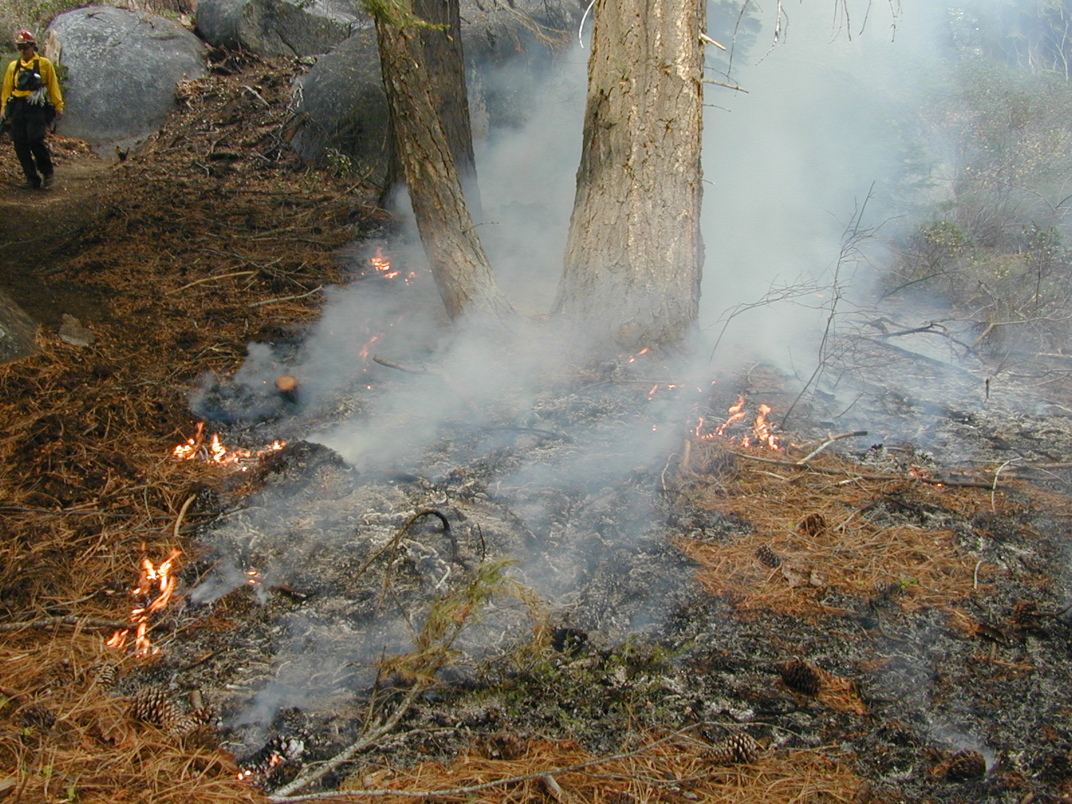
Sierra Nevada, CA

Slide 35
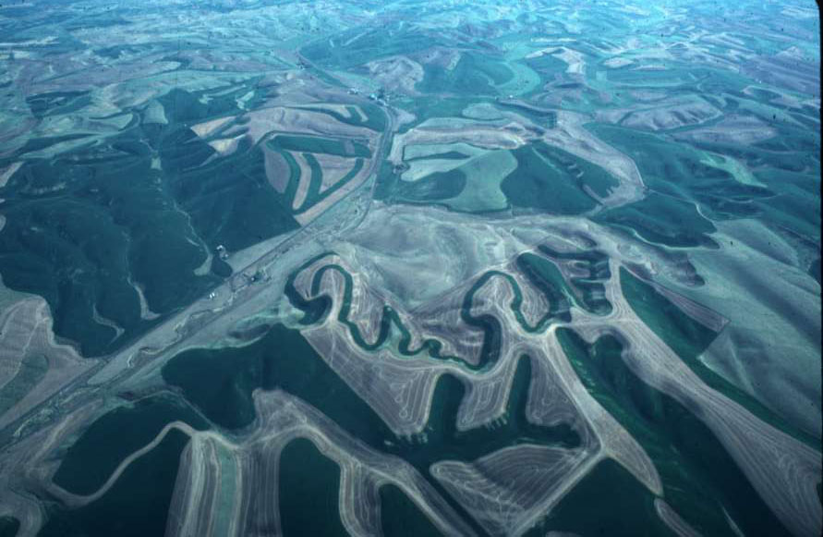
An agricultural landscape pattern

Slide 36
Needs from managers and policy makers
Each management option is accompanied with some expectations and many surprises
Lacks of theoretical and empirical bases remain frustrations for landscape managers
Managers need “cook books”: available information is too abstractive, not specific. Products need to be simple, straightforward.

Slide 37
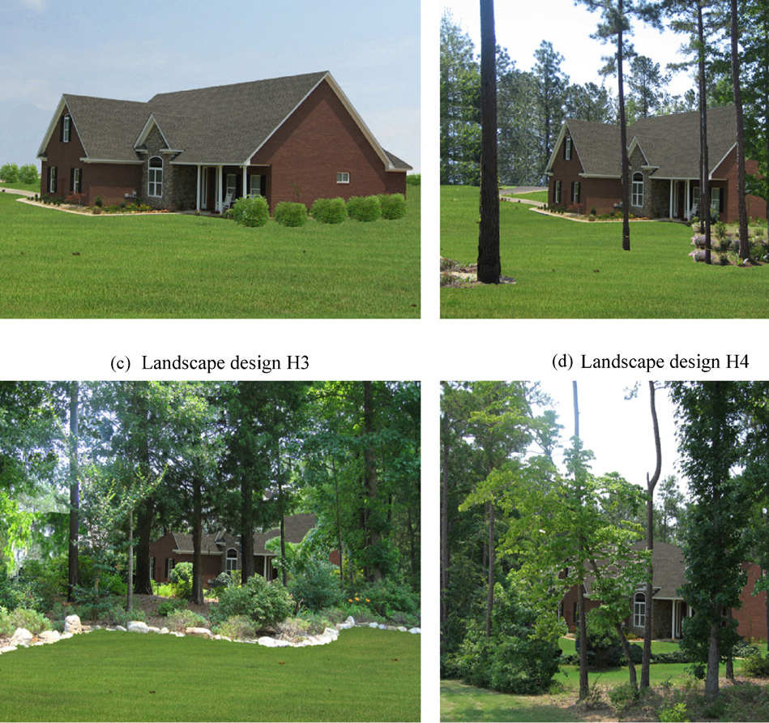
Education holds the key for tomorrow
Students decides the landscapes of future cities
Explored students’ preferences toward natural and wild versus clean and neat residential landscapes.
Zheng, B., Y. Zhang, and J. Chen. 2011. Preference to home landscape: wilderness or neatness? Landscape and Urban Planning 99:1-8.

Slide 38

LEES Lab
http://research.eeescience.utoledo.edu/lees/index.html
Questions?

