Slide 1

Advances in Restoration Ecology: From Reference Ecosystems to Novel Ecosystems
Hua Chen
(陈华)
Department of Biology
University of Illinois at Springfield
Notes:
Open remark – Thank you for the invitation and the nice introduction.
I am very glad to have this opportunity to discuss advances in restoration ecology. There are two reasons for me to choose this topic. First, restoration ecology faces many challenges, especially under global change environment (special timing).
Special location—South China Botanical Garden, CAS

Slide 2
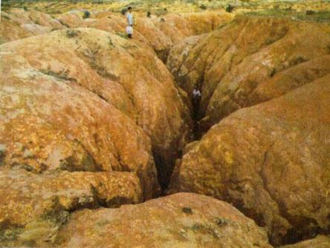
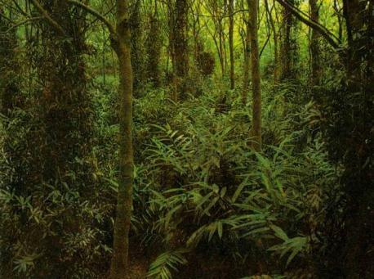
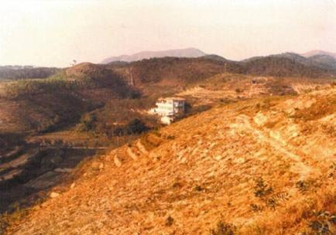
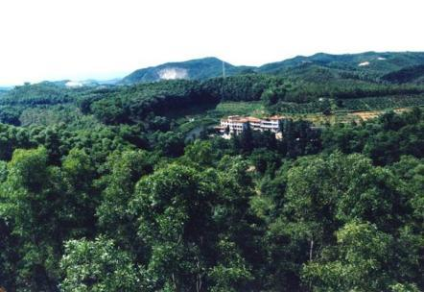
Notes:
中国科学院小良热带海岸带退化生态系统恢复与重建定位研究站始建于1959年，是由中国科学院华南植物园与茂名市水土保持研究所共同建设的生态站。建站的主要目标是热带海岸台地退化土地的恢复与利用。
中科院华南植物研究所从1959年开始，与当地政府合作，在广东西南部沿海的电白县小良立定位研究站，利用多学科的手段，系统开展沿海极度退化生态系统的恢复研究。小良站也因此成为我国最早开展恢复生态学研究的野外台站。
The earliest restoration ecology study was conducted by scientists (YU Zhu Yue) in South China of Botanic Garden, CAS in late 1950s.

Slide 3
Roadmap
Ecosystem degradation, ecological restoration, and restoration ecology
Reference and dynamic reference
Novel ecosystems and implications for restoration ecology
Conclusion
Notes:
First of all, I will briefly discuss why restoration ecology is very important and the brief history of restoration ecology (ecosystem degradation and brief history of restoration ecology).
Second, I will discuss one of most important concepts in restoration ecology—reference ecosystem (site)
Third, I will discuss one key advance in restoration ecology is novel ecosystem and the implications for restoration ecology.
Then, I would like to discuss Intervention ecology, a new term in restoration ecology. Do we really need it??
In the discussion, I will use a few case studies of ecological restoration.

Slide 4
Ecosystem Degradation
Ecosystems have been degraded, damaged, transformed or entirely destroyed as the direct or indirect result of human activities.
Terrestrial ecosystems (e.g.,forests, grasslands, wetlands, etc) and aquatic ecosystems (e.g., lakes, rivers, etc)
Notes:
因直接或间接的人类活动干扰影响，many 生态系统已经退化、被损害、被转化，或者被完全破坏的

Slide 5
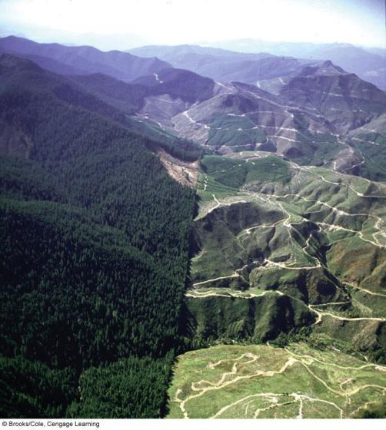
Clear-Cut Logging in Washington
State, U.S.
Notes:
Old-growth coniferous forests in PNW
5

Slide 6
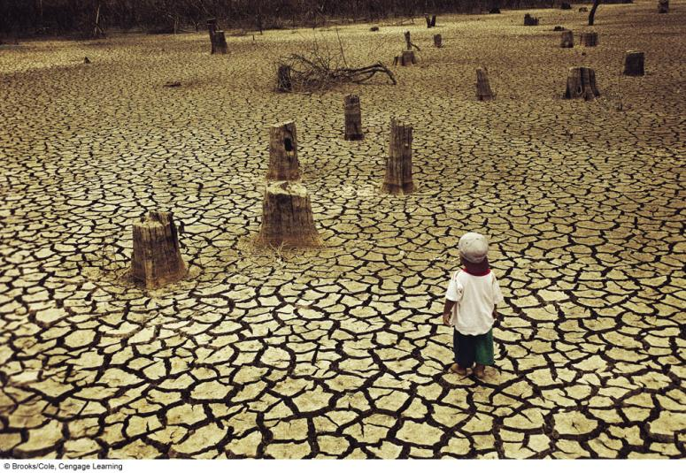
Extreme Tropical Deforestation in Thailand
Notes:
Tropical deforestation results in many forests disappear permanently.
6

Slide 7
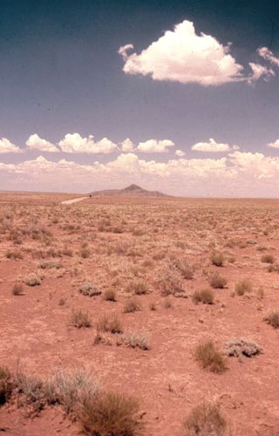
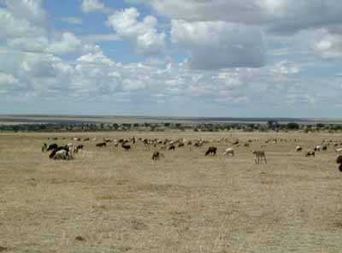
Overgrazed Grassland
Maasai sheep grazing in a Themeda grassland,
southwestern Kenya
Colorado
Notes:
7

Slide 8
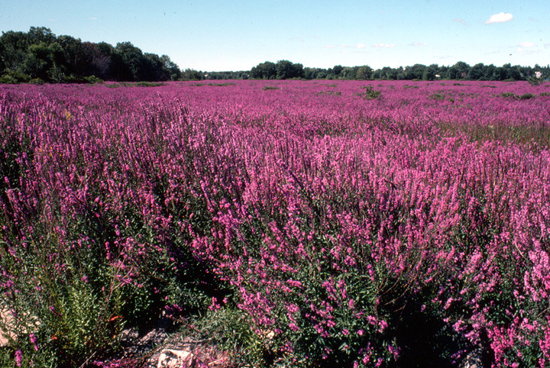
Purple Loosestrife Invasion in Wetlands
Notes:
千屈菜

Slide 9
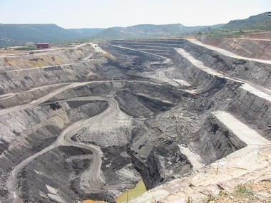
Coal Mine Site in Spain
Corta Alloza & Utrillas Coal Mine Site in Spain

Slide 10
Ecological Restoration (生态恢复)
An intentional activity that initiates or accelerates the recovery of an ecosystem with respect to its health, integrity and sustainability (The Society for Ecological Restoration, 2004)
Help system return to its historic natural trajectory
The PRACTICE of restoring ecosystems as performed by practitioners at specific sites.
Notes:
生态恢复是一个有目的的行动，这个目的就是启动或者促进一个生态系统恢复其健康、完整性和可持续性 (国际生态恢复学会科学政策工作组. 2004)。
Introduction of native plant species into a prepared (or unprepared) site with the goal of fostering natural ecosystem processes and returning the site to a more natural condition (SER Primer 2004)
Note how this differs from the old 1991 definition quoted in the book “intentionally altering site to establish a defined, indigenous, historic ecosystem.”

Slide 11
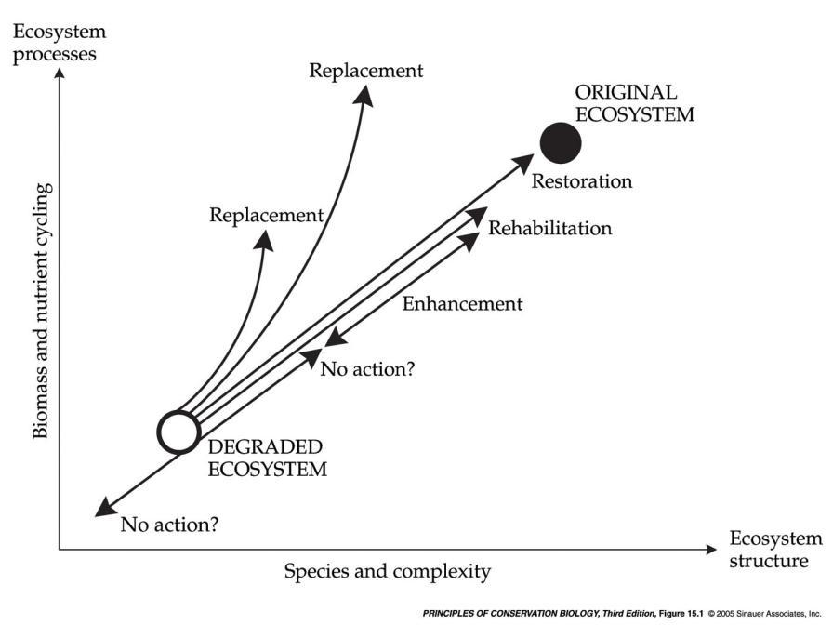
The trajectory of a restoration project
Reference
Ecosystem
Bradshaw 1984
Notes:
pcb3e-fig-15-01-0.jpg

Slide 12
Restoration Ecology (恢复生态学)
A young field. The term was coined in later 1980s
  Society for Ecological Restoration (SER) was founded in 1987
To provide a scientifically sound basis for the recovery of degraded ecosystems and to produce self-sustaining systems (Temperton et al. 2004).
Restoration ecology provides clear concepts, models, methods, and tools for practioners in support of ecological restoration (The Society for Ecological Restoration, 2004).
Notes:
the scientific field of "restoration ecology" was not first formally identified and coined until the late 1980s, by John Aber and William Jordan when they were at the University of Wisconsin-Madison.
Bradshaw, A.D. (1987). Restoration: the acid test for ecology. In Jordan, W.R., Gilpin, M.E. & Aber, J.D. (Eds.), Restoration Ecology: A Synthetic Approach to Ecological Research, pp. 23–29. Cambridge: Cambridge University Press. ISBN 0-521-33728-3

Slide 13
Restoration Ecology (恢复生态学)
Restoration ecology is the interdisciplinary, complex science field, involving science, society, policy etc. It deals with the restoration of ecological system (Palmer et al. 2007)
Notes:
the scientific field of "restoration ecology" was not first formally identified and coined until the late 1980s, by John Aber and William Jordan when they were at the University of Wisconsin-Madison.
Bradshaw, A.D. (1987). Restoration: the acid test for ecology. In Jordan, W.R., Gilpin, M.E. & Aber, J.D. (Eds.), Restoration Ecology: A Synthetic Approach to Ecological Research, pp. 23–29. Cambridge: Cambridge University Press. ISBN 0-521-33728-3

Slide 14
Roadmap
Ecosystem degradation, ecological restoration, and restoration ecology
Reference and dynamic reference
Novel ecosystems and implications for restoration ecology
Conclusion
Notes:
First of all, I will briefly discuss why restoration ecology is very important and the brief history of restoration ecology (ecosystem degradation and brief history of restoration ecology).
Second, I will discuss one of most important concepts in restoration ecology—reference ecosystem (site)
Third, I will discuss one key advance in restoration ecology is novel ecosystem and the implications for restoration ecology.
Then, I would like to discuss Intervention ecology, a new term in restoration ecology. Do we really need it??
In the discussion, I will use a few case studies of ecological restoration.

Slide 15
Reference ecosystem (参照生态系统)
A reference ecosystem can serve as the model for planning an ecological restoration project, and later serve in the evaluation of that project (The Society for Ecological Restoration, 2004).
The reference represents a point of advanced development that lies somewhere along the intended trajectory of the restoration.

Slide 16
Reference ecosystem (参照生态系统) 2
The reference can consist of one or several specified sites that contain model ecosystems. A reference is best assembled from multiple reference sites.
Notes:
a simple reference inadequately expresses the constellation of potential states and the historic range of variation expressed by the restored ecosystem.
Therefore, a reference is best assembled from multiple reference sites and, if necessary, other sources.
This composite description gives a more realistic basis for restoration planning.

Slide 17
The trajectory of a restoration project
Reference
Ecosystem
Bradshaw 1984
Notes:
pcb3e-fig-15-01-0.jpg
Historical range of variability (HRV)

Slide 18
How to Define Reference Ecosystems?
ecological descriptions and species lists of similar intact or historical ecosystems;
herbarium and museum specimens;
historical accounts and oral histories by persons familiar with the project site prior to damage (e.g., expert review)
historical and recent aerial and ground-level photographs
Notes:
Reference ecosystem– ideal description of an ecosystem should look like.
The description of a reference is complicated by two factors that should be reconciled to assure its quality and usefulness. First, a reference site is normally
selected for its well-developed expression of biodiversity, whereas a site in the process of restoration typically exhibits an earlier ecological stage. In such a
case, the reference requires interpolation back to a prior developmental phase for purposes of both project planning and evaluation. The need for interpretation diminishes where the developmental stage at the restoration project site is sufficiently advanced for direct comparison with the reference. Second, where the goal of restoration is a natural ecosystem, nearly all available references will have suffered some adverse human-mediated impacts that should not be emulated. Therefore, the reference may require interpretation to remove these sources of artifice. For these reasons, the preparation of the description of the reference requires experience and sophisticated ecological judgement.

Slide 19





Illinois River
Program
Waterfall Glen
Goose Lake
Emiquon
Spunky Bottoms
Reference
Conservancy Property
Conservancy Office
Illinois River Watershed
Wagon Lake
Chauncey
Notes:
The Illinois River: A Floodpulse System
Emiquon is located on Illinois River at La Grange Reach.
Why Emiquon?
Marsh:
Chauncey Marsh
Wagon Lake Land and Water Preserve
Sedge Meadow:
Goose Lake State Natural Area
Waterfall Glen Preserve

Slide 20
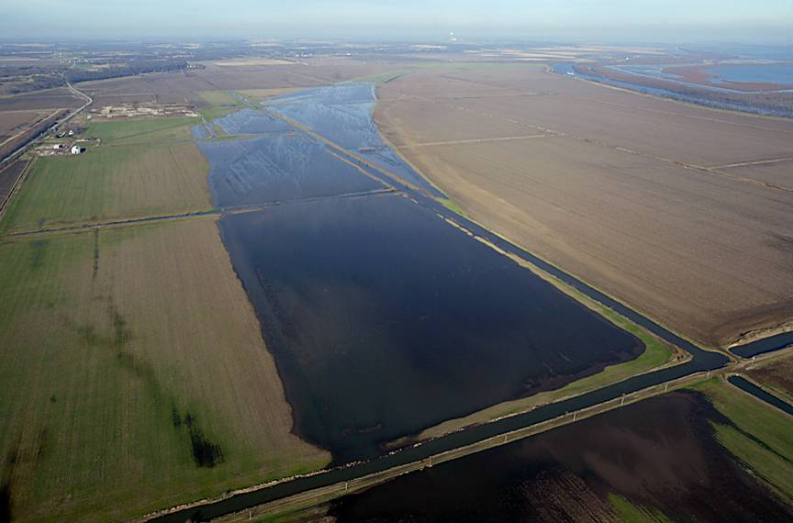
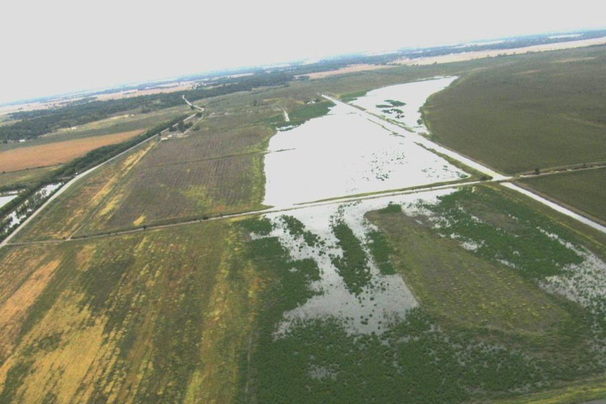
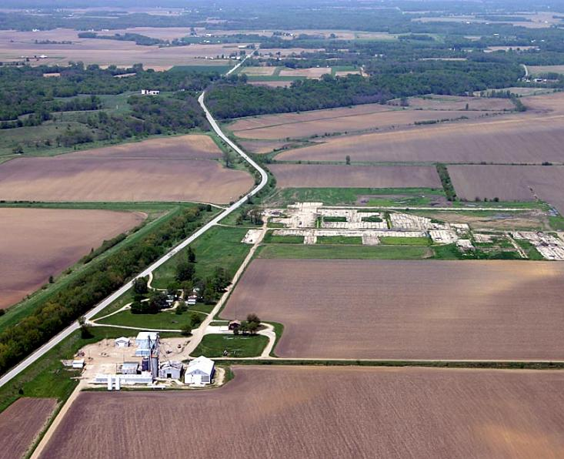
Emiquon

Slide 21
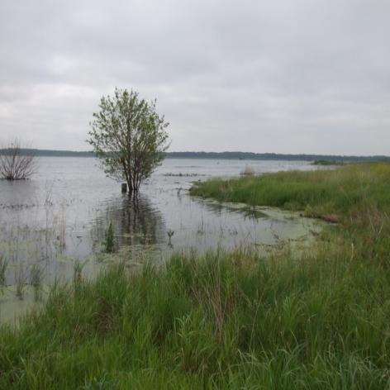
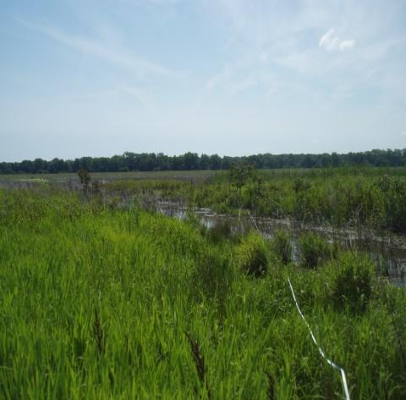
Two Restored Wetlands--Emiquon (2007) and Spunky Bottoms (1997)
Emiquon
Spunky Bottoms
Notes:
All constructed marsh soils are classified as typic psammaquents

Slide 22
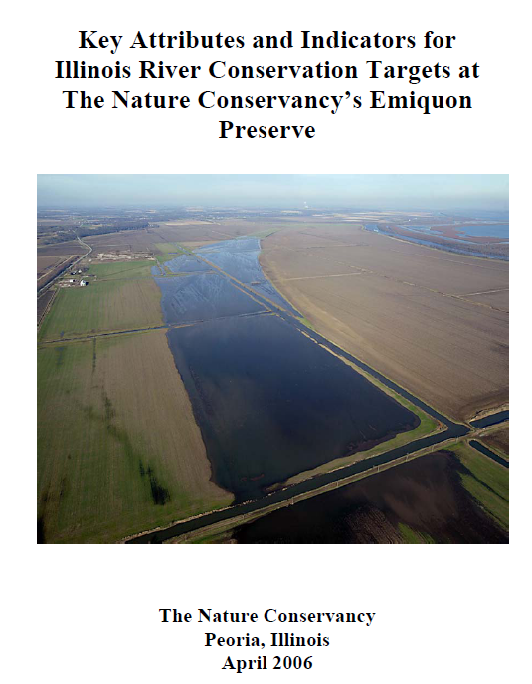
1. Key attributes and
indicators for Illinois
River Plant Communities
2. Key attributes and
indicators for Illinois
River Animal
Communities
Notes:
35 pages
best assembled from multiple reference sites.
Key attributes and indicators for plant communities at Emiquon.
Submersed aquatic vegetation
Emergent/floating-leveed vegetation
Key attributes and indicators for animal communities at Emiquon.
Fishes; Mussels; Birds etc.
No soil related indicators– since this project focus on biodiversity conservation. My research focuses on C and N dynamics during the restoration process– so I need to identify soil related indicators from reference sites in this region.

Slide 23
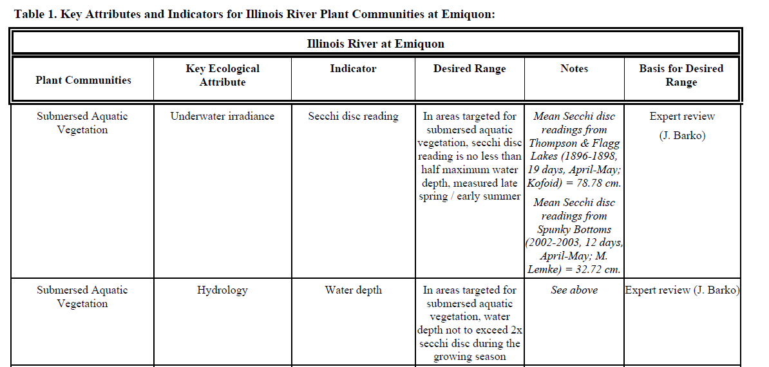
Key Attributes & Indicators for IL
River Plant Communities at Emiquon
best assembled from multiple reference sites.
Key attributes and indicators for plant communities at Emiquon.
  Submersed aquatic vegetation
  Emergent/floating-leveed vegetation
Key attributes and indicators for animal communities at Emiquon.
  Fishes; Mussels; Birds etc.
Notes:
An example

Slide 24
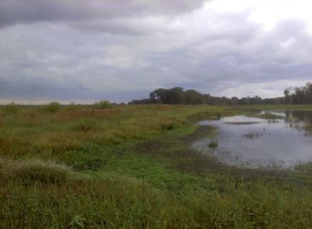
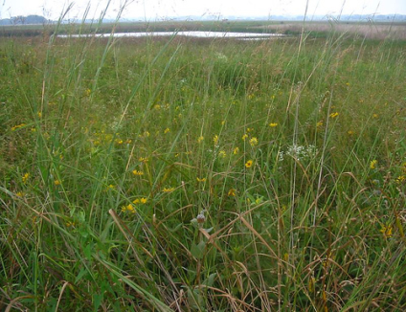
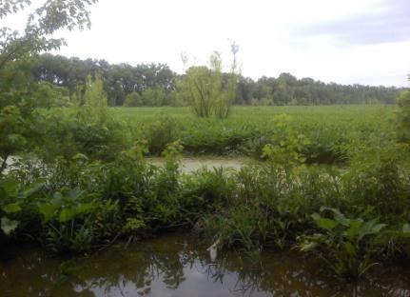
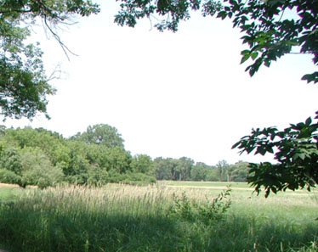
Study Sites
Chauncey Marsh Nature Preserve Goose Lake State Natural Area (Lawrence County) (Grundy County)
Wagon Lake Land and Water Preserve
(St. Clair County)
Waterfall Glen Preserve
(DuPage County)
Notes:
Average air temp (oC)
GL: 10
WG: 9
WL: 13
CM: 13

Slide 25
C Sequestration Potential of SOM in Emiquon and Spunky Bottoms
Briddell and Chen, in prep. for Wetlands
Notes:
Big potential for Emiquon and Spunky Bottoms:
First Sedge meadow—107 Mg/ha 156 Mg/ha
Marsh--73 Mg/ha 27 Mg/ha

Slide 26
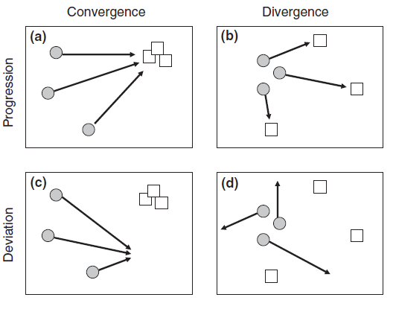
Temporal Trajectories in Species Composition
In Restored Wetlands vs Reference Wetlands
Matthews & Spyreas 2010
Notes:
Fig. 1. Given a set of restoration sites (grey circles) and reference targets (squares), four patterns are possible for temporal trajectories
(arrows) in species composition: (a) convergence in species composition among restorations and progression towards the target composition,
(b) divergence among restorations and progression towards a spectrum of potential targets, (c) convergence among restorations but
deviation away from the intended reference targets, (d) divergence among restorations and deviation from intended targets.
3. Over the first 4 years, restored wetlands that were initially similar in species composition
diverged, progressing towards different high integrity target states. Planting a large number of
native species in restorations increased their similarity to reference wetlands.
4. Over longer time scales (5–11 years post-restoration), however, restored wetlands deviated from
the ideal trajectory and converged upon the species composition of degraded wetlands, mainly
because of non-native species invasion.
Barriers to restoration, including non-native species and a lack of native propagules,
can limit long-term progression towards target communities and constrain restoration to undesirable
outcomes. Furthermore, convergence of restored wetlands on an undesirable community state
limits the effectiveness of wetland mitigation policies.
收敛, 集合；会聚
差异 (扩散)

Slide 27
Dynamic Reference
Defining reference conditions is a challenge in the contemporary landscape
  Impacts of human activities
  Environmental changes including climate change, species invasion, etc.
Dynamic reference—ecological change of both reference conditions and restored sites are measured simultaneously and are statistically evaluated.
Hiers et al. 2012 Ecol. Res. 30: 27-36; Matthews & Spyreas 2010

Slide 28
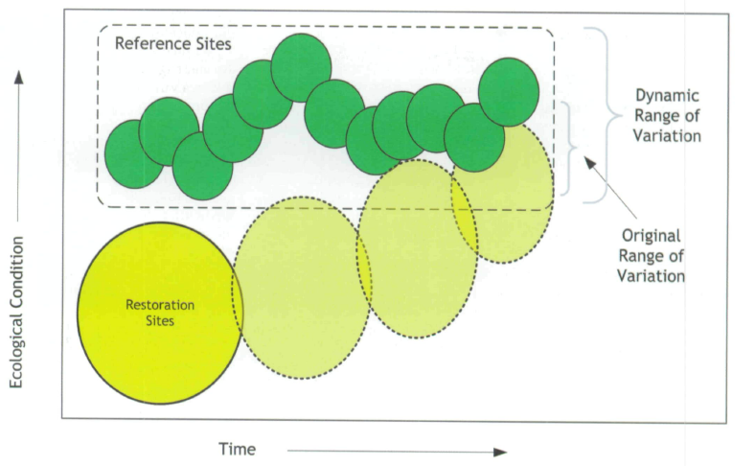
Dynamic Reference Concept
Hiers et al. 2012 Ecol. Res. 30: 27-36.
Notes:
Conceptual model of the dynamic reference concept illustrating movement of restoration sites towards a changing set of reference conditions. The dashed line surrounds a full range of desired ecological conditions. This approach monitors the ecological change in reference conditions to quantify what targets of restoration are realistic and achievable over time in response to both anthropogenic and natural disturbance.

Slide 29
Issues with Reference Concept
the changed biophysical settings due to global change is occurring and will be prevalent in the future
Is that possible to restore ecosystems based on the usefulness of historical ecosystem conditions as references under global climate change?
How do we know what the historical ecosystems were like?
Harris et al. 2006 Rest. Ecol. 14: 170-176.

Slide 30
Issues with Reference Concept
Is it appropriate to consider a temperate woodland restoration endpoint in an area likely to be flooded by rising sea level? Why establish wetland in an area likely to become semiarid?
Harris et al. 2006 Rest. Ecol. 14: 170-176.

Slide 31
Deviation Away From the Intended
Reference Targets
Matthews & Spyreas 2010
Notes:
Fig. 1. Given a set of restoration sites (grey circles) and reference targets (squares), four patterns are possible for temporal trajectories
(arrows) in species composition: (a) convergence in species composition among restorations and progression towards the target composition,
(b) divergence among restorations and progression towards a spectrum of potential targets, (c) convergence among restorations but
deviation away from the intended reference targets, (d) divergence among restorations and deviation from intended targets.
3. Over the first 4 years, restored wetlands that were initially similar in species composition
diverged, progressing towards different high integrity target states. Planting a large number of
native species in restorations increased their similarity to reference wetlands.
4. Over longer time scales (5–11 years post-restoration), however, restored wetlands deviated from
the ideal trajectory and converged upon the species composition of degraded wetlands, mainly
because of non-native species invasion.
Barriers to restoration, including non-native species and a lack of native propagules,
can limit long-term progression towards target communities and constrain restoration to undesirable
outcomes. Furthermore, convergence of restored wetlands on an undesirable community state
limits the effectiveness of wetland mitigation policies.
收敛, 集合；会聚
差异 (扩散)

Slide 32
Issues with Restoration Ecology
Should we be focusing on past systems as the target for ecological restoration activities—or should we rather be reinstating the space and capacity for ecosystem functions and processes
Its past-oriented, static, and idealistic approach has been criticized for subjectivity in determining restoration goals, inapplicability to dynamic ecosystems, and inability for restoring certain irreversible loss
Harris et al. 2006 Rest. Ecol. 14: 170-176; Choi 2007 Rest. Ecol. 15: 351-353.

Slide 33
Roadmap
Ecosystem degradation, ecological restoration, and restoration ecology
Reference and dynamic reference
Novel ecosystems and implications for restoration ecology
Conclusion
Notes:
First of all, I will briefly discuss why restoration ecology is very important and the brief history of restoration ecology (ecosystem degradation and brief history of restoration ecology).
Second, I will discuss one of most important concepts in restoration ecology—reference ecosystem (site)
Third, I will discuss one key advance in restoration ecology is novel ecosystem and the implications for restoration ecology.
In the discussion, I will use a few case studies of ecological restoration.

Slide 34
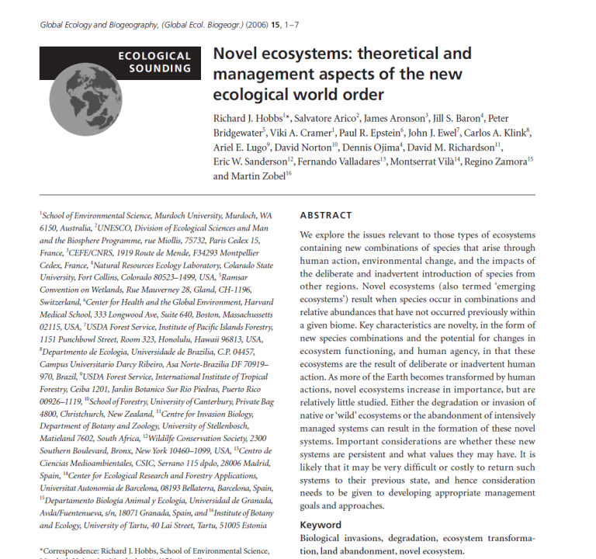
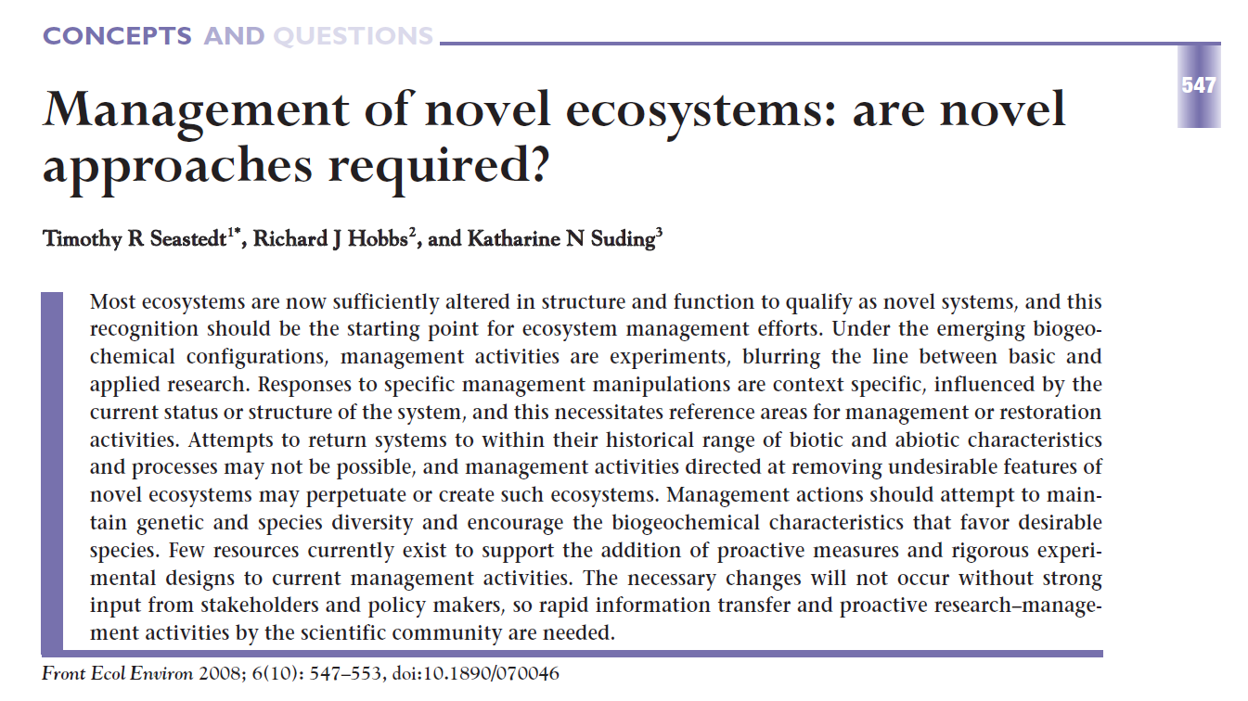
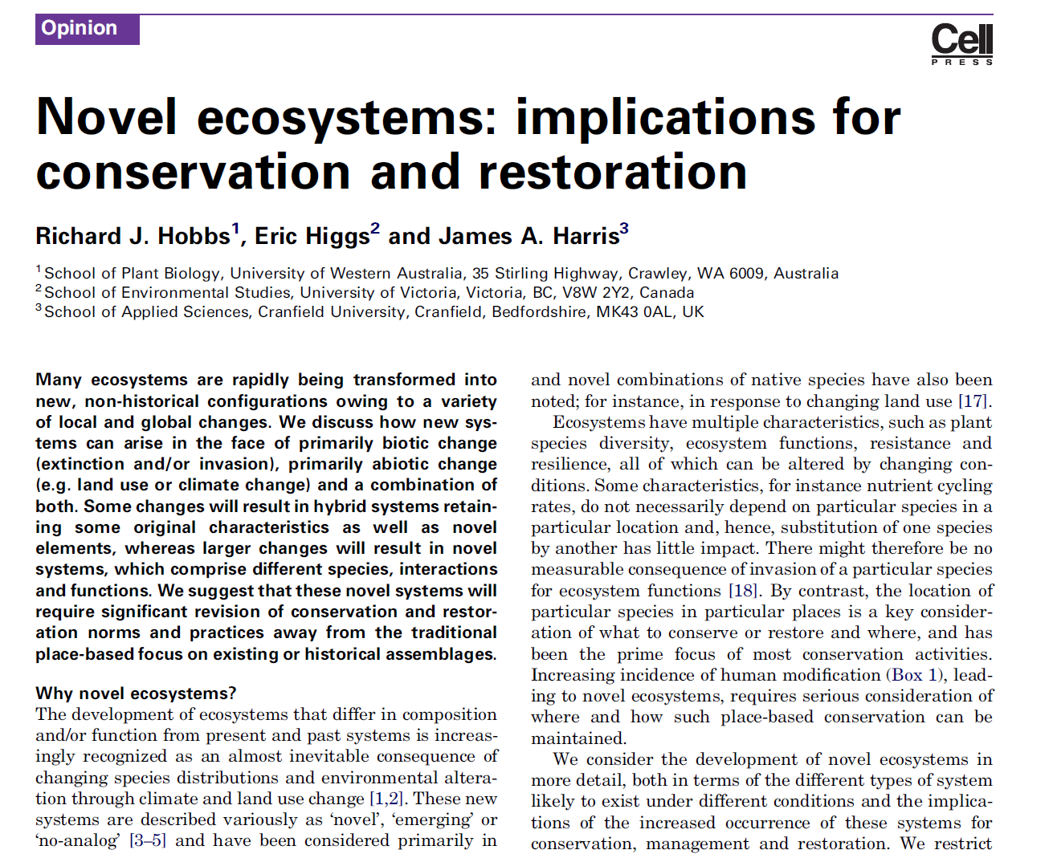
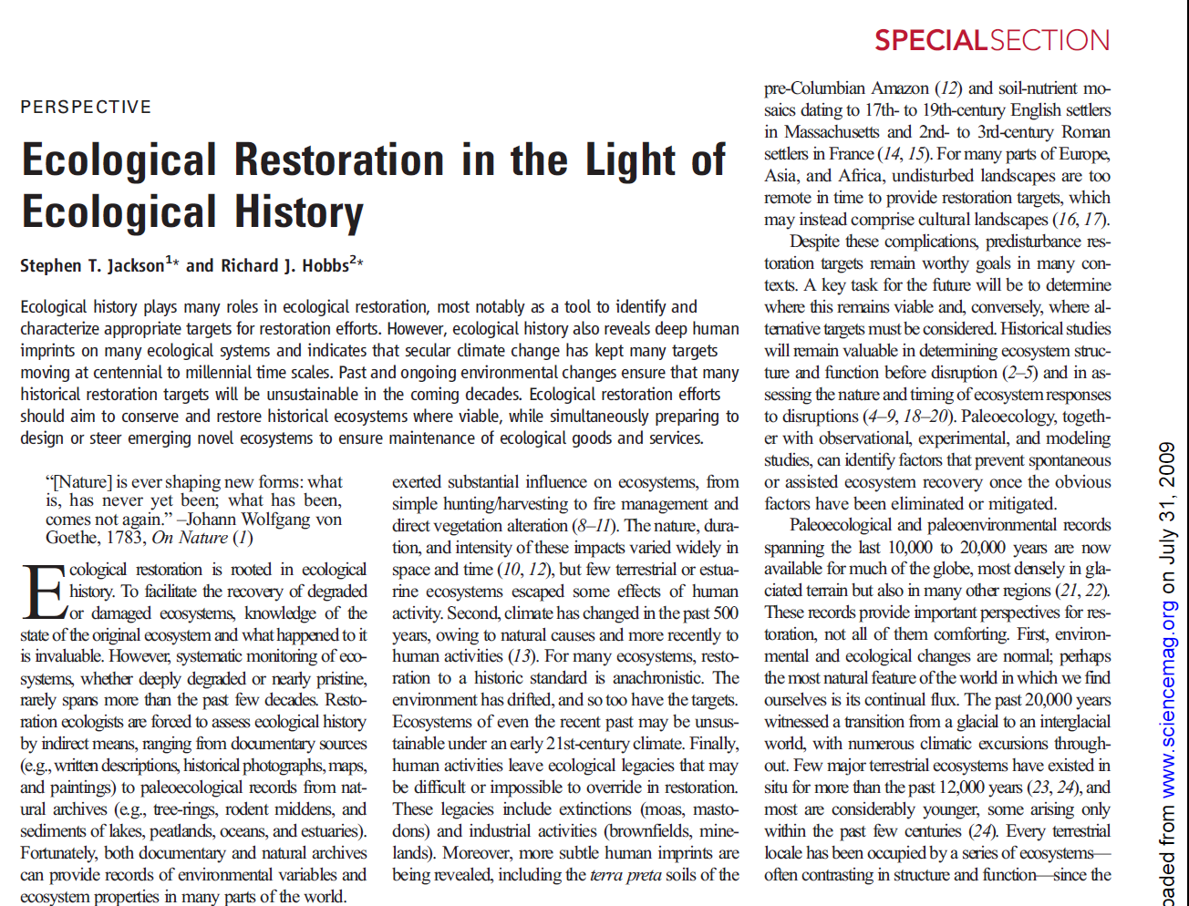
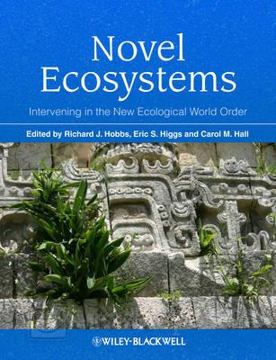
Novel Ecosystem (新型生态系统)
Notes:
Hobbs et al. (2006). Novel ecosystems: theoretic and management aspects of the new ecological world order. Global Ecol. Biogeogr. 15:1-7.
Based on a workshop in Spain (Granada) in 2002
Hobbs et al. (2009). Novel ecosystems: implications for conservation and restoration. Trends Ecol. Evol. 24:599-605.
Seastedt et al. (2008). Management of novel ecosystems: are novel approaches required? Front. Ecol. Environ. 6: 547-553.
Jackson and Hobbs. (2009). Ecological restoration in the light of ecological history. Science 325: 567-568.
Hobbs, R., E.S. Higgs, and C. M. Hall 2013. Novel ecosystems: Intervening in the New Ecological World Order.

Slide 35
Publications on Novel Ecosystems
(Google Scholar search 6/1/2013)
Notes:
In the past decade, publication has risen about 10 times

Slide 36
Definition of Novel Ecosystems
In novel ecosystems, species occur in combinations and relative abundances that have not occurred previously in a given biome.
Caused by human action, environmental change, and the impacts of the deliberate and inadvertent introduction of species.
Hobbs et al. 2006. Global Ecol. Biogeogr. 15:1-7;

Slide 37
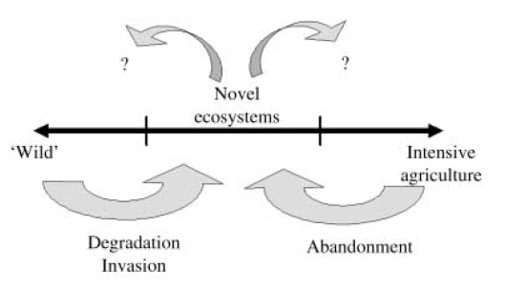
Formation of Novel Ecosystems
Hobbs et al. 2006. Global Ecol. Biogeogr. 15:1-7
Notes:
Figure 1 Novel ecosystems arise either from the degradation and
invasion of ‘wild’ or natural/seminatural systems or from the
abandonment of intensively managed systems.

Slide 38
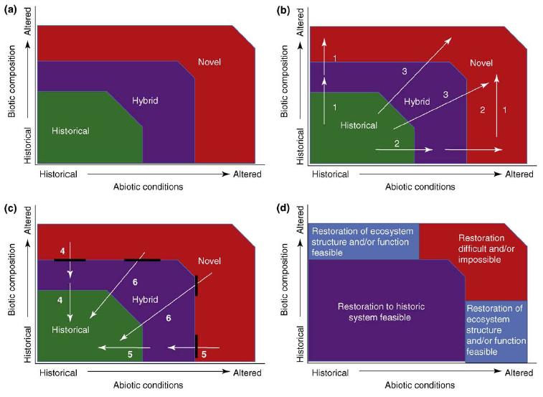
Definition
Hobbs et al. 2009. TREE
Notes:
Figure 1. Types of ecosystem that develop under varying levels of biotic and abiotic alteration. (a) three main types of system state: (i) historical, within which ecosystems remain within their historical range of variability; (ii) hybrid, within which ecosystems are modified from their historical state by changing biotic and/or biotic characteristics;and (iii) novel, within which systems have been potentially irreversibly changed by large modifications to abiotic conditions or biotic composition. (b) Potential pathways of development of ecosystems in the face of changing biotic composition (loss or addition of species) and abiotic change (land use or climate). Pathway 1 is driven primarily by loss of existing species and addition of invasive species (either native or non-native), Pathway 2 by changing abiotic conditions and Pathway 3 by biotic and abiotic changes acting synergistically. (c) Reversing the pathways of development in (a) requires removal of invasive species (Pathway 4) and/or amelioration of altered environmental conditions (Pathways 5 and 6). Black lines indicate the presence of potential restoration thresholds that prevent the system moving back to a less altered state without significant management input. (d) The state space can be divided into an area within which restoration to a system within the historic range of variability remains feasible (which includes some or most hybrid systems), areas within which restoration of ecosystem structure and/or function can be achieved without a return to historic system characteristics, and an area within which restoration is likely to be difficult or impossible and hence alternative management objectives are required.
(Developed from previous conceptualizations from Refs [12,34]).

Slide 39
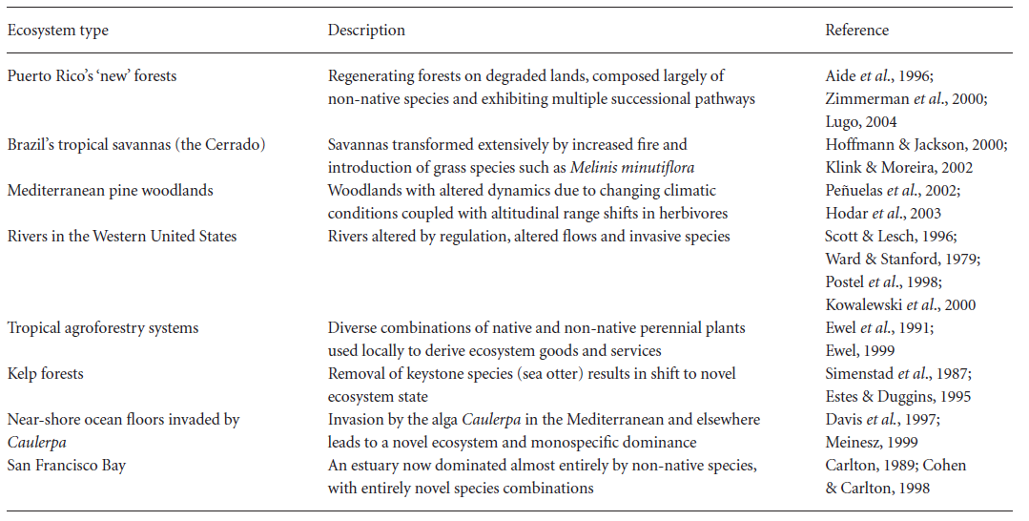
Examples of Novel Ecosystems (Hobbs et al. 2006, GEB)

Slide 40
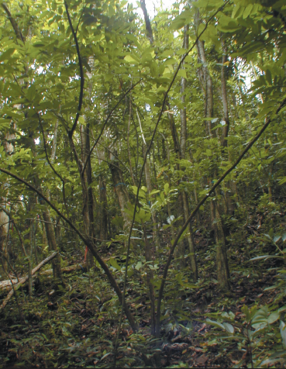
Puerto Rico New Forest—African tulip trees
Lugo 2004. Front. Ecol. Environ.
Notes:
Ａ２５－ｙｒ ｆｏｒｅｓｔ ｄｏｍｉｎａｔｅｄ ｂｙ Ａｆｒｉｃａｎ ｔｕｌｉｐ ｔｒｅｅｓ． Ｔｈｅ ｕｎｄｅｒｓｔｏｒｙ ｉｓ ｅｘｐｅｒｉｅｎｃｉｎｇ ａｎ ｉｎｖａｓｉｏｎ ｂｙ ｎａｔｉｖｅ ｔｒｅｅ ｓｐｅｃｉｅｓ ｕｎｄｅｒ ｔｈｅ ｃａｎｏｐｙ ｏｆ ｔｈｅ Ａｆｒｉｃａｎ ｔｕｌｉｐ ｔｒｅｅ．

Slide 41
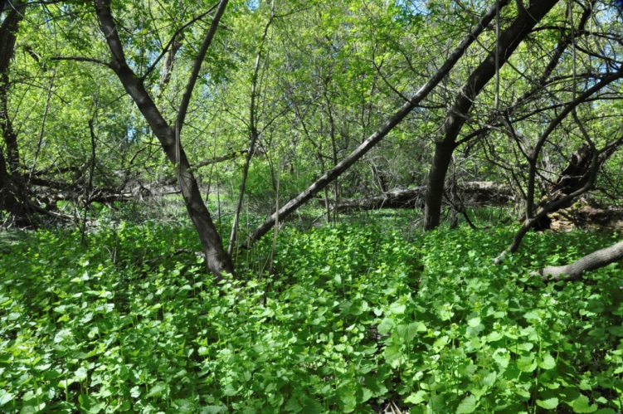
Garlic Mustard (Alliaria petiolata) Invasion in a Stormwater Floodplain, UW-Madison Arboretum
Photo by Stephen B. Glass.
Notes:
A novel, or emerging ecosystem, is one without an analog in the natural environment that develops in response to radically altered environmental conditions caused by social, economic, or cultural activities. Novel ecosystems include those with urban soil contaminated by storm water runoff; systems with altered ground and surface water flows; or systems with soil disturbed by ditching, dredging, or drainage
The woodland pictured here is a typical novel ecosystem. The site has, for decades, been subjected to all the disturbances listed, and more; it also has a significant component of herbaceous pest species like garlic mustard (Alliaria petiolata), Dame’s Rocket (Hesperis matronalis), and Japanese knotweed (Polygonum cuspidatum or Fallopia japonica). Few of the original native wetland and sedge meadow species grow on the site. The historic and modern-day disturbances like storm water runoff continue.
Planning Restoration for a Novel Ecosystem
Let’s start with some questions: Where does the restoration ecologist start with a site like this? What are practical goals? Can the altered hydrology be restored? What can one do about the dried and disturbed peaty soils?
Is the top priority the eradication of pest species? Does the restoration learn to live with some of the pest species? If the pest species are removed, what will replace them? Will this site support a restored system based upon historic models? Or, will restoration of this novel ecosystem require novel approaches and ecosystem models?
大蒜芥

Slide 42
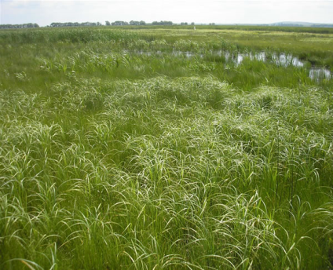

Purple Loosestrife Invasion in Wetlands
Purple loosestrife
Notes:
千屈菜

Slide 43
Implications for Restoration Ecology
Our present beliefs on restoration ecology likely require significant adjustment. A more dynamic approach is needed in dealing with an increasingly uncertain future. Restoration goals are determined by us, not by nature.
restoration may be difficult even impossible for some novel ecosystems.
Hobbs et al. 2009. TREE; Choi et al. 2008. Ecoscience.
Notes:
traditional notion of restoring biodiversity by direct appeal to historical condition are being reconsidered in the light of rapid environmental change. Establish the ecosystems that are able to sustain in the future, not the past environment

Slide 44
Definition
Notes:
Figure 1. Types of ecosystem that develop under varying levels of biotic and abiotic alteration. (a) three main types of system state: (i) historical, within which ecosystems remain within their historical range of variability; (ii) hybrid, within which ecosystems are modified from their historical state by changing biotic and/or biotic characteristics;and (iii) novel, within which systems have been potentially irreversibly changed by large modifications to abiotic conditions or biotic composition. (b) Potential pathways of development of ecosystems in the face of changing biotic composition (loss or addition of species) and abiotic change (land use or climate). Pathway 1 is driven primarily by loss of existing species and addition of invasive species (either native or non-native), Pathway 2 by changing abiotic conditions and Pathway 3 by biotic and abiotic changes acting synergistically. (c) Reversing the pathways of development in (a) requires removal of invasive species (Pathway 4) and/or amelioration of altered environmental conditions (Pathways 5 and 6). Black lines indicate the presence of potential restoration thresholds that prevent the system moving back to a less altered state without significant management input. (d) The state space can be divided into an area within which restoration to a system within the historic range of variability remains feasible (which includes some or most hybrid systems), areas within which restoration of ecosystem structure and/or function can be achieved without a return to historic system characteristics, and an area within which restoration is likely to be difficult or impossible and hence alternative management objectives are required.
(Developed from previous conceptualizations from Refs [12,34]).

Slide 45
Implications for Restoration Ecology
How to manage novel ecosystems? how to maximize the ecosystem services?
  Is the system maturing, or capable of maturing, along a stable trajectory?
  Is the system resistant and resilient?
  Is the system providing ecosystem services?
Hobbs et al. 2009. TREE
Notes:
抵抗力(resistance) ;弹性 (resilient)

Slide 46
Implications for Restoration Ecology
A logical approach to manage novel ecosystems would be to maximize genetic, species, and functional diversity wherever possible, to increase the viability of communities and ecosystems under uncertain climate regimes.
Seastedt et al. (2008). Front. Ecol. Environ. 6: 547-553

Slide 47
Two Misconceptions
accepting or acknowledging novel ecosystems implies that managers will surrender any attempt to control invasive species.
accepting novel ecosystems will result in the replacement of traditional restoration practice

Slide 48
Take home message
traditional notion of restoration ecology NEEDS to be reconsidered. A more dynamic approach is needed in dealing with an increasingly uncertain future.
accepting or acknowledging novel ecosystems and managing them by maximizing ecosystem services.

Slide 49
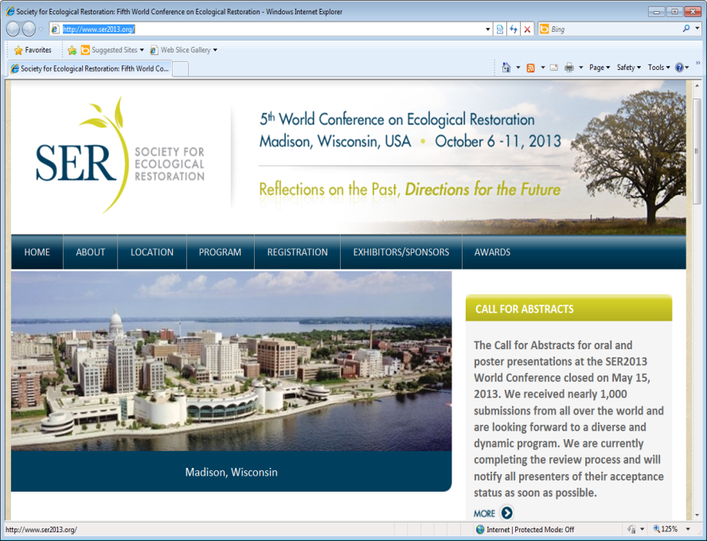
  生态恢复

Slide 50
Acknowledgements
undergraduate & graduate students who took Restoration Ecology course
USDA NRICGP (1997, 2000)
  NSF (2002, 2008)
  DOE (2006-2009)
University of Illinois at Springfield Collaborative Project Seed Funding Grant
UIS Therkildsen Field Station at Emiquon
Thank you!
Photo by Lizanne Gray

Slide 51
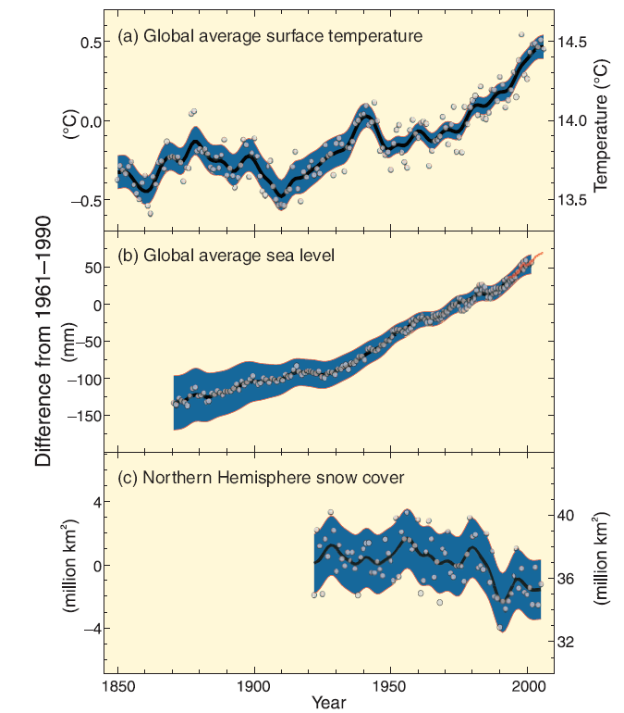
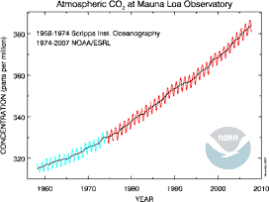
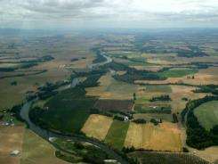

Global Change
393 ppm in Jan, 2012
Climate change
Land use change
Species invasion and
biodiversity loss
Purple loosestrife
Notes:
Global change at least include climate change, land-use change, and biodiversity change [species invasion and biodiversity loss]. Global Change is a much broader term than Climate change.
As we realize that our global environment is experiencing change in many aspects. This is the famous Keeling Curve. Atmospheric CO2 concentration showed a sustainable increase due to human activities (fossil fuel burning) since 1960. I checked early this week the atmospheric CO2 concentration reach 393 ppm in the end of Jan. this year. Most scientists agree that the increasing greenhouse gas such as CO2, CH4, and N2O concentration in atmosphere is responsible for the global warming and other related changes.
Temperature increase/ global average sea level rise/ snow cover decline in northern hemisphere
This is often known as the "Keeling curve," named for the C. David Keeling who started to take CO2 observations at Mauna Loa in 1958. These data are now taken and maintained by NOAA's Earth Systems Research Laboratory, Global Modeling Division. This web site is excellent, provides references, as well as access to the observations. Here is a recent update of the Keeling Curve.
There are two obvious things in this record. The first is that there is a steady upward trend of CO2. The second is that there is an annual oscillation of CO2. What is not so obvious on this scale is that the amplitude of the annual cycle is increasing. Here is a link to the NOAA site which has much more information on this figure, as well as global averages and numbers of how much the CO2 increases each year.
The steady upward trend is mostly attributed to the release of CO2 by fossil fuel burning. There has been significant effort to account for all of the sources (and sinks) of carbon dioxide, and the increase both correlates with the increased burning of fossil fuels, and it is generally consistent with amounts that are estimated based on fuel consumption.
Back picture 1961
Front picture 1990s
Land-cover change is another important aspect of global change.
Historically, most forests were cleared for croplands. This is especially true in the eastern United States. The conversion of natural vegetation to croplands releases a large amount of carbon into atmosphere.

Slide 52
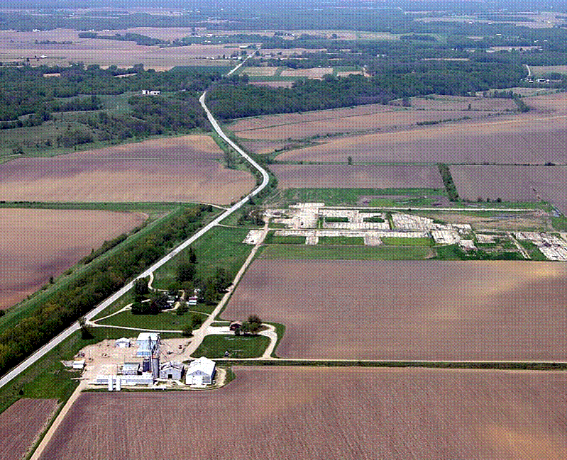
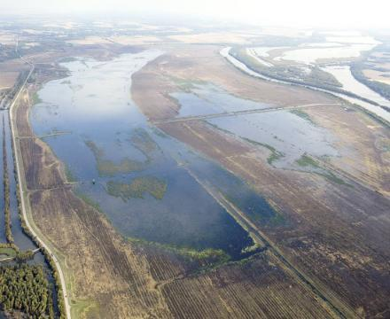
Wetland restoration from croplands
Increasingly important for various reasons
  Removing stream nutrient load
  Enhancing native species (e.g., plants, fishes)
  Carbon sequestration

