Slide 1
Animal Movement and Habitat Selection in Response to Human Activities and Urbanization
By Alyssa Ayan

Slide 2
Papers
Movement models and simulation reveal highway impacts and mitigation opportunities for a metapopulation-distributed species
Aiello et al., 2023
Scale of effect of landscape patterns on resource selection by bobcats (Lynx rufus) in a multi-use rangeland system
Branney et al., 2024

Slide 3
Movement models and simulation reveal highway impacts and mitigation opportunities for a metapopulation-distributed species Aiello et al., 2023

Slide 4
Human-Made Barriers and Wildlife
Human development limits animal access to habitats and movement
Compromises behaviors like migration and dispersal
Creates fragmented habitat patches
Mitigates fragmentation by:
Finding previous locations of wildlife crossings
Implementing safe wildlife crossings to improve corridor function

Slide 5
Bighorn Sheep (Southern California)
Habitat fragmented by highways
Still attempt to cross – motivation to access fragmented habitat
Elevation gradient
High elevation: vegetation refuge
Low elevation: spatial and temporal heterogeneous resources affected by human activities

Slide 6
Objectives
Simulate bighorn sheep metapopulation movement and habitat selection near highways in Southern California.
Simulate movement in a hypothetical barrier-free landscape
Find likely site crossing locations that mitigate fragmentation.
Quantify gains in habitat reachability from barrier mitigation

Slide 7
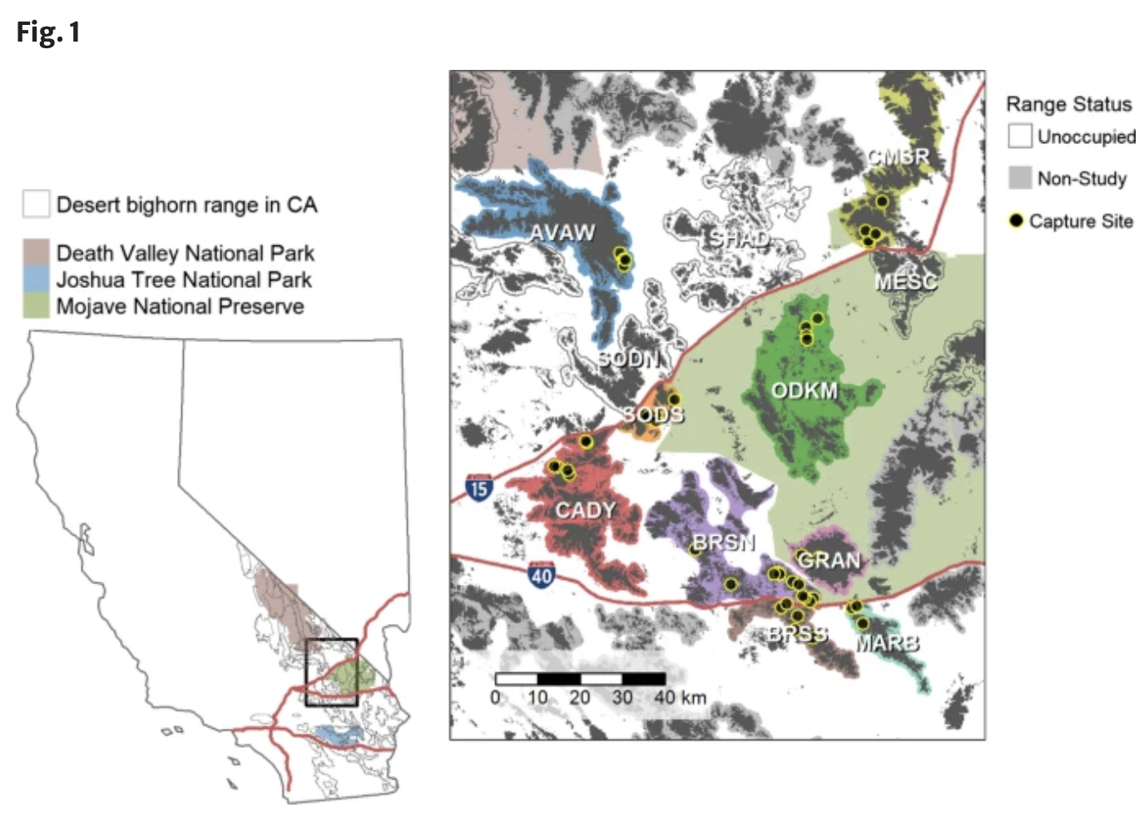
Methods
Captured 49 adult desert bighorn sheep in focal habitat along I-15 and I-40 and fitted GPS collars (Oct 2018)
Collect location once every hour if further than 1 km from a highway or once every 30 min if less than 1 km from a highway
Collected data until animal mortality, collar failure, or study end date (Oct 2021)

Slide 8
Methods
iSSFs: integrated Step Selection Functions
Step selection functions represent animal movement data, compare to sample of possible steps – find habitat selection
Sampled random steps to represent available movement – modelled each individual
iSSF describes an animal’s characteristic speed and directional persistence
Tested iSSFs on Terrain, Water, Forage
Identified crossing locations and habitat barriers
Simulated without barrier to predict habitat use

Slide 9
Results

Slide 12
Discussion/Conclusions
Crossing locations are the most convenient – not the most efficient
High road kill incidence
Potential increase in used bighorn sheep habitat would be substantial
Includes high elevation resources for low elevation populations, reduces likelihood of climate extinction
Long-term benefits for connectivity and metapopulation dynamics
More opportunities for interpopulation interactions

Slide 13
Scale of effect of landscape patterns on resource selection by bobcats (Lynx rufus) in a multi-use rangeland system Branney et al., 2024

Slide 14
Habitat Loss and Agriculture
Development of agriculture has led to wildlife habitat fragmentation and loss
Cultural landscape
“Relationship between human activity and environment have created ecological, socioeconomic, and cultural patterns and feedback mechanisms that govern the presence, distribution, and abundance of species assemblages.” (Branney et al., 2024)
Prevalent in South Texas

Slide 15
Bobcats
Largest remaining high density obligated carnivores in study system (South Texas)
Negatively affected by fragmentation
Increased fragmentation → larger home range (reduced habitat productivity)
Strong associations with vegetations structure and prey density
Both influenced by landscape patterns
Effects of novel cultural landscapes on carnivores unknown

Slide 16
Questions and Objectives
Which landscape patterns have the strongest effect on wildlife behavior?
What is the scale of this effect?
Assess bobcat resource selection within the home range
Hypothesized resource selection would occur at multiple scales, but effects of landscape pattern would be strongest
Predicted bobcats would select contiguous woody vegetation and avoid energy infrastructure

Slide 17
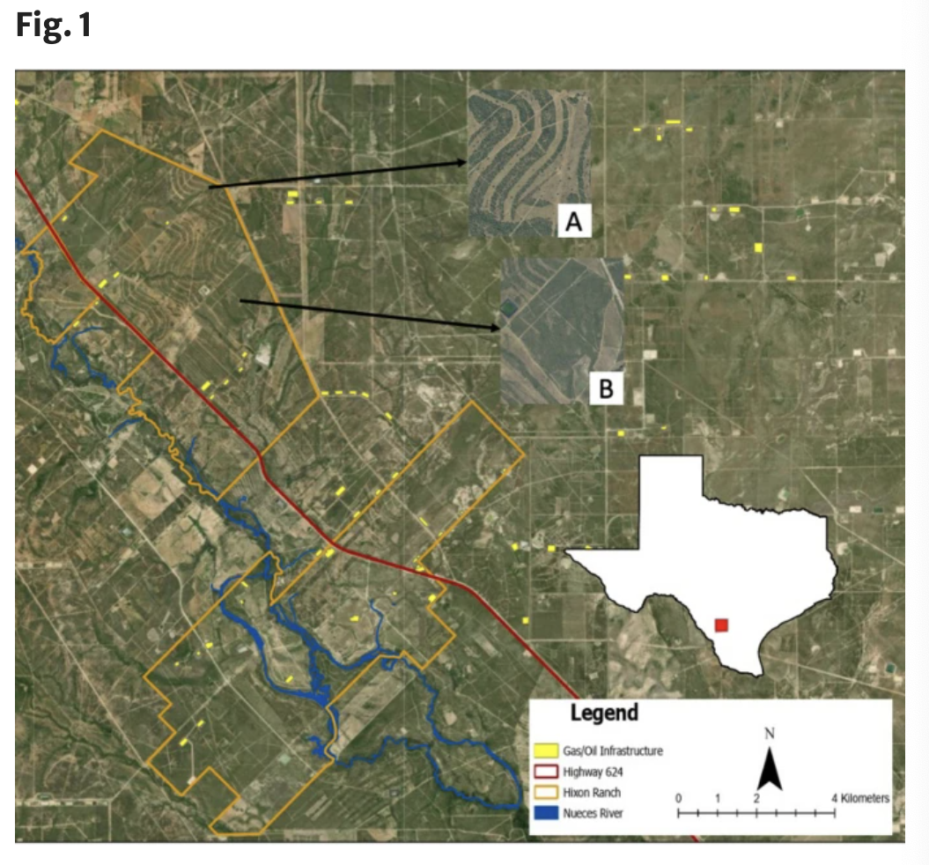
Methods: Study Area
Agriculture (cattle) and energy infrastructure
Previous restoration efforts from 2009-2019 to remove invasive grasses using prescribed fire, herbicide, and native plant seeding

Slide 18
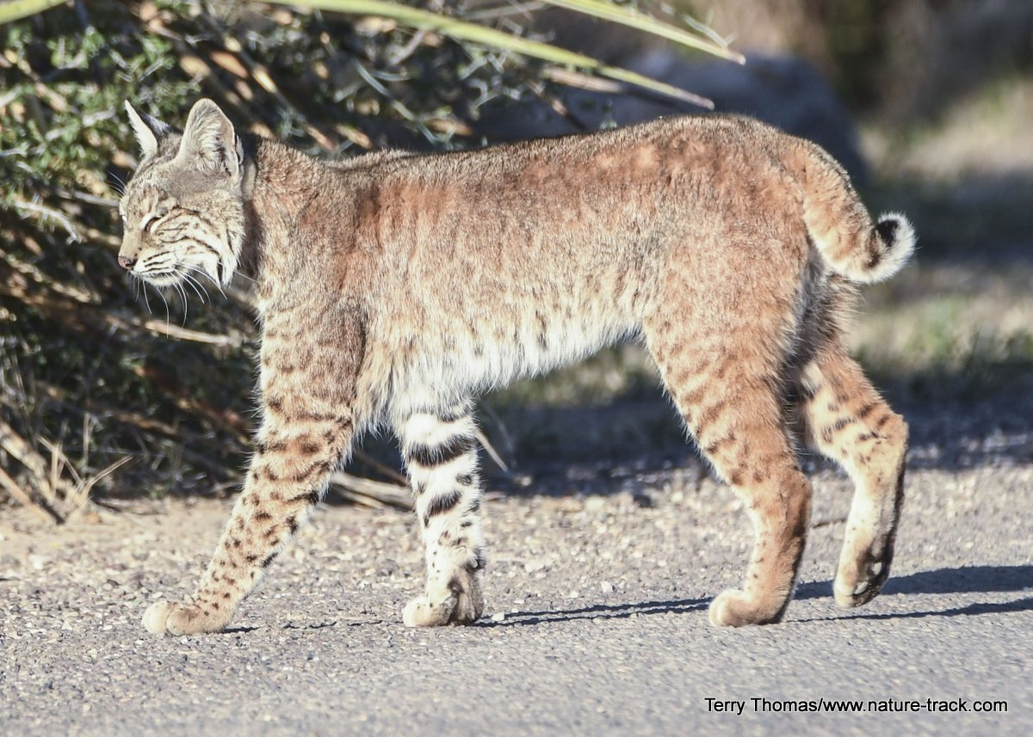
Methods
Captured 9 bobcats and fitted GPS collars for 12 months
Landscape metrics at 10 scales
Edge and patch density
Distance to woody vegetation, herbaceous cover, bodies of water, and energy infrastructure

Slide 19
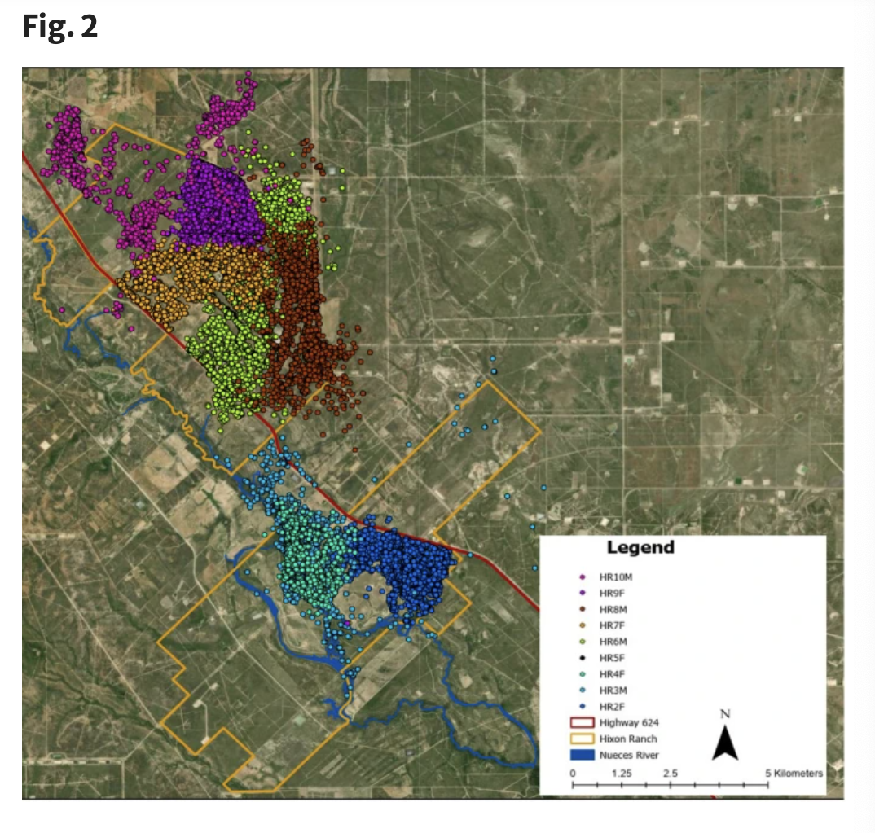

Slide 20
Results
Scale of effect of patch density and edge density of woody vegetation was 30 m –finest scale
Bobcats selected for woody vegetation and locations close to water
Avoided herbaceous vegetation and energy infrastructure

Slide 22
Discussion/Conclusions
Woody vegetation had finest scale effect – potential perception of hunting efficiency and prey availability within woody patches
Avoided herbaceous area and interspersed areas
Aggregation of patches of similar vegetation can improve connectivity
Select areas near water for themselves and potential prey

Slide 23
References
Movement models and simulation reveal highway impacts and mitigation opportunities for a metapopulation-distributed species
Aiello et al., 2023
Scale of effect of landscape patterns on resource selection by bobcats (Lynx rufus) in a multi-use rangeland system
Branney et al., 2024

