Slide 1
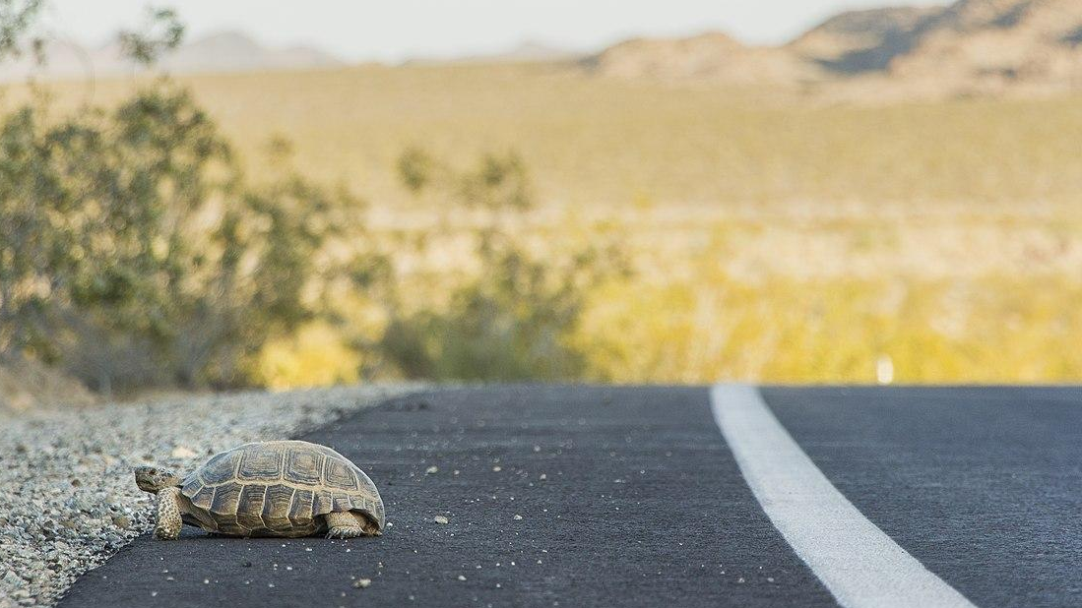
A Tale of Two Tortoises: Patch Connectivity and the Effects of Distance
Madison Bigham
Mojave desert tortoise (Gopherus agassizii) crossing the road (Source: NPS/Brad Sutton Public Domain)
Notes:
hello + welcome

Slide 2
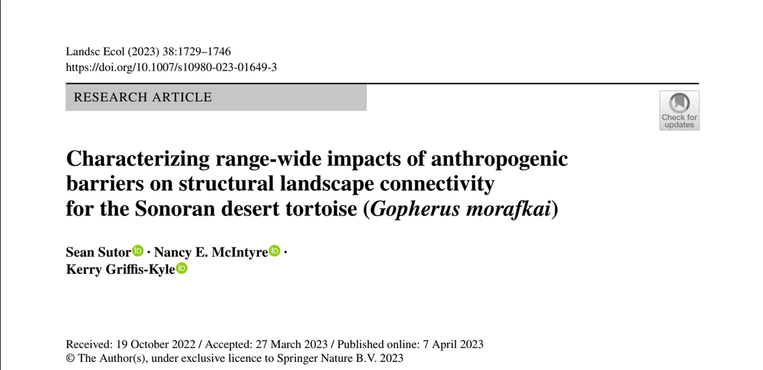
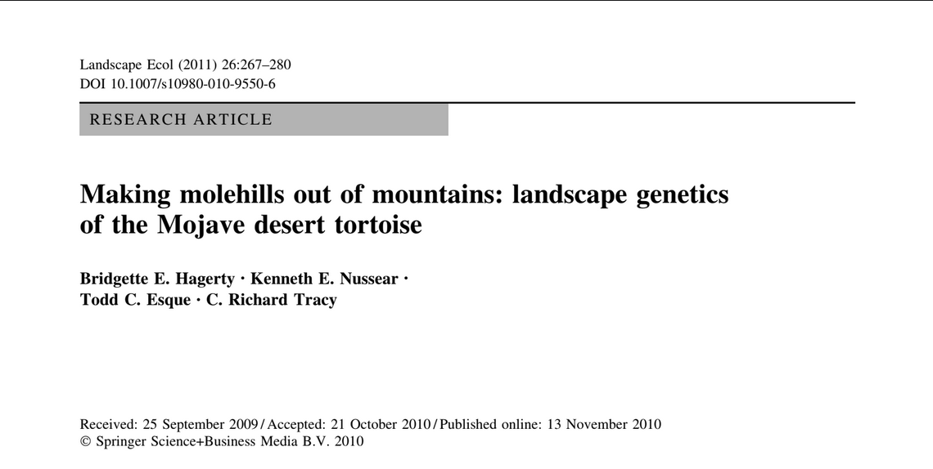
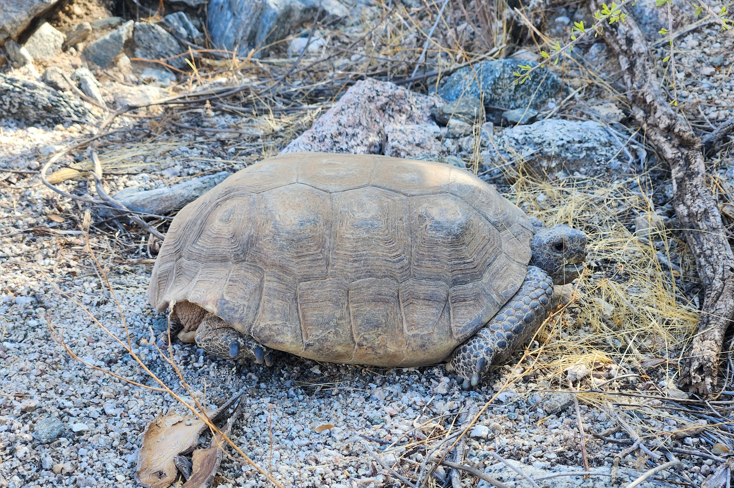
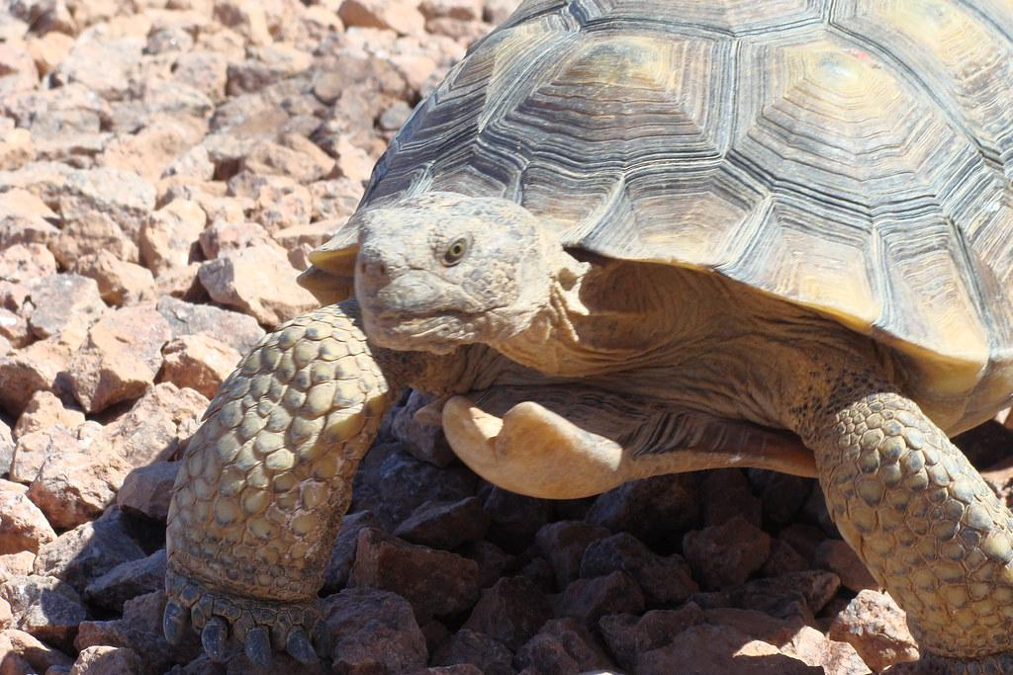
Paper Selection
Structural connectivity
Functional connectivity
Sonoran desert tortoise (Source: Me)
Mojave desert tortoise (Source: USFWS CC-BY-2.0)

Slide 3
Paper 1: Characterizing range‐wide impacts of anthropogenic
barriers on structural landscape connectivity
for the Sonoran desert tortoise (Gopherus morafkai)
Sean Sutor, Nancy E. McIntyre,
Kerry Grifs‐Kyle

Slide 4
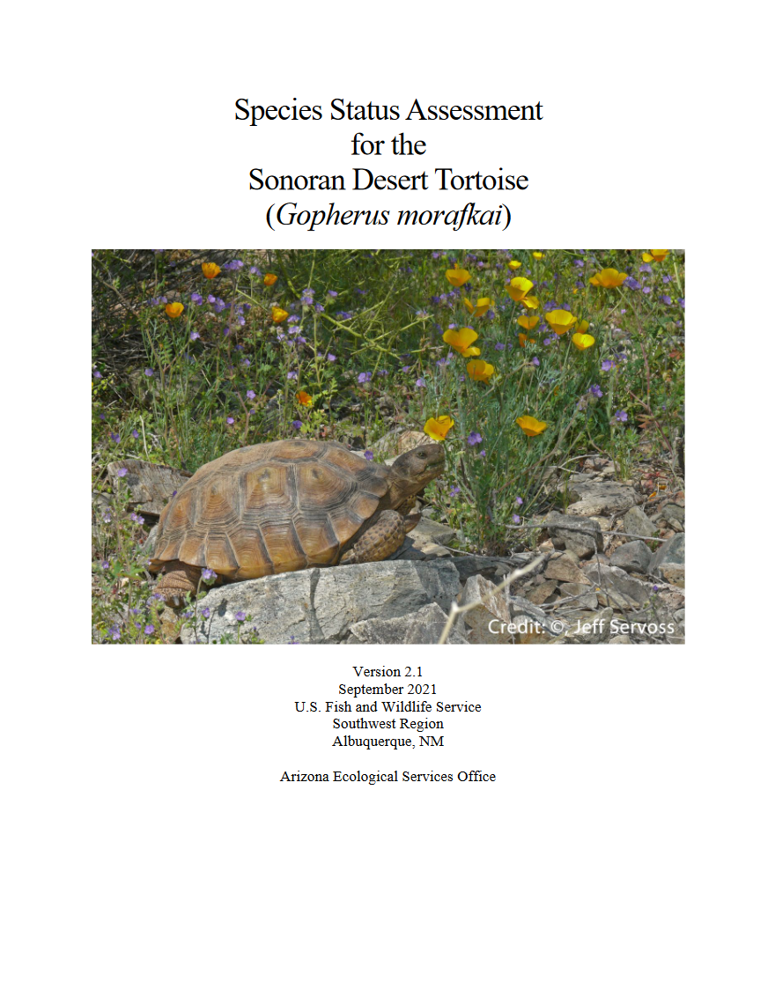
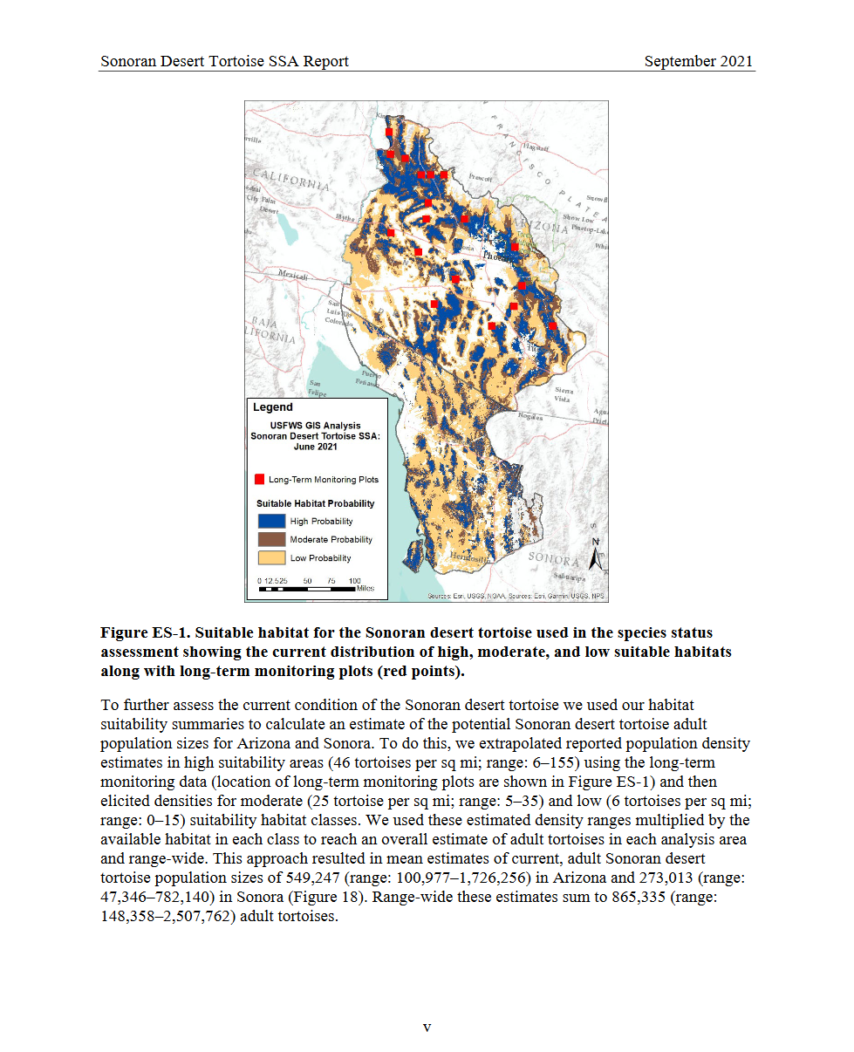
Context
Sonoran desert tortoises are state protected; they are vulnerable but not warranted for ESA listing
Long lived with presumed generational dispersal
Little genetic structuring
Threats include fragmentation, habitat loss
(USFWS 2021)
Notes:
To begin, I wanted to provide some background information that was used to inform this paper. SDT’s are a species of greatest conservation concern for the state of Arizona, but in 2021 they were found to be not warranted for ESA protections. This process resulted in an assessment which included a detailed habitat suitability map through the SDT entire range. This model is what the authors used in this paper.
Other information of note include the SDT life history. They are long lived (60+ years) but do not move too much once they are an adult (~20), making juveniles the main mechanisms for dispersal.
They also do not have genetic structuring, meaning that they were once historically connected, but now face threats of habitat loss, degradation, and fragmentation, among others. Specifically there is a lot of linear barriers throughout their range.

Slide 5
Objectives and Research Questions
Understand how linear barriers may affect isolation of habitat patches and populations.
What are the individual and combined impacts of barriers on structural landscape connectivity between tortoise habitat patches throughout the species range?
How does structural connectivity and the impact of barriers change at different spatial scales?
Which habitat patches are important for maintaining connectivity in the existing landscape?
Notes:
So the speakers sought to understand how these linear barriers may affect isolation of habitat patches for the SDT. Specifically, they wanted to know how they impact landscape connectivity of patches across scales and identify important patches for maintaining connectivity.

Slide 6
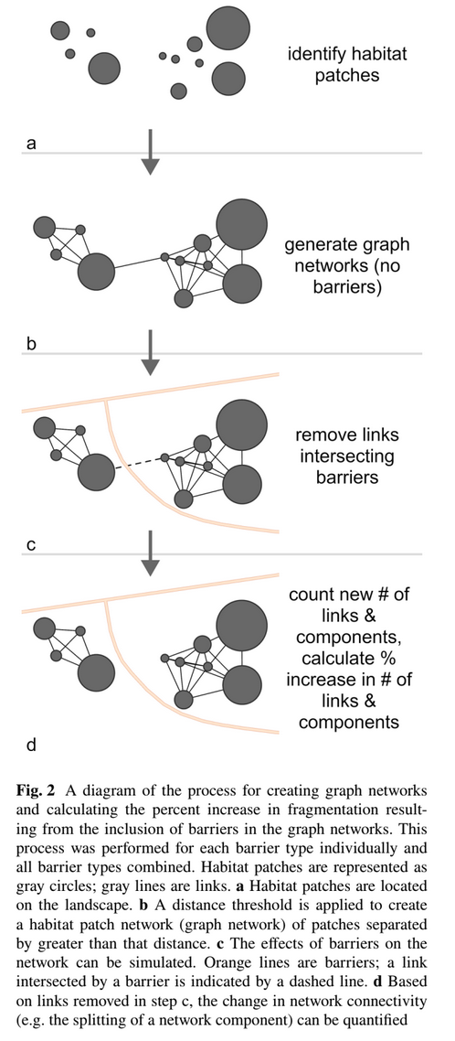
Methods
Collected data
Habitat data from the habitat suitability model (USFWS 2021)
Open-sourced data for highways, railroads, canals, and border wall
Applied graph theory (Conefor 2.6)
1 km distance threshold start to 35 km
Calculated connectivity indices (patch importance)
Betweenness Centrality (BC)
Relative integral index of connectivity (dIIC)
Notes:
To do that, they used the habitat suitability models generated by USFWS and combined the high and moderate habitat quality areas to designate as habitat patches. They also used available shapefiles of highways, railroads, canals, and the border wall to present the potential linear barriers on the ground.
They then applied graph theory, which was talked about in the assigned reading from last week, but I prefer the authors demonstration better. Essentially, they used the patches and identified linked between those nodes, then removed any links that were bisected by linear barriers. They used varies distances from 1 km to 35 km which are based on the average distance a tortoise will travel (1 km) to the maximum recorded distance (32km)
(least-cost pathways to be evaluated for their contribution to the configuration of the overall network.)
They also calculated two indices. BC quantifies the importance of each patch based on its position in the network and the number of shortest paths through the network that intersect that patch
dIIC incorporates connectivity occurring within and between each patch when quantifying patch importance. unlike BC, index values are not based on node topology alone. takes patch area into account

Slide 7
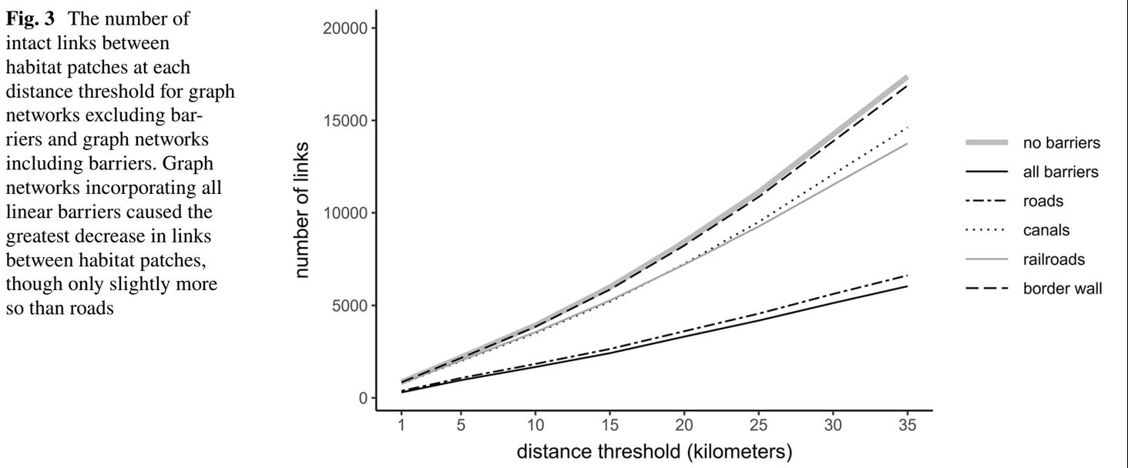
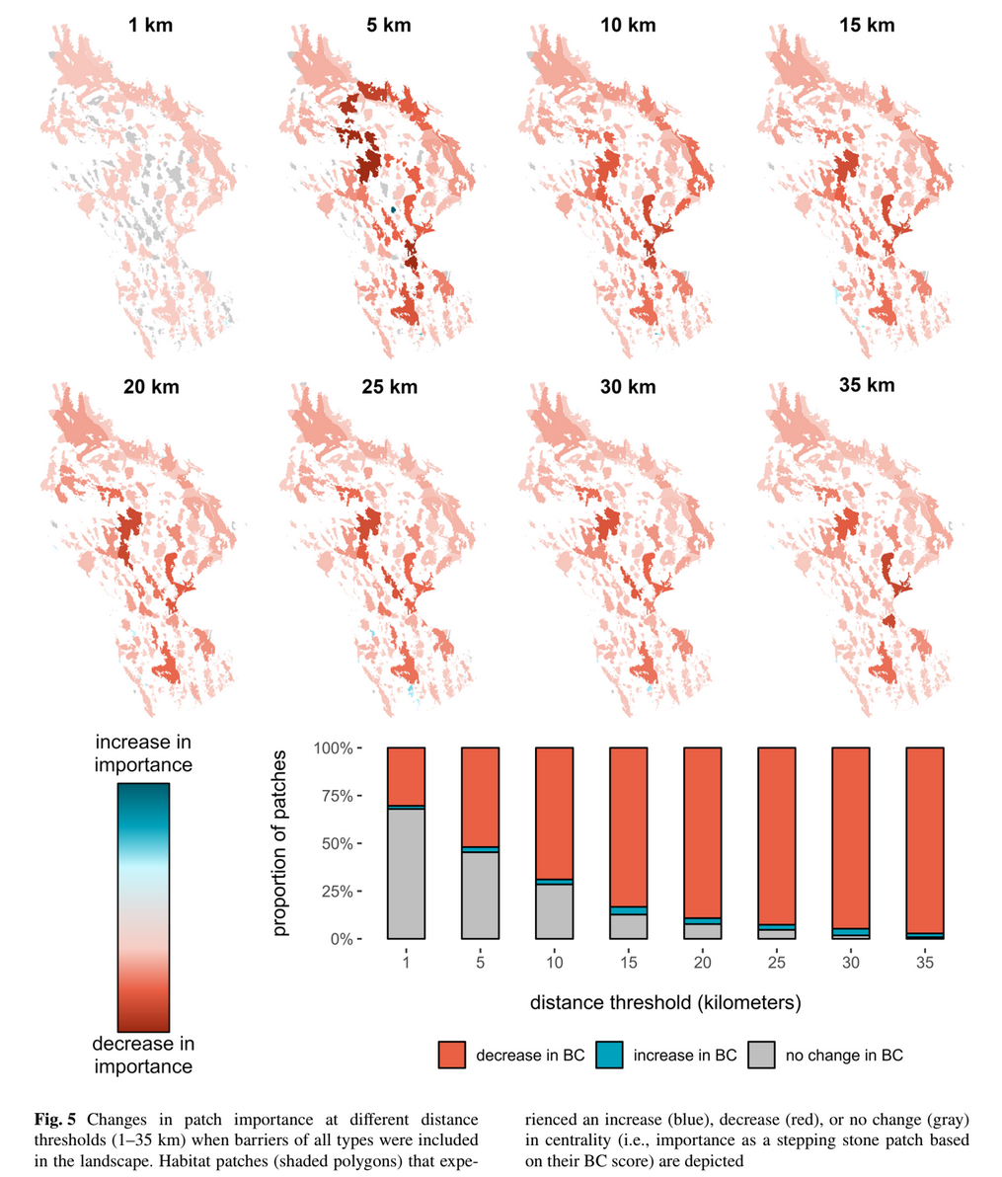
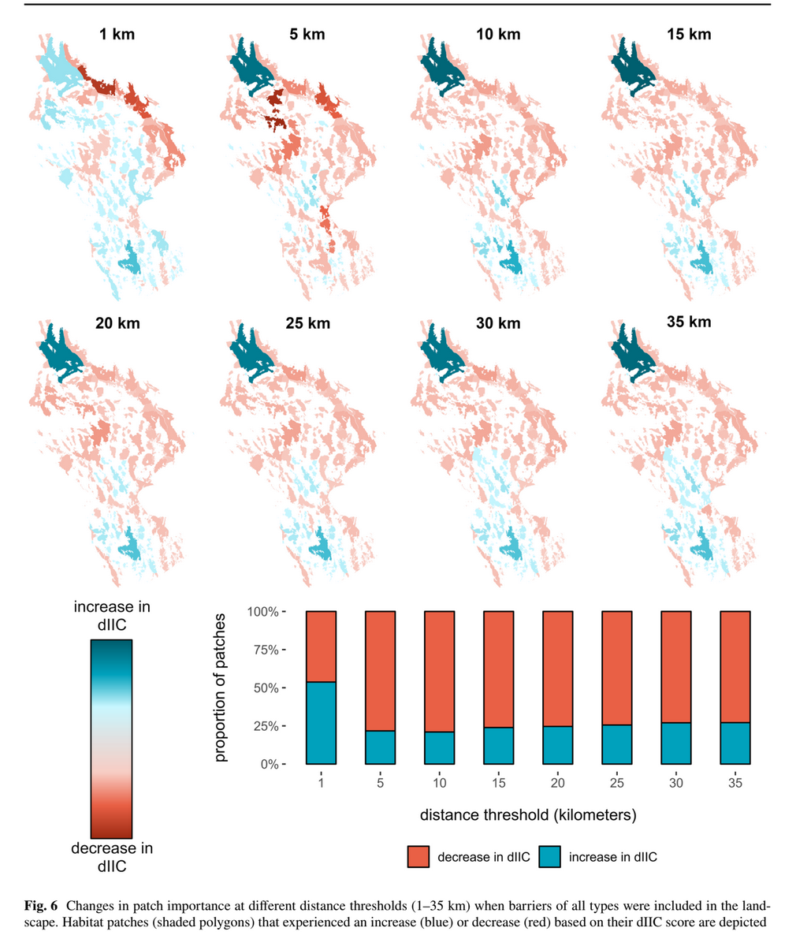
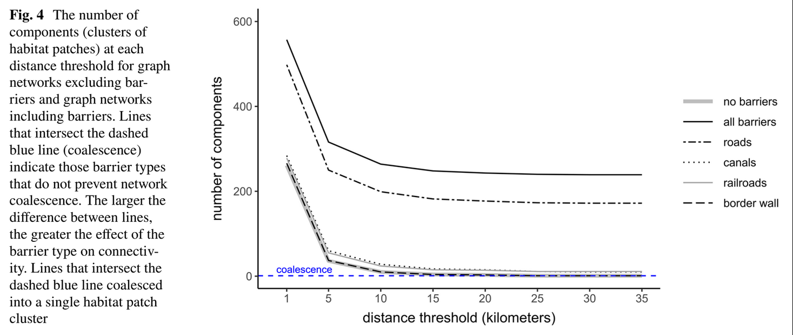
Results
Barriers impact the number of links available (Fig 3)
Barriers disrupt patch coalescence (Fig 4) - e.g. fragments habitat
Roads impacting most*
Border wall impacting least*
BC mostly decreased with barriers
1 km - mix of decrease and increase in dIIC with barriers
5 km and above - large percent decrease in dIIC with barriers

Slide 8
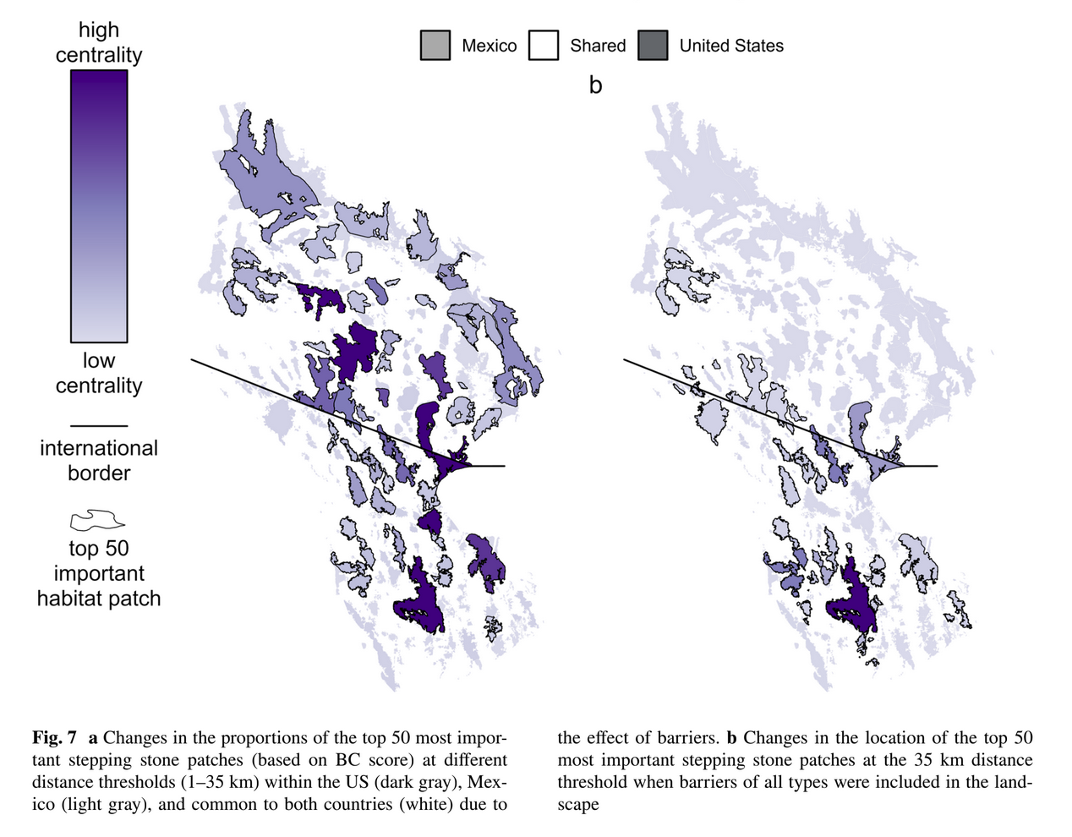
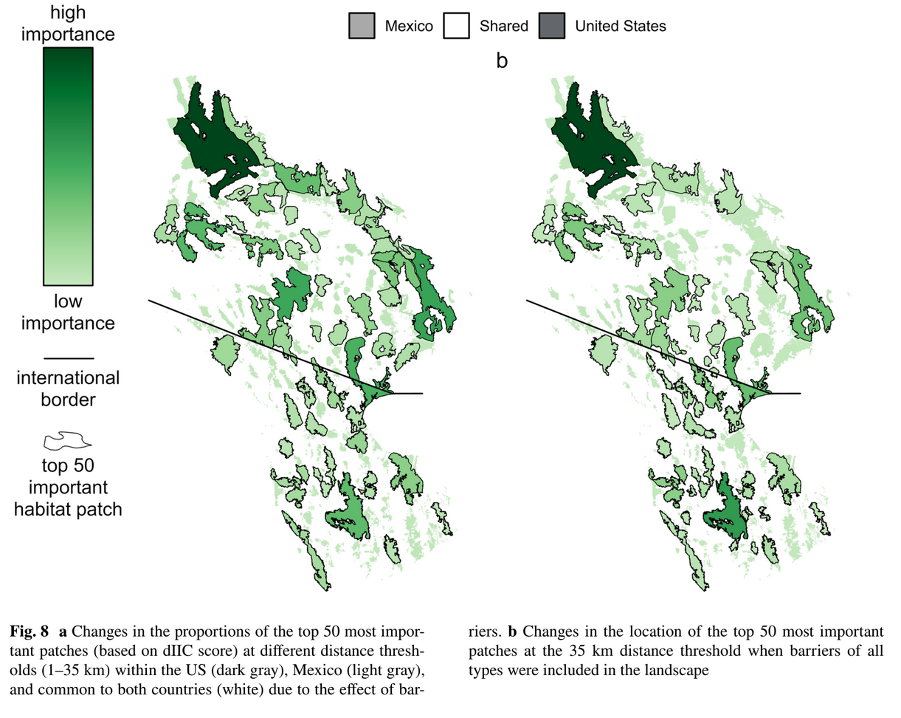
Conclusions
Linear barriers may be reducing structural connectivity
Varies from barrier type - likely due to prevalence on landscape
Indexes meaning
Decreased in BC = patches that were once important stepping stones
Increased in dIIC = important for dispersing individuals or accepting immigration
Long-distance movements likely impossible - implications for genetics
Management actions that focus on patches separated by as little as 5 km could go a long way toward improving connectivity

Slide 9
Paper 2: Making molehills out of mountains: landscape genetics
of the Mojave desert tortoise
Bridgette E. Hagerty, Kenneth E. Nussear,
Todd C. Esque, C. Richard Tracy

Slide 10
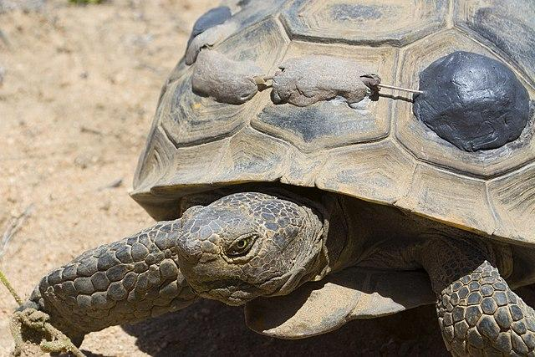
Context
Mojave desert tortoises listed under the ESA as threatened
Regular monitoring including blood tests
Threats include disease, habitat loss, fragmentation
Mojave desert tortoise (Source: NPS/Hannah Schwalbe Public Domain)

Slide 11
Objectives and Research Questions
Understand landscape connectivity and evaluate isolation for the Mojave desert tortoise
How does (1) geographic
distance, (2) dispersal barriers, and (3) landscape
friction affect isolation?
What can genetic tests tell us about Mojave desert tortoise dispersal and connectivity?
Notes:
This paper sought to understand the landscape connectivity by way of using genetics. They wanted to see if geographic distance, barriers, and landscape friction affected isolation.

Slide 12
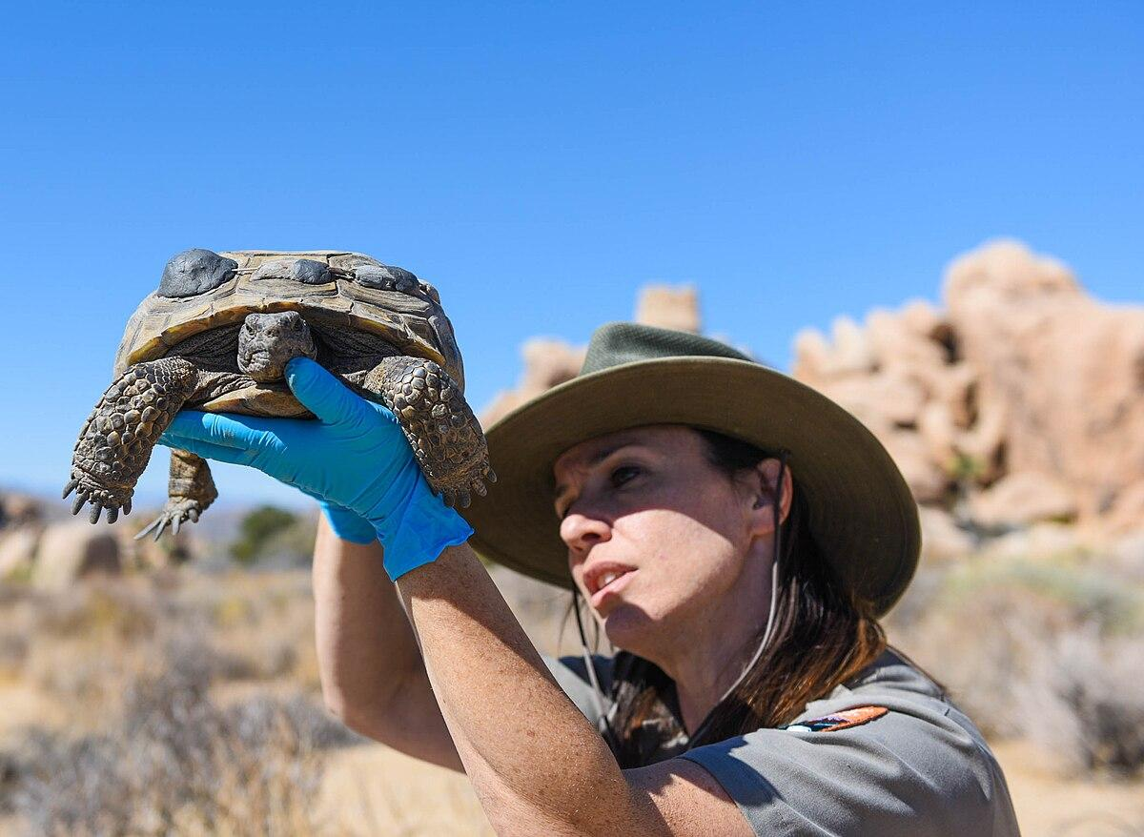
Methods
Data collection
Genetic samples from 744 tortoises
Modeled habitat suitability
Presence data and environmental features
Computed least-cost path (landscape friction)
Computed isolation-by-resistance (Circuitscape; circuit theory)
Computed casual model framework & Mantel tests
Evaluate geographic distance, barriers, and landscape friction
Ranger looking at tortoise (Source: NPS/ Shay Spatz Public Domain)
Least-cost path analysis example (Rudnick et al 2012)
Notes:
Their methods were a bit more technical, statistical. They used the genetic samples required from USFWS, then they modeled habitat suitability similar to how it was done for the first paper. They used the least-cost path, which was in the paper from last week, as shown here, to understand the landscape friction. They also used a program to compute isolation by resistance, which is similar to least-cost path but resistance distance decreases as the number of available pathways between locations increases - similar to the graph theory from earlier. They also used some models and statistical tests to understand the relationship between genetic distance
and each of these factors: geographic distance, barriers, and landscape friction.

Slide 13
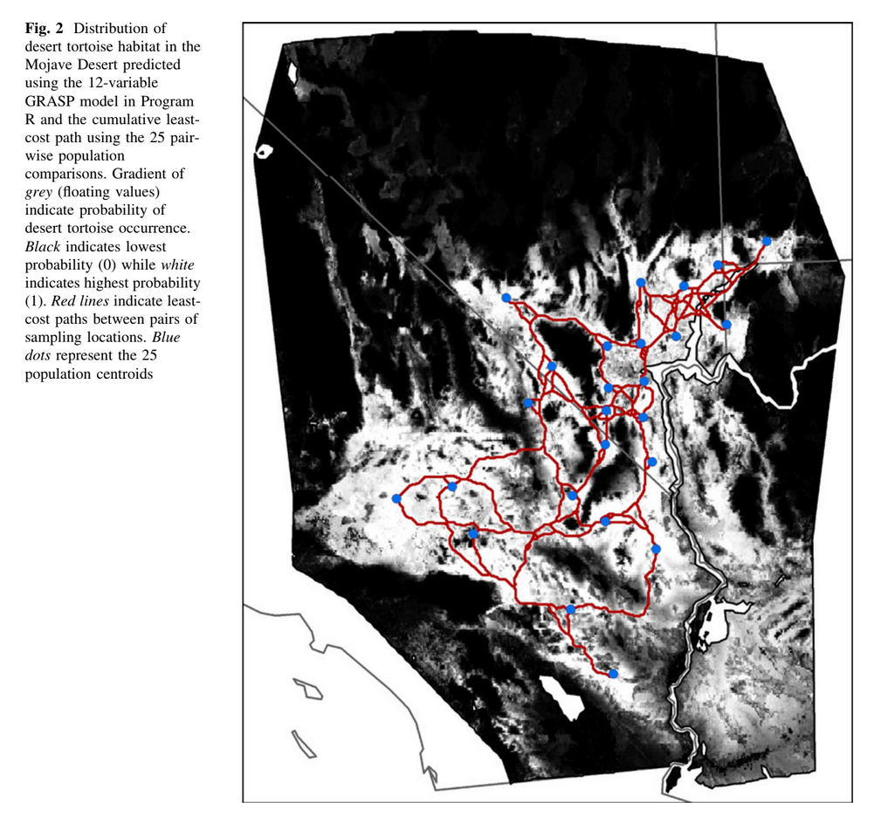
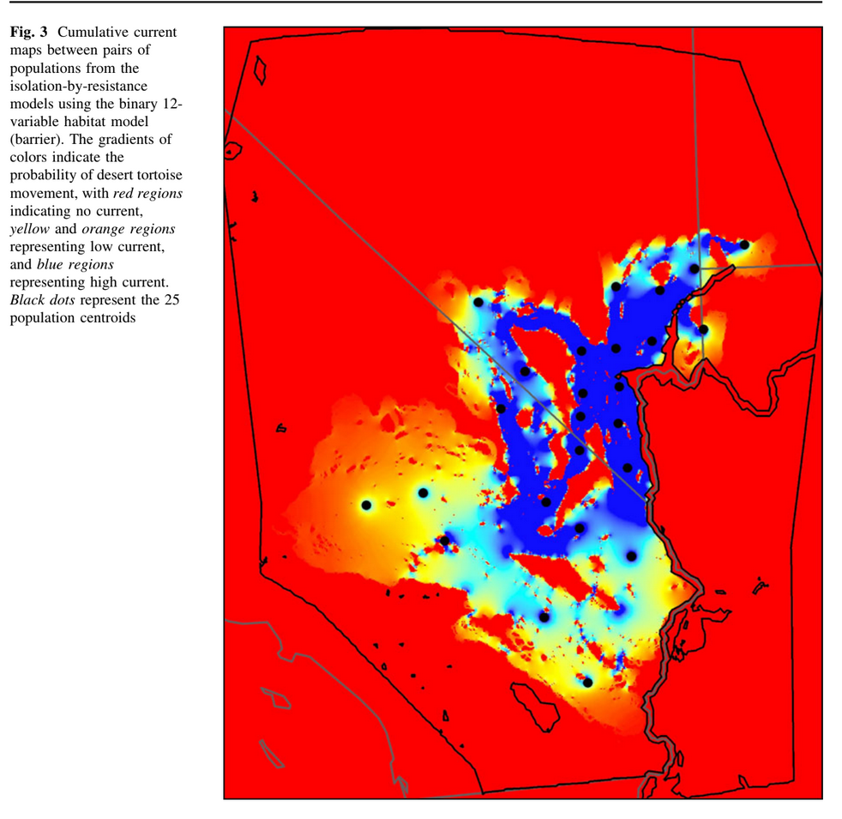
Results
Euclidean distance correlated significantly with pairwise genetic distance (divergence)
Least-cost distances and resistance distances for the landscape-friction and barrier models were correlated significantly with genetic distances
Mountain ranges and extremely low-elevation valleys influence connectivity at the regional scale
Habitat model
Movement model
Notes:
In the first model here (left) we see the habitat in a white (habitat) to black (not habitat) gradient with population (blue dots) and least cost pathways.
In the second model, we see the probability of tortoise movement (blue high current and red low) based on isolation by resistant models.
They also included some statistical tables but the general understanding was that euclidean distance correlated with genetic distance. Least cost and resistance distance for friction and barrier models correlated with genetic distance, which in this case was mountain ranges and extremely low elevation valleys

Slide 14
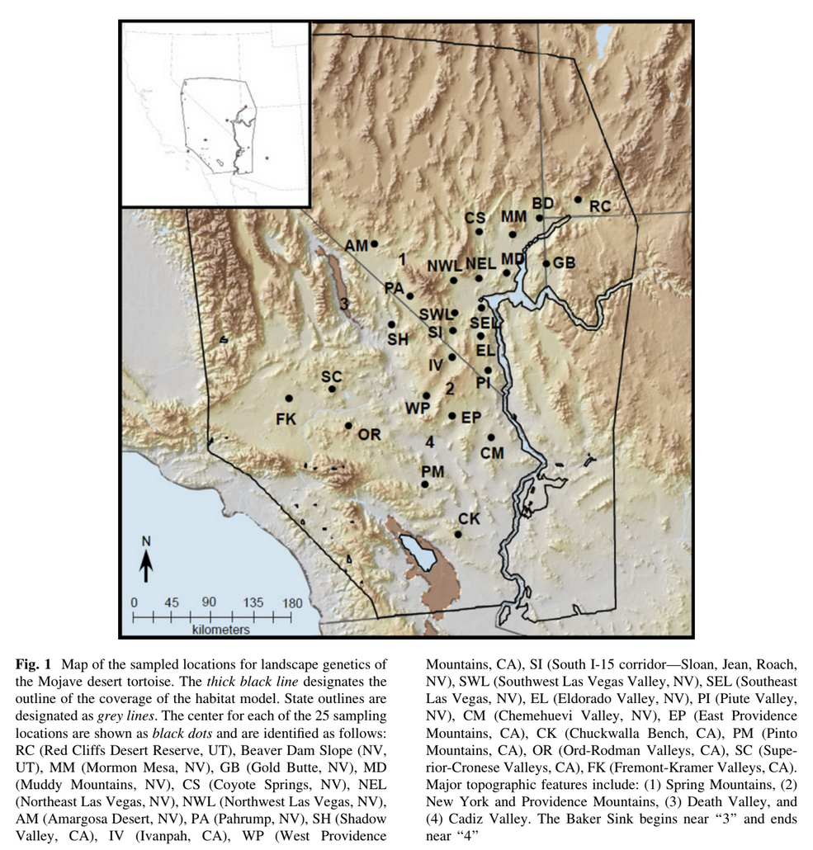
Conclusions
Geographic distance and dispersal barriers are dominant factors associated with genetic structure
Dispersal distance shaping genetic structure
Landscape friction had little to no little influence.
Study limitations may be influencing results
Not enough factors incorporated? Isolation-by-distance masking friction?
Habitat within the Mojave population of the desert tortoise was well connected
Historically - cannot address current barriers
Notes:
So what does that mean? It means that genetic distances amongst tortoises were well explained with geographic distance and barriers, and not so much with just landscape friction. although this could be because their models may not have included as many landscape factors that are important to tortoises, or perhaps because other variances are masking isolation by distance.
And in general, the Mojave desert tortoise once had well connected habitat based on their genetic structuring. Because developments in the area are so new, it’s hard to address any current changes against their genetic composition (life span and all that).
This is just another photo of the populations they looked at, similar to the previous models.

Slide 15
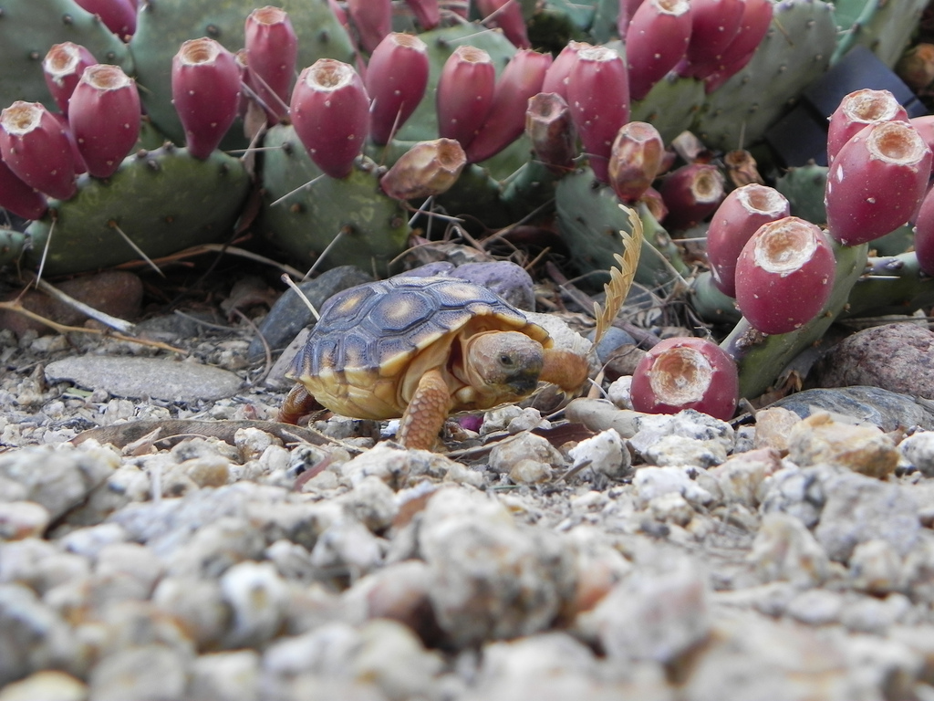
Discussion Questions
Remember: What is graph theory?
Apply: What research topic(s) from Wu and Hobbs 2002 or Wu 2013 align with these papers?
Evaluate: Are there any topics from the class that could have been incorporated into these studies to better answer their intended questions?
Baby Sonoran desert tortoise (Source: USFWS Public Domain)
Notes:
Graph theory = modeling uses centers, or “nodes,” of these patches as points of connection and the connections between these patches- the linear representations of which are described in graph theory language as “edges.” Once identified, nodes and edges can be prioritized based on their overall contribution to the landscape network.
Potential answers…
Integrating humans and their activities into landscape ecology
relating landscape metrics to ecological processes
landscape history and legacy effects
landscape sustainability
Maybe using other metrics like patch interaction index.

Slide 16
Questions?
Thank you!
Mojave desert tortoise (Gopherus agassizii) crossing the road (Source: NPS/Brad Sutton Public Domain)

Slide 17
References
Hagerty, B. E., K.E. Nussear, T.C. Esque, and C.R. Tracy. 2011. Making molehills out of mountains: landscape genetics of the Mojave desert tortoise. Landscape Ecology 26: 267-280.
Rudnick, D. A., S. J. Ryan, P. Beier, … and S. C. Trombulak. 2012. The Role of Landscape Connectivity in Planning and Implementing Conservation and Restoration Priorities. Issues in Ecology 16. Ecological Society of America.
Sutor, S., N.E. McIntyre, and K. Griffis-Kyle. 2023. Characterizing range-wide impacts of anthropogenic barriers on structural landscape connectivity for the Sonoran desert tortoise (Gopherus morafkai). Landscape Ecology 38: 1729-1746.
USFWS. 2021. Species Status Assessment for the Sonoran Desert Tortoise (Gopherus morafkai). U.S. Fish and Wildlife Service. Albuquerque, New Mexico.

