Slide 1
Green Infrastructure for Ecological Connectivity and Ecosystem Services
Brittany Blake

Slide 2
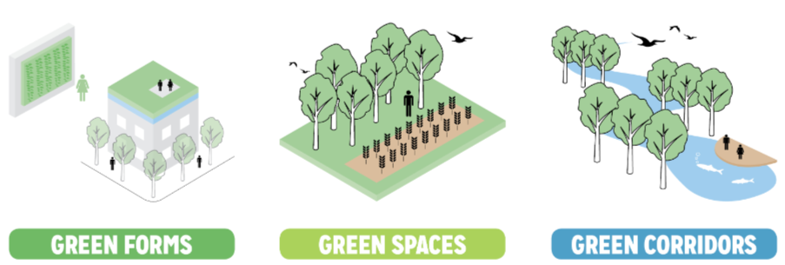
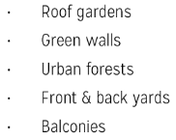
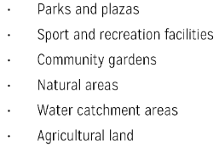
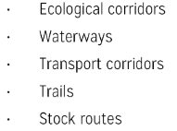
Green Infrastructure (GI):
“A strategically planned network of high-quality natural and semi-natural areas, designed and managed to provide the greatest amount of ecosystem services and protect biodiversity, both in rural and urban settlements” (European Commission, 2013).
Notes:
GI = a network of green areas in and around cities
Designed to provide multiple environmental & social benefits
Forms, spaces, corridors
Versus “grey infrastructure” = human-engineered structures that serve a single purpose, such as roads, dams, pipes, etc.

Slide 3
Primary Goals of GI
Ecological connectivity
Maintain ecological networks for the movement of species and gene flow
Provision of ecosystem services
Enhance ecosystem function to protect ES supply for human well-being
Benefits for people and wildlife
European Commission’s Biodiversity Strategy for 2030: Restore at least 15% of degraded ecosystems through the integration of a GI in territorial planning
Notes:
Ecological connectivity for movement of species & their genes
ES: benefits humans gain from ecosystems: clean air/water, pollination of crops, flood control, etc.
GI benefits both people & wildlife
Both case studies take place in Europe

Slide 4
Case Study #1:
Identifying a green infrastructure to prioritise areas for restoration to enhance the landscape connectivity and the provision of ecosystem services Ortega et al. 2023

Slide 5
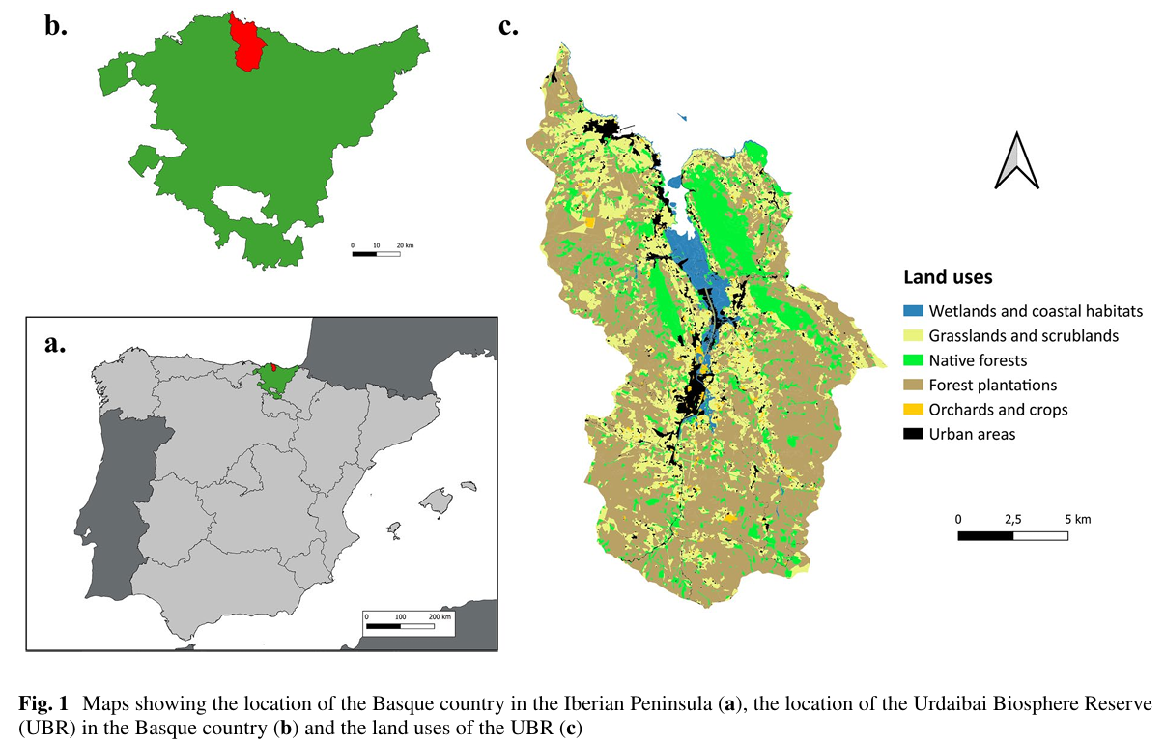
Introduction
Study area: Urdaibai Biosphere Reserve in Spain
Native forests highly fragmented by forest plantations of exotic species
Objective = Identify priority areas for restoration using two approaches…

Slide 6
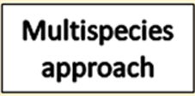
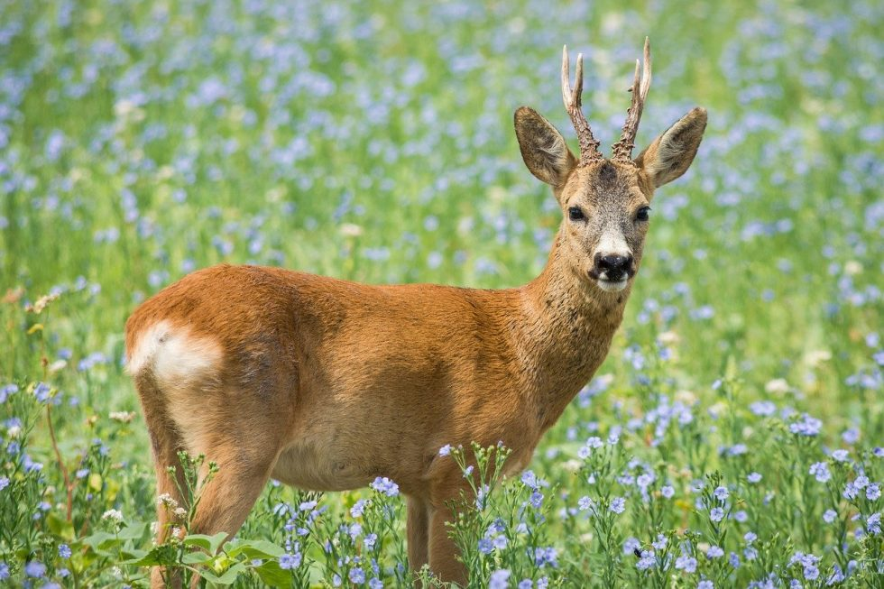
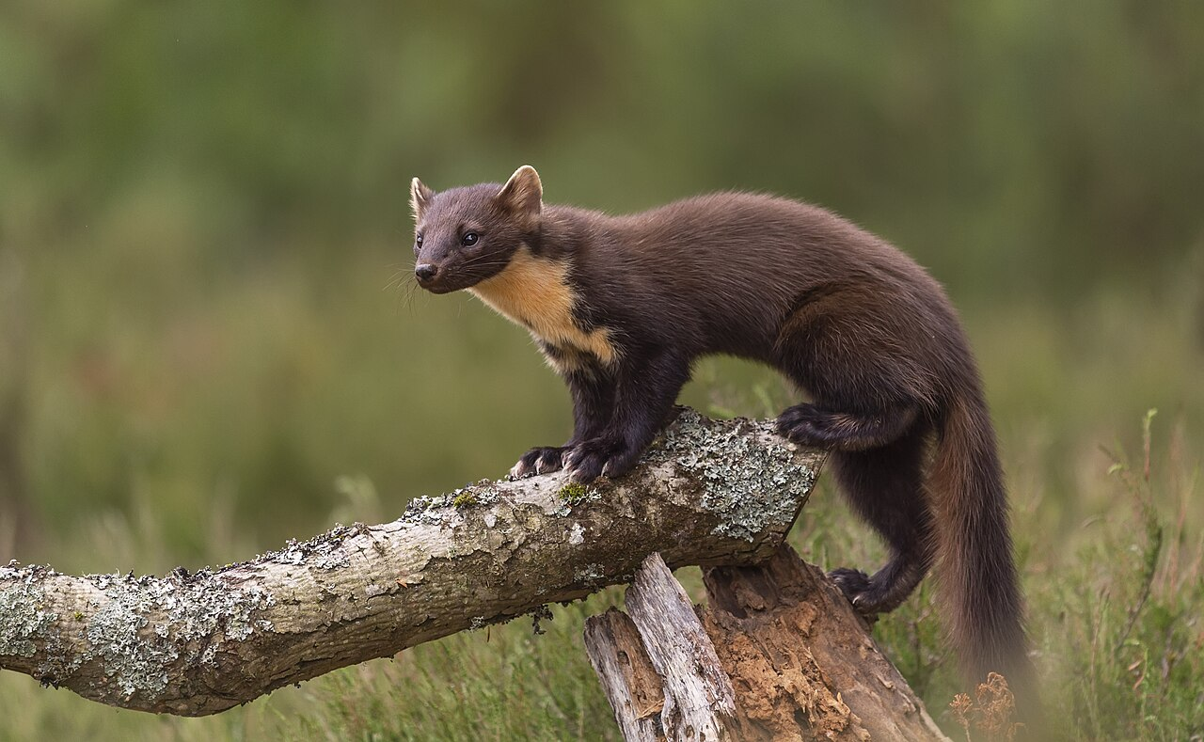
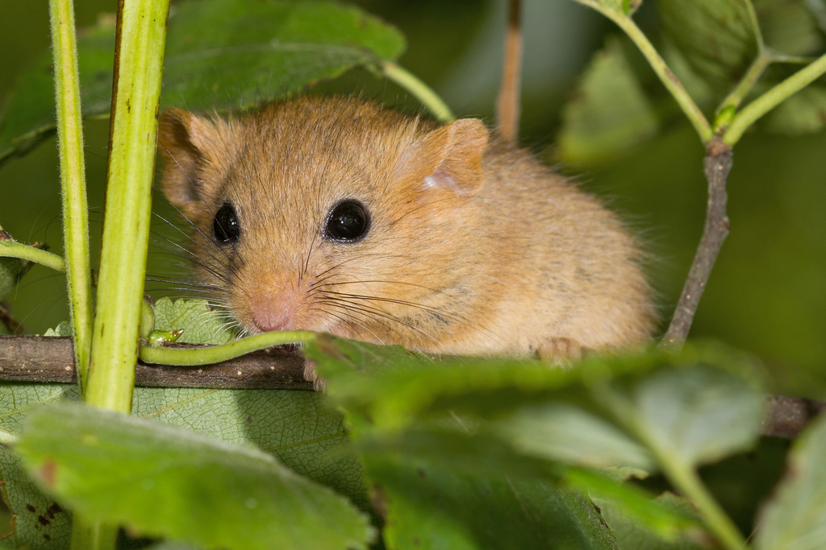
3 key species:
Roe deer - large mammal, max dispersal 100 km
Pine marten - meso mammal, max dispersal 30 km
Edible dormouse - small mammal, max dispersal 10 km
Core areas = Native forest areas > 20 ha where all 3 species coexist

Slide 7
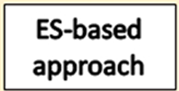
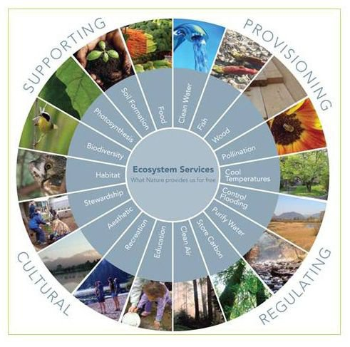
7 of the area’s most important ecosystem services:
Water flow regulation
Pollination
Air quality regulation
Climate regulation
Habitat maintenance
Maintenance of soil fertility
Fire control services
Core areas = multifunctional areas > 20 ha

Slide 8
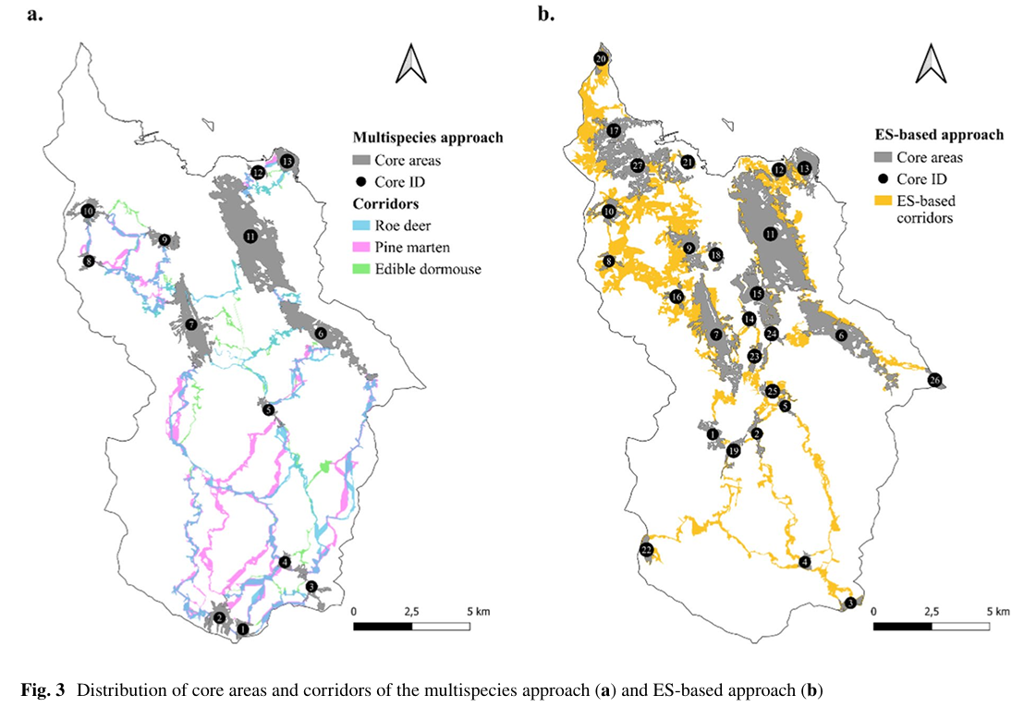
Analysis
Identified corridors by performing a connectivity analysis with Linkage Mapper in ArcMap
Least-cost path method
Circuit theory
Assigned resistance values
MS Approach: barriers to species movement + light and noise pollution
ES Approach: number of ES supported (multifunctionality)
Notes:
This program outlines least cumulative cost pathways for species movement and ultimately creates least cost corridors between core areas.
Circuit theory – used to indicate relative importance of each pathway
MS approach resistance values – difficulty experienced by species in moving across landscape, inc. things like light & noise pollution
ES-based approach RV – correlated w/ multifunctionality of landscape; fewer ES supported = higher RV

Slide 9
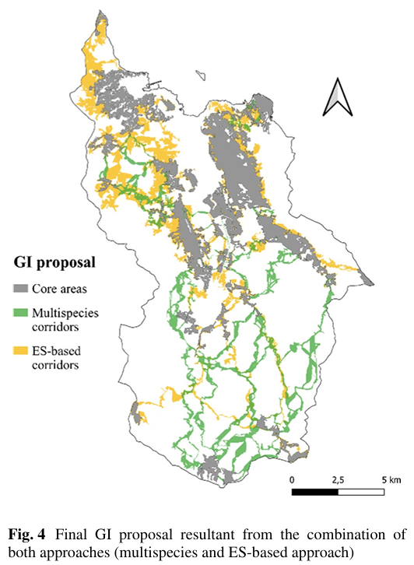
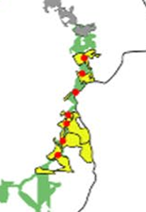
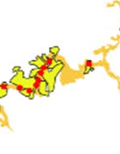
Results
Multispecies and ES-based networks combined into a single network
Core areas and corridors of both networks maintained = 36% of total area of RBU
Identified and ranked “pinch points” = areas where connectivity is particularly vulnerable

Slide 10
Case Study #2: Mapping green infrastructure based on ecosystem services and ecological networks Liquete et al. 2015

Slide 11
Introduction & Methods
Continental scale: European Union
Used indicators/proxies (ex. water infiltration, nitrogen retention efficiency) to map the EU’s natural capacity to deliver 8 key ES
Chose large mammals as focal group for habitat modeling → large home ranges/migration distances are appropriate for large scale study
Core areas: based on field studies and/or models
Potential corridors: identified with connectivity analysis (Linkage Mapper) + interpretation by experts

Slide 12
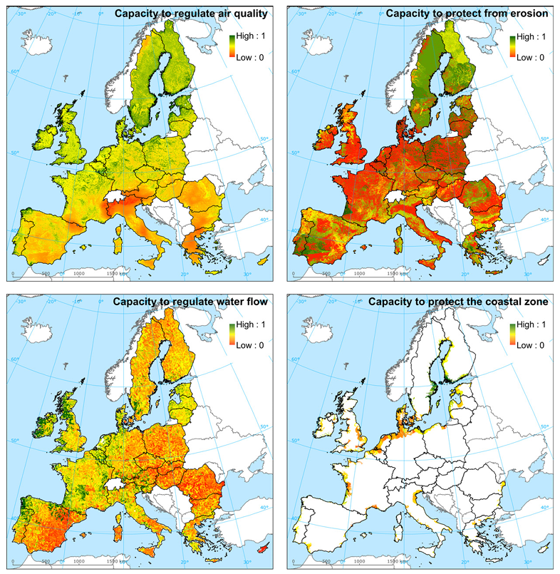
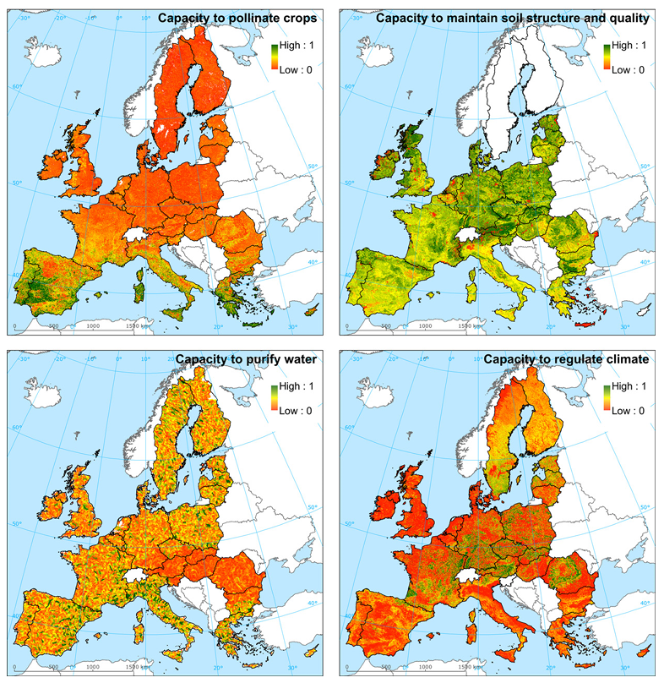
Natural capacity to deliver ES across Europe

Slide 13
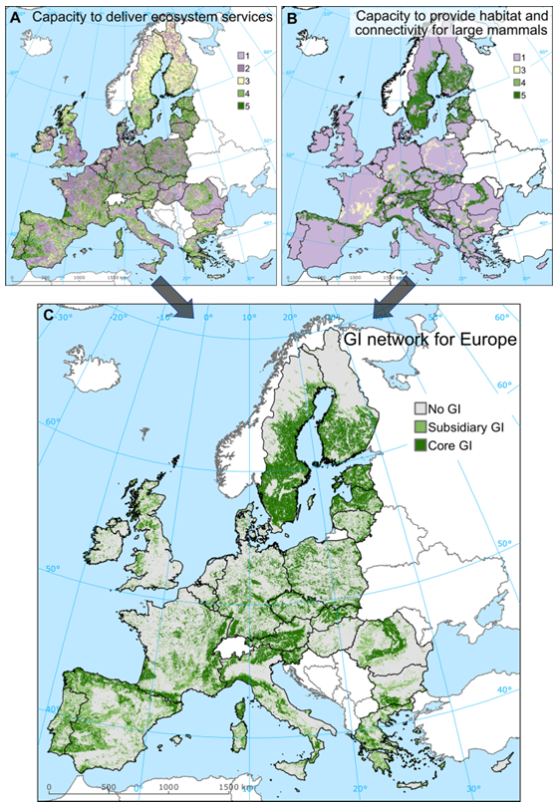
Analysis & Results
Made comparable using a ranking normalization method and integrated
Of EU-27 total territory:
Core = 23%
Subsidiary = 16%
Used to inform EU Biodiversity Strategy

Slide 14
Conclusions
GI requires cooperation of stakeholders at multiple levels – private, governmental, even international – but shows promise.
EU’s Nature Restoration Law of 2024 → incremental targets for 2030, 2040, 2050
GI implemented in urban planning, agriculture, and disaster risk reduction
Conservation funding is often limited, so identifying priority restoration areas is crucial.
The methodology used in these case studies can be replicated at other locations/scales.

Slide 15
References
Liquete, C., Kleeschulte, S., Dige, G., Maes, J., Grizzetti, B., Olah, B., & Zulian, G. (2015a). Mapping green infrastructure based on ecosystem services and ecological networks: A Pan-European case study. Environmental Science & Policy, 54, 268–280.
Ortega, U., Ametzaga-Arregi, I., Sertutxa, U., & Peña, L. (2023). Identifying a green infrastructure to prioritise areas for restoration to enhance the landscape connectivity and the provision of ecosystem services. Landscape Ecology, 38(12), 3751–3765.

