Slide 1
Connecting Landscapes: Predicting Wildlife-Vehicle Collisions and Modeling Corridors
Kathryn Dick
Landscape Ecology
October 23, 2024

Slide 2
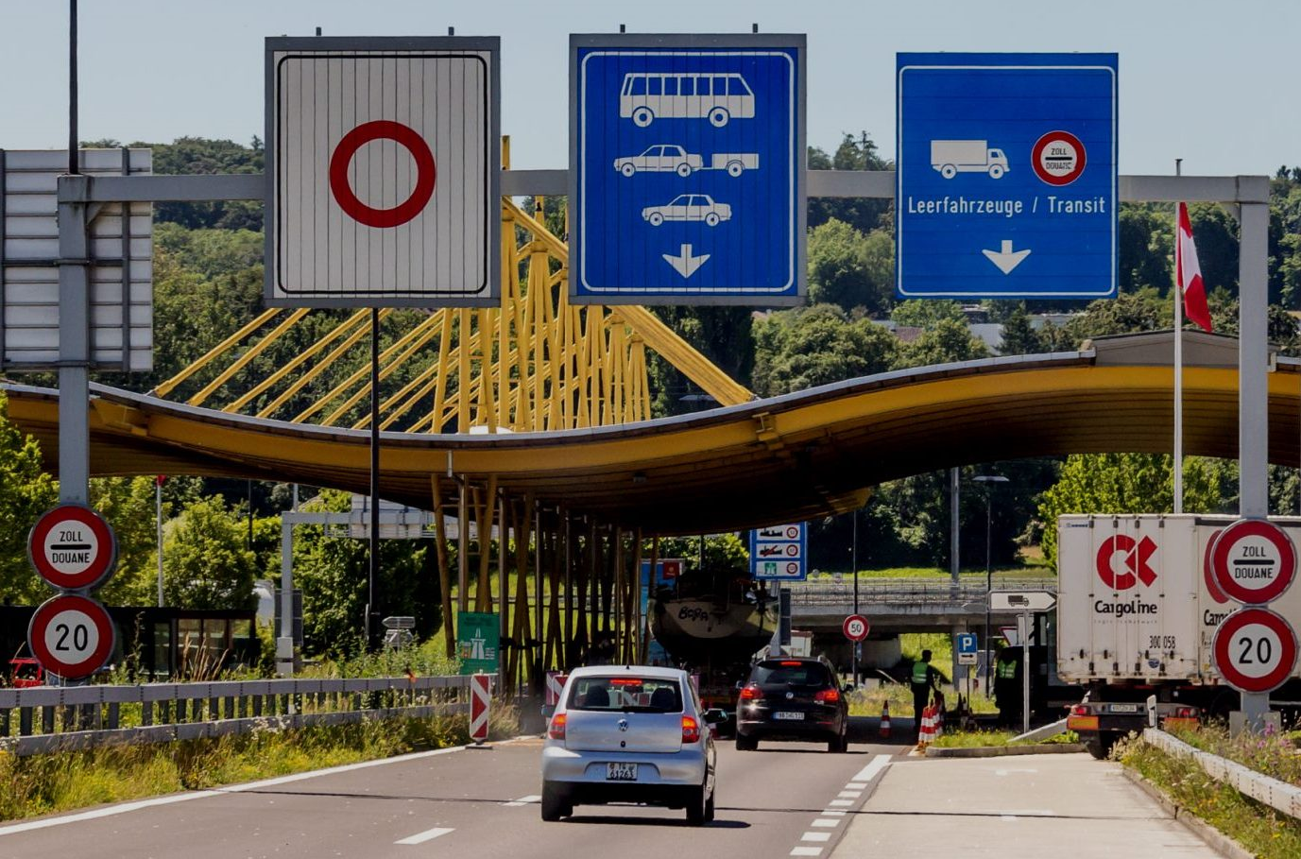
STUDY #1: Analyzing and predicting wildlife–vehicle collision hotspots for the Swiss road network
Laube, P., Ratnaweera, N., Wróbel, A. et al.

Slide 3
Wildlife–vehicle collisions:
threat for species
cause of financial loss
risk to motorist safety

Slide 4
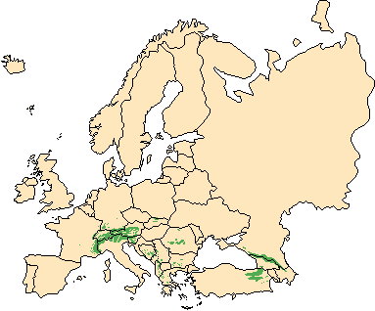
Objectives
Analyze spatial patterns of wildlife-vehicle collisions (WVCs) using Swiss regional data
Identify key environmental factors contributing to collision risk (road characteristics + proximity to wildlife habitats)
Develop predictive models for WVC risk at a national level
Provide insights for mitigation strategies to reduce WVCs and improve road safety

Slide 5
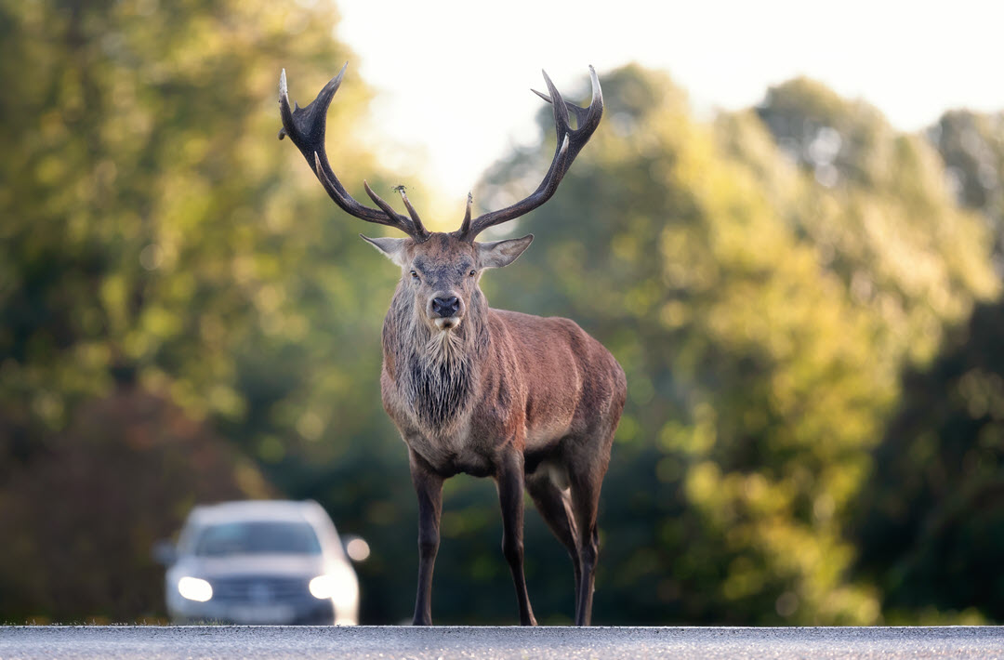
Research questions
What are the key predictors for WVC on Swiss roads and what are differences between the midlands and mountainous areas?
How well do environmental variables predict collision risk using regression models and machine learning?

Slide 6
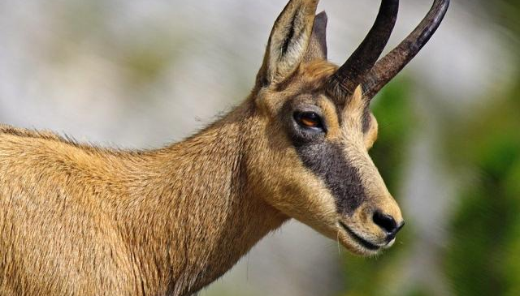
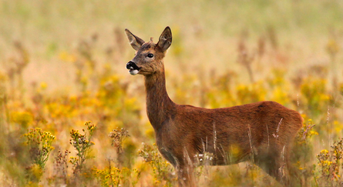

Slide 7
Methods
Analyzed 43,000 WVCs (roe deer, red deer, wild boar + chamois)
Study covered two landscape types: midlands and mountainous areas.
Compared two road segmentation approaches:
Fixed-length road segmentation (divided roads into equal-length segments)
Kernel Density Estimation (data-driven method to create segments based on density of collision records)

Slide 8
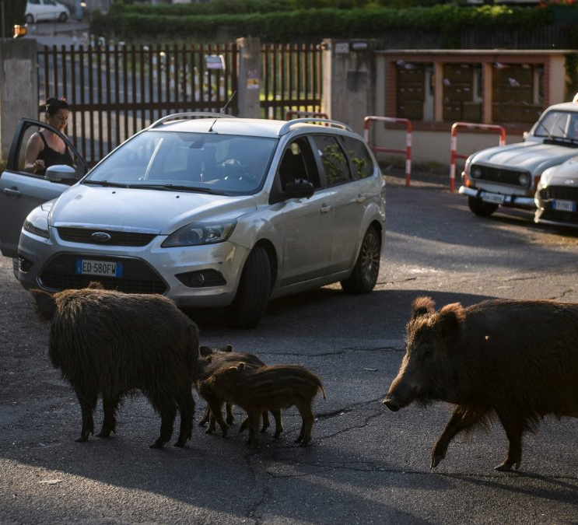
Methods
Found environmental characteristics of road segments from land-cover geodata using neighborhood operations (a spatial analysis technique)

Slide 9
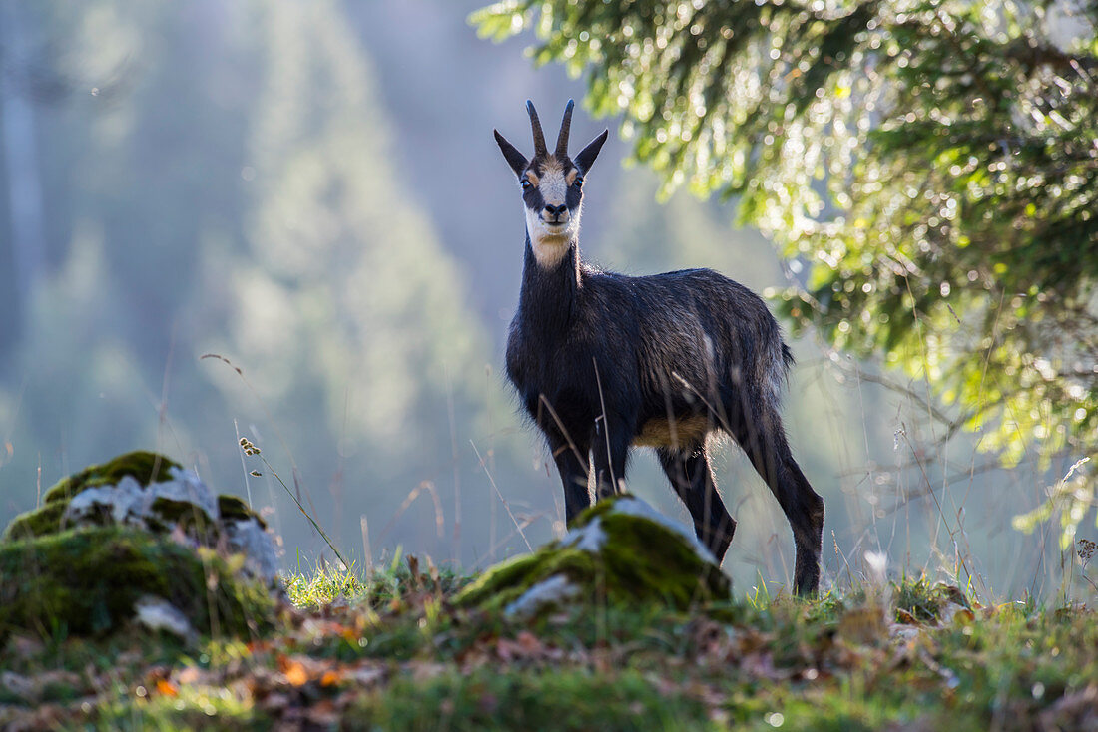
Used logistic regression and random forest classifiers:
Logistic regression (to ID environmental factors contributing to collision risk)
Random forest (to rank importance of these factors + predict collision risk in regions without WVC data)

Slide 10
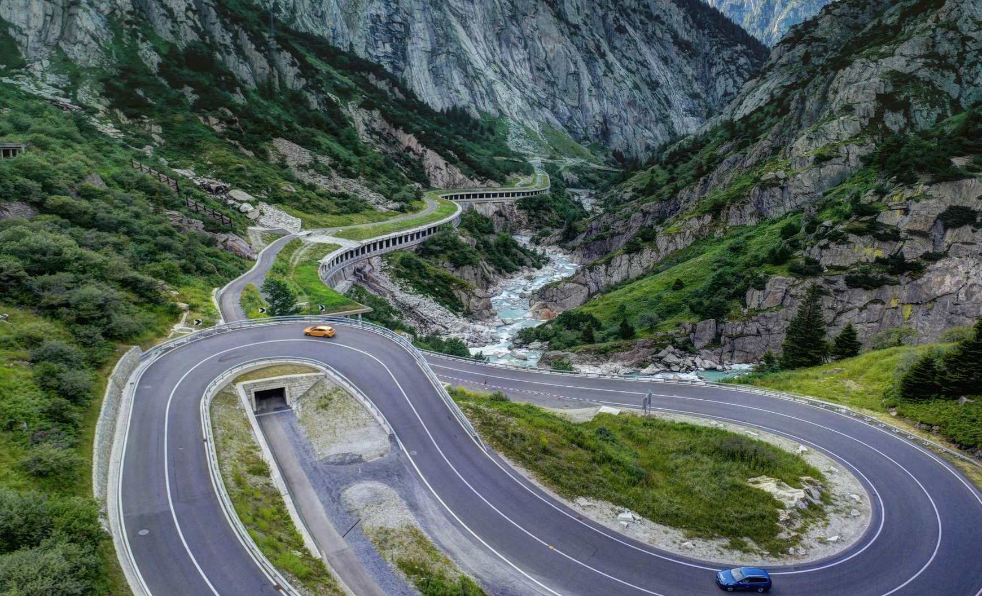
Top factors for WVC hotspots
Curviness of roads
Browsing + forage availability (vegetation near roads that attracts wildlife)
Traffic noise symbolizing traffic flow (higher noise correlating with higher traffic volume)

Slide 11
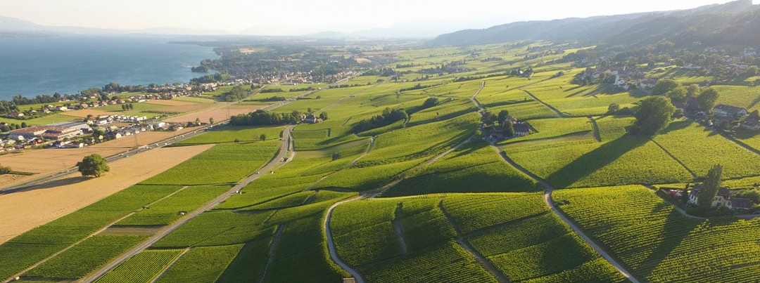
Landscape-specific results
Forested areas showed better predictive accuracy.
Open landscapes had limitations due to outdated data on annual crop changes.

Slide 12
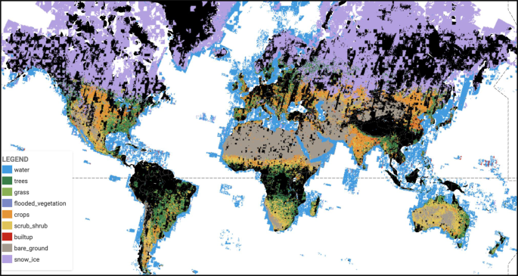
Conclusions
Highlighted benefits of fine-grained land-cover data for improving WVC models
Demonstrated how detailed environmental data can be linked to road segments (incorporated nearby vegetation use and land use into road segment)
Recommended including annual crop data to improve WVC predictions (specifically in open landscapes)

Slide 13
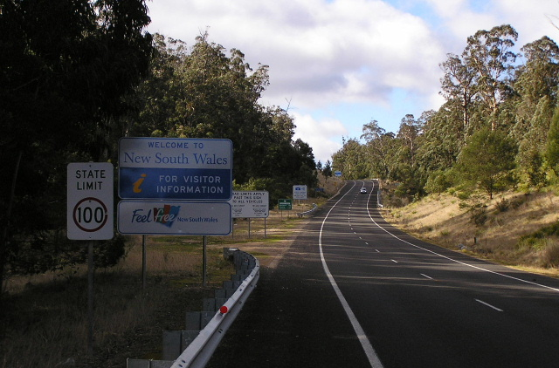
STUDY #2: Evaluating modelled wildlife corridors for the movement of multiple arboreal species in a fragmented landscape
Gracanin, A., Mikac, K.M.

Slide 14
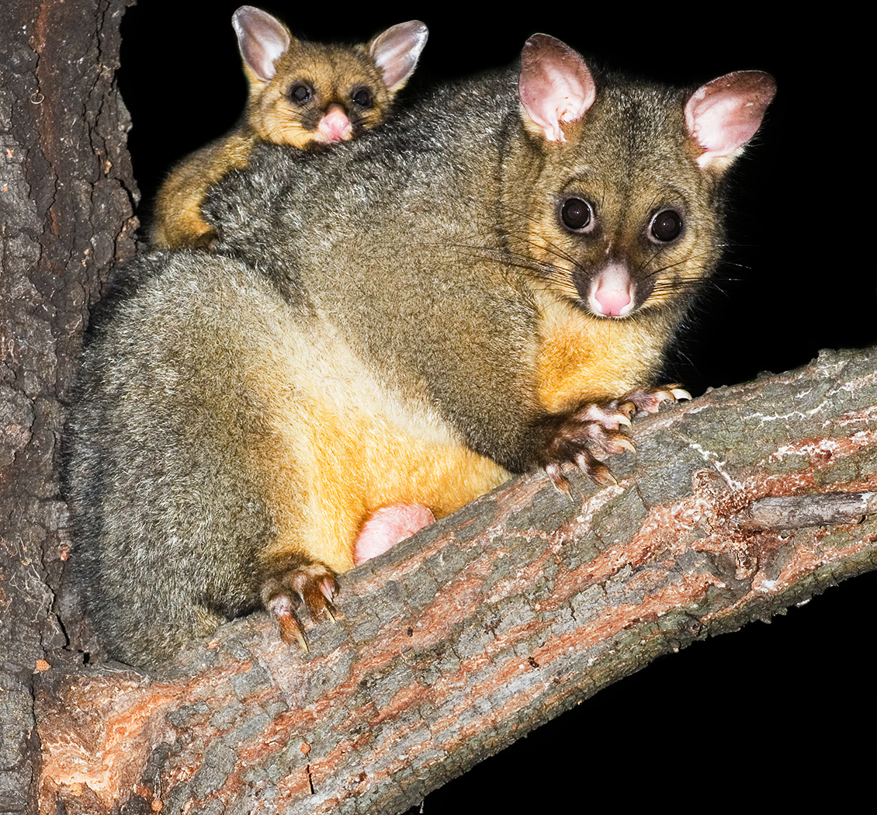
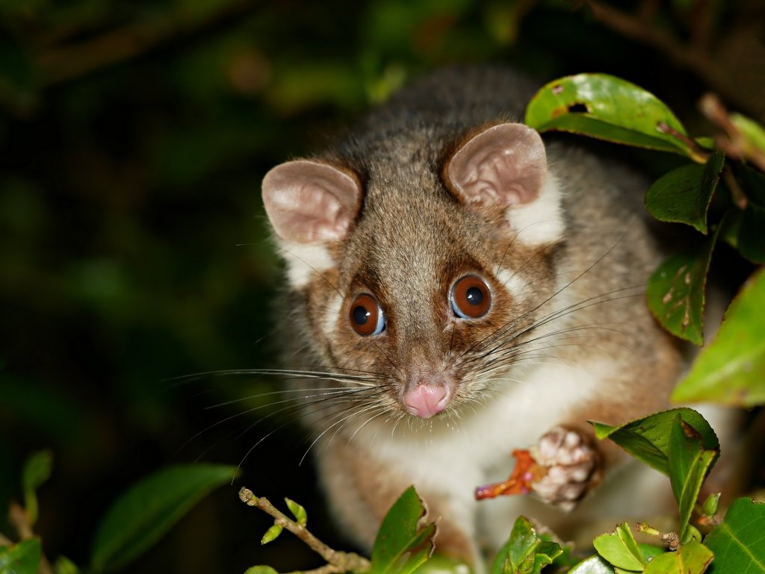
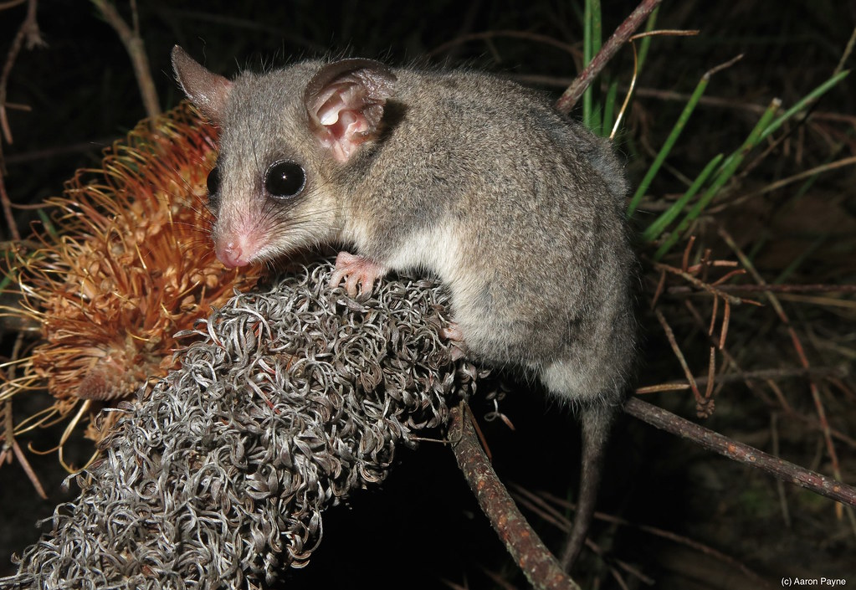
Arboreal mammals: limited by ability to move + disperse
Connectivity modelling: identifies most efficient dispersal corridor

Slide 15
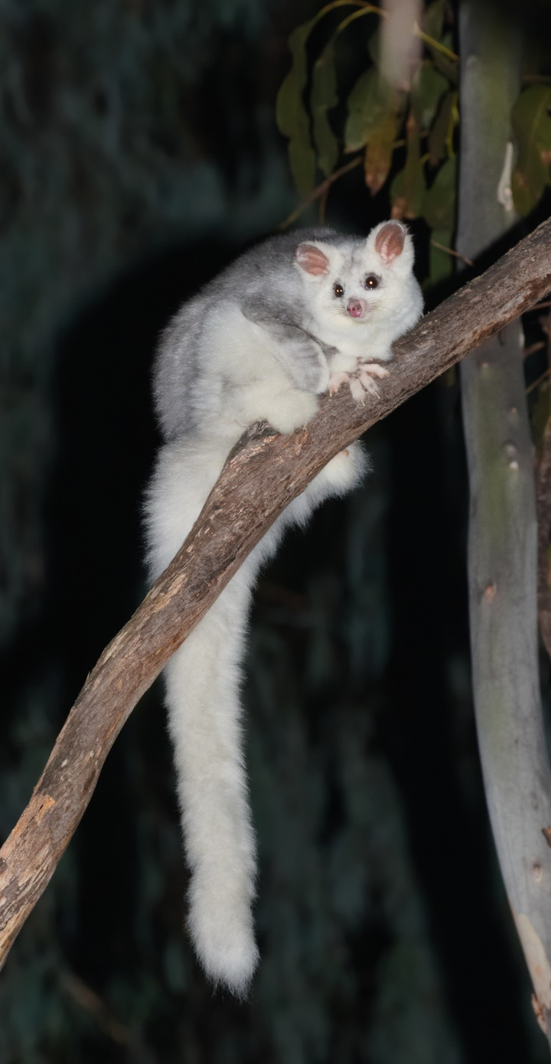
Objectives
Evaluated cost-effective wildlife corridors for eight species of arboreal mammals
Focused on an endangered population of greater gliders
Aimed to identify the best pathways that balance conservation effectiveness and cost-efficiency

Slide 16
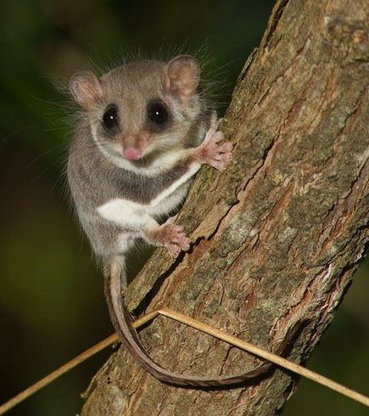
Research questions
What are the most efficient movement and dispersal pathways for multiple species of arboreal mammals in highly fragmented landscapes?
How suitable is the modelled corridor pathway for each species?

Slide 17
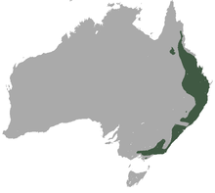
Methods
Utilized species distribution modeling to assess the habitat and range of each arboreal mammal species

Slide 18
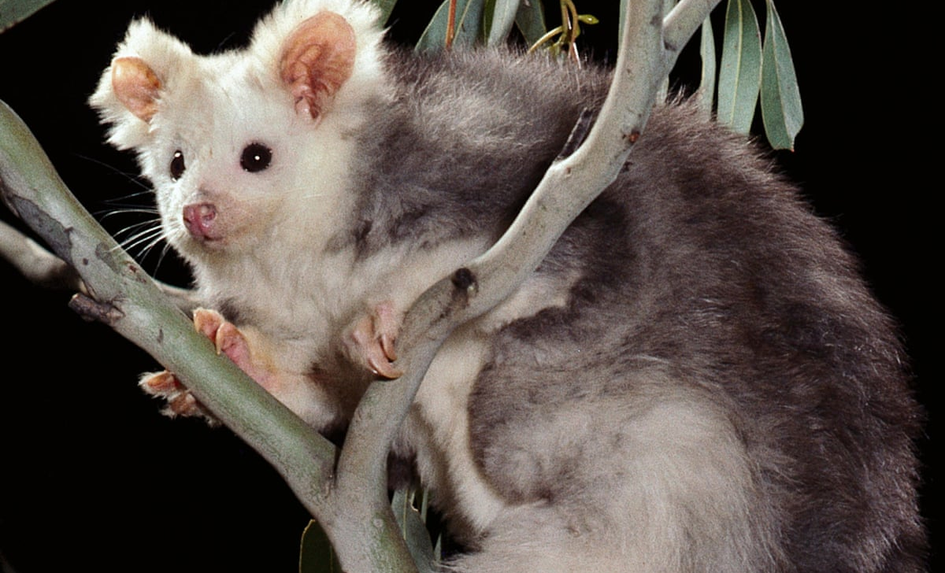
Applied circuit theory (models the flow of resources) to find connectivity across the landscape for each species, IDing how well different habitats connect to help movement
Modeled an all-species corridor using least cost path analysis to find the most efficient pathway that minimizes resistance of movement

Slide 19
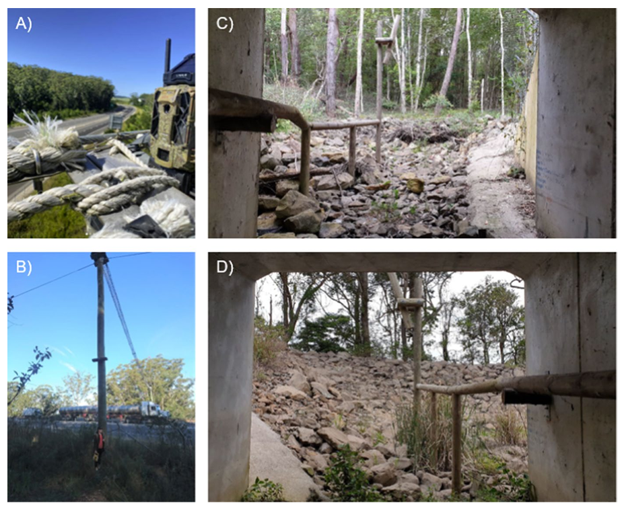
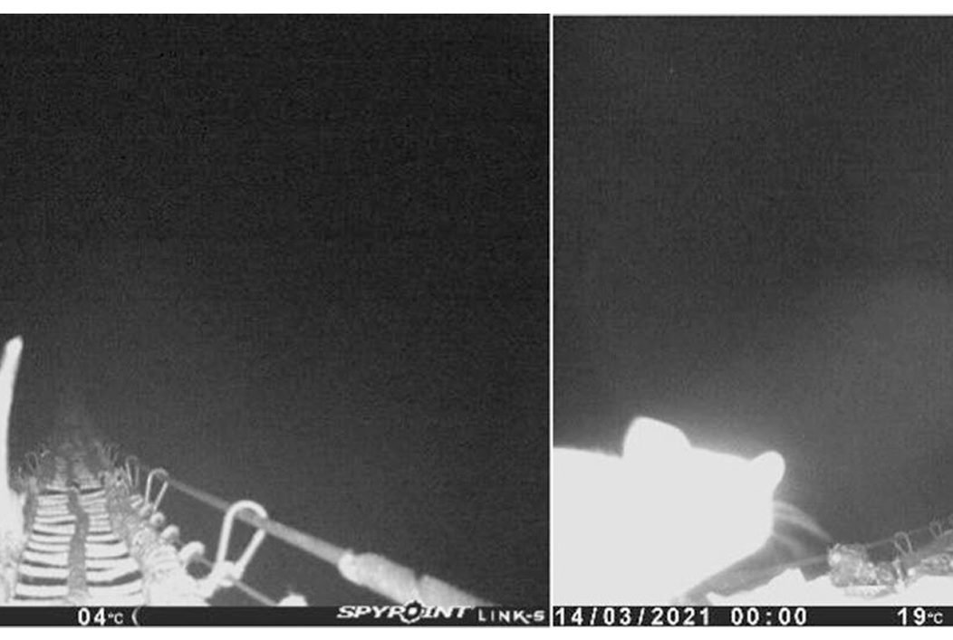
Evaluation
Conducted ground-truthing (gathering objective data) to verify accessibility of IDed corridor segments for all species

Slide 20
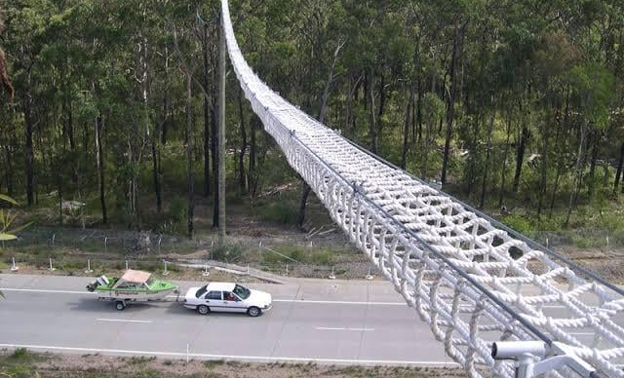
Major findings: flaws with model
IDed segments of the corridor with low suitability for highly specialized species, specifically those needing tree hollows for denning
The all-species corridor incorporated an artificial crossing structure over a highway
Monitoring of the rope bridge revealed limited use
Only 2 species (sugar gliders and ringtail possums) used the structure occasionally

Slide 21
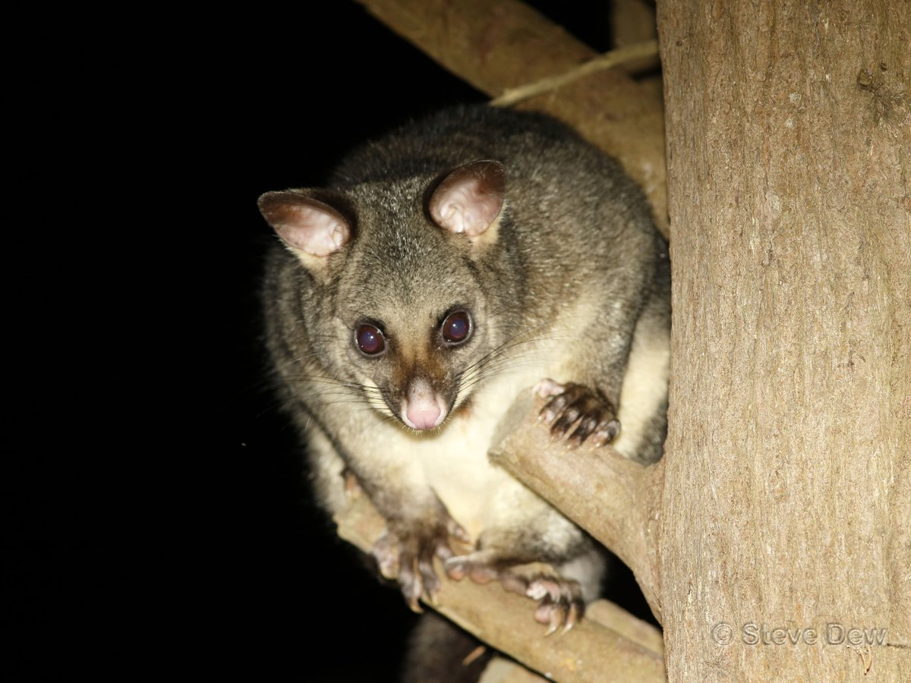
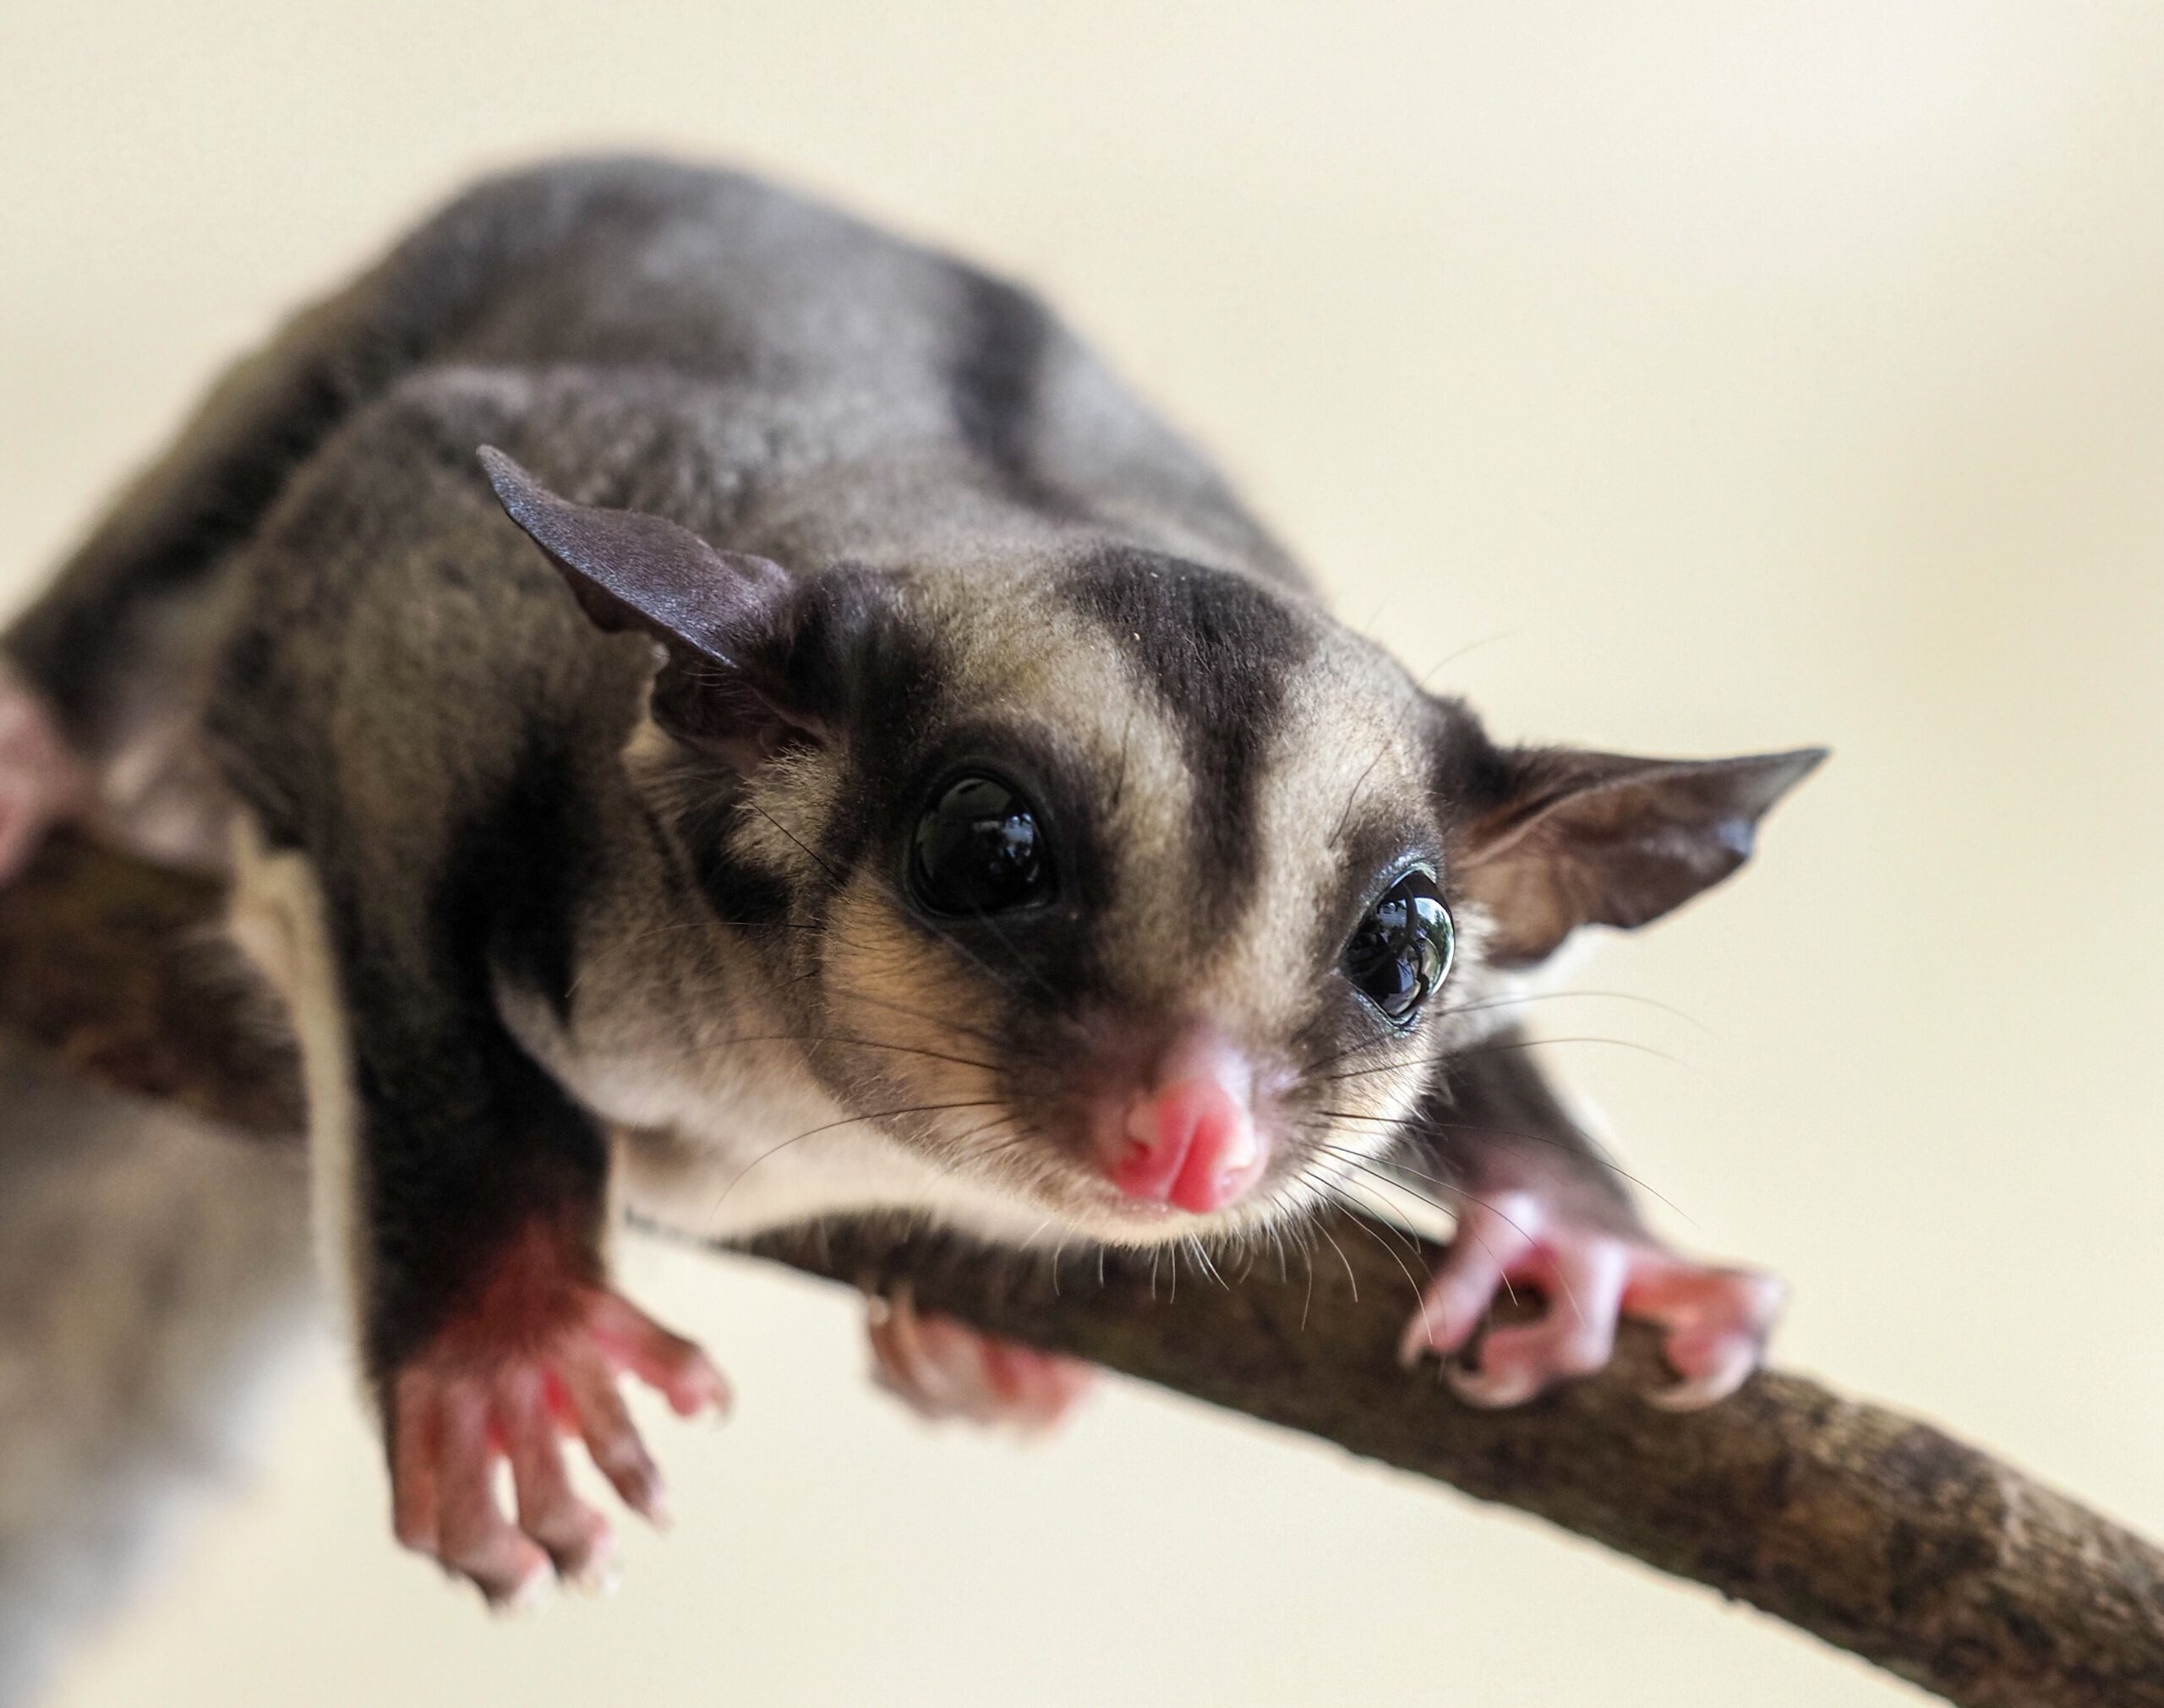
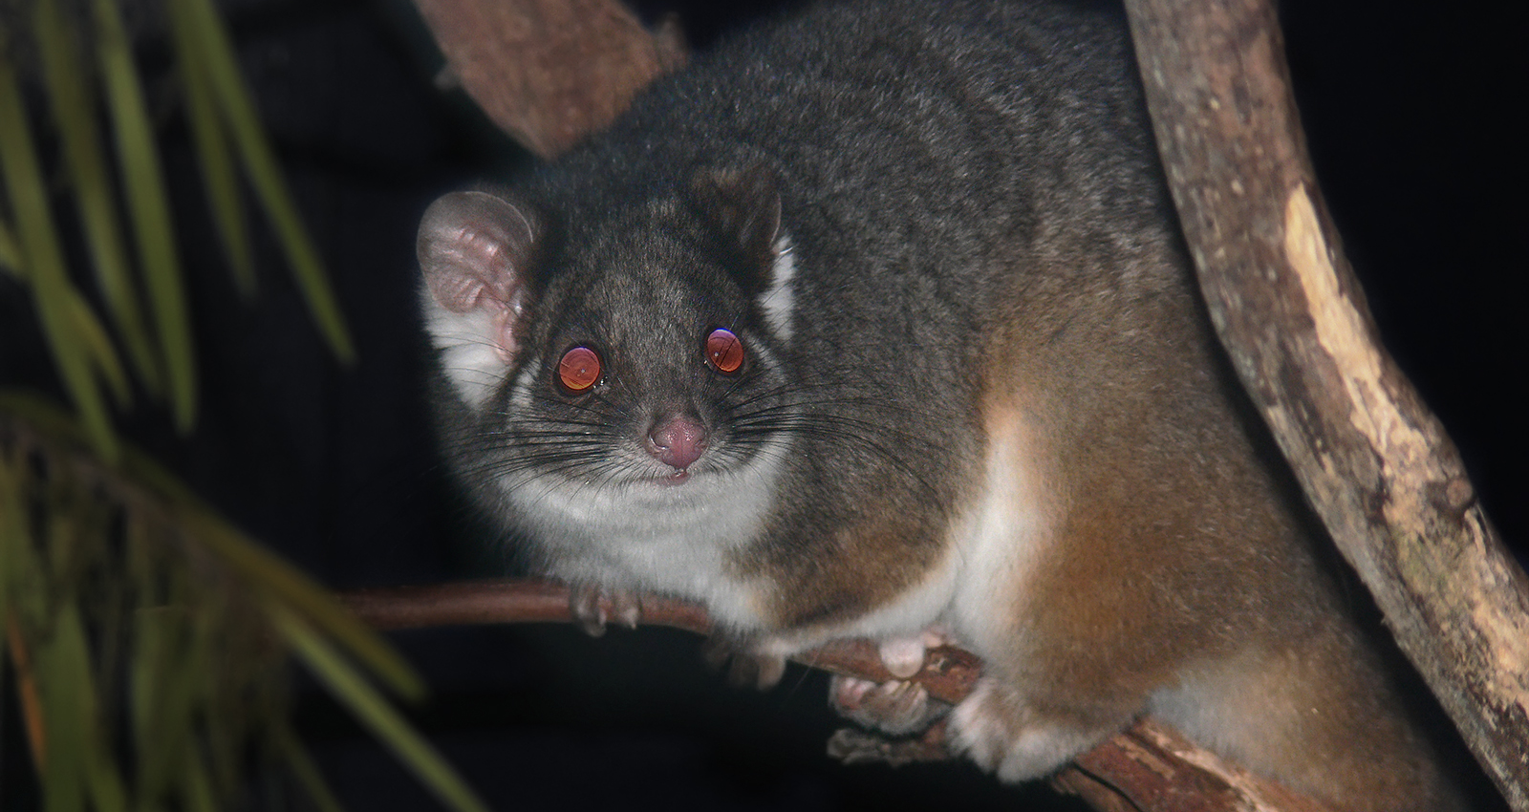
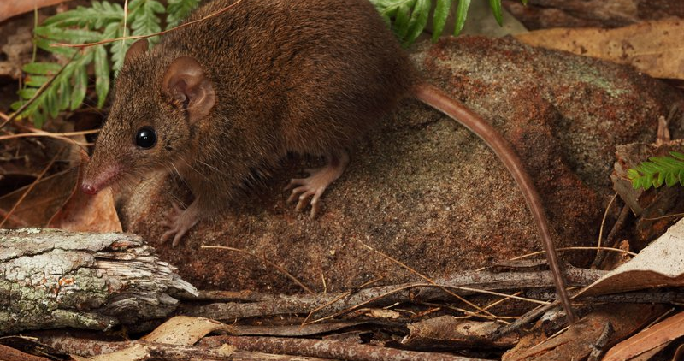
Species Suitability
The modeled corridor was not universally suitable; it was found to be more accommodating for generalist species, including:
Sugar gliders
Ringtail possums
Brown antechinus
Brushtail possums

Slide 22
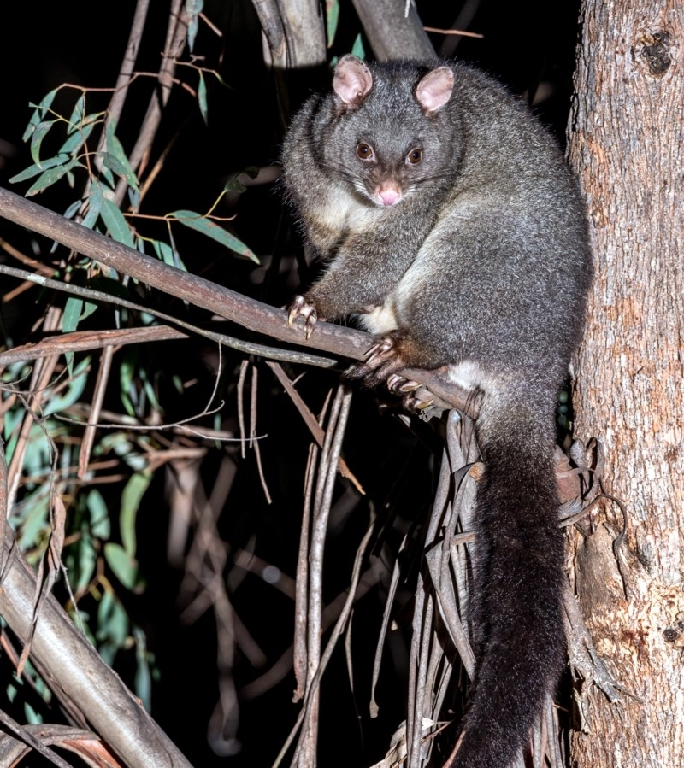
Conclusions
Emphasized the importance of ground-truthing in connectivity conservation studies
Shows that ground-truthing helps ID potential issues in habitat connectivity
Gave detailed recommendations for conservation managers to enhance the usage of existing habitat corridors

Slide 23
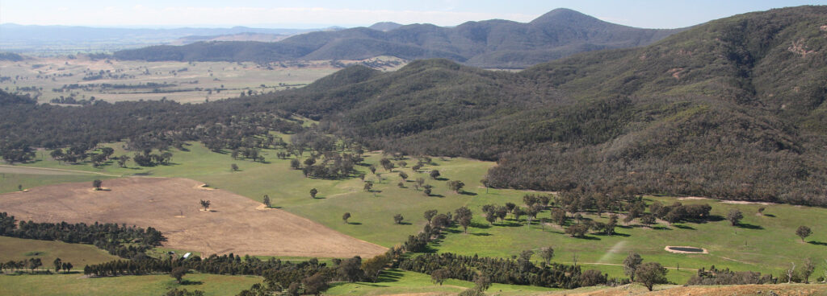
Discussion
Swiss study:
Geodata availability and improvement areas
Importance of annual crop data
Temporal and spatial analysis
Australian study:
Connectivity trends among species
Presence records in fragmented landscapes
Potential for habitat restoration

Slide 24
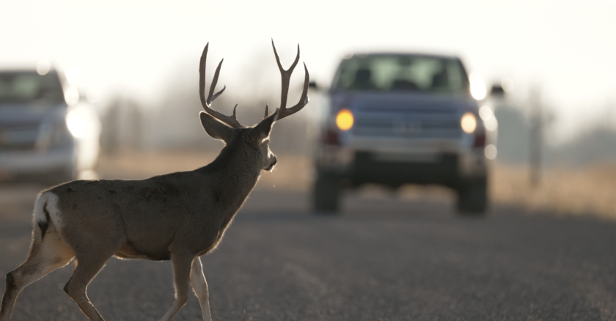
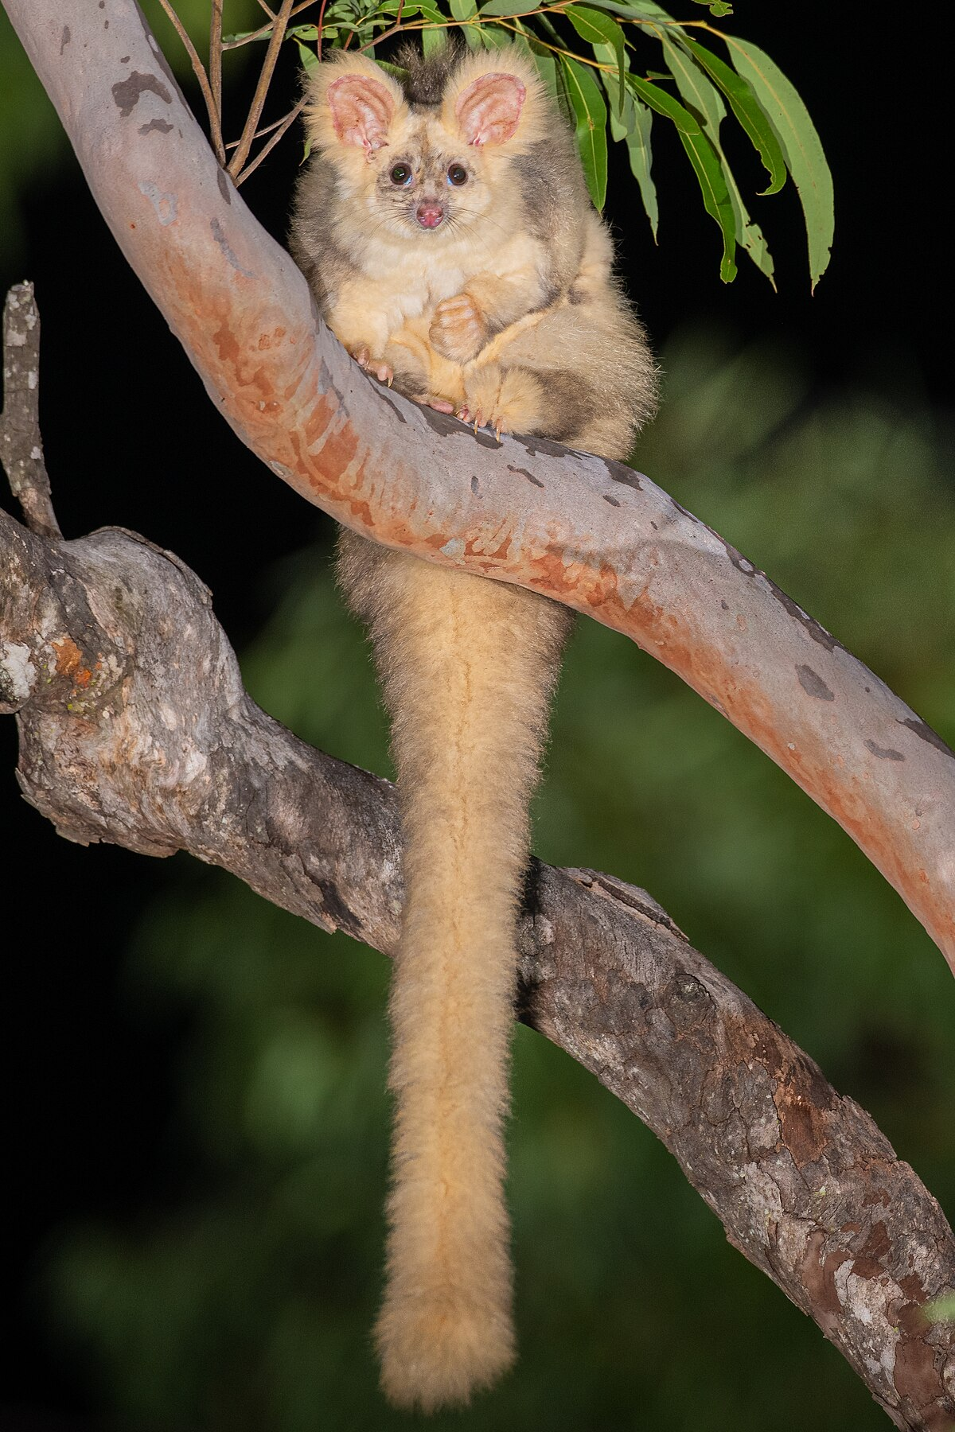
Questions
Laube, P., Ratnaweera, N., Wróbel, A. et al. Analysing and predicting wildlife– vehicle collision hotspots for the Swiss road network. Landsc Ecol 38, 1765–1783 (2023). https://doi.org/10.1007/s10980-023-01655-5.
Gracanin, A., Mikac, K.M. Evaluating modelled wildlife corridors for the movement of multiple arboreal species in a fragmented landscape. Landsc Ecol 38, 1321– 1337 (2023). https://doi.org/10.1007/s10980-023-01628-8.

